Slide 1
Study with Aprocitentan in patients with resistant hypertension
CHIEF:DR.A.SENTHAMARAI MD
ASSISTANT PROFESSORS:
DR.SUDHA MD
DR.SENTHILKUMAR MD
DR.SUGADEV MD

Slide 2
Background of the study:
The goal of the trial was to evaluate aprocitentan compared with placebo among patients with resistant hypertension.
Resistant hypertension is defined as uncontrolled blood pressure despite use of 3 anti-hypertensive drug classes including Renin angiotensin system blocker, Calcium Channel blocker and a diuretic at maximally tolerated doses.
Resistant hypertension is associated with increased risk of heart failure, stroke and chronic kidney disease.
Optimization of blood pressure control is particularly challenging in patient population who frequently present with Resistant hypertension such as elderly, CKD, etc.
Aprocitentan is a dual endothelin A/endothelin-B antagonist.

Slide 3
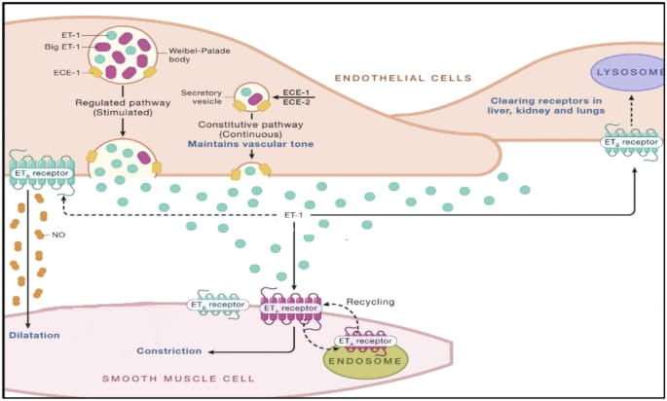

Slide 4
Study design:
The most recent study to address potential utility of ET receptor antagonist for resistant hypertension is PRECISION.
It is a phase 3 MULTICENTER, blinded, randomized and parallel group trial.
Total duration of follow-up: 48 weeks
Mean patient age: 61 years

Slide 5
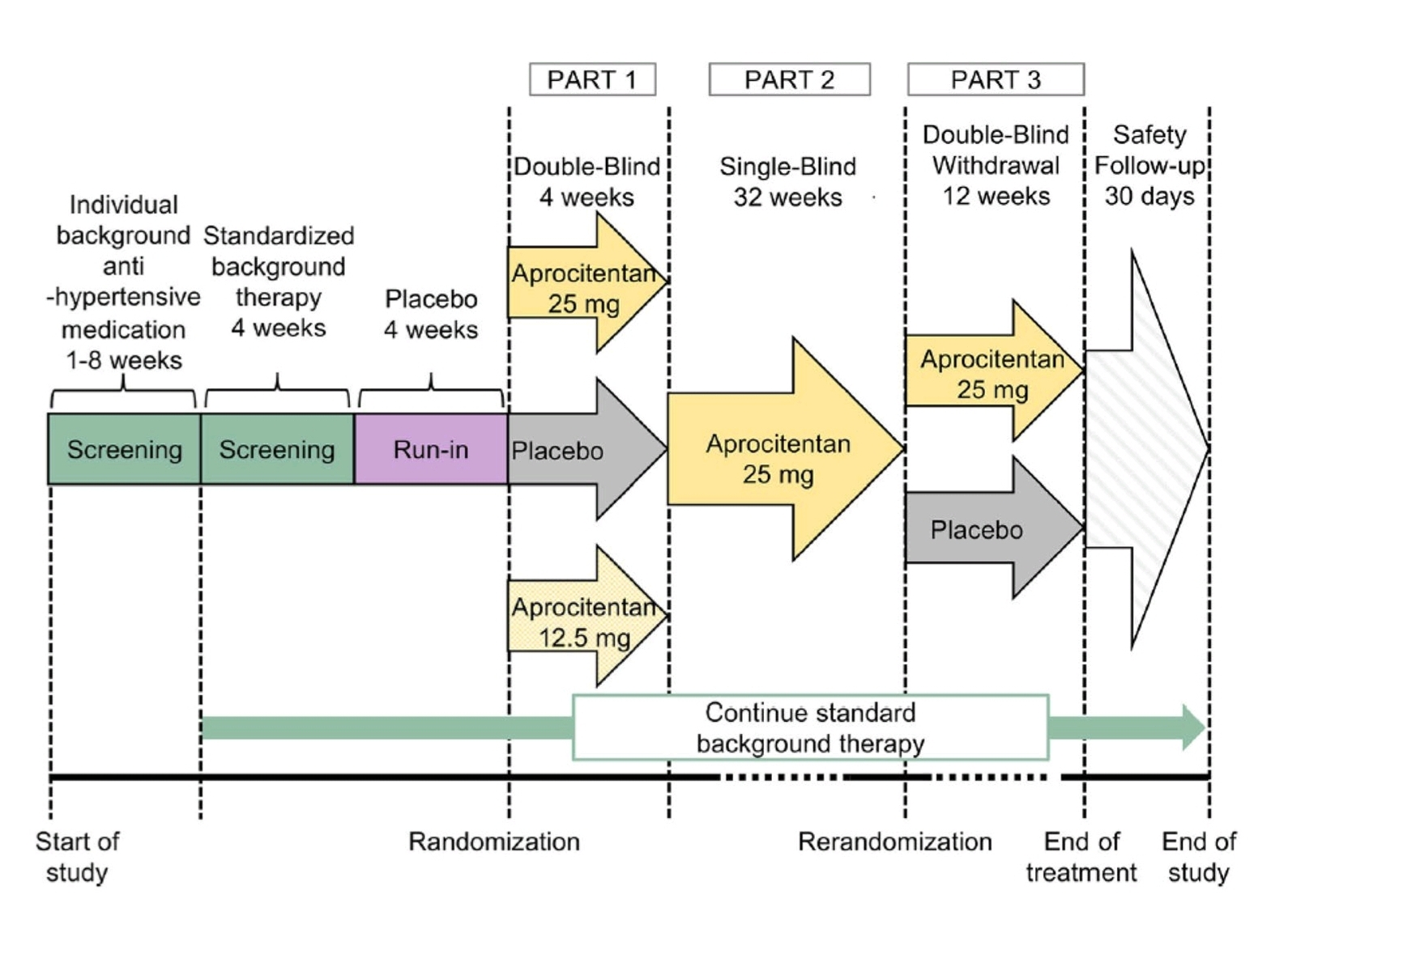

Slide 6
Inclusion criteria:
Systolic blood pressure ≥ 140 mmhg despite use of ≥ 3 antihypertensive agents.

Slide 7
Exclusion criteria:
Major Cardiovascular, renal or cerebrovascular problem within past 6 months.
NYHA class 3-4 heart failure.
N-terminal pro B type natriuretic peptide level ≥ 500 pg/ml.

Slide 8
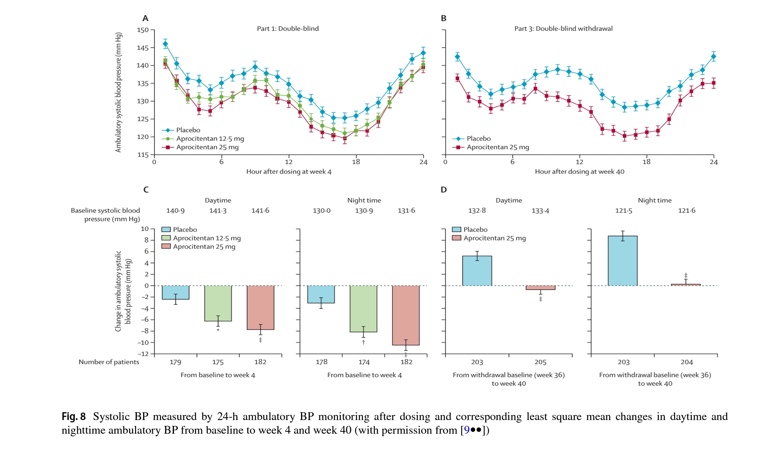

Slide 9
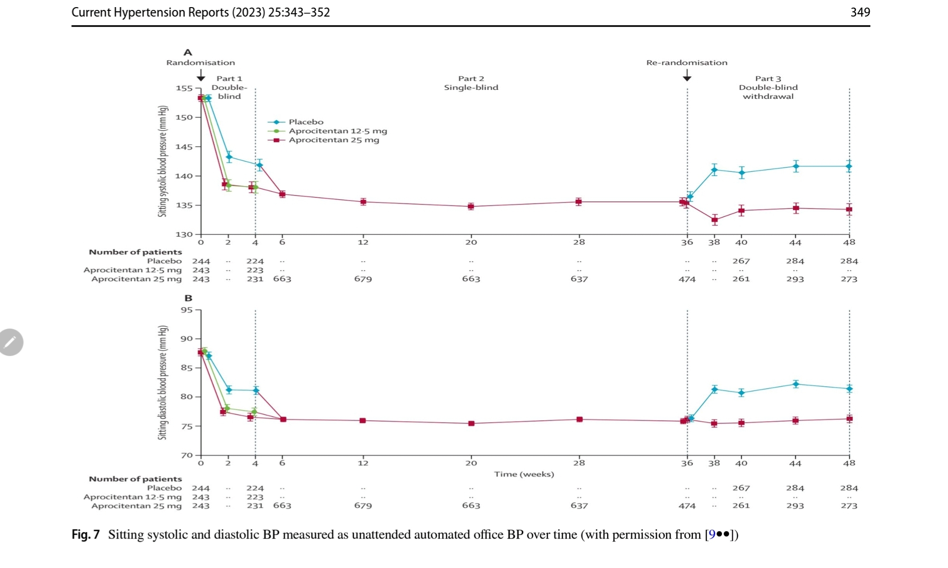

Slide 10
Primary outcome:
Changes from baseline to week 4 in mean systolic blood pressure was 3.8mmhg in Aprocitentan 12.5mg group and 3.7mmhg in Aprocitentan 25mg group.

Slide 11
Secondary outcome:
At week 40, systolic blood pressure remained stable with Aprocitentan 25mg while it increased with placebo.
Edema 9.1%with aprocitentan 12.5 mg vs 18.4% with aprocitentan 25mg vs 2.1% with placebo.

Slide 12
Discussion:
Aprocitentan was found to be useful addition to therapeutic armamentarium for resistant hypertension.
Aprocitentan is a useful treatment option in elderly and those with chronic kidney disease stage 3-4.
Long term use of endothelin receptor antagonist substantially reduced the risk of end stage kidney disease in high risk patients with type 2 diabetes.

Slide 13
Thank You

