Slide 1
JOURNAL PRESENTATION
2nd MEDICAL UNIT
CHIEF – PROF. DR. BHAKIYALAKSHMI M.D.,
ASST. PROF. DR. VALLIDEVI M.D.,
DR. PONSENTHIL KUMAR M.D.,
DR. ILAMARAN M.D.,
PRESENTOR – DR. PANNEER SELVAM

Slide 2
A Study on QT Dispersion before and after Thrombolysis in Acute Myocardial Infarction and its Prognostic Implications: A before and after Comparison Study

Slide 3
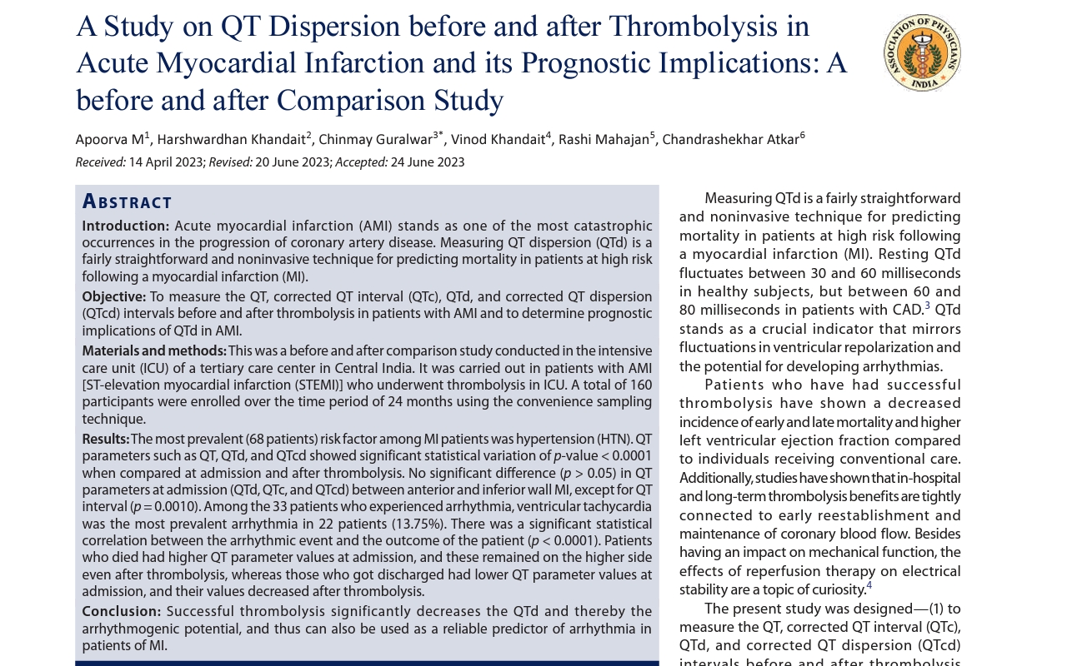

Slide 4
INTRODUCTION
Acute myocardial infarction stands as one of the most catastrophic occurrences in the progression of coronary artery disease(CAD)
It is the most common diagnosis in hospitalized patients in developed countries.
Roughly 50% of AMI-related deaths occur before the patient arrives at the hospital.
Despite notable recent improvements in AMI treatment, its occurrence is linked to substantial early and late mortality.
Early (both out and in-hospital) mortality is attributed to arrhythmic events, mainly ventricular tachycardia and ventricular fibrillation

Slide 5
QT interval represents the electrical activity of the ventricles during systole
Ventricular systole comprises two phases, including depolarization and repolarization
QT interval can be altered by any change in cardiac electrophysiology, autonomic tone, pharmacological characteristics or electrolyte imbalance
Variable cells in distinct areas of the left ventricle have variable ventricular repolarization times, resulting in regional heterogeneity of repolarization time, which in turn results in QT interval dispersion in different ECG leads

Slide 6
Increased dispersion of ventricular recovery time facilitates the occurrence of severe ventricular arrhythmias.
Patients experiencing arrhythmias display notably higher QTd compared to similar patients who do not experience such occurrences.
Resting QTd fluctuates between 30 and 60 milliseconds in healthy subjects, but between 60 and 80 milliseconds in patients with CAD
QTd stands as a crucial indicator that mirrors fluctuations in ventricular repolarization and the potential for developing arrhythmias.

Slide 7
OBJECTIVE OF STUDY
The present study was designed
(1) to measure the QT, corrected QT interval (QTc), QTd, and corrected QT dispersion (QTcd) intervals before and after thrombolysis in patients with AMI and
(2) to determine prognostic implications of QTd in AMI.

Slide 8
STUDY DESIGN
This was a before and after comparison study
Conducted in the ICU of a tertiary care centre in Central India
Carried out in patients with AMI (STEMI)] who underwent thrombolysis in ICU.
A total of 160 participants were enrolled over the time period of 24 months
Using the convenience sampling technique

Slide 9
Inclusion criteria :
• Patients with AMI (STEMI).
• Treatment with a thrombolytic agent (streptokinase).
Exclusion criteria:
• Drugs affecting QT interval.
• Prior coronary bypass surgery.
• Atrial fibrillation.
• Serum potassium <3.5 mmol/L or >5.0 mmol/L.
• Hypertrophic cardiomyopathy.
• Bundle branch blocks.
• Congenital long QT syndromes.

Slide 10
OPERATIONAL DEFINITIONS
ACUTE MYOCARDIAL INFARCTION (STEMI)
Detection of a rise and/or fall in cardiac biomarker values (preferably cardiac troponin), with at least one value above the 99th percentile upper reference limit and with at least one of the following:
Symptoms of ischemia.
New ST-elevation at the J point in two contiguous leads with the following cut points:
• Around ≥0.1 mV in all leads (except V2–V3).
• In leads V2–V3, the following cut points apply:
• Around ≥0.2 mV in men ≥40 years.
• Around ≥0.25 mV in men <40 years.
• Around ≥0.15 mV in women.

Slide 11
Development of pathologic Q waves on the ECG imaging evidence of new loss of viable myocardium or new regional wall motion abnormality.
QT interval: onset of QRS complex to the end of T wave.
Corrected QT interval (QTc): using Bazett’s formula for each lead:
• QTc = QT/√RR.
QTc range falls between 0.35 and 0.43 seconds.
QT interval dispersion (QTd): difference between maximum and minimum QT interval.
Corrected QTc dispersion (QTcd): difference between maximum and minimum QTc interval.

Slide 12
COLLECTION OF DATA
Details of the patients were collected using a predesigned proforma after taking well-informed written consent.
All of the study participants’ 12-lead ECGs were captured at the time of admission, and a follow-up ECG 1 hour after thrombolysis. ECG was recorded at a 25mm/second paper speed
Patients monitored for at least 5 days during their stay for occurrence of abrupt death, VF, or poorly sustained VT as an arrhythmic event

Slide 13
Statistical Analysis
The QTd was compared before and after thrombolysis in the study group by performing paired t-test for normalized data.
For nonnormalized data, the Wilcoxon signed-rank test was used.
p < 0.05 was taken as statistical significance.

Slide 14
RESULTS
A total of 160 patients were studied
Mean age was 50.09 ± 12.76 years.
121 (75.63%) male subjects and 39 (24.37%) female subjects
Mean age in male 49.09 ± 13.29 years, and in female patients, 53.20 ±10.47 years.
There was no significant statistical correlation between age and gender of the study subjects (p = 0.08)
The most prevalent (68 patients) risk factor among MI patients was hypertension (HTN) (42.50%), followed by diabetes mellitus (DM) in 57 patients (35.63%).
A total of 106 patients suffered from anterior wall MI (66.25%), and 54 patients suffered from inferior wall MI (33.75%).
Thrombolysis significantly decreased QT interval, QTd, and QTcd, but not QTc

Slide 15
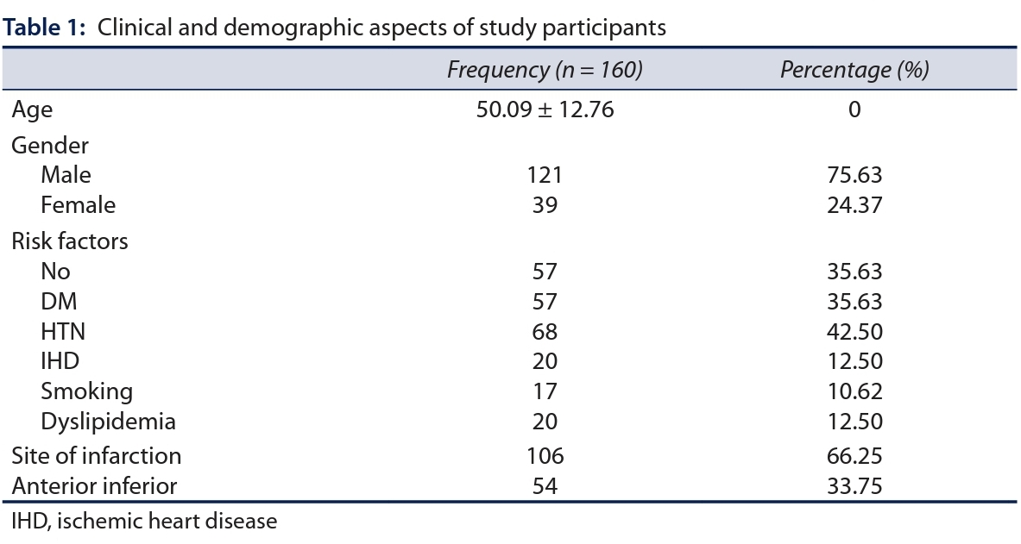
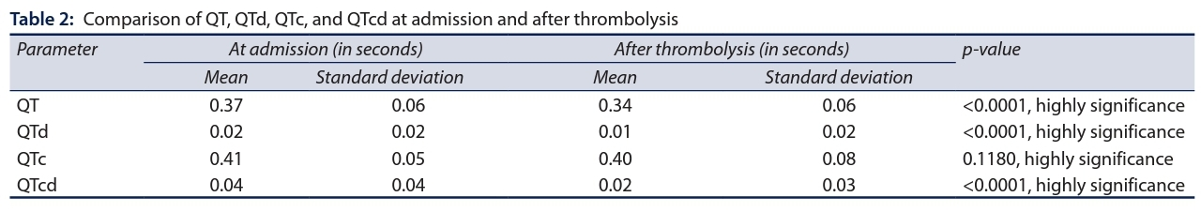

Slide 16
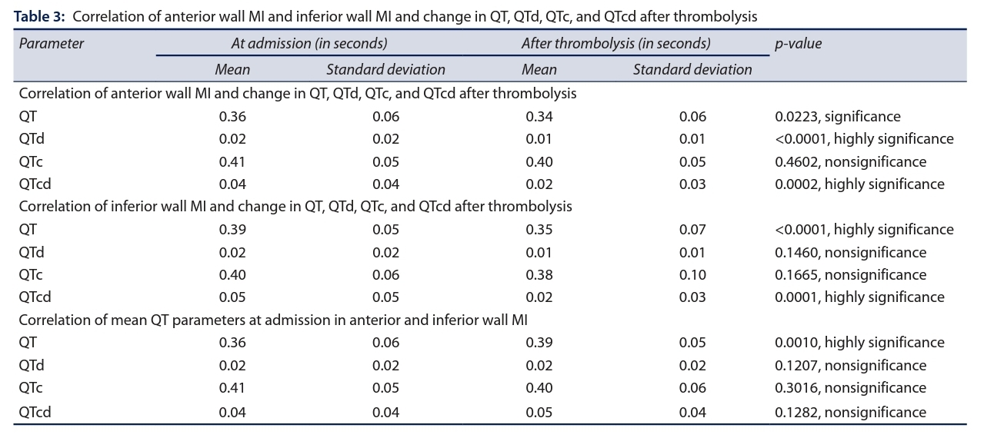
No significant difference (p > 0.05) was seen in QT parameters at admission (QTd, QTc, and QTcd) between anterior and inferior wall MI, except for QT interval (p = 0.0010).

Slide 17
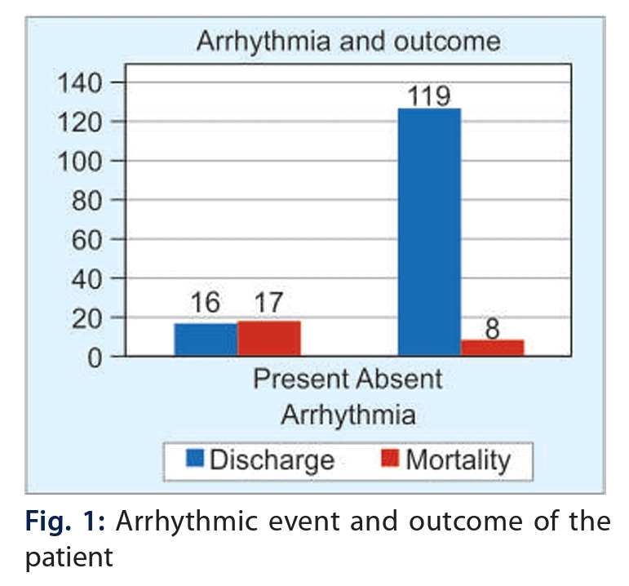
In our study, out of 160 study subjects,
-127 of them did not have any arrhythmic episodes (79.38%).
-33 experienced arrhythmia, 22 patients suffered VT (13.75%), followed by ventricular premature capture beats in 8 patients (5%) and only 3 patients suffered from VF (1.88%).
A significant statistical correlation was seen between the occurrence of arrhythmic events and the patient’s outcome (p < 0.0001)

Slide 18
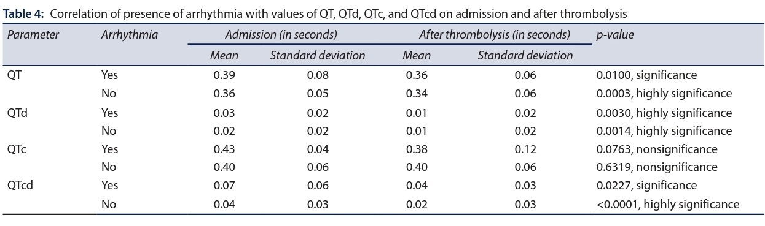

Slide 19
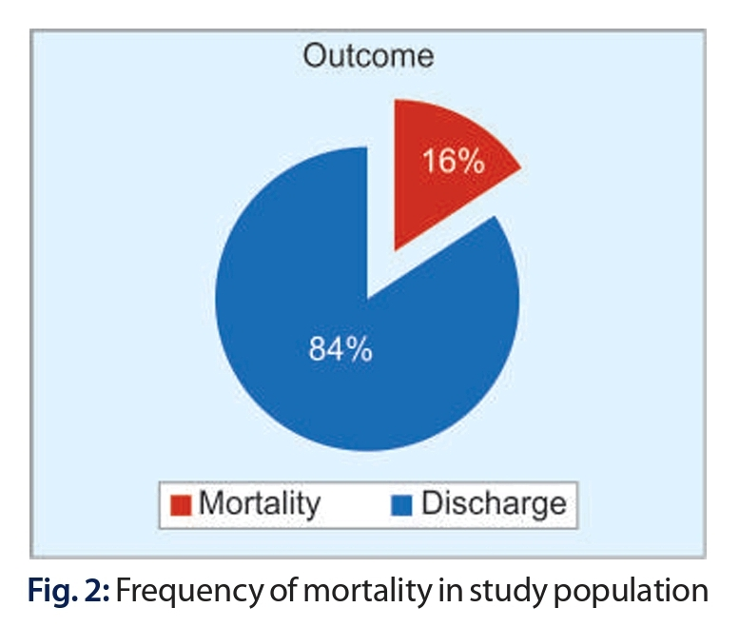
Out of 160 study subjects, majority 135 patients discharged (84.38%), and 25 patients expired during the hospital stay (15.63%).
Patients who died had higher QT parameter values at admission, and these remained on the higher side even after thrombolysis, whereas those who got discharged had lower QT parameter values at admission, and their values decreased after thrombolysis.

Slide 20
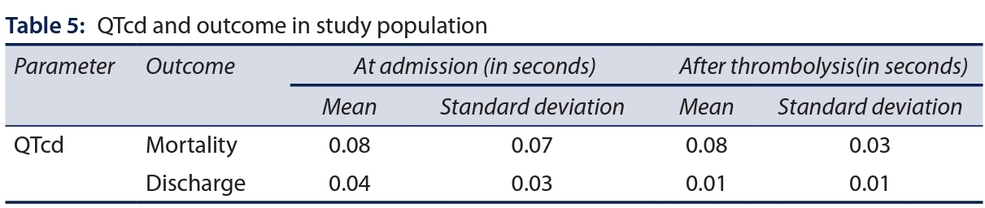
Only QTcd showed significant statistical correlation after thrombolysis in predicting the outcome of MI patients (p = 0.0120) with the median [interquartile range (IQR)] QTcd of 0.01 (0–0.09) in discharged patients and 0 (−0.09–0.03) in patients who expired

Slide 21
STUDY LIMITATIONS
Since the QT parameter measurement was done manually and the readings were subjective, this is a non-standardized way, and that would preclude the use of this QT parameter commonly.
It is largely unclear if QTd adds any additional information relative to other prognostic markers and to quantify that information even if it adds any.
The outcomes in the longer term were not studied in this study.
Therefore, further research studies need to be done to confirm the clinical consequence of reduced QTd after thrombolysis.

Slide 22
CONCLUSION
The results of the present study show that successful thrombolysis is associated with lesser QTd on ECG in patients of AMI.
Our data support the hypothesis that QTd after MI depends on reperfusion status. Reduction in QTd may be a mechanism of benefit of thrombolytic therapy.
The predictive significance of prolonged QTd is still a subject of debate.
Based on the existing data, it can be explained by the effect of scarred myocardium on future arrhythmogenicity, which is reflected in the amount of QTd.
Thus, at the very least, it can be an indicator of increased risk of death after AMI

Slide 23

THANK YOU

