Slide 1

JOURNAL CLUB
BY 1ST MEDICAL UNIT
CHIEF : PROF.DR.M.NATARAJAN MD.,
ASSISTANT PROFESSOR :
DR.PALANIKUMARAN MD., D.Diab.,
DR.VASANTHAKALYANI MD.,
DR.SURESHKUMAR MD.,
SPEAKER : DR.K.VIGNESHKUMAR

Slide 2
GESTATIONAL EXPOSURE TO MATERNAL SYSTEMIC GLUCOCORTICOIDS AND CHILDHOOD RISK OF CKD

Slide 3
Introduction
Objective:
Investigate the association between maternal systemic glucocorticoid exposure during pregnancy and the risk of chronic kidney disease (CKD) in childhood.
Rationale:
The potential effects of antenatal glucocorticoids exposure on children's long-term health, particularly on kidney function are unclear.

Slide 4
Approximately 10% of the global population suffer from chronic kidney disease.
Fetal exposure to an adverse maternal environment may result in an increased risk of CKD in later life.
Hence, the need to address the importance of kidney disease from the maternal and fetal health perspective was highlighted in 2018 on World Kidney Day.
Unlike the case with adults, congenital anomalies of the kidney and urinary tract (CAKUT) constitute the leading cause of CKD in pediatric populations.
In addition to genetic factors, maternal factors also mediate the core mechanisms that result in CAKUT.
Continues…

Slide 5
Antenatal systemic glucocorticoids have been widely used to mature fetal lungs for preterm delivery. However, the long-term risk associated with their use remain uncertain.
Therefore, This study assessed the associations between gestational systemic glucocorticoid exposure and CKD development in offspring based on mother-Child dyad cohort derived from the health care delivery system in Taiwan.

Slide 6
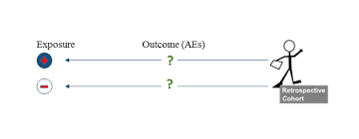
Study Design
Retrospective Cohort Study

Slide 7
Inclusion Criteria
The maternal-child cohort, a part of the Mother and Child Health (MACH) study , included live newborns delivered between January 1,2004, and December 31,2018.
Children with valid maternal-child linkage , complete birth information(eg, sex and birthweight), and with any medical records corresponding to follow-up evaluation were ascertained and included in the maternal-child cohort

Slide 8
Exclusion Criteria
Unknown newborn sex.
Any congenital anomalies , except for CAKUT.
Topical glucocorticoids use.
Systemic glucocorticoids used only in pre-gestational period.
Concordant siblings.

Slide 9
Gestational Exposure vs
Non - Exposure
Newborns those whose mothers did not use systemic glucocorticoids before pregnancy but received it during pregnancy
Newborns those whose mothers did not use any systemic glucocorticoids before or during pregnancy
Continues…

Slide 10
The intention to treat approach was applied for all mothers who had received at least 1 dose of systemic glucocorticoids prescriptions.
To ascertain total cumulative dose of systemic glucocorticoids during pregnancy, doses of different systemic glucocorticoids were converted into dose of hydrocortisone equivalent in milligrams by the relative potencies.
Duration of exposure was summed in day(s) based on the day’s supply of each prescription.
Infants whose mothers used systemic glucocorticoids during the pregestational period but discontinued or continued the treatment during pregnancy were excluded from the analysis.

Slide 11
Outcomes
Primary Outcomes:
According to the definition of CKD by Kidney Disease: Improving Global Outcomes (KDIGO),pediatric patients needed to have ≥1 ICD-9/10 codes for CKD as inpatients or ≥2 ICD-9/10 codes for CKD within 1 year and ≥3 months apart as outpatients.
The Causes of CKD were grouped as CAKUT and non CAKUT based on the date of diagnosis.

Slide 12
Covariates
Maternal Covariates:
gestational comorbidities (diabetes, hypertension, pre-eclampsia, anemia, and pregnancy-related complications) and the prespecified medications used during pregnancy
Pregestational Comorbidities including body weight , BMI, prior hypertention, hyperlipidemia , use of prespecified medications.
Offspring Covariates:
Offspring characteristics were sex, gestation age at birth, birthweight, and prematurity.

Slide 13
Stratification
Stratified by Offspring Characteristics:
Sex Groups : Male vs Female
Gestational Age Groups : Less than 37 weeks vs 37 weeks or more
Birthweight Groups : Less than 3,000 g (median) vs 3,000 g or more
Primary Model Stratification:
Gestational Timing of Exposure
Cumulative Dose of Glucocorticoids
Duration of Treatment

Slide 14
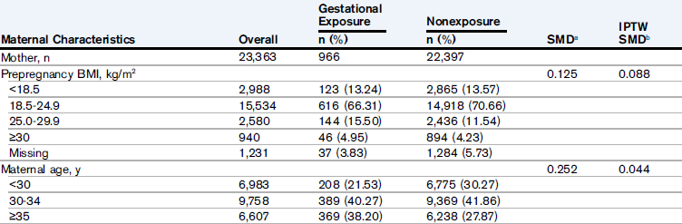
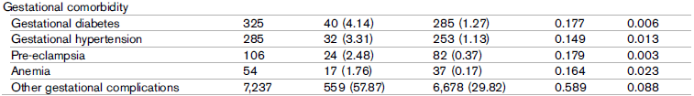













Slide 15
A
S
S
O
C
I
A
T
I
O
N
A
S
S
O
C
I
A
T
I
O
N
GESTATIONAL SYSTEMIC GLUCOCORTICOIDS
CHILDHOOD CKD

Slide 16




Over the 10-year follow-up period, the cumulative incidence of childhood CKD diagnosis was 1.87% (n = 437), with 84.2% (n = 342) CAKUT in the singleton-born cohort. The overall median time to CKD event was 29 days , 22 days for CAKUT, and 1.4 years for non-CAKUT . Both CAKUT (2.17%) and non-CAKUT (0.62%) CKD event rates were higher in the exposure group than in the non exposure group (1.55% vs 0.28%, respectively).
Gestational systemic glucocorticoid exposure, compared with non exposure, was significantly associated with a greater risk for the childhood CKD outcome
Among children with both types of CKD, the median time between CAKUT and non-CAKUT diagnoses was about 6 months(128 days), and renal agenesis/hypoplasia/dysplasia and urinary tract dilation and anomalies of the urethra or ureters were commonly related to acute or chronic nephritis/nephrotic syndrome/nephrosis

Slide 17
Effect Modification & Additivity
Male Offspring
Birth Weight < 3000g
Gestational Age < 37 Weeks
Systemic Glucocorticoid Treatment in Second Trimester
Total Cumulative dose of more than 24mg hydrocortisone

Slide 18
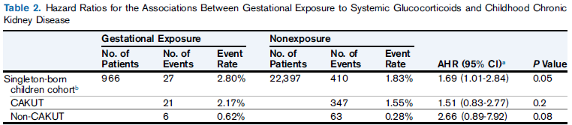




Slide 19
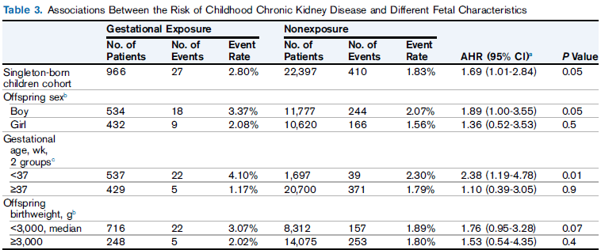







Slide 20
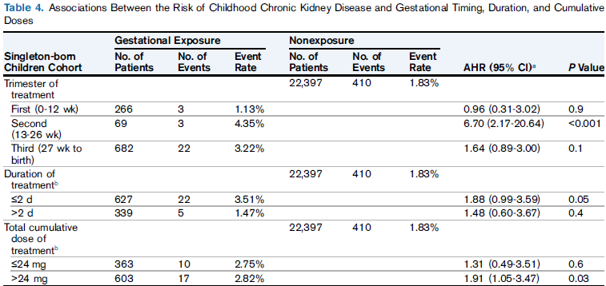






Slide 21
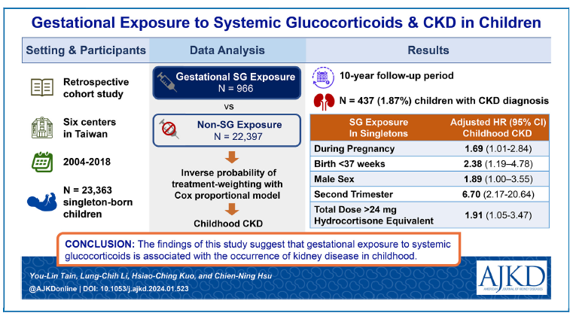
Summary

Slide 22


