Slide 1
PRIMARY SJOGREN SYNDROME WITH HYPOKALEMIC PARALYSIS
II MEDICAL UNIT
CHIEF
PROF DR.R.BALAJINATHAN M.D
ASST.PROF
DR.V.N.ALAGA VENKATESAN M.D
DR.P.V.BALA MURUGAN M.D

Slide 2
45 years old female, Tailor by occupation
Presented with complaints of
Weakness of both lower limb & upper limb for past 4 days
HISTORY OF PRESENTING ILLNESS
She was apparently normal 3months back then she stopped working due to increasing pain in both legs
4 days before admission while she was sleeping developed increasing pain in both legs followed which she noticed Symmetric weakness of both lower limbs
Next day she developed weakness of both upper limb followed by inability to lift her neck

Slide 3
H/O difficulty in walking
H/O difficulty in raising both upper limbs
H/O difficulty in buttoning the blouse
H/O difficulty in combing the hair
H/O difficulty in swallowing both solid & liquid foods

Slide 4
No H/O involuntary micturition / defaecation
No H/O fever
No H/O vomiting/loose stools
No H/O recent vaccination
No H/O blurring of vision
No H/O seizures
No H/O altered sensorium
No H/O heavy exercise
No H/O mucorrhoea

Slide 5
PAST HISTORY
She had history of pain in both legs for past 3 months on and off for which she takes analgesics
No H/O similar episode in the past
No H/O
Diabetes mellitus, Hypertension, Bronchial asthma, Epilepsy,
Coronary artery disease, Chronic kidney disease
No H/0 recent surgery

Slide 6
PERSONAL HISTORY
She is on mixed diet ; bowel & bladder habits normal
MENSTRUAL HISTORY
Regular 5/30 days cycle
OBSTETRIC HISTORY
2 children FTNVD; No H/O abortion
FAMILY HISTORY
No H/O similar episode in the family members.

Slide 7
GENERAL EXAMINATION
Conscious, oriented
Afrebile
Pallor
Not icteric
No cyanosis
No clubbing
No lymphadenopathy
No pedal edema

Slide 8
VITAL SIGNS
PULSE RATE 78/MIN ; regular in rhythm; normal in volume & character; no radio radio or radio femoral delay, all peripheral pulses felt equally
BLOOD PRESSURE ; 120/80 RIGHT UPPER LIMB
SINGLE BREATH COUNT ; < 10
RESPIRATORY RATE; 30/MIN

Slide 9
SYSTEMIC EXAMINATION
CNS:
HMF – conscious, oriented
Language - Fluency
Comprehension
Repitition Normal
Writing
Reading
Memory & sleep - Normal

Slide 10
Cranial nerve examination
B/L smell sensation – intact
B/L pupil 3mm – ERTL
AR +
Fundus – Normal
color vision –Normal
Visual acuity 6/6

Slide 11
.III
.IV EOM ; Full
.VI
.V – SENSORY + +
MOTOR + +
No jaw deviation
Jaw jerk just present

Slide 12
VII No facial asymmetry
No deviation of angle of mouth
Wrinkles +
Eye lid closure full
VIII Weber – no lateralisation
Rinne +

Slide 13
IX Gag reflex +
X B/L Palatal movements – equal
XI Uvula -midline
XII Tongue No deviation
Tongue texture Normal
No fibrillation

Slide 14
SPINOMOTOR SYSTEM
 | RIGHT | LEFT
BULK UL | NORMAL | NORMAL
LL | NORMAL | NORMAL
TONE UL
LL
POWER UL | 4/5 | 4/5
LL | 2/5 | 2/5
NECK MUSCLE WEAKNESS +

Slide 15
DTR | RIGHT | LEFT
BICEPS | + | +
TRICEPS | + | +
SUPINATOR | + | +
KNEE | + | +
ANKLE | + | +
PLANTAR

Slide 16
SENSORY SYSTEM
Touch
Pinprick Intact
Temperature
POSTERIOR COLUMN
Vibration Intact
Romberg’s Could not be tested
CEREBELLUM Could not be tested
SPINE & CRANIUM - Normal

Slide 17
SYSTEMIC EXAMINATION….
CVS – S1S2+
No murmur
RS – B/L AE+
Normal vesicular breath sounds+
No added sounds
ABDOMEN – Soft
Bowel sounds+
No organomegaly

Slide 18
Diagnosis - Acute flaccid quadriparesis for evaluation with no sensory/ bladder involvement
DD - Hypokalemic paralysis
Guillain barre syndrome

Slide 19
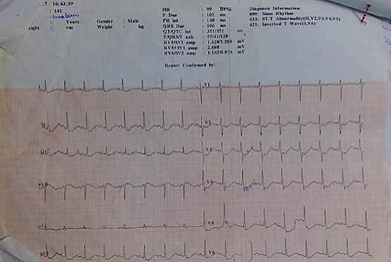
ECG

Slide 20
TREATMENT
Nasal o2 4l/min
Head end elevation
Iv fluids
Ryles tube feeding 1.5l/day
Inj kcl 40meq in 500 ml NS over 4 hours
Syp kcl 30 ml tds
Frequent ECG monitoring

Slide 21
Hb 12.9 gm
Tc 11400
Dc 80/18/2
Platelet 1.5 lakhs
PCV 38%
URINE ROUTINE Albumin 2+
Sugar – Nil
Deposits- 0-2 pus cells

Slide 22
INVESTIGATIONS…..
Na- 135 meq/l
K - 1.8 meq/l
Cl -102 meq/l
LFT
T.BILIRUBIN 0.7 mg/dl
SGOT 343 U/l
SGPT 99 U/l

Slide 23
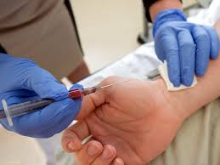
ARTERIAL BLOOD GAS
PH-7.2
pco2- 21
pa02 -122
Na – 145
K - 1.5
Cl - 116
HCO3 -12.5
ANION GAP 12
METABOLIC ACIDOSIS WITH COMPENSATORY RESPIRATORY ALKALOSIS

Slide 24
Electrolytes in random urine sample
Na – 72.9
K - 54.2
Cl - 101
Urine PH – 6.5
Urine anion gap - 26
TTKG - 23.7
Serum Mg – 2.30 (1.90- 2.50)

Slide 26
EXPERTS OPINION
Neurologist
DIAGNOSIS; Acute flaccid quadriparesis-
Hypokalemic paralysis
To R/O Polyradiculoneuropathy
Suggestion
Syp kcl 15 ml qid
Correction of hypokalemia & its evaluation
Nephrologist opinion
Thyroid profile, S. CPK level
To fix for NCS

Slide 27
S.CPK – 15
NERVE CONDUCTION STUDIES
B/L Median , ulnar, peroneal, tibial nerves showed normal amplitude
SNAP –Normal
F wave - Normal

Slide 28
Endocrinologist
TSH 1.77 (0.3- 5.5IU/ml)
Total T4 8.4 ( 5.2- 12.7mg/dl)
EUTHYROID

Slide 29
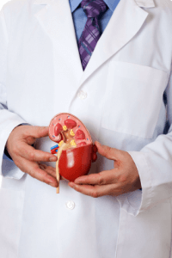
Nephrologist
Diagnosis -Sjogrens syndrome ? Distal RTA
Suggestion
ANA
Lip biopsy

Slide 30
ANA - POSITIVE
SSA/RO – 163.93 ( <20U )
SSB/La - 26.86 ( <20U )
RF- POSITIVE
LIP BIOPSY-
Lip biopsy showed groups of mucin secreting glands with mild lymphocytic infiltration .

Slide 31
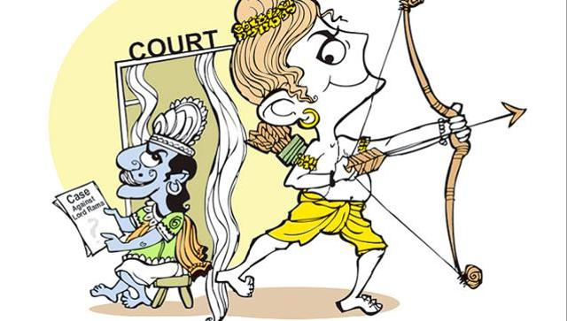
Rheumatologist;
Diagnosis: Primary Sjogren syndrome
Suggestion T. Mycophenolate mofetil 500mg BD
T. Hydroxychloroquine 100mg OD
T. Prednisolone 10mg od

Slide 32
FINAL DIAGNOSIS
SJOGREN SYNDROME WITH HYPOKALEMIC PARALYSIS

Slide 33
AIM OF PRESENTATION
Prescence of severe RTA causing hypokalemic paralysis in ss reflects the severity of underlying autoimmune tubulointerstitial nephritis
Kidney involvement in Sjogren syndrome can
uncommonly present as hypokalemic paralysis in the absence of significant sicca symptoms.

