Slide 1
A HEART TOUCHING DYE (DIE)
- BY IMCU AND MEDICAL UNIT 6

Slide 2
HISTORY OF PRESENTATION :
PATIENT Dhivya bharathi , age 18 , presented with the alleged history of supervasmol-33 100 ML poisoning with the intention of suicide , consumed at her home on 26.12.2020
On presentation the patient had cervico facial edema and stridor , her airway was secured with emergency insertion of Tracheostomy tube and she maintained her saturation on room air

Slide 3
On general examination , :
patient was conscious
oriented
afebrile
cervicofacial edema +
with tongue protrusion
cvs : s1s2+, no addedsounds or murmur
RS: BAE + , with TT insitu , no added sounds
PA : SOFT , diffuse abdominal wall tenderness
no organomegaly
CNS : able to move the limbs with command againt gravity and minimal resistance
reflexes preserved , with flexor plantar response

Slide 4
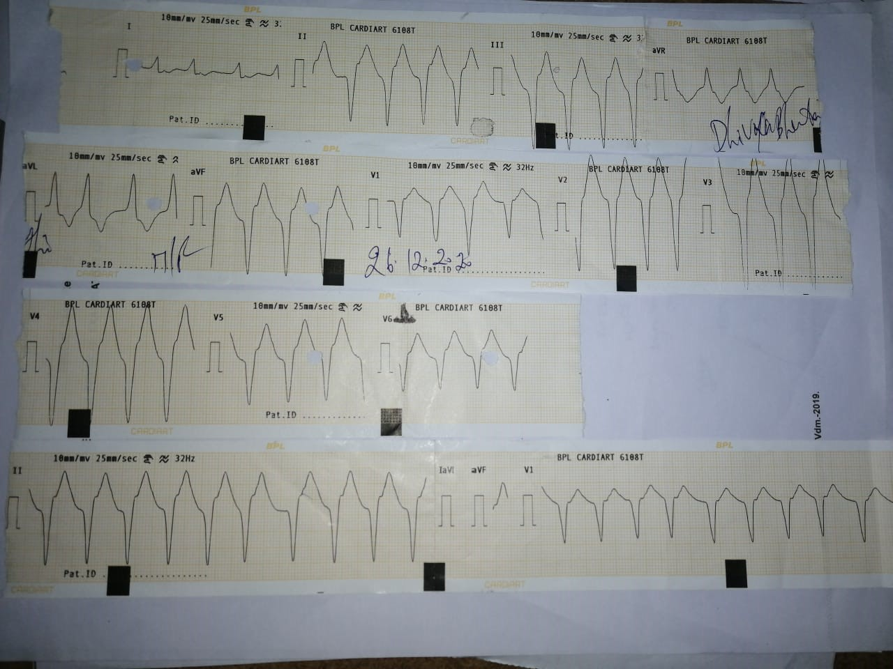
THE FIRST HEARTBREAK
ECG ON ADMISSION ,

Slide 5
With the above ecg finding , the patient was stable , maintaining the following vital signs
BP: 90/60 mmhg
PR : 146/min , Regular rhythm, small volume
Spo2 : 98 % with TT on RA
RR : 32 / MIN
URINE COLOUR : burgundy colour

Slide 6
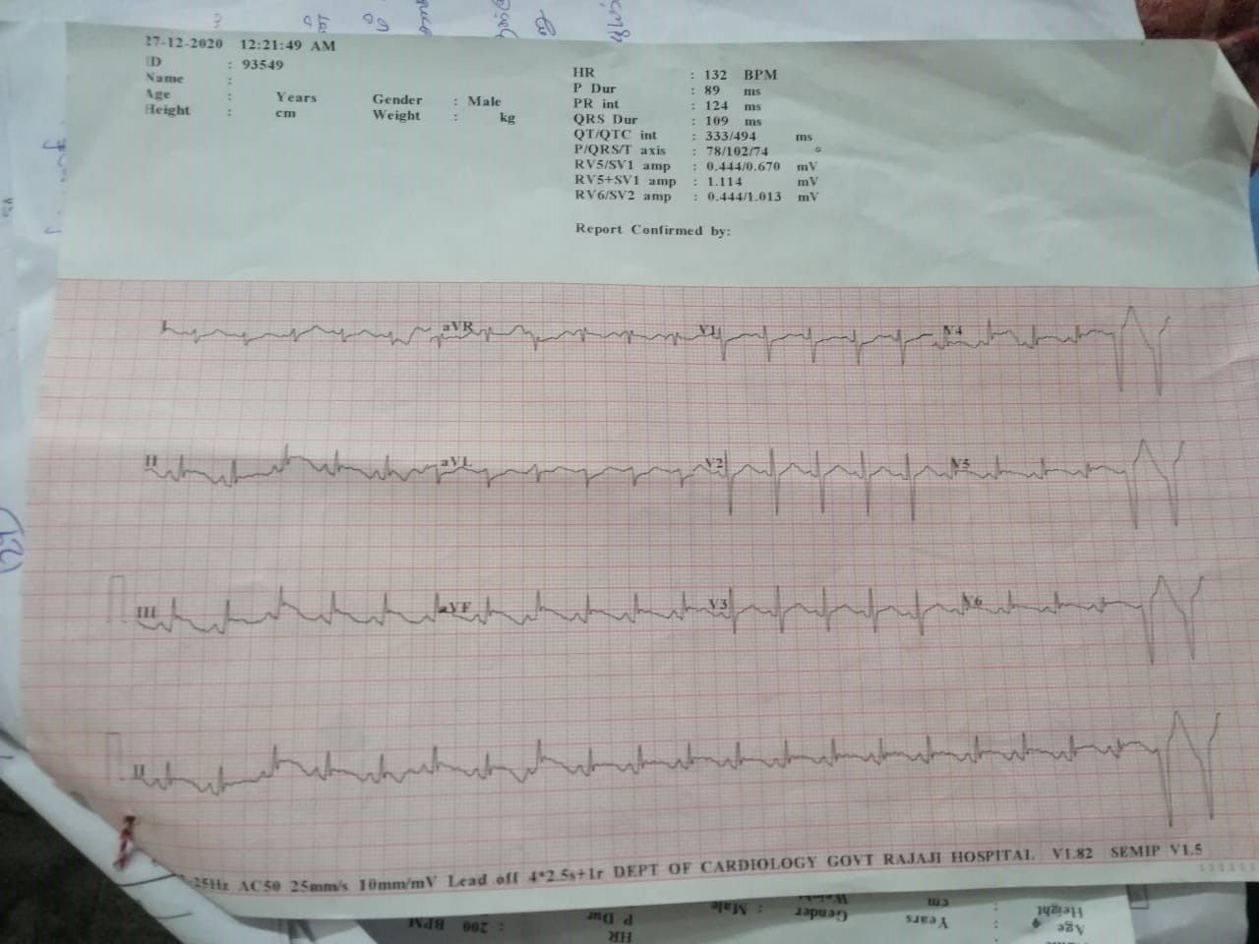
The patient was shifted to cardiology department for consultation
ECG at the cardiology department showed the following :

Slide 7
Cardiology opinion :
- Stable monomorphic vt
- DC cardioversion if hemodynamically unstable
- Inj. Amiodarone 150 mg /10 min
f/b , 360mg /6hrs
180 mg / 18 hrs

Slide 8
The patient was shifted to imcu and treated accordingly with
1) IV steroids
2) Anti histamines
3 )FORCED ALKALINE DIURESIS
4)IV DIURETICS
5)Inj. Calcium gluconate 10 ml 10 % iv as infusion in DNS
With the aim of maintaining the urine output of 300 ml /hr

Slide 9
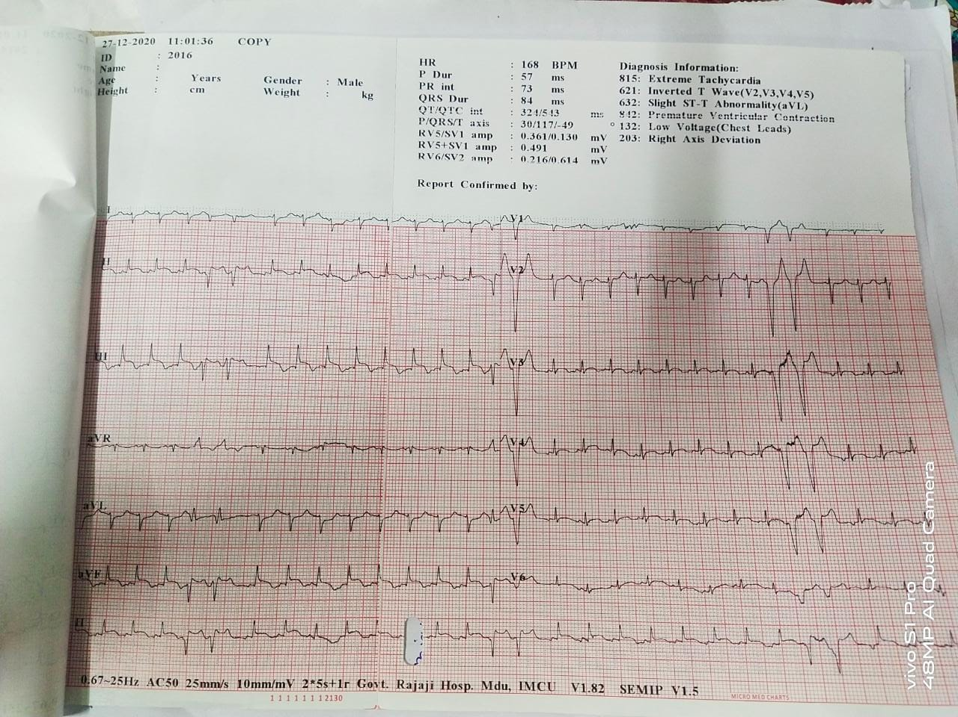
Ecg taken at IMCU :

Slide 10
Inspite of the above interventions , the urine output of the patient did not improve and was still high colored .
NEPHROLOGY opinion was obtained :
-Suggested to continue FAD CYCLES
And review after serial RFT monitoring

Slide 11
INVESTIGATIONS | 26/12/2020 AT 10.10 PM | 27/12/2020 AT 10.30 AM
HB | 11.2 | 11
TOTAL COUNT | 10,600 | 20,400
PLATLETS | 2.64 LAKS | 1.85 LAKS
HEMATOCRIT | 34 | 33
DIFFERENTIAL | 72/20/8 | 86/12/2
UREA | 24 | 37
CREATININE | 1.0 | 1.4
BILLIRUBIN (D/I) | 0.9(0.3/0.6) | 1.3(0.5/0.8)
AST | 56 | 167
ALT | 34 | 90
ALP | 102 | 119
URINE ALBUMIN | NIL | LOADED
URINE DEPOSITS | 0-2 PUS CELLS | 6-8 PUS CELLS

Slide 12
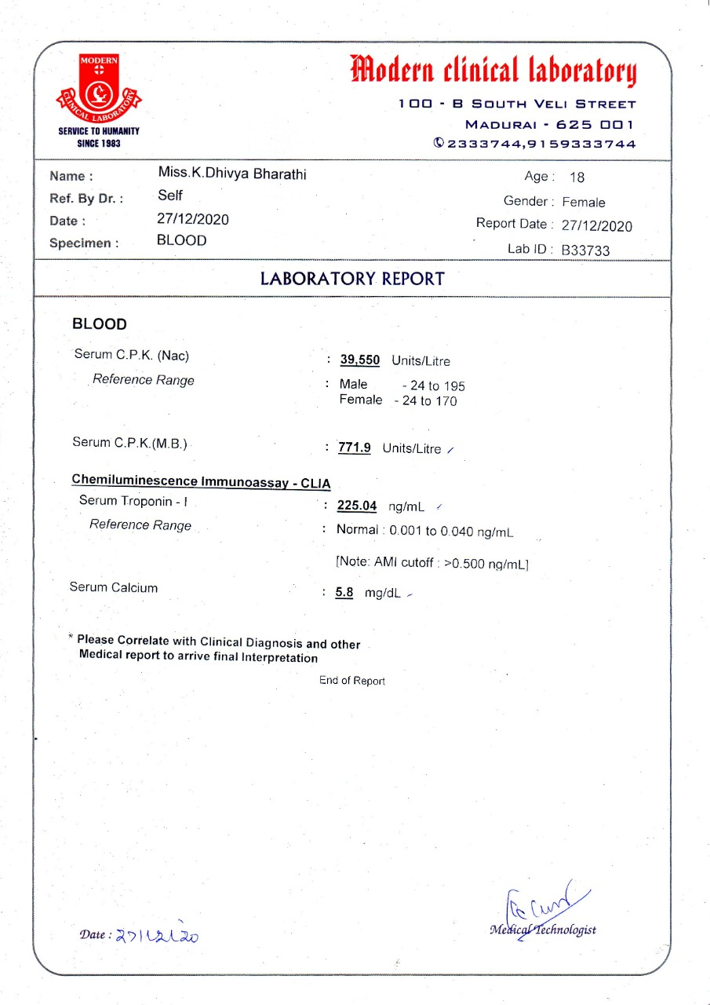
OTHER INVESTIGATIONS SENT :

Slide 13
PATIENT WENT INTO SUDDEN CARDIORESPIRATORY ARREST AT 10.50 AM on 27.12.2020 ,
Cardiopulmonary resuscitation was done ,
Patient was revived but , cerebral hypoxia was unavoidable .
Following resuscitation , patient was Started on ionotrope supports and was connected to mechanical ventilation with volume A/C mode

Slide 14
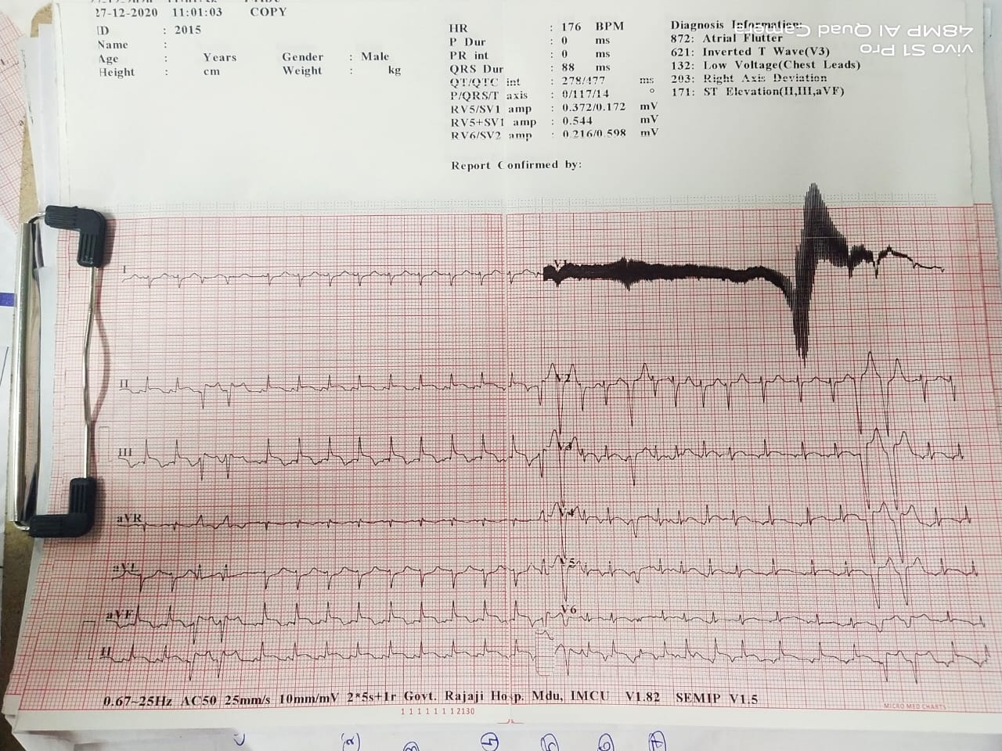
Ecg done post resucitation :

Slide 15
On examination post resucitation :
pt was unconscious
not responding to pain or oral commands
afebrile
cvs – s1s2+
RS – BAE + with TT ON MV
CNS- areflexic , hypotonic ,
b/l plantar no response
having spontaneous movements
B/L PUPILS 3.5MM SRTL
BP - 90/?
PR-158/MIN , small volume
SPO2- 97% WITH MV

Slide 17
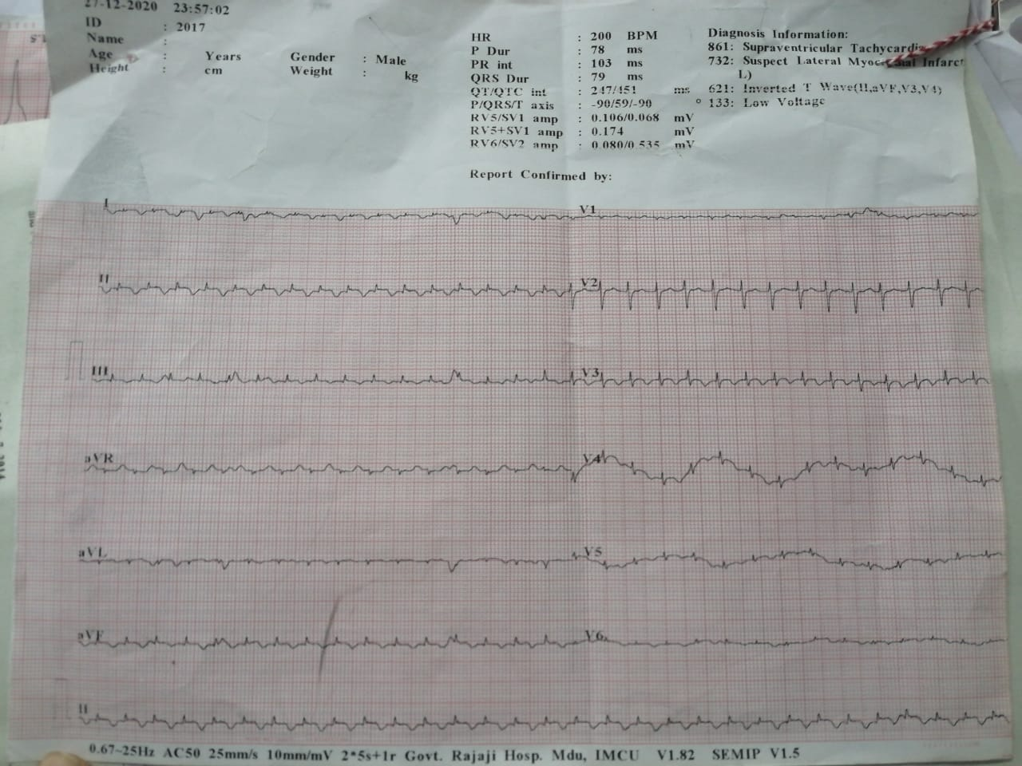
A REPEAT ECG DONE AT 11 . 57 PM

Slide 18
Patient once again went into cardio respiratory arrest at around ,4.00 am on 28.12.2020
She could not be revived this time , and was declared dead at 4.15 am on 28.12.2020.
With the ECG findings above and cardiac specific enzyme abnormalities ,
TOXIC MYOCARDITIS due to hair dye poisoning was considered ,

Slide 19
Through literature review , it was found that in ppd poisoning
. Myocarditis is one of the rare complications.
Studies report a myocarditis incidence of 15% with a high mortality rate of 29%
Myocardial damage with supervasmol poisoning is associated with
1. supraventricular and ventricular ectopics with elevated parameters of myocardial damage
2. ST segment elevation and T wave inversion in anterior chest leads, new onset RBBB

Slide 20
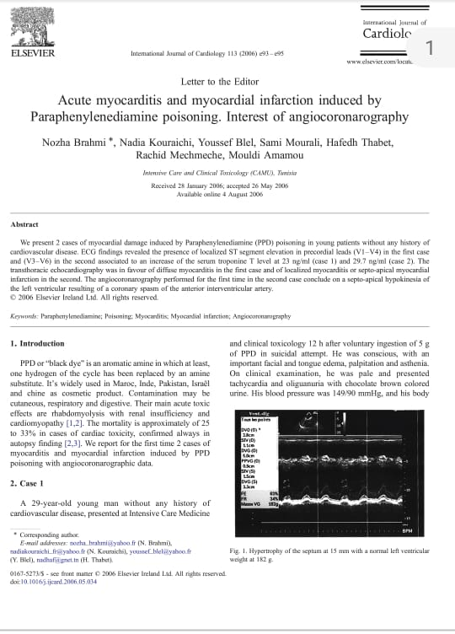
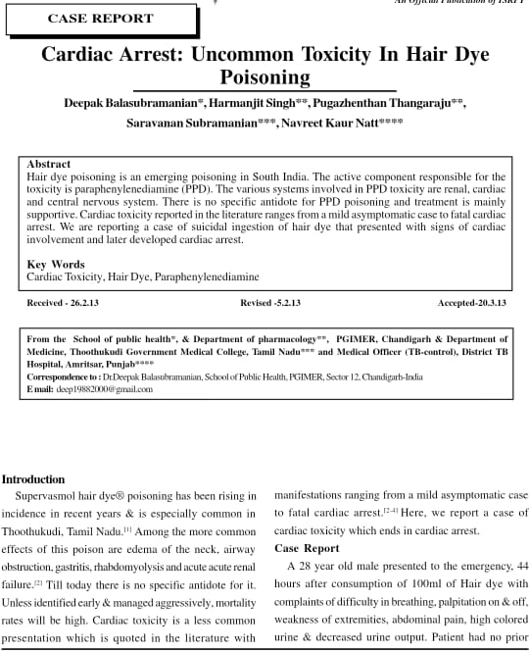

Slide 21
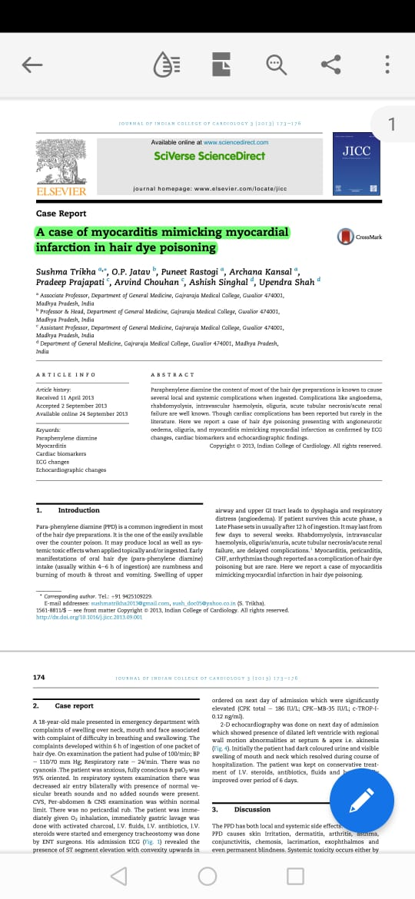

Slide 22
Recommended reads :
RBBB: AN UNCOMMON CARDIOTOXIC MANIFESTATION ,D.BALASUBRAMANIAM,JCDR
Myocarditis in hair dye poisoning – A.singh,O.P.Jatav ,M.Dudani- indian heart journal
Cardiac and Hepatic toxicity in PPD poisoning among sudanese –A.mohammed

