Slide 1
An interesting CT CHEST for discussion
Presentor
Dr Shyam
III Medical Unit
Chief:Dr.Natarajan
Asst. Prof:Dr.Palanikumar
Dr.Vallidevi

Slide 2
CASE SCENARIO
59/M came with
C/O non specific cough on and off *6 months
low grade fever on and off * 6 months
Clinical examination was normal.
INVESTIGATIONS
ESR-118
CRP-33

Slide 3
All other investigations were normal.
Mantoux –negative.
ANA- negative.
Bence Jones proteins- negative.
Electrophoretic pattern –negative.
Cause for elevated ESR could not be found.
CT chest and screening of abdomen was done to R/O tb.

Slide 8
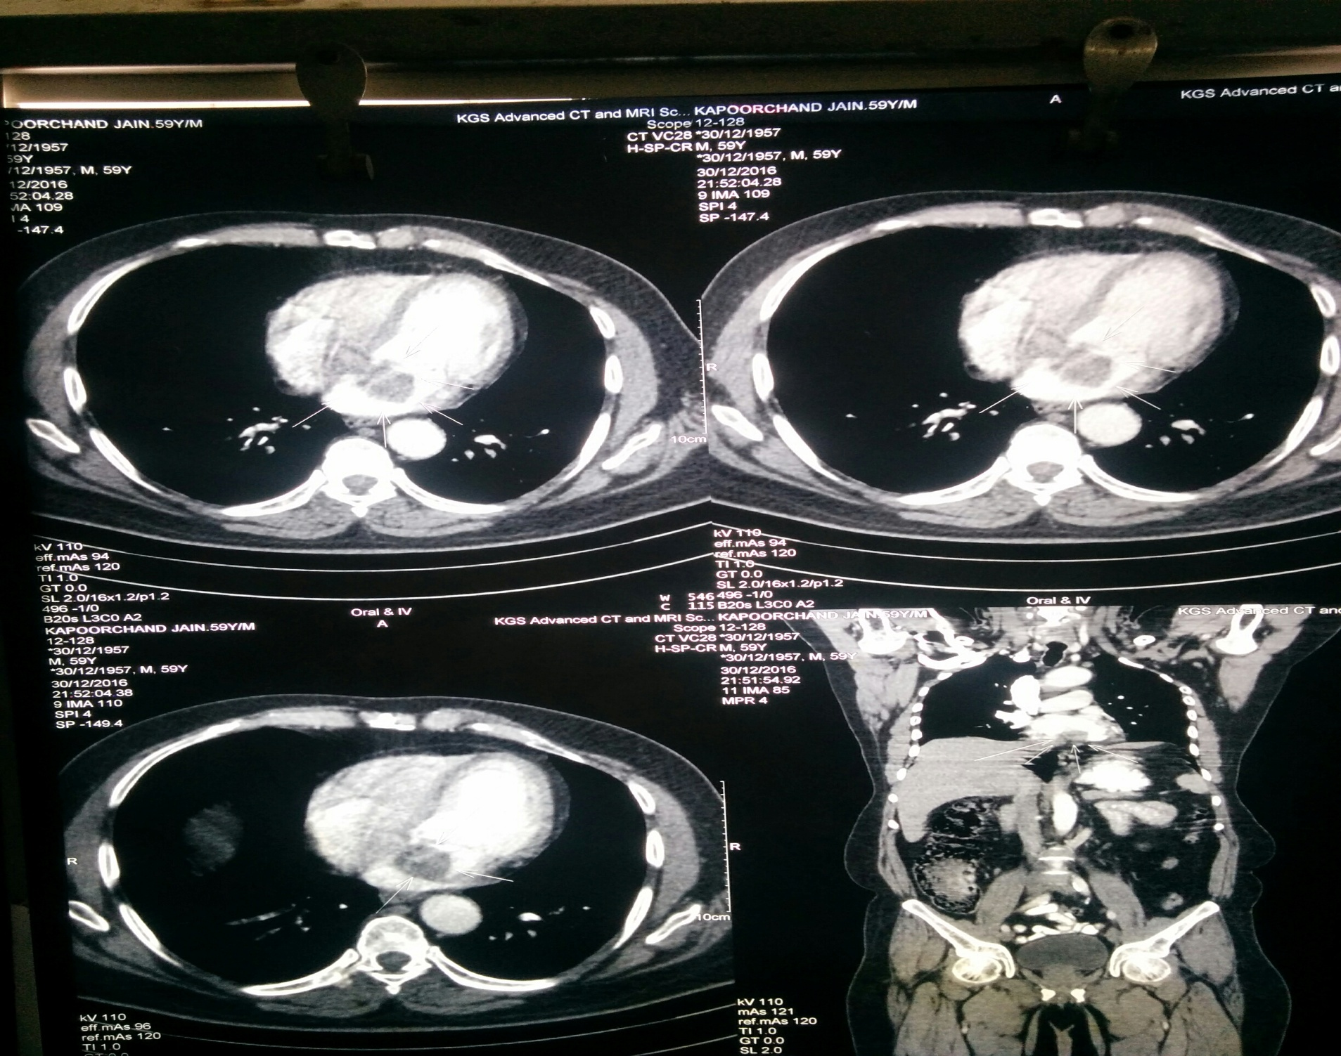

Slide 10
Discussion
CT finding:
Homogenous low attenuated globular ovoid mass 3cm *3cm is visualized in Left Atrium near inter atrial septum suggestive of Left Atrial Myxoma.

Slide 11
THANK YOU

