Slide 1
Medical Management of surgical Patients
        by 1st Medical Unit
  Prof and HOD : Dr Senthil K M.D
    Associate Prof. : Dr Muralidharan M MD
Asst Professors. : Dr Sudha P M.D
      Dr Manikandan MD., DA
Dr Saravanamadhav MD.,DTCD
Presenter : Dr Sasikumar M MD(Postgraduate)

Slide 2
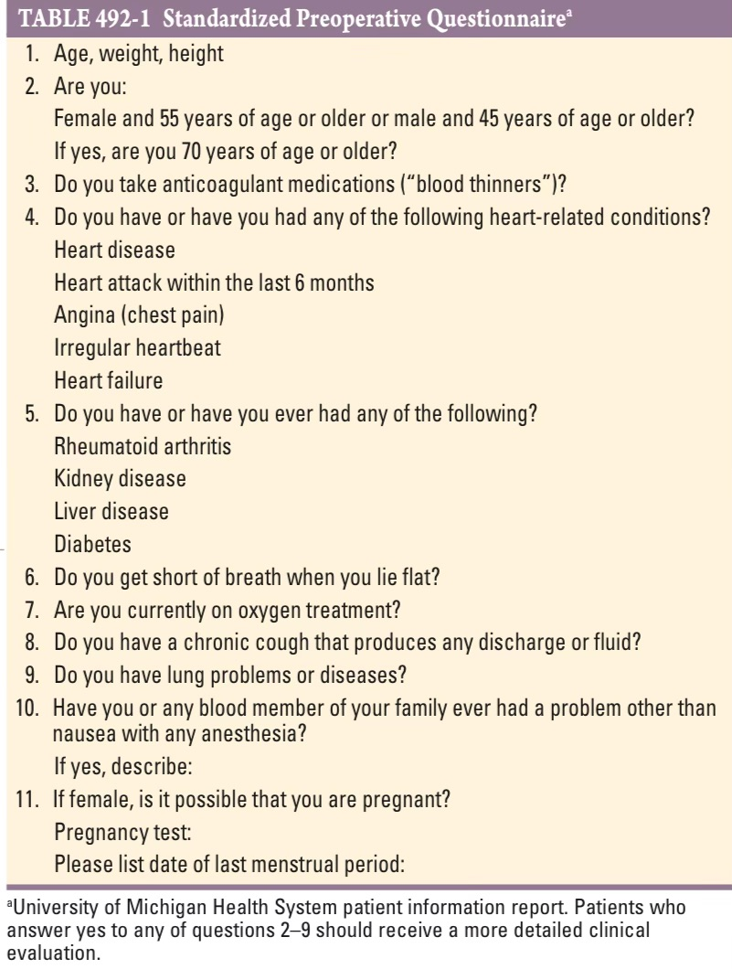
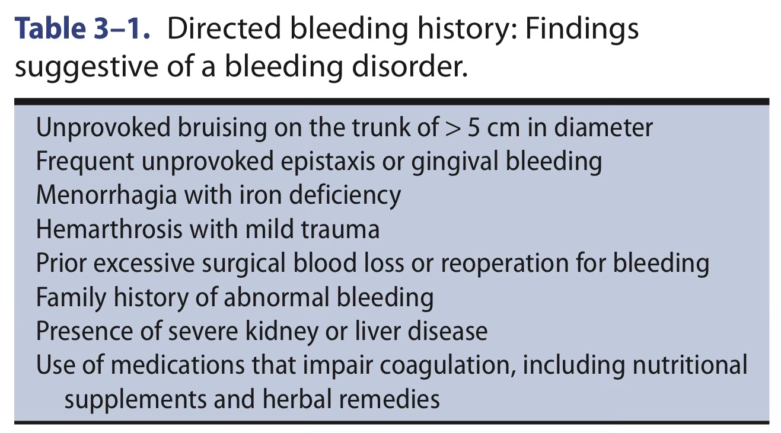
Standardized Preoperative Questionnaire
Patients who answer yes to any of questions 2–9
Need more detailed clinical evaluation.

Slide 3
PREOPERATIVE CARDIAC RISK ASSESSMENT

Slide 4
Clinical tools for cardiac risk Assessment
American College of Surgeons’ National Surgical Quality Improvement Program (NSQIP) risk calculator
Revised Cardiac Risk Index (RCRI)
Surgical Outcome Risk Tool (SORT)
American University of Beirut (AUB)-HAS2 Cardiovascular Risk Index.

Slide 5
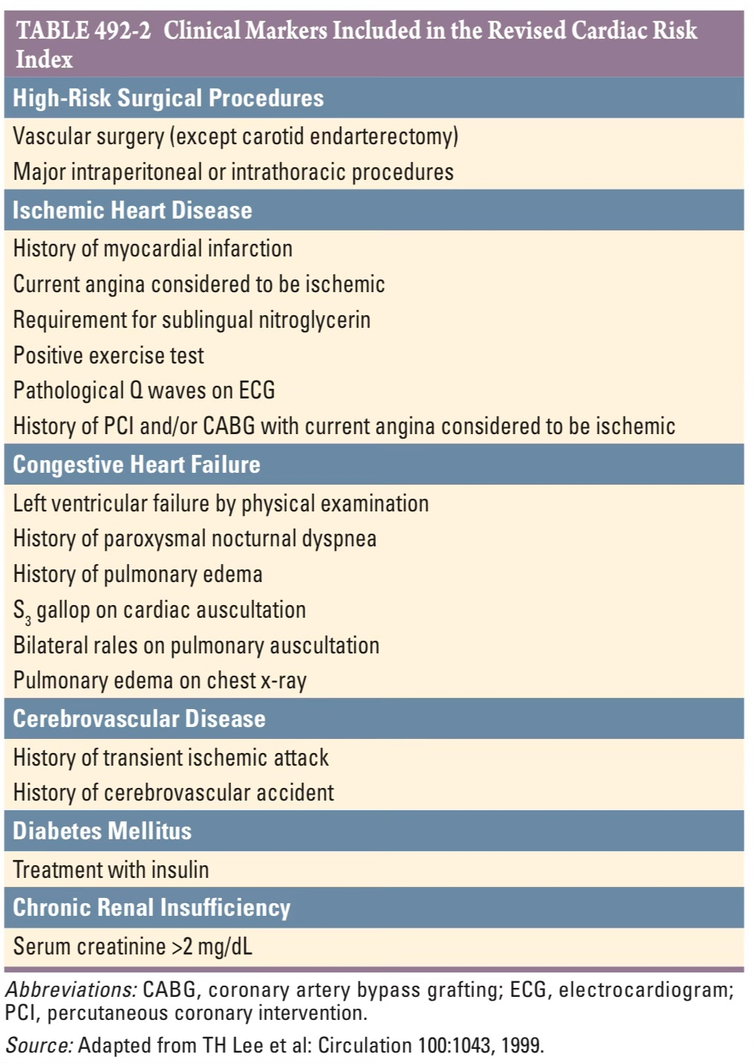
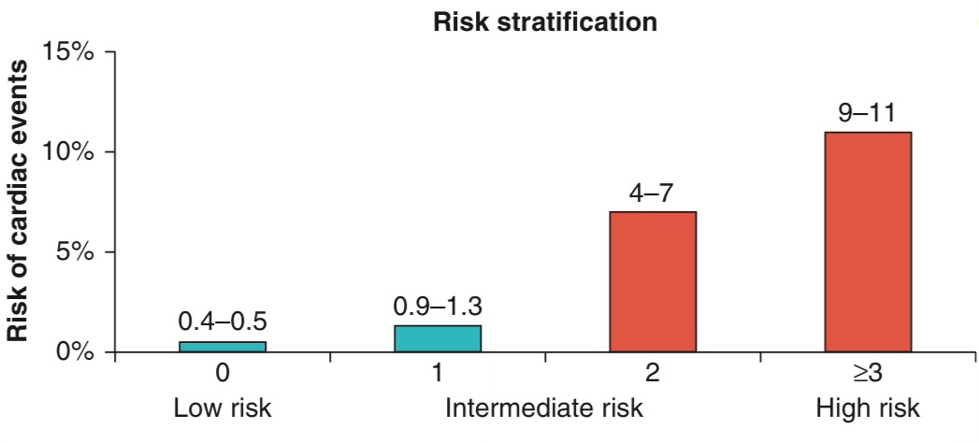
Revised Cardiac Risk Index (RCRI)
Cardiac events include
Myocardial Infarction,
Pulmonary Edema,
Ventricular Fibrillation,
Cardiac Asystole,
Complete Heart Block.

Slide 6
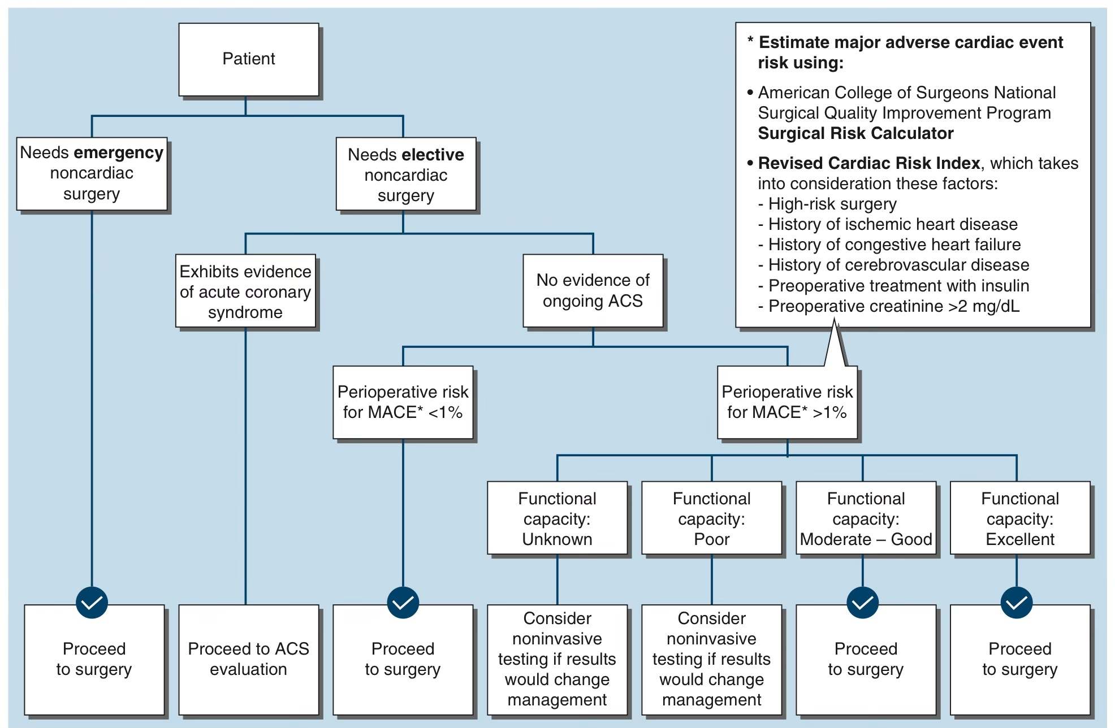
Composite algorithm for Cardiac Risk Assessment and Stratification in patients undergoing Non-cardiac surgery
Pharmacologic stress testing
Dobutamine stress ECHO
Myocardial Perfusion imaging with coronary vasodilator stress (dipyridamole, adenosine, or regadenoson) with thallium-201 and/or technetium-99m

Slide 7
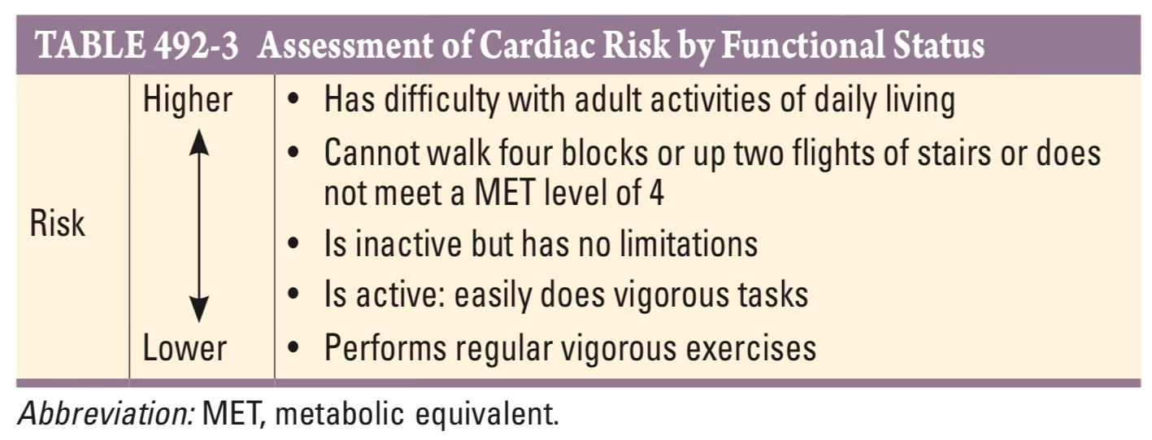
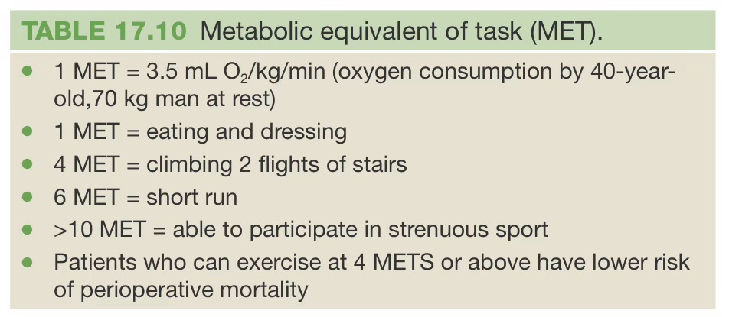
patients with poor (<4 METs) or unknown functional capacity (inability to walk four blocks or climb two flights of stairs at a normal pace or to meet a MET level of 4 (e.g., carrying objects of 15–20 lb. or playing golf or doubles tennis)
should undergo pharmacologic stress testing
Patients with moderate or greater (≥4 METs) functional capacity (e.g., climbing up a flight of stairs, walking up a hill, or walking on level ground at 4 mph)
generally should not undergo further noninvasive cardiac testing

Slide 8
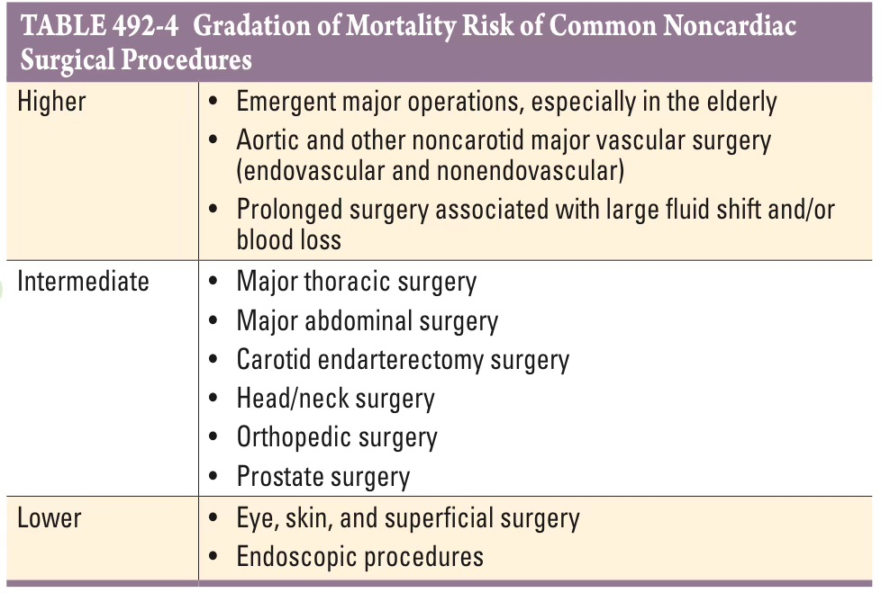

Slide 9
Heart failure and LV dysfunction - Elective surgery should be postponed until decompensated HF (manifested by an elevated jugular venous pressure, an audible third heart sound, or evidence of pulmonary edema) has been brought under control.
In patients with compensated HF, the risk of perioperative cardiac complications is similar in patients with ischemic or nonischemic cardiomyopathy

Slide 10
RISK MODIFICATION: PREVENTIVE STRATEGIES TO REDUCE CARDIAC RISK
Perioperative Coronary Revascularization
Prophylactic coronary revascularization with either coronary artery bypass grafting (CABG) or percutaneous coronary intervention (PCI) provides no short- or mid-term survival benefit for patients without left main CAD or three-vessel CAD in the presence of poor left ventricular systolic function and
It is not recommended for patients with stable CAD before noncardiac surgery.
Elective noncardiac surgery
delayed for 6 months after elective PCI
delayed for 12 months after acute coronary syndrome.
time sensitive noncardiac surgery could be a consideration as soon as 1 month of treatment with DAPT has passed.

Slide 11
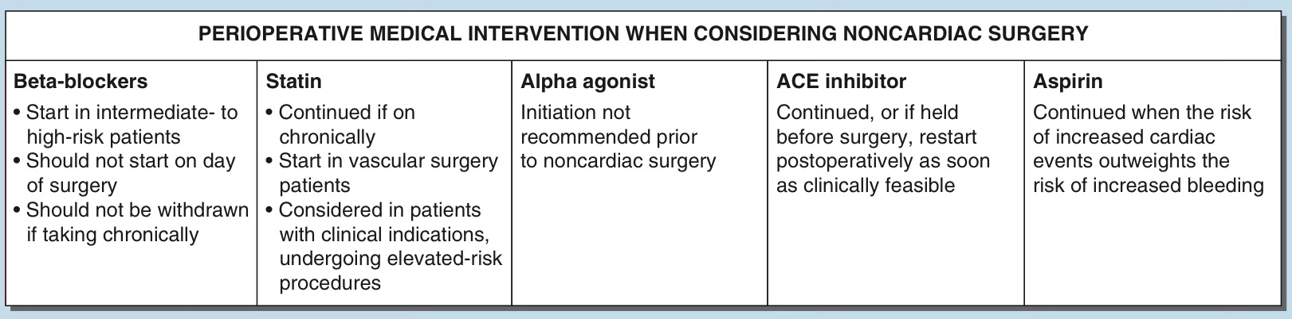
PERIOPERATIVE PREVENTIVE MEDICAL THERAPIES
SGLT-2 inhibitor therapy should be interrupted for at least 3–4 days prior to scheduled noncardiac surgery- risk of Euglycemic DKA
Diuretics - discontinued 24-48hrs before surgery

Slide 12
Oral antiplatelet drugs
DAPT may be interrupted to allow for noncardiac surgery
 | Condition | Duration of DAPT
1 | Stable IHD | 6 months
2 | Acute coronary syndrome | 12 months
 | Condition | DAPT may be interrupted
1 | If Bare metal stent | 30 days
2 | If DES | 6 months
 | Drugs | Drugs stopped
1 | P2Y12 Inhibitors
 | Clopidogrel | 5 days before | should be restarted as soon as possible postoperatively
 | Prasugrel | 7 days before
 | Ticagrelor | 3-5 days before
2 | Aspirin | should be continued perioperatively

Slide 13
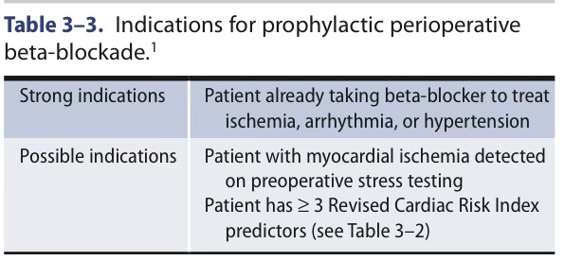

Slide 14
Valvular Heart disease
Patient with asymptomatic valvular heart disease
Pt with asymptomatic valvular disease proceed with surgery with careful perioperative fluid Balance and hemodynamic monitoring
Patient with Mitral stenosis
Moderate to severe mitral stenosis consider pt is opt for valvular intervention proceed to valvular repair then proceed to noncardiac surgery
Mitral regurgitation
Usually well tolerated Valvular heart disease and usually associated with increased cardiovascular complications not mortality
Aortic regurgitations
Pt with moderate to severe aortic insufficiency with LV dysfunction carry increased risk of perioperative mortality

Slide 15
Valvular Heart disease
Aortic stenosis
Severe symptomatic aortic stenosis - should generally undergo aortic valve intervention (surgical aortic valve replacement or transcatheter aortic valve implantation) if noncardiac surgery can be deferred.
Asymptomatic patients with severe aortic stenosis and preserved ejection fraction can generally safely undergo low- or intermediate-risk noncardiac surgery.
Balloon valvotomy is usually not recommended but may serve a role in the minority of patients who need “bridging” to a necessary surgery or procedure.

Slide 16
Arrhythmia
Patients with adequately controlled rhythm disturbance without evidence of underlying heart disease are at low risk for perioperative cardiac complications.
While longterm antiarrhythmic medications should be continued perioperatively
Patients with symptomatic arrhythmias should not undergo elective surgery until their cardiac condition has been addressed.
Adequate rate control of atrial fibrillation or other supraventricular arrhythmias should be established prior to surgery.
Symptomatic ventricular tachycardia must be thoroughly evaluated and controlled prior to surgery.
postoperative atrial fibrillation is associated with increased long-term risk of atrial fibrillation stroke.

Slide 17
Preoperative management hypertension
Pt with stage 3 (SBP>180 &DBP >110)
Look for any Features of end organ damage
Stage 1 (SBP 140-159 &DBP 90-99)
Stage 2 (SBP 160-179 &DBP 100 -109)
proceed to surgery
if present
delay procedure for 4-6weeks
If no
proceed with surgery
Beta blocker and calcium channel blocker - continued on the day of sugery
Ace inhibitors ,ARB - can be continued on day of surgery
Diuretics discontinue 24 hours prior to surgery

Slide 18
Postoperative hypertension
first rule out - hypercabria,agitation,anaesthetic withdrawal, pain
After ruling out if this pt is on NPO- IV LABETOLOL or NICARDIPINE or NITROPRUSSIDE or NTG
Moniter Bp for 24-48hrs
If patient is chronic hypertensive - start oral antihypertensives once the started on oral diet

Slide 19
Diabetes
Practice guidelines advocate a target glucose range of 100–180 mg/dL in the perioperative period.
Oral hypoglycemic agonists should not be given on the morning of surgery.
Perioperative hyperglycemia should be treated with IV infusion of short-acting insulin or subcutaneous sliding-scale insulin
American College of Physicians recommends maintaining serum glucose between 140 mg/dL and 200 mg/dL (7.8–11.1 mmol/L), whereas the British National Health Service guidelines recommend a range of 108–180 mg/dL (6–10 mmol/L).
Tight control of 80 to 150 mg/dl is recommended for those with shorter duration of diabetes.
Poor preoperative glycemic control, sometimes defined as a hemoglobin A 1c level above 8%, is associated with a greater risk of surgical complications, particularly infections.

Slide 20
Pre-operative Evaluation - Diabetes
Assess glycaemic status:
Fasting and post-prandial blood sugar and HbA1c.
If the HbA1c is >9% - insulin should be started.
If above 12%. - consideration should be given to improving control before elective surgery is planned.
Assess cardiac risk by detailed history and cardiac risk score.
Evidence of peripheral vascular disease may indirectly suggest co-existing coronary artery disease.
Look for carotid bruits.
Assess for cardiac autonomic neuropathy by electro-cardiogram for CAD and heart rate variability (HRV) after deep breathing. HRV of <5 beats/min signifies serious cardiac autonomic neuropathy and prone for arrhythmias.
Assess renal risk by blood urea, creatinine, electrolytes, urinary proteinuria, and microalbuminuria.
Detect hypertension or orthostatic hypotension.

Slide 21
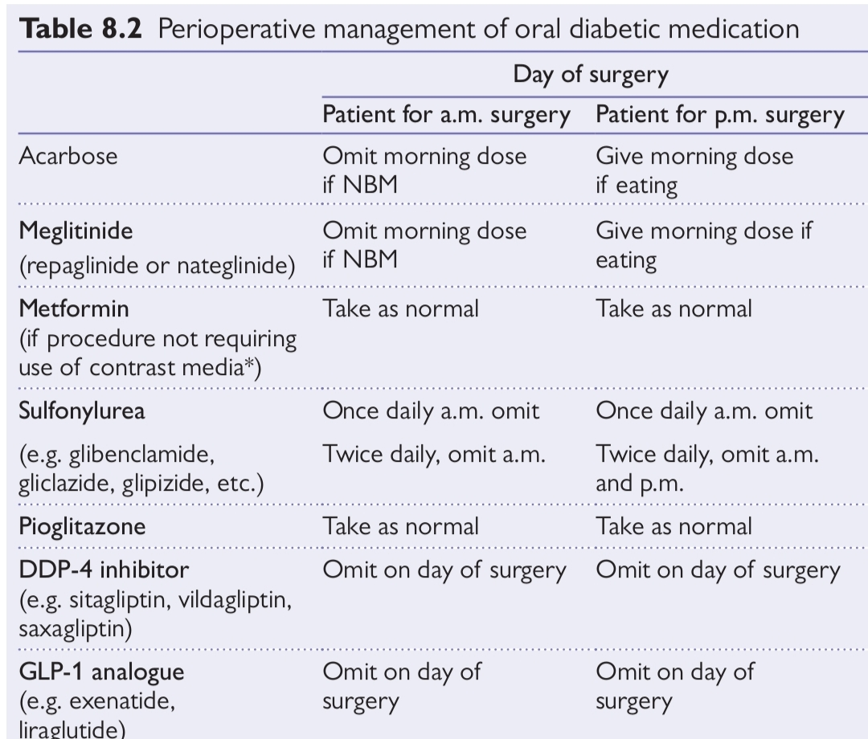
A. Diabetes Controlled by Diet
For people with diabetes controlled with diet alone, no special precautions must be taken
diabetic control is markedly disturbed by the procedure - small doses of short-acting insulin as needed will correct the hyperglycemia.

Slide 22
B. Diabetes Treated with Oral Hypoglycemic Agents
Admit 48 hrs prior to the surgery
Most oral hypoglycemic agents should be held on the day of surgery.
the SGLT-2 inhibitors (eg, canagliflozin) should be discontinued for 3–4 days before surgery due to their long half-life and associated risk of ketoacidosis.
Oral hypoglycemic agents should not be restarted after surgery until patients are clinically stable and oral intake is adequate and unlikely to be interrupted.
A possible exception are dipeptidyl peptidase-4 inhibitors which have a low risk of causing hypoglycemia and might be continued perioperatively.
Patients who experience significant hyperglycemia when oral agents are held should be treated in the same way as patients with type 2 diabetes who require insulin
Postoperative kidney function should be checked with a serum creatinine level prior to restarting metformin.

Slide 23
B. Diabetes Treated with Insulin
The protocol used to control glucose depends on
(1) the kind of diabetes (type 1 or type 2);
(2) whether it is minor surgery (lasting less than 2 hours and patient able to eat afterward) or major surgery (lasting more than 2 hours, with invasion of a body cavity, and patient not able to eat afterward); and
(3) the preoperative insulin regimen (basal bolus or premixed insulin twice a day or premeal bolus only or regular insulin before meals and NPH at bedtime).

Slide 24
Preoperative Insulin Regimen
Post-operative Insulin Regimen
to reduce the last preoperative dose of long-acting, basal insulin (used to control fasting glucose levels) by 30–50% and hold rapid-onset, short-acting nutritional insulin
After surgery, when a patient with either type 1 or type 2 diabetes has resumed adequate oral intake, subcutaneous administration of insulin can be restarted.
Intravenous administration of insulin and dextrose can be stopped 30 minutes after the first subcutaneous dose of long-acting insulin
Peri-operative Insulin Regimen
Patients with type 1 diabetes must receive basal insulin to prevent the development of diabetic ketoacidosis
Major surgical procedures(lasting more than 2 hours) in patients with type 1 diabetes and some Type 2 DM usually require an insulin infusion

Slide 25
If pt started on NPO
2 hrly blood glucose monitoring done
if pt have blood sugar between 108-180mg/dl controlled with their own medication
If pt had blood sugar of more than >200 mg /dl Started on insulin infusion by Variable Rate IV Insulin Infusion(VRIII) or by alberti regime(GIK Regimen)
VRIII ( VARIABLE RATE INTRAVENOUS INSULIN INFUSION)
Indicated in
pt on long starvation period or
well controlled pt with CBG >200 mg/dl on
NPO in perioperative period
given by infusion pump
Adjust according to sliding scale
VRIII (VARIABLE RATE INTRAVENOUS INSULIN INFUSION)
0.45 %of NACL,5% GLUCOSE,0.15%or 0.3% KCL
Or 4% or 5%or 10%glucose and 0.18 %NACL

Slide 26
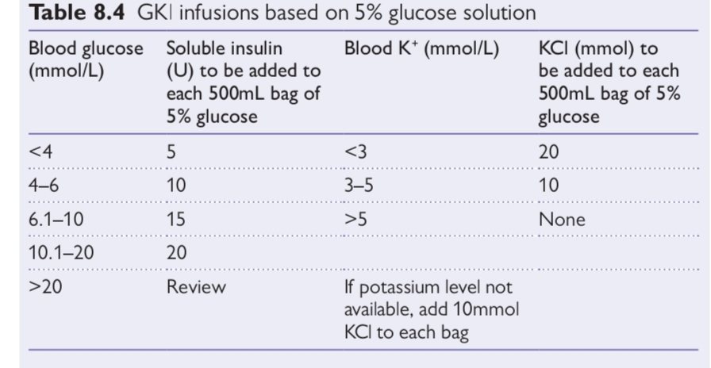
Glucose-insulin-potassium regimen: (ALBERTI REGIMEN)
Skip morning dose of insulin. 5 to 10 units of insulin + 10% dextrose + 10 MEq potassium – at the rate of 100 ml/hr starting half an hour before surgery (if diabetes poorly controlled, 10 to 20 IU of insulin and 5% dextrose can be used). Use of 5% dextrose with 10 IU of insulin and 10 MEq of potassium has been used with excellent results.

Slide 27
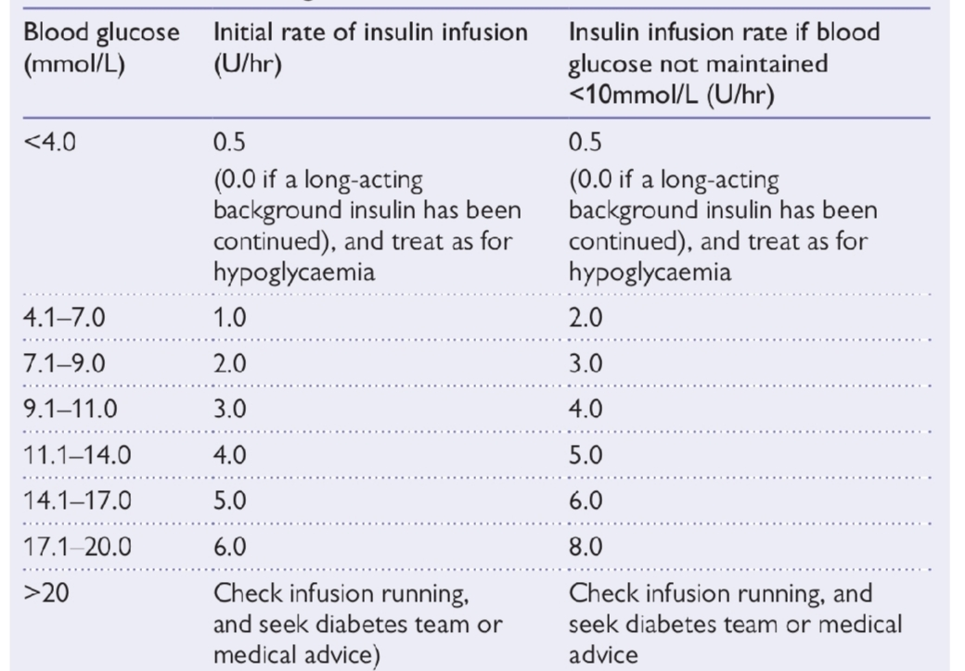
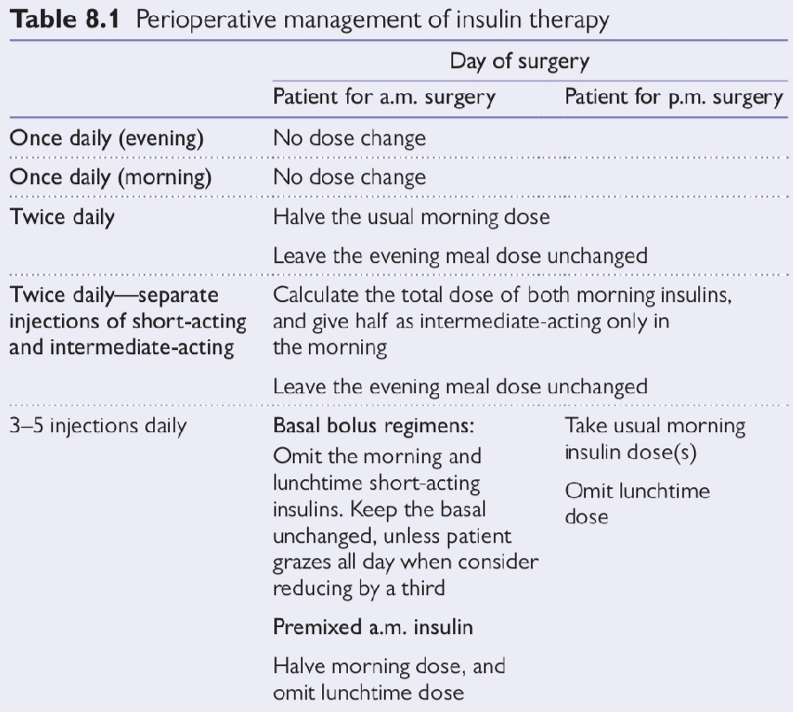
When to stop VRIII
when pt started on oral diet stopped 30 minutes after commencing the usual OHA or INSULIN
Check blood glucose 1 hr after discontinuing VRIII and atleast 4 times in the first 24 hrs

Slide 28
PERIOPERATIVE HEMATOLOGIC EVALUATION
ANEMIA- the AABB states that a threshold of 7.5 g/dL (75 g/L) could be considered for hospitalized patients undergoing cardiac surgery, and
8 g/dL (80 g/L) could be considered for hospitalized patients undergoing orthopedic surgery or who have underlying CVD.
For most hemodynamically stable hospitalized patients, the AABB (formerly American Association of Blood Banks) recommends transfusion for a hemoglobin level less than 7 g/dL (70 g/L).
When feasible, the diagnostic evaluation of the patient with previously unrecognized anemia should be done prior to surgery because certain types of anemia (particularly those due to sickle cell disease, hemolysis, and acute blood loss) have implications for perioperative management

Slide 29
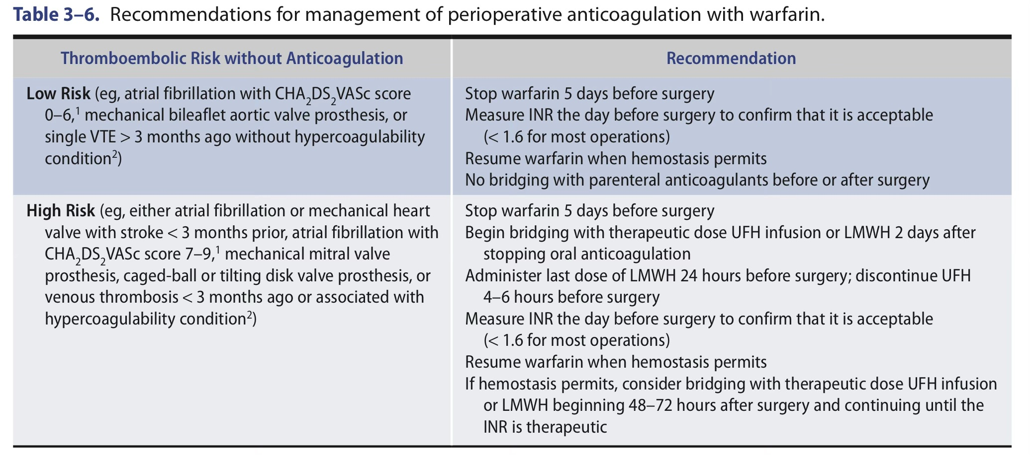
Management of perioperative Anticoagulantion with warfarin

Slide 30
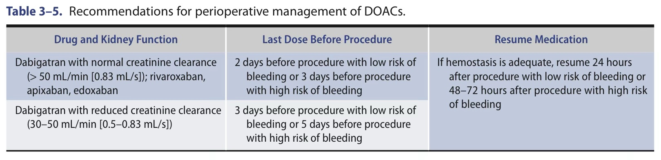
Perioperative Management of DOACs

Slide 31
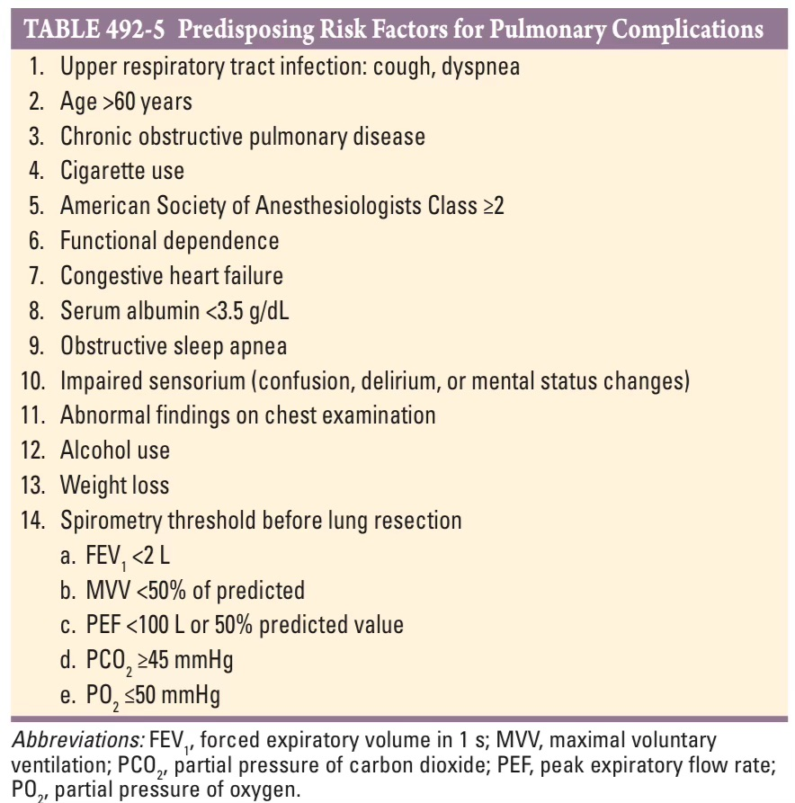
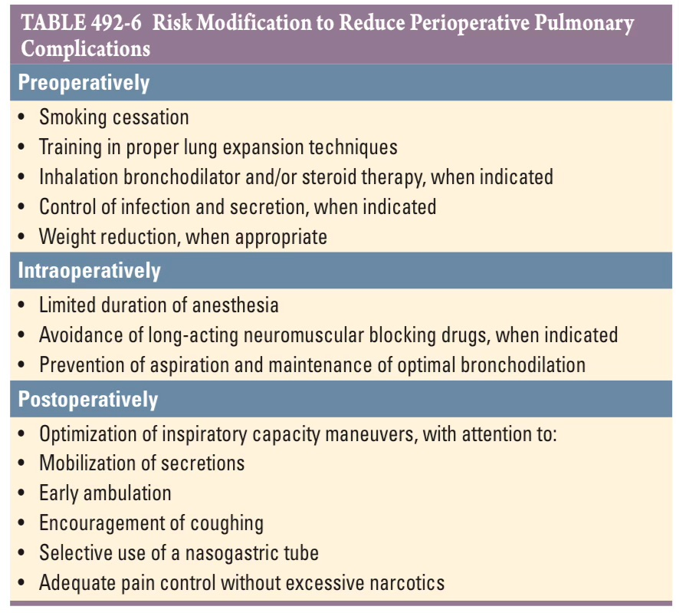
PREOPERATIVE PULMONARY RISK ASSESSMENT

Slide 32
Management of perioperative Venous thromboembolism
Aspirin is not supported as a single agent for thromboprophylaxis.
Low-dose unfractionated heparin(UFH) (≤5000 units SC BD),
low-molecular-weight heparin (LMWH) (e.g., enoxaparin, 30 mg BD or 40 mg OD), or
a pentasaccharide (fondaparinux, 2.5 mg OD) is appropriate for patients at moderate risk;
unfractionated heparin (5000 units SC TDS) - high risk patients .
The use of direct oral anticoagulants(NOAC) may be an alternative to the use of prophylactic doses of low-dose unfractionated heparin and low-molecular-weight heparin;
among patients immobilized after nonmajor orthopedic surgery, rivaroxaban 10 mg once daily when compared to enoxaparin was associated with a decrease in venous thromboembolic events, without a significant change in bleeding.
Graduated compression stockings and pneumatic compression devices are useful supplements

Slide 33
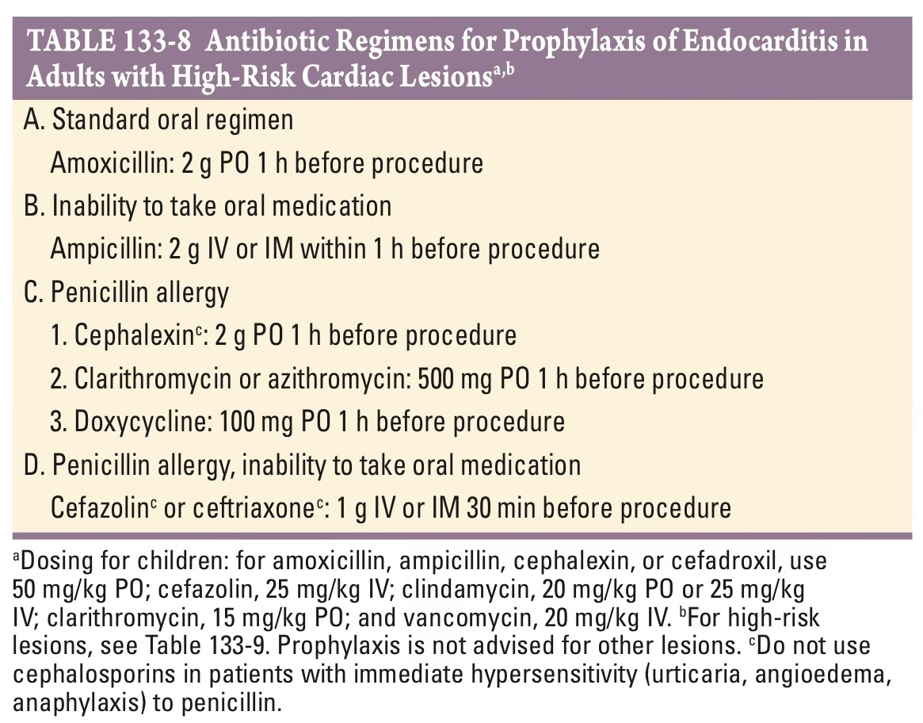
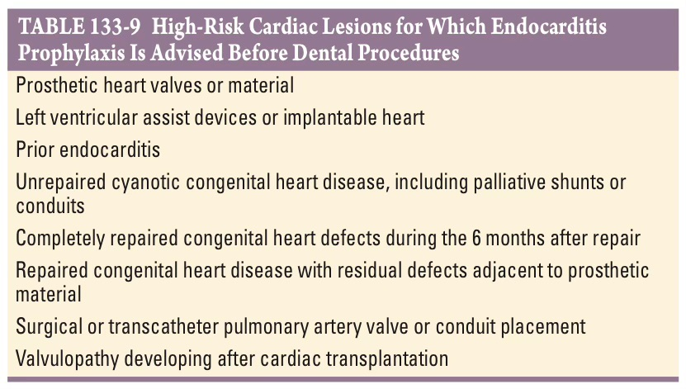
Prophylaxis of Infective endocarditis

Slide 34
DRUGS | STOP | START
ASPIRIN | 7-10 days | 1-2days
CLOPIDOGREL/TICAGRELOR | 5-7 days | 1-2days
PRASUGREL | 7 days | 1-2days
WARFARIN | 5 days | On the evening with bridinging
ACENOCOUMARALS | 4 Days | On the evening with bridging
DABIGATRAN | 2-5 before depend on CrCl | 1-2days
ENDOXABAN/RIVAROXABAN/APIXABAN | 2-3 days depend on crcl | 1-2days
ACE I/ARB | 24 hrs before | As soon as pt started on oral diet
DIURETICS | 24 hrs before | “
SULFONYLUREAS | Omit morning dose | “
SGLT2 I | Omit the morning dose | “
Drugs To be continued during surgery
CCB
Beta blockers
metformin and gliptins
Statin

Slide 35
Thank you

