Slide 1
MULTIPLE MYELOMA
Dr. Akshay N Kumar
PGY1
Sixth Medical Unit
Department of General Medicine

Slide 2
Content
Introduction
Etiology
Pathogenesis
Clinical Features

Slide 3
PLASMA CELL DISORDERS/DYSCRASIAS/ MONOCLONAL GAMMOPATHIES/ PARAPROTEINEMIAS/DYSPROTEINEMIAS
Plasma cell disorders include:-
Multiple Myeloma
AL Amyloidosis
Waldenstrom macroglobulinemia
Heavy chain diseases

Slide 4
MULTIPLE MYELOMA
Multiple Myeloma represent malignant proliferation of plasma cells derived from a single clone.
Most common primary malignancy of bone.
Accounts for 1.8% of all cancers
Malignant B cell lymphoproliferative disorder of the marrow with plasma cell predominating
Males> females, Blacks> Whites(2:1)
Common in 5th to 7th decade( Median Age-69 yrs)

Slide 5
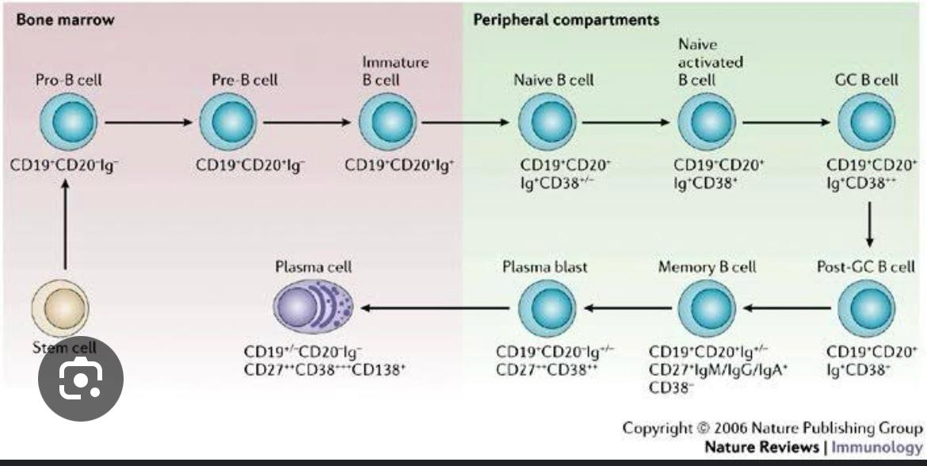
PLASMA CELL PRODUCTION

Slide 6
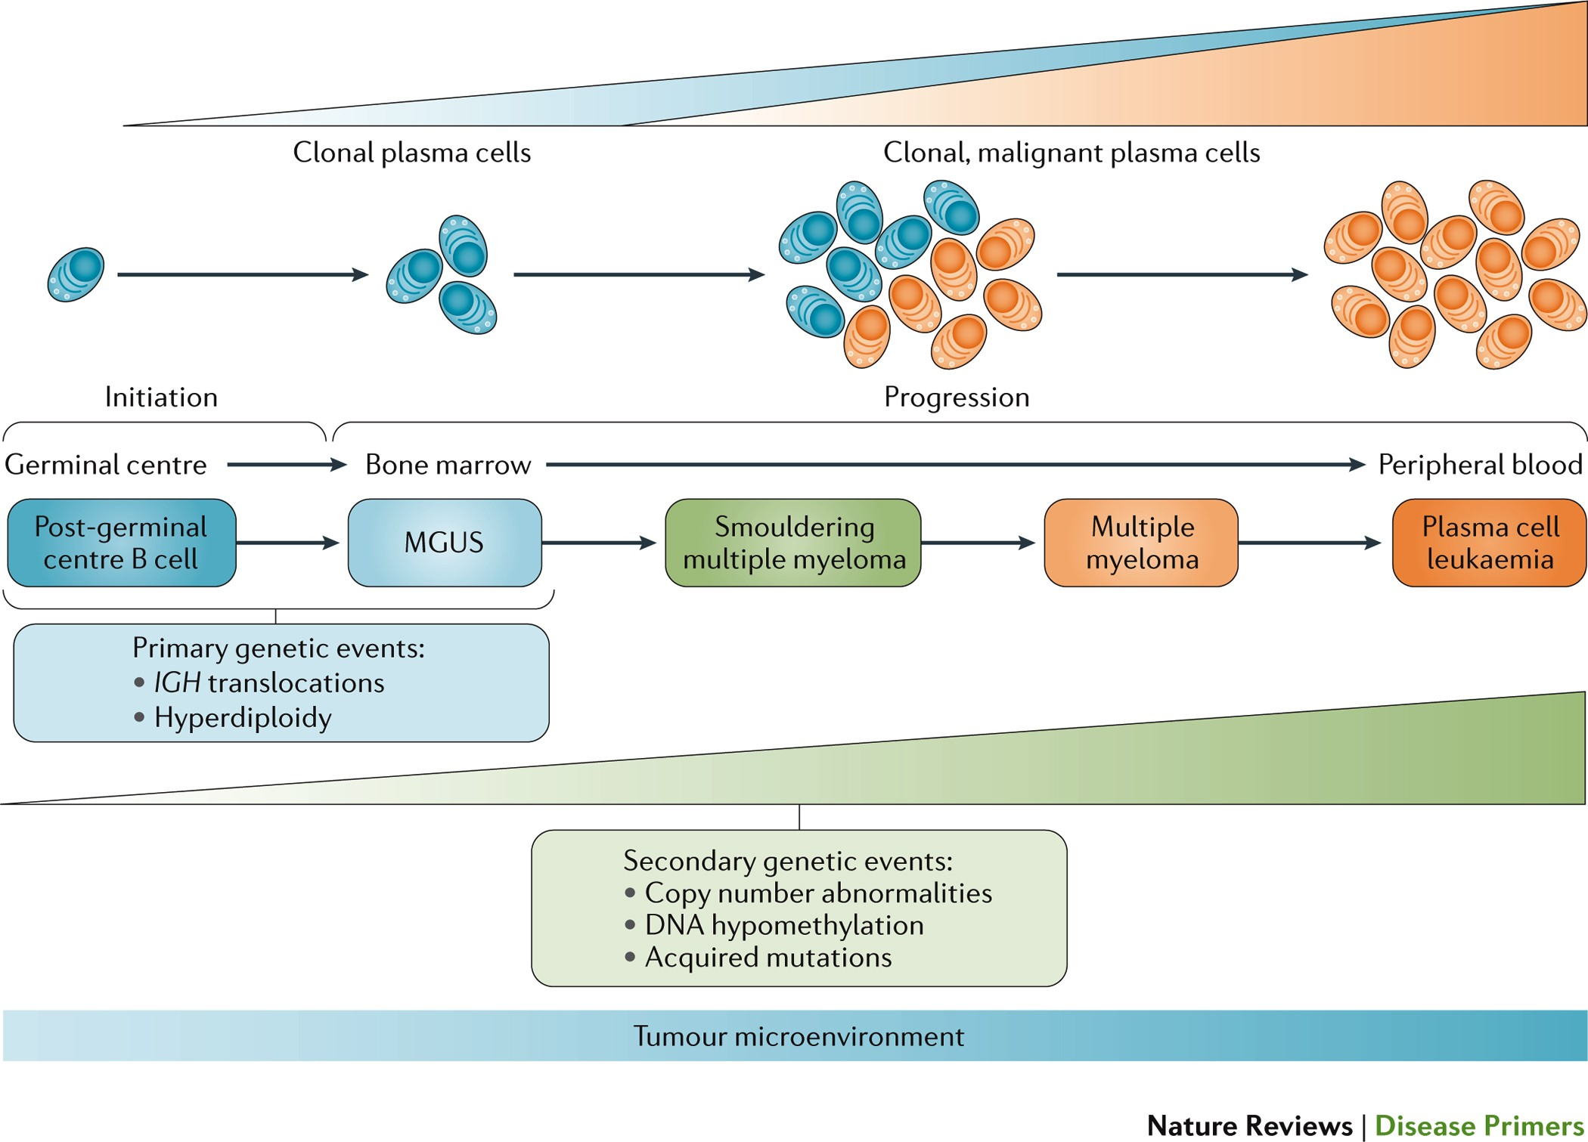

Slide 7
Etiology
The cause of myeloma is not known.
More common seen in farmers, wood workers, leather workers, and those exposed to petroleum products.
Chromosomal alterations in MM:
Hyperdiploidy 13q14 deletions
Translocations t(11;14) t(4;14) t(14;16)
N-ras, K-ras, and B-raf mutations are common (occurring in >40% patients).
IL-6 may play a role as driving factor for clonal proliferation

Slide 8
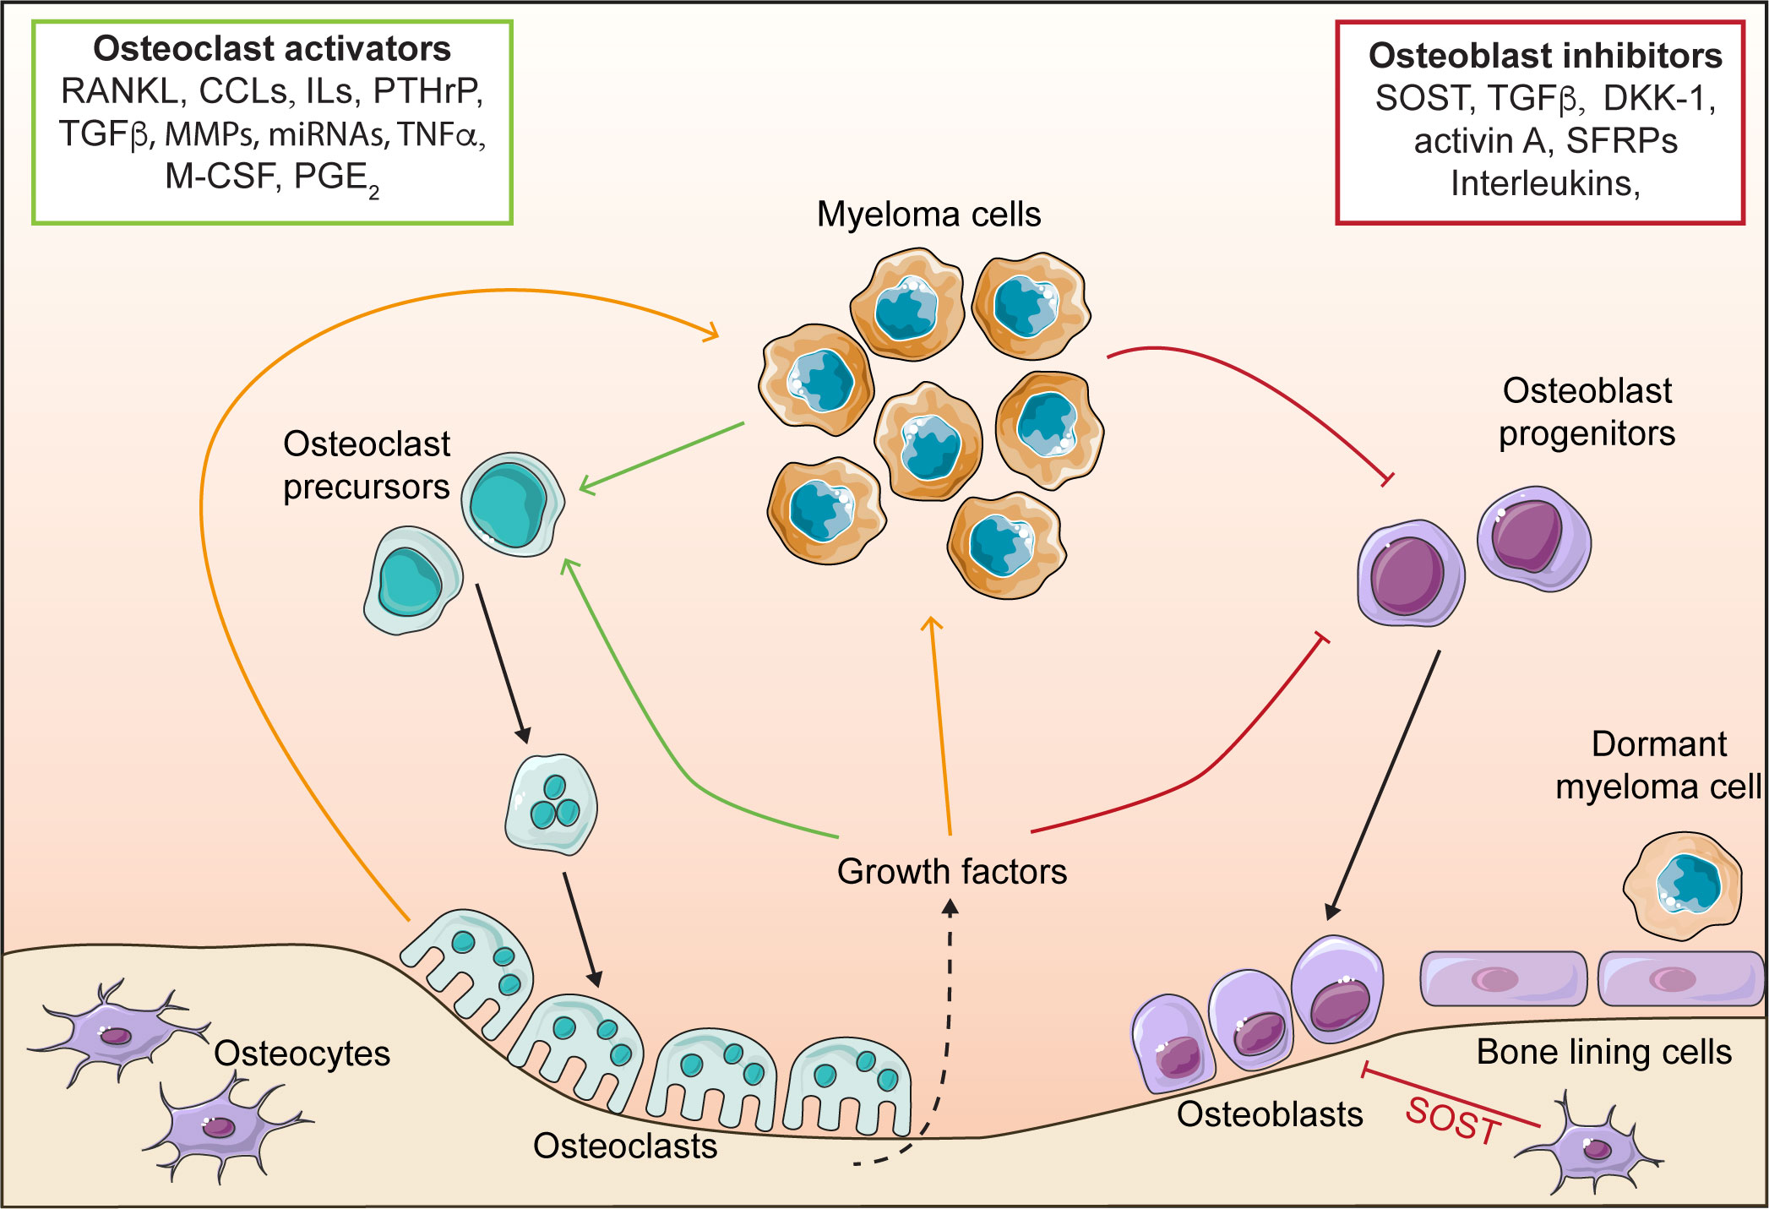
Pathogenesis
MM cells bind to bone marrow stromal cells (BMSCs) and extracellular matrix (ECM) via cell surface adhesion molecules
↓
triggers MM cell growth, survival, drug resistance, and migration in bone marrow.
These effects are due to:
• Direct MM cell-BMSC binding via adhesion molecules (Adhesion mediated signaling)
• Induction of various cytokines ( Cytokine mediated signaling)

Slide 9
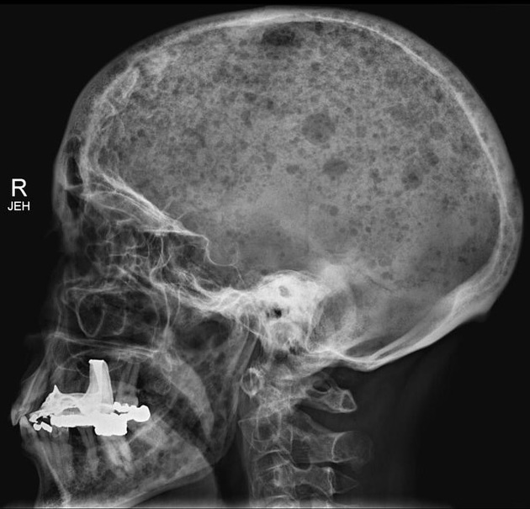
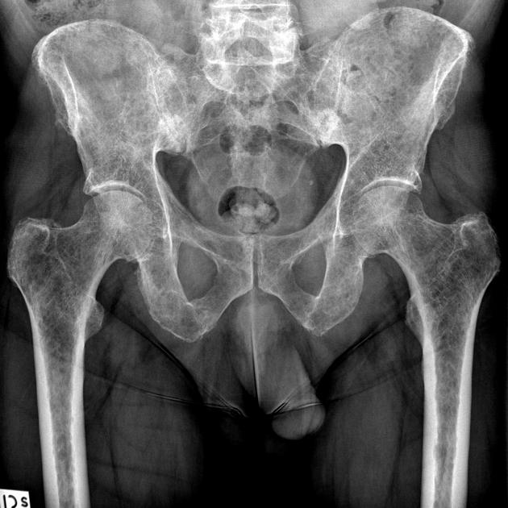
MM and Bones
(increased osteoclastic activity decreased osteoblastic activity)
Most common symptom : bone pain (70% patients); involves axial skeleton and induced by movement.
Persistent localised pain usually signifies a pathological fracture.
Bone lesions are lytic in nature(>0.5 cm of bone destriuction), resulting in substantial mobilisation of calcium, leading to Hypercalcemia.
Localised bone lesions can cause compressive vertebral fracture, leading on to spinal cord compression.
Typical “Punched out”lesion of skull
Multiple small lytic foci throughout the pelvic bone

Slide 10
MM and Kidneys
Renal failure in >25% patients.
Causes :
Antibody independent - hypercalcemia(overall most vommon).
other causes: hyperuricemia, recurrent infection, use of NSAIDs, iodinated contrast dye for imaging, bisphosphonate use.
Antibody dependent - Cast Nephropathy, Amyloid.
Normal Light chain excretion < 30 mg/day.
In MM reabsorptive capacity of light chain excretion is exceeded due to its overproduction (100 mg /day- 20 gm/day).
Proteinuria- if glomerulus is involved

Slide 11
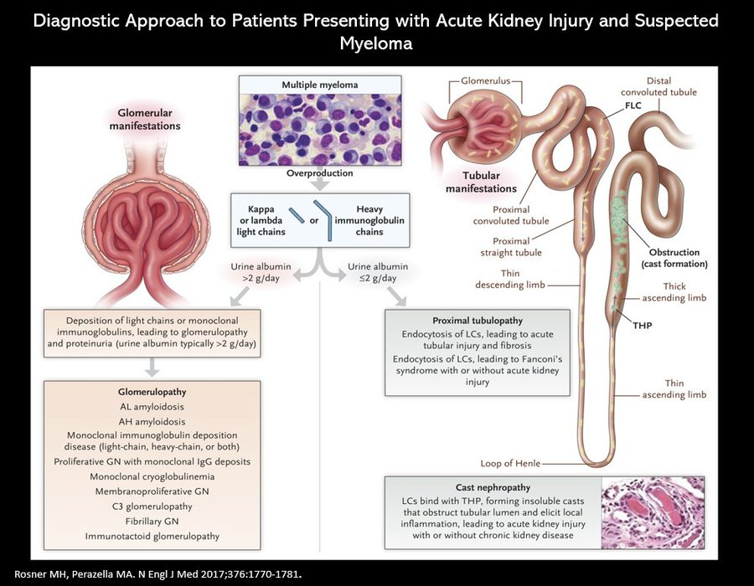

Slide 12
When to do kidney biopsy in multiple myeloma?
Involved Free Light Chain (iFLC) > 1500mg/dl.
Low urinary albumin (non selective).
Bland urinary sediments.
NOTE: Cast Nephropathy is only the multiple myeloma defining renal abnormality.

Slide 13
Multiple Myeloma & Anemia
Normocytic Normochromic anemia is seen in 80% of the patients.
Anemia is due to :
Replacement of normal hematopoeisis by multiple myeloma cells.
Relative EPO deficiency.
Dilution (in case of Large M protein)
Mild Hemolysis.

Slide 14
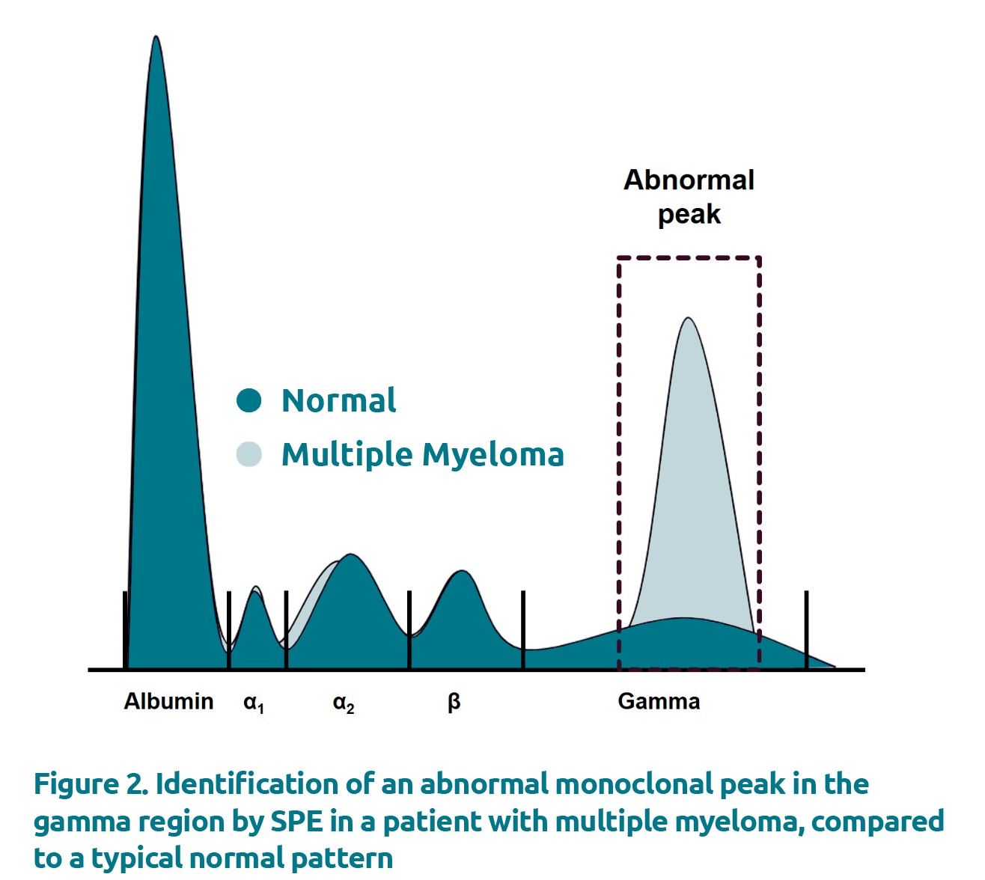
Multiple Myeloma & Proteins
Normal Albumin > Globulin with A:G ratio of 1.5-2:1
In MM total proteins are elevated (primarily due to high globulins) hence A:G ratio reversal occurs.
Globulins which increased are defective so they do not protect against infections.

Slide 15
Multiple Myeloma & Infections
Susceptible to bacterial infections.
﻿﻿MDSC, PDC, TH-17 increased (CO4, CD8, B NK are decreased).
﻿﻿Sites: LRTI (Strep pneumoniae, Staph aureus, Klebsiella pneumonia), UTI (E.coli, GNB)
﻿﻿Recurrent infections: Presenting features in 25%
﻿﻿>75% serious infection: Sometime in course of disease.
Reasons :
﻿﻿Hypogammaglobulinemia (Less production, increased destruction FCR8-16% vs normal a%).
﻿﻿complement dysfunction.
﻿﻿Aberrant T-regulation function.
﻿﻿Granulocyte dysfunction (Low lysozyme content with faulty migration).
﻿﻿Treatment: Dexa (Bacterial, fungal) bortezomib (HSV), Anti-BCMA CART.

Slide 16
Other Manifestations: (contd.)
CNS symptoms: Headache, Somnolence
Visual symptoms: Blurring of vision
Precipitation of Heart Failure
Neuropathy - Associated with MGUS and MM is sensory > motor.
﻿﻿Igm associated (Anti-MAG).
﻿﻿Amyloidosis.
﻿﻿Cord and Root compression (Due to vertebral body fracture).
﻿﻿Hypervicocity.

Slide 17
Other Manifestations:
Decreased anion gap is seen in multiple myeloma.
Pseudohyponatremia is seen in multiple myeloma.
Bleeding.
Cryglobulinemia.
HYPERVISCOSITY :
Normal Sr.Viscosity is 1.8cp
Hyperviscosity is > 4cp.
Hyperviscous state is reached at 4gm/dl for IgM, 5g/dl for IgG3,7gm/d for IgA

Slide 18
Classification of Multiple Myeloma
Monoclonal Gammopathy of Undetermined significance(MGUS)
Asymptomatic Multiple Myeloma
  Smoldering SMM
  Indolent IMM
3. Symptomatic Multiple Myeloma

Slide 19
MGUS (MONOCLONAL GAMMOPATHY OF UNDETERMINED SIGNIFICANCE)- What is risk of progression?
SMOULDERING MULTIPLE MYELOMA – What is risk of progression?
MGUS normally seen 1% of population aged > 50 years.
10% of population aged > 75 years.
Progression of MGUS to MULTIPLE MYELOMA 1% per year.
Higher in IgM MGUS 1.5% per year.
Lower in light chain MGUS 0.3% per year.
10% risk of progression in 1st 5 years.
3% risk of progression in 5-10 years.
1% risk of progression after 10 years.

Slide 20
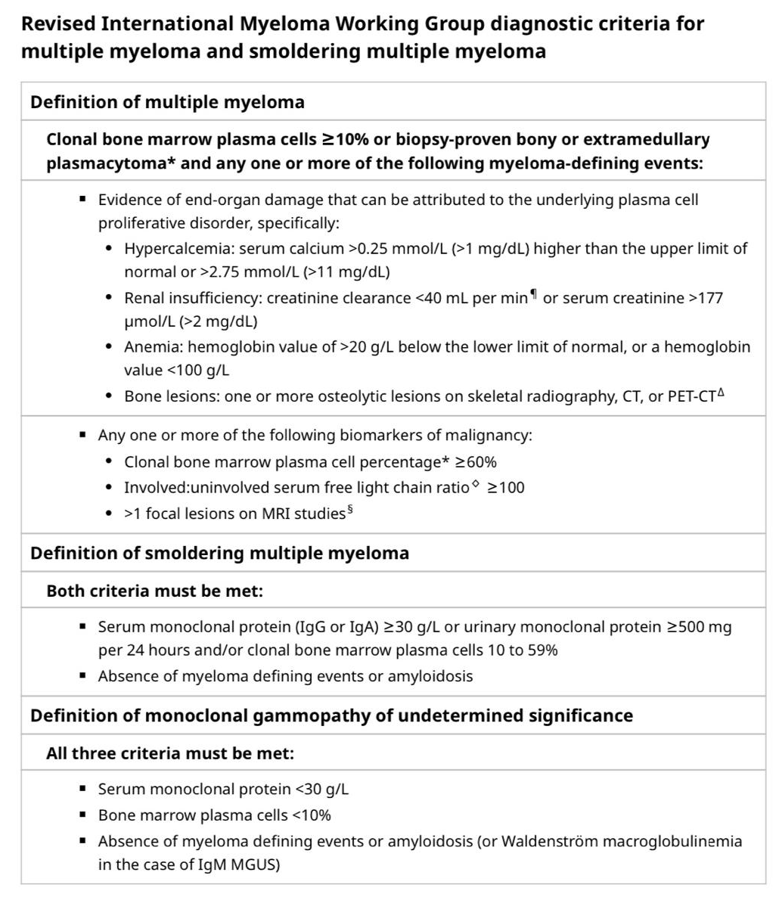
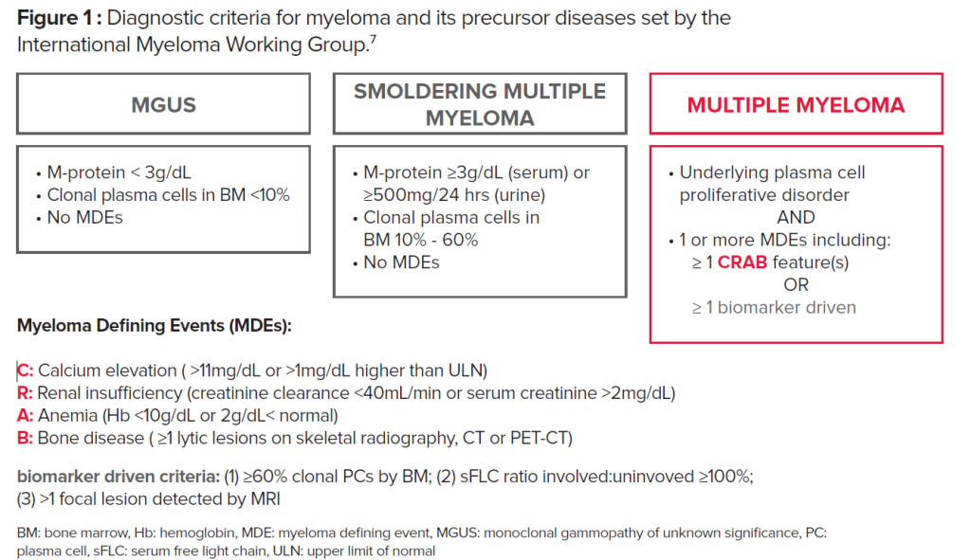

Slide 21
THANK YOU !

