Slide 1
ECG FOR DISCUSSION
III Medicine Unit
Chief
Prof Dr.M.Natarajan MD
Asst Professors
Dr Syed Bahavudeen Hussaini MD
Dr ValliDevi MD
Presentor
Dr.Vathsalyan

Slide 2
A 17yr old female diagnosed as Rheumatic heart disease at 8 yrs of age has been admitted with complaints of fever for 3 days
HOPI
H/O fever x 3days
low grade, intermittent
not ass with chills & rigors
H/O joint pain x 2 days
involving both knees
intermittent
relieved with drugs
No h/o abdominal pain
No h/o swelling of legs
No h/o breathlessness on exertion
No h/o burning micturition
No h/o cough with expectoration
No h/o headache

Slide 3
Past h/o
Pt is diagnosed to have Rheumatic fever at 8 yrs of age & is on T.Penicillin 250mg 1BD & T.Digoxin 0.25mg 1OD.
Not a k/c/o TB, Asthma, Seizure disorder
Personal h/o
Mixed diet
Normal bowel & bladder habits
Menstrual h/o
Attained menarche at 14 yrs
RMP, 3/30 day cycle
LMP- 5 days back

Slide 4
General examination
pt is conscious, oriented
afebrile, comfortable at rest
no pallor, no icterus
no cyanosis, no clubbing
no pedal edema
no generalised lymphadenopathy
Vitals
BP- 120/70 mm Hg in right arm in sitting posture
PR-96/min , regular rhythm, normal volume, felt in all peripheral accessible vessels
Temp- 99 F

Slide 5
System examination
CVS
S1S2 heard, Soft S1
S2 split
PSM is heard in Mitral area radiating to axilla
RS
B/L Air Entry
No added sounds
Abdomen
Soft, No tenderness
No organomegaly, Bowel Sounds +
CNS
No FND

Slide 6
Investigations
RBS- 102 mg/dl
Blood Urea- 27 mg/dl
Serum Creatinine- 0.9 mg/dl
Total bilirubin-0.6 mg/dl
Hb- 12.7 g/dl
TC-12,800 cells/mm3
DC- N 72%, L 23%, Mix- 5%
ESR- 58 mm/hr
PCV- 37%
Platelet Count- 2.85 lakhs/mm3
Urine routine- Normal

Slide 7
Continued
ECHO
AML, PML thickened
AML, PML prolapse
Mitral Regurgitation- Severe
Pulmonary hypertension- mild
ASO titre- 447 units/ml
CRP- 44 mg/dl

Slide 8
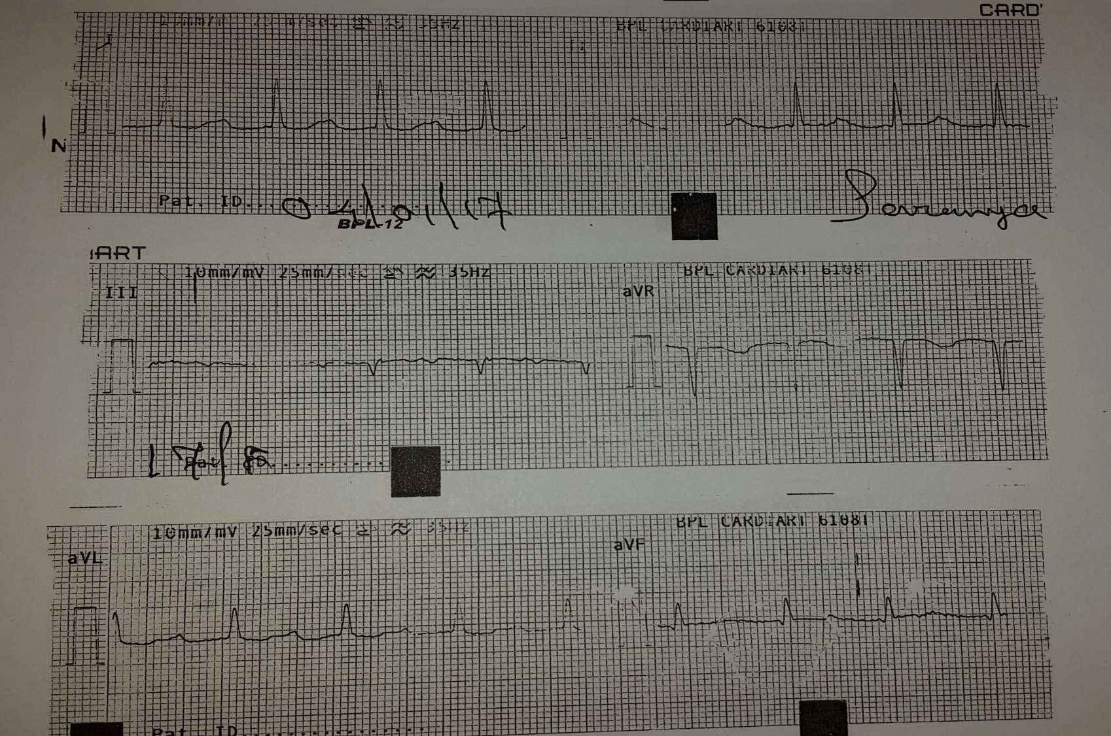
ECG at the time of admission

Slide 9
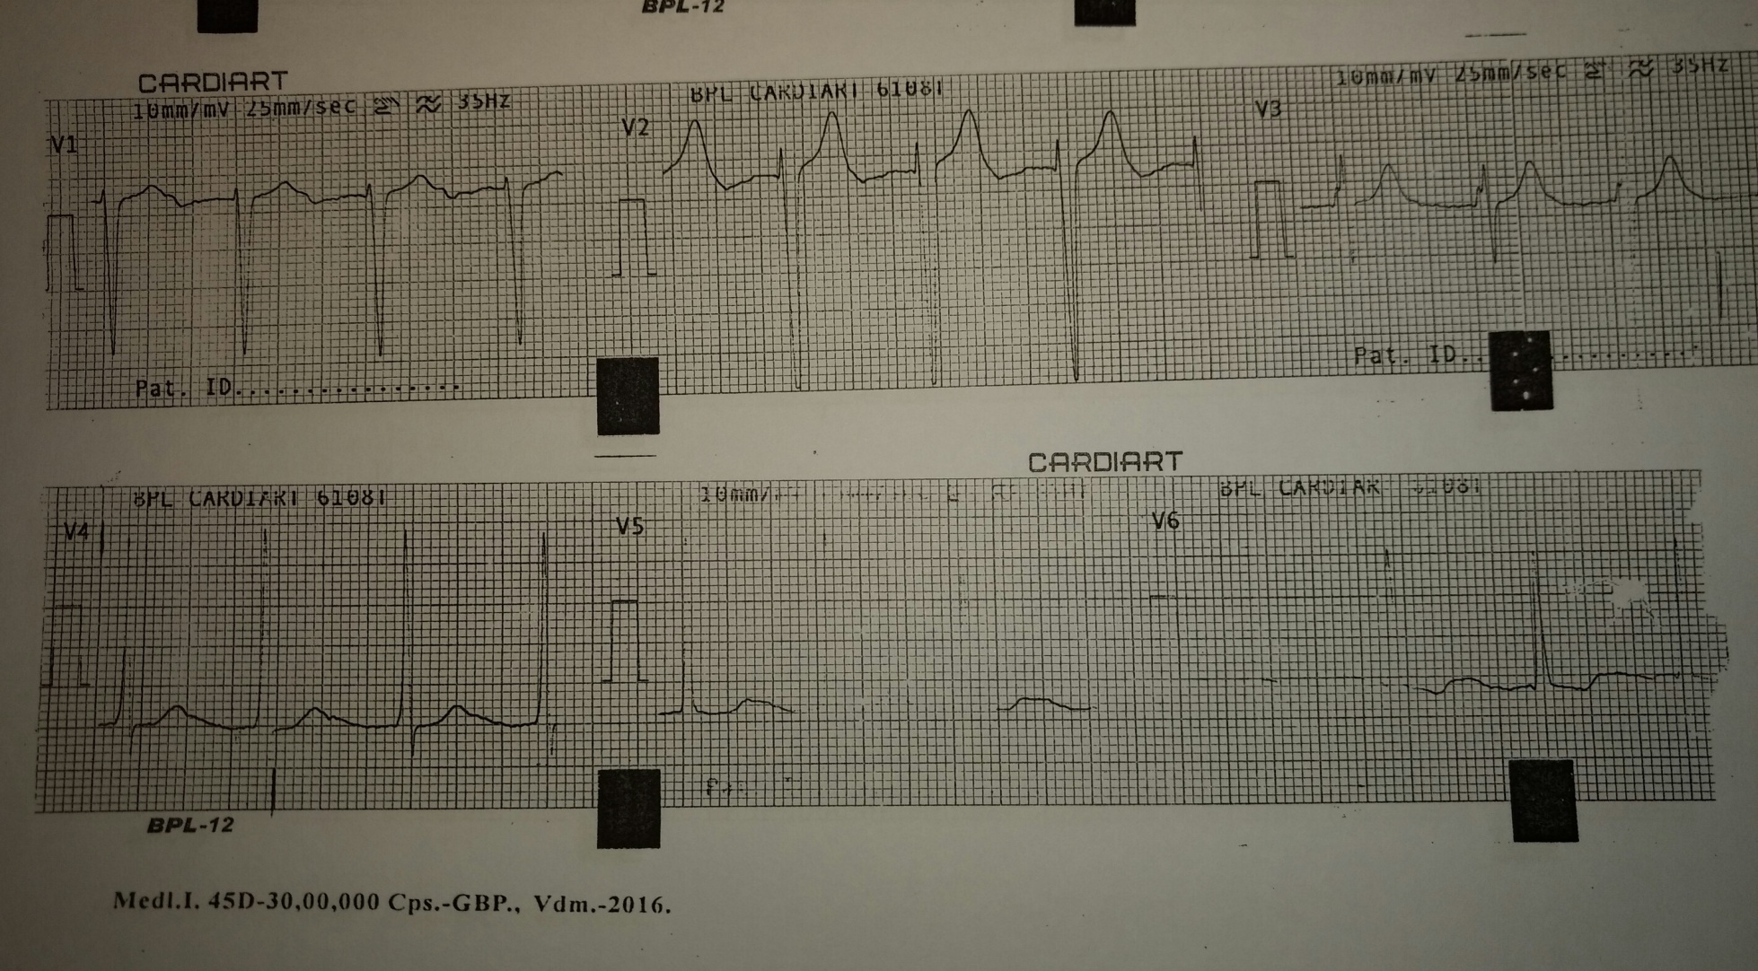
ECG at the time of admission

Slide 10
DIAGNOSIS??

Slide 11
Diagnosis
Prolonged PR interval
P wave on T wave
Rheumatic Carditis with Digitalis effect

Slide 12
Aim of Presentation
If p wave is not visible, look for p wave on T wave
ECG with 50mm speed may help to detect occult P wave if it is associated with prolonged PR interval with P on T wave

Slide 13
ECG at 50mm Speed

Slide 14
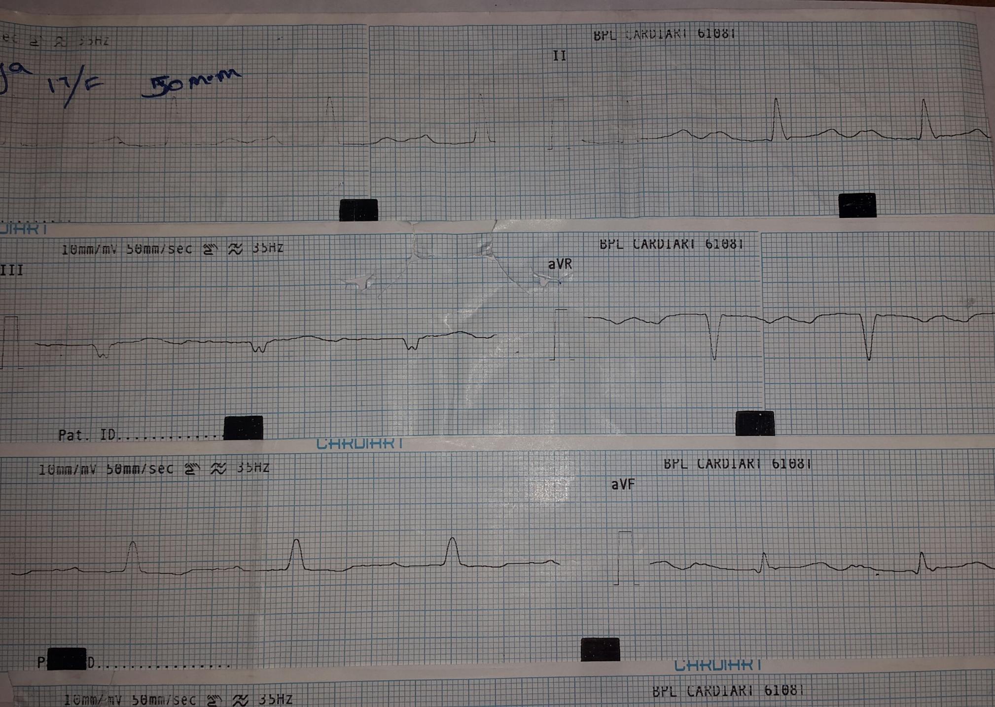

Slide 15
