Slide 1
THE SHOT AND THE CLOT
1st MEDICAL UNIT
H.O.D : DR.M.NATARAJAN M.D
ASST.PROF: DR.PALANIKUMARAN M.D
DR.VASANTHA KALYANI M.D
DR.SURESH KUMAR M.D
PRESENTOR : DR.S.ELANGOVAN

Slide 2
Mrs.bhuvaneswari 37 yrs female admitted in GRH on june 28th with complaints of
headache for 10 days
holocranial ,tight band like
intermittent type
not a/w aura symptoms
a/w blurring of vision +
Releived by pain killers,aggravated during work
h/o vomiting for 1 week
No h/o altered sensorium
No h/o seizure
No h/o fever

Slide 3
No h/o loose stools., no h/o trauma.
No h/o chestpain /palpitation
No h/o syncopal attack
No h/o dyspnoea
No h/o abdominal pain /distension
No h/o reduced urine output
No h/o yellowish discolouration of urine
No h/o bleeding manifestations
No h/o leg swelling

Slide 4
Past history ;
pt not a k/c DM /SHTN/TB/BA/EPILEPSY/CAD/THYROID DISORDER
Personal history ;
mixed diet ,normal bowel and bladder habits,
regular menstrual cycle.

Slide 5
Obstetric history;
P4L2A2
A1- at 5 months of gestation( MTP done –anencephaly)
A2-at 50 days of gestation (induced abortion-failed contraception)
Two live children+
H/O COVID VACCINATION(COVISHIELD)
- ON JUNE 21

Slide 6
On examination ;
Pt conscious
Oriented
Afebrile
No pallor
Not icteric
No cyanosis
No clubbing
No pedal edema
No generalised lymphadenopathy
Vital signs –
Bp -120/70
PR-82/min
SPO2- 98% in RA
RR-16/min

Slide 7
Systemic examination;
CVS –s1 s2 + ,no murmur
RS – BAE+ ,no added sounds
P/A- soft, not distended
CNS-conscious,oriented
NO focal neurological deficit
EOM –full, B/L pupil- ERTL

Slide 8
INVESTIGATIONS
TC – 7800
DC- 60/29/05%
RBC -4.93 millions
Hb-12.1
Hct-36.6%
Platelets-2.98 lakhs.
ESR- 28
CRP- 2 mgs
Urine routine –normal
Electrolytes –normal.
UREA-41
CREATININE-0.9
RBS -70
BILIRUBIN -0.8
DIRECT -0.1
INDIRECT-0.7
SGOT-19
SGPT-15
ALP-64

Slide 9
Peripheral smear study –
Normocytic , Normochromic
WBC normal in number
Platelet normal in number and morphology
Hbsag- negative ,anti hcv –negative
VCTC –non reactive.
APTT – 25 SECONDS , INR -1.2
ECHO- NORMAL STUDY ,EF -60%
S.FIBRINOGEN- 239mg/dl (150- 400)
D-DIMER – 92 ng/dl ( 0-255)

Slide 10
ANA- weak positive (1:40)
Factor v leidan mutation- Awaited
Ct brain &plain –contrast- thrombus involving the superior sagittal sinus,torcular herophili and transverse sinus noted with raised ICT considered.

Slide 13
OPTHAL OPINOIN –normal fundus.
NEUROGIST OPINION-
1. Suggested MRI brain with MRA AND MRV
2. Anti edema measures
3. W/F seizures.

Slide 14
Treatment
IV FLUDS
Inj .mannitol 100 ml IV TDS
Inj. Ondansetron 4mg IV BD
Inj. Heparin 5000units iv QID
Tab.acitrome 2mg 0-0-1-0 ( overlap done)
Tab .paracetamol 500 mg TDS

Slide 16
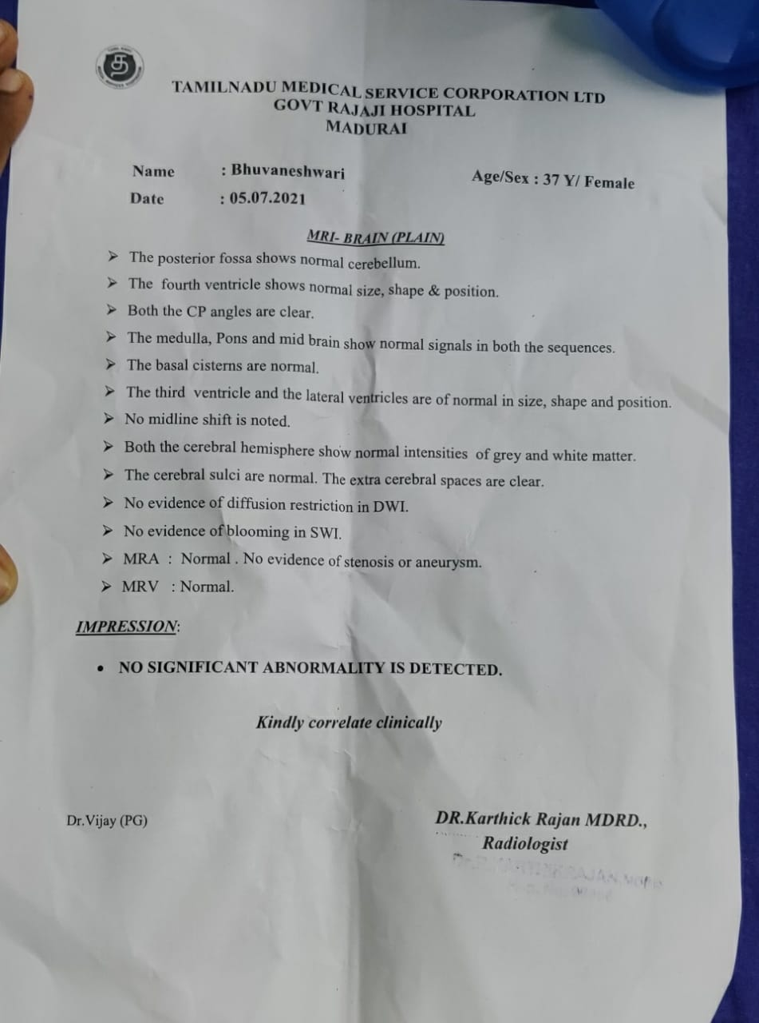

Slide 17
AIM OF DISCUSSION
TO highlight the incidence of thrombosis in covishield vaccination.
To discuss the treatment protocol for vaccination induced thrombosis.

Slide 18
ARTICLES

Slide 21
THANK YOU ☺☺☺☺

