Slide 1
Ecg slides
By III medical unit
CHIEF : Dr. PALANIKUMAR B MD
ASSISTANT
PROFESSOR : Dr. PONSENTHIL KUMAR MD
Dr. ILAMARAN MD

Slide 2
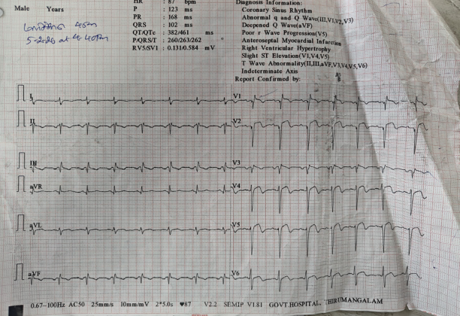

Slide 3
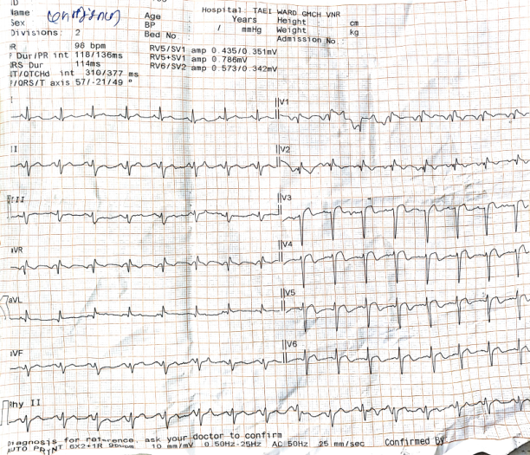

Slide 4
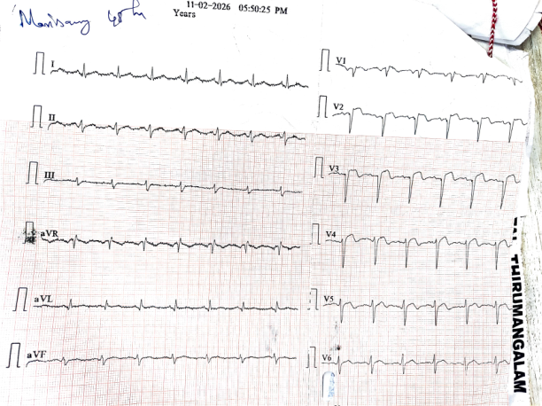

Slide 5
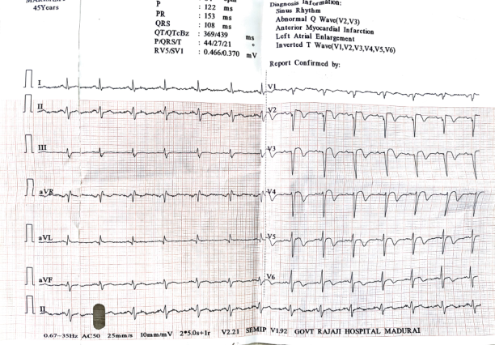

Slide 6
lets dicuss

