Slide 1
APLASTIC ANEMIA- A RARE CAUSE

Slide 2
VII MEDICAL UNIT
CHIEF: PROF.DR.K.SENTHIL.MD
ASSOCIATE PROF: DR.K.MURALIDHARAN MD
ASST PROF: DR V.MANIKANDAN MD
DR R. PONRAJ MD
DR C. RAMANAN MD

Slide 3
A 31 Years old female patient ,from TENKASI, Housewife, admitted with 6 months of amenorrhoea ,
G4 P2 L2 A1
L M P - 26/12/2020
E D D - 03/10/2021
Complaints of –Dyspnea on exertion
Easy Fatiguability , for past 2 months

Slide 4
HOPI:
Patient was apparently alright through out pregnancy till 20 weeks , she then developed
Dyspnea on exertion
Easy fatiguability
For which she went to private hospital and was treated with Iron sucrose injections
Referred to TIRUNELVELI med clg

Slide 5
H/O FEVER present 1 month back, 1 episode low grade not associated with chills ,no diurnal variation
H/O Gum bleeding present ,relieved spontaneously
No h/o any bleeding symptoms
No h/o Jaundice, abdominal pain,abdominal distension
No h/o Cough, Chest pain, Hemoptysis
No h/o Burning micturition
No h/o loose stools

Slide 6
Past history:
Not a known DM, SHTN , Epilepsy, PTB,HIV, Bleeding disorder, CKD, Heart disease
Obstetric history:
1. Female, alive baby of 2.75 kg by NVD -8yrs
2.Male,alive baby of 3.1 kg by NVD -5 yrs
3.Induced abortion at 45 days of amenorrhoe
4.Present pregnancy- Spontaneous conception
All previous pregnancies are uneventful

Slide 7
Family history:
No h/o hematological, Lung,
Liver disease and premature death
TREATMENT HISTORY:
INJ vit B12, Tab Folic acid ,
5 units of PC and 7 units of platelets
at Tirunelveli med clg

Slide 8
PERSONAL HISTORY:
-Mixed diet
-No history of any drug intake(OTC,Herbal)
-No history of exposure to Radiation
-No history of exposure to toxins,chemicals

Slide 9
O/E
Pt Concious oriented
Pallor+
No PE/LN/Cy/Cl
Head to foot examination – Normal
Oral cavity – normal
Fundus - normal
CVS – NAD
RS – NAD
P/A – SOFT, NO HSM, Uterus - just above umbilicus, FH +
CNS -- NFND

Slide 10
 | 30/05 | 05/06 | 06/06 | 10/06 | 17/06 | 24/06 | 1/7 | 6/7
TC | 2100 | 1600 | 1000 | 1400 | 1200 | 900 | 1000 | 1500
DC | 46/50/4 | 43/52/5 | 44/51/5 | 64/36/0 | 64/35/1 | 60/39/1 | 52/42/6 | 48/46/6
RBC | 1.11 | 1.40 | 1.7 | 2.06 | 1.8 | 1.76 | 1.64 | 1.30
HB | 4.2 | 4.7 | 5.6 | 6.5 | 5.7 | 5.4 | 6.3 | 5.0
PCV | 12.8 | 15.2 | 16.8 | 19.2 | 17.3 | 15.8 | 19 | 16
MCV | 115.3 | 108.6 | 97.1 | 93 | 92 | 89.8 | 91 | 92
MCH | 37.8 | 33.6 | 16.8 | 31 | 30.3 | 30.7 | 31 | 30.7
MCHC | 32.8 | 30.9 | 33.1 | 33 | 32.9 | 34.2 | 32 | 33
Platelets | 73000 | 59000 | 32000 | 28000 | 14000 | 20000 | 14000 | 22000

Slide 11
RBS | 98 | PT | 12.2 | VIT B12 | >2000pg/ml
UREA | 20 | APTT | 23.9 | FOLIC ACID | >40ng/ml
CREAT | 0.8 | INR | 0.89 | Sr IRON | 305.5µg/ml
T.BIL | 0.86 | SODIUM | 139 | TIBC | 335µg/ml
SGOT | 20 | POTASSIUM | 3.9 | Sr FERRITIN | 892ng/ml
SGPT | 10 | ESR | 64 | Sr PRO/ ALB/GLOB | 5.5/3.3/3.2mg/dl

Slide 12
RPI | 0.5%
ANA (IF) | NEGATIVE | VCTC /VIRAL MARKERS | NON REACTIVE
Anti DS-DNA | NEGATIVE | USG ABDOMEN | NO ABNORMALITY
Sr URIC ACID | 2.5 | PORTAL VEIN DOPPLER | NORMAL
DCT | NEGATIVE | COVID RT-PCR | NEGATIVE
ICT | NEGATIVE | BLOOD C/S, URINE C/S | NEGATIVE
CRP | 19.5 | B/L LL VENOUS DOPPLER | NORMAL

Slide 13
Peripheral blood smear
HB-7.8 , Reticulocyte proliferative index-0.4
WBC COUNT-1400,(N-12%, L-75%, M-12%, E-1%), no atypical or immature cells
PLATELET COUNT-40000- normal morphology
IMP: PANCYTOPENIA
Leukopenia,severe neutropenia,
Moderate thrombocytopenia,
Normocytic anemia

Slide 14
BONE MARROW SMEAR STUDY
Cellularity: Mildly hypocellular
Erythropoiesis-Mildly increased, M:E-1:1, mild megaloblastosis
Leucopoiesis- decreased Granulopoiesis, no excess blasts
Megakaryopoiesis-Mildly decreased
HYPOCELLULAR MARROW WITH DECREASED GRANULOCYTIC AND MEGAKARYOCYTIC LINEAGE

Slide 15
BONE MARROW BIOPSY

Slide 16
TREATMENT
Inj cefotaxime 1g iv TDS
T. folic acid 5mg OD
T. Vit C/ BCT OD
Washed PRBC/ Platelet transfusion
PLAN: T. cyclosporine 5mg/kg/day after discussion with Oncologist/Nephrologist

Slide 17
PNH Panel-FCM
PNH CLONE IDENTIFIED ON WBC and RBC
Granulocytes- FLAER/CD24 deficiency- 9.69%
Monocytes- FLAER/CD 14 deficiency- 23.31%
RBC-type II-0.1%
Type III- 0.2%
total RBC Clones- 0.3%
Urine hemosiderin was sent –Report awaited

Slide 18
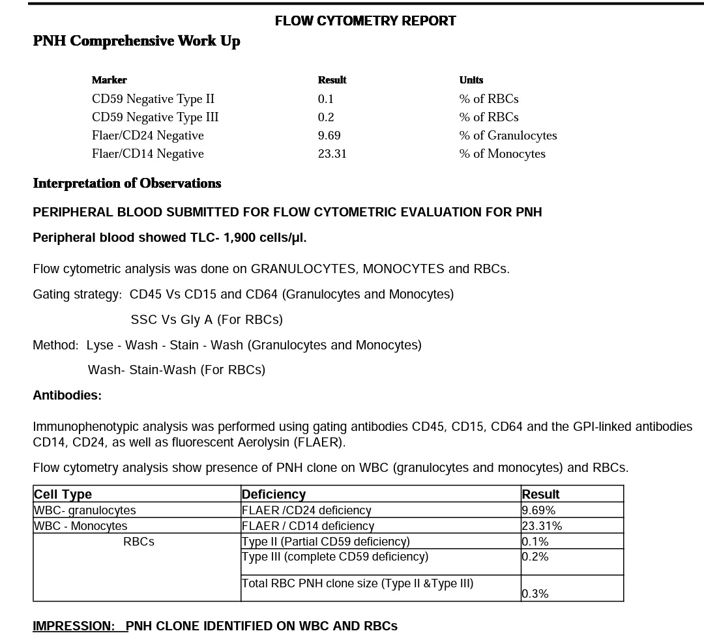

Slide 19
FINAL DIAGNOSIS
APLASTIC ANEMIA With MINOR PNH CLONES
complicating pregnancy

Slide 20
THANK YOU

