Slide 1
KAALA ARTHRITIS
BY VI TH MEDICL UNIT
CHIEF: DR. A. SENTHAMARAI MD
ASSIST PROFESSOR:
DR.P.SUDHA MD
DR.M.J.SENTHIL KUMAR MD
DR.S.SUGADEV MD
PRESENTOR: DR.S.PRAVEEN KUMAR

Slide 2
Chief complaints
A 41 years old gentleman , electrician by occupation, presented with
c/o low back pain for past 1 year

Slide 3
History of presenting illness
Patient was apparently normal before 1year back after which he had started developing complaints of
Low back pain persisting for 1year
Increased in morning
Difficulty in bending forward
Improves with exercise and NSAID,
Worsens by rest
H/o shooting pain both lower limb
No h/o swelling in joints
No h/o deformity of joints

Slide 4
No h/o neck pain
No h/o fever
No h/o photophobia/blurring of vision
No h/o diarrhea
No h/o weakness of limbs
No h/o abdominal pain
No h/o skin pigmentation
No h/o itching
No h/o chest pain
No h/o difficulty in breathing

Slide 5
Past history
Patient had no history of Diabetes mellitus, Hypertension, CAD, CKD, Tuberculosis
No h/o similar illness in the past
No h/o previous surgeries
No h/o previous blood transfusion
Personal history
Mixed diet
Not an alcoholic
no addictive habits

Slide 6
Family history

Slide 7
General examination
Patient is conscious
Oriented
Afebrile
Moderately built and nourished
No pallor
No pedal edema
Not icteric
No cyanosis
No clubbing
No generalised lymphadenopathy
SKIN
No vesicles
No pigmentation
No silvery scaly papule
No nail changes
VITALS
BP | 110/70mmhg in all 4 limbs
PR | 90/min
Spo2 | 98% in RA

Slide 8
Systemic examination
Modified Schober test – Positive
No cervical flexion deformity
No deformities of joints
No joint swelling
CVS – S1,S2 + no murmur
RS – NVBS+ ,no added sounds
P/A – soft bs+
no free fluid
no bruits
CNS – power 5/5 in all 4 limbs
Tone normal
bilateral plantar - flexor

Slide 9
INVESTIGATIONS
Complete blood count
TC – 7300
Hb – 13 g
Pcv – 45%
Plt – 2.45 lakhs
MCV – 86 fl
MCH – 26 pg
MCHC - 32
Renal function test
Urea- 19
Creatinine-0.9
Serum electrolytes
Sodium - 140
Potassium -3.6
Liver function test
T.B – 0.6
D.B -0.2
I.B – 0.4
OT -20
PT- 13
ALP - 90

Slide 10
Urine routine
Albumin – nil
Sugar- nil
Deposit – 1 to 2 pus cells
ESR- 16 mmhr
VCTC – non reactive
HCV – negative
HBSAG – negative
Serum calcium – 8.78
Phoshorous – 2.48
TSH – 2.05
FT4 – 1.07
AntiTPO - <37
PTH – 27..2
USG abdomen – normal study

Slide 11
Cardiology opinion obtained
LVIDd : 4.5
LVIDs : 3.0
LVEF : 60%
Normal study
Ophthalmology opinion obtained
Fundus – normal
No uveitis
No conjuctival/scleral pigmentation

Slide 12
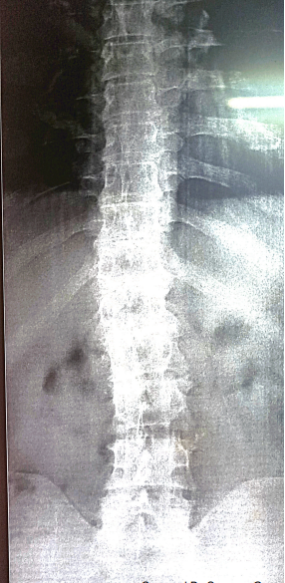
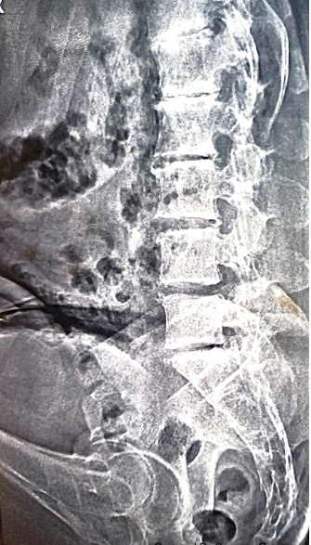
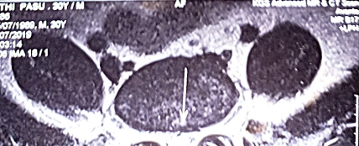

Slide 14
MRI report - lower thoracic and lumbosacral spine with both SI joints
Schmorl’s node formation seen at opposing end plates of lower thoracic upper lumbar vertebra with early degeneration and calcification of all disc spaces
Broad based disc protrusion with bilateral facet arthropathy and thickening of ligamentum flavum seen at L4-L5 level narrowing the spinal canal, lateral recesses and compressing the thecal sac and nerve roots
Sclerosis, erosion and marrow edema involving sacral and iliac aspect of both SI joints could represent Sacro Ilitis
IMP: possibility of Seronegative Arthropathy and lumbar disc disease

Slide 15
What next?

