Slide 1
AN APPROACH TO DYSPNOEA AND PALPITATION
DR.SATHISH
II MEDICAL UNIT

Slide 2
DEFINITION
“Subjective experience of breathing discomfort that consists of qualitatively distinct sensations that vary in intensity”
Abnormal or uncomfortable awareness of one’s own breathing

Slide 3
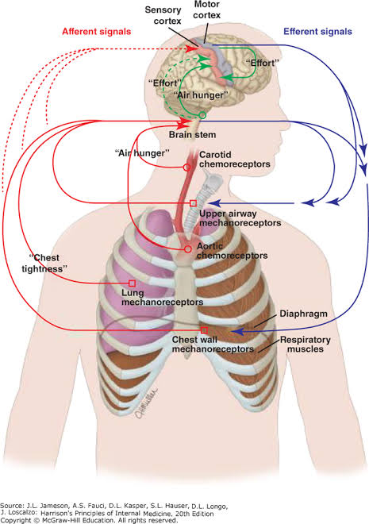
Mechanisms→

Slide 4
Types of dyspnoea:
Nocturnal dyspnoea- dyspnoea occurring only at night and may be paroxysmal as in patients with heart failure
Orthopnea-dyspnoea occurs when a patient lies down as in cases with heart failure,asthma,COPD.
Trepopnea-dyspnoea occurs only in left or right lateral lying position but does not occur when a patient is in supine position
Platypnea-dyspnoea occurs only in upright position

Slide 5
THE MODIFIED MEDICAL RESEARCH COUNCIL (MMRC) DYSPNEA SCALE GRADE OF DYSPNEA DESCRIPTION
0-Not troubled by breathlessness, except with strenuous exercise
1-Shortness of breath walking on level ground or with walking up a slight hill
2-Walks slower than people of similar age on level ground due to breathlessness, or has to stop to rest when walking at own pace on level ground
3-Stops to rest after walking 100 m or after walking a few minutes on level ground
4-Too breathless to leave the house, or breathless with activities of daily living (e.g., dressing/ undressing)

Slide 6
CAUSES OF DYSPNEA
Respiratory causes:
Diseases of the airways like
  Asthma
  COPD
Parenchymal dieases
Interstitial lung diseases
Chest wall abnormalities like kyphoscoliosis
Neuro muscular weakness such as amyotropic lateral sclerosis

Slide 7
Contd..
Diseases affecting pulmonary vasculature like
  Pulmonary hypertension
  Chronic thrombo embolism

Slide 8
CVS CAUSES:
Disease affecting left heart function
  Coronary artery disease
  Cardiomyopathy
Disease affecting pericardium
  Restrictive pericarditis
  Cardiac tamponade

Slide 9
OTHER CAUSES
Anaemia
Deconditioning
Anxiety

Slide 10
Diagnostic approach:
HISTORY:
Dyspnoea on exertion-cardiac or pulmonary disease
Orthopnea,paroxysmal dyspnoea,oedema-CCF,COPD
Smoking –COPD
Coronory Artery Disease-dyspnea as anginal equivalent
High Blood Pressure-LVH,CCF
Anxiety-hyperventilation,panic attack

Slide 11
Contd..
Recent trauma –pneumothorax,chest wall pain limiting respiration
Occupational exposure to dust,asbestos or volatile chemicals-interstitial lung disease

Slide 12
Investigations:
Chest X-Ray
Complete blood count
Thyroid function test
Pulse oximetry
Spirometry
Arterial blood gas analysis
Exercise Tread Mill Testing
Echo

Slide 13
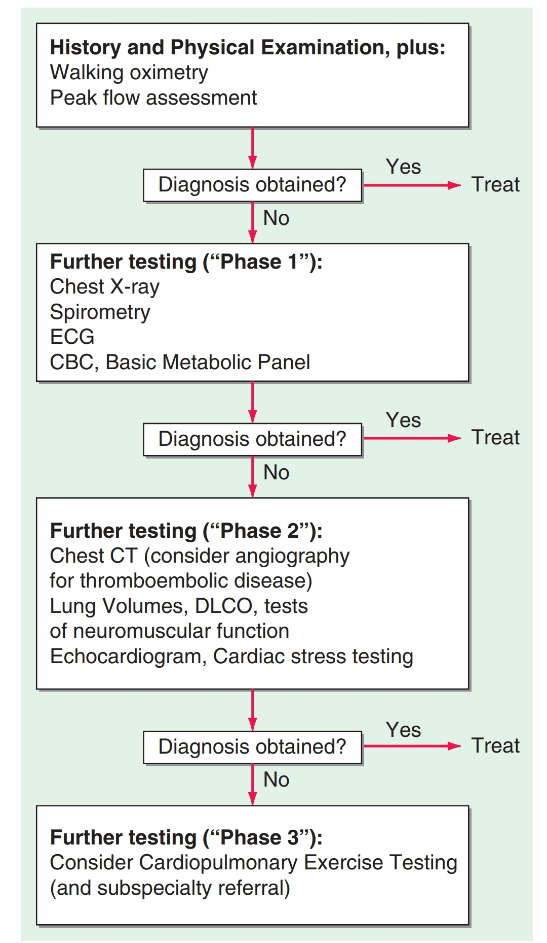

Slide 14
TREATMENT
First goal –correct the underlying causes
Supplemental oxygen thearpy if resting O2 saturation ≤88%
Opioids

Slide 15
PALPITATIONS

Slide 16


Slide 17
DEFINITION:
Defined as thumping,pounding or fluttering sensation in the chest.

Slide 18
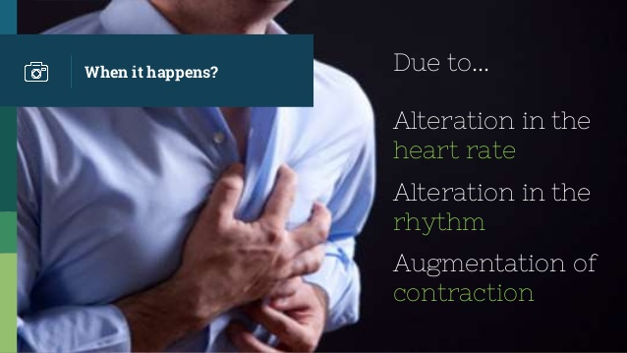

Slide 19
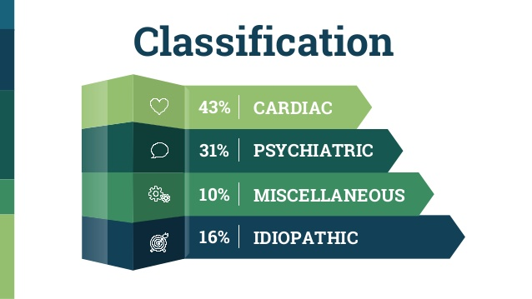

Slide 20
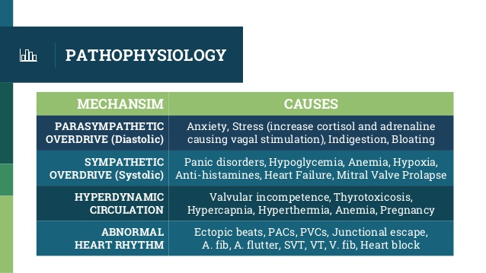

Slide 21
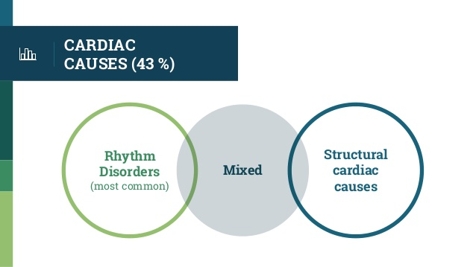

Slide 22
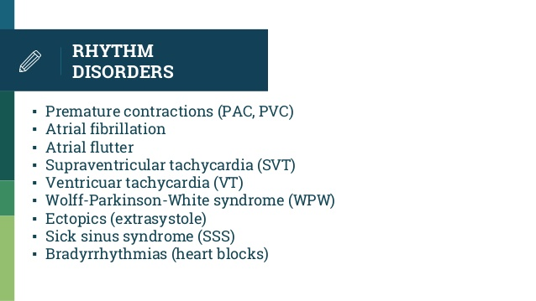

Slide 23
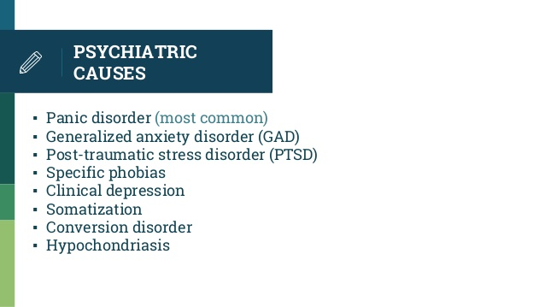

Slide 24
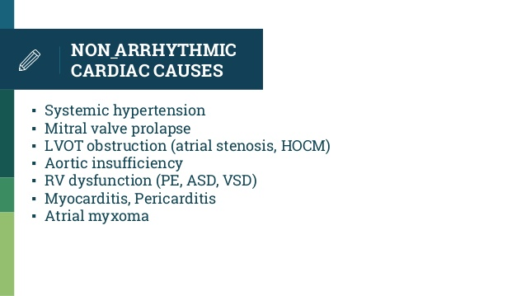

Slide 25
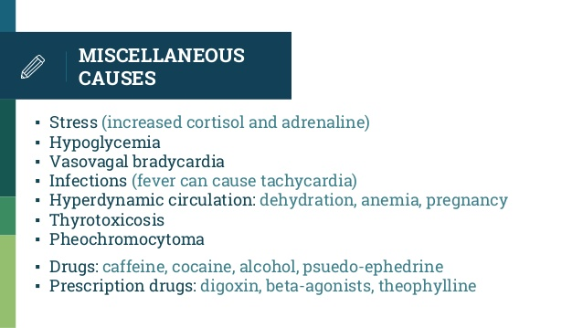

Slide 26
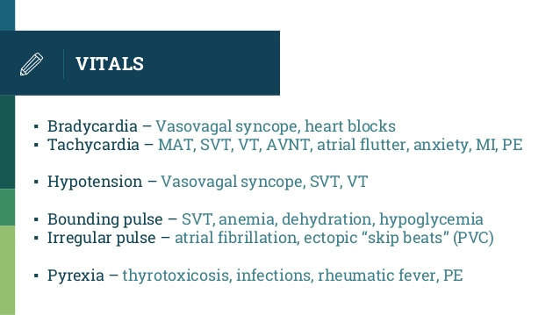

Slide 27
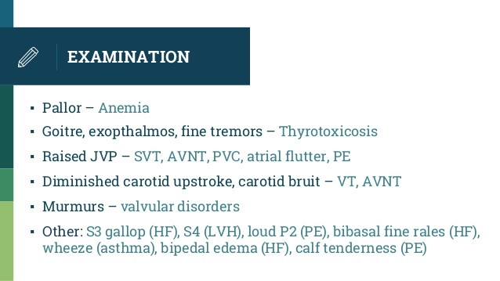

Slide 28
Investigations:
ECG
CBC
RFT
Random blood sugar
Serum electrolytes
Serum ca++,Mg2+,PO4

Slide 29
SUPPORTIVE INVESTIGATIONS
Thyroid function tests
Cardiac biomarkers
D-Dimers
Echocardiography
Treadmill exercise testing

Slide 30
TREATMENT
Holter monitoring –electrodes of the monitoring device are attached to the patient for 1-14days
Patient is asked to continue and record his activities in a diary
Rhythm strips are then analysed.

Slide 31
THANK YOU…

