Slide 1
ECG DISCUSSION IVth MEDICAL UNIT
CHIEF : DR.DAVID PRADEEP KUMAR, MD.,
ASST PROF: DR. N. RAGAVAN , M.D.,
DR. M. RAM KUMAR , M.D.,
DR. R. PONRAJ , M.D.,

Slide 2
A 36 year old man K/C/O RHD-MS/ Moderate MR diagnosed 2 months back and on treatment admitted with complaints of breathlessness and palpitations
- 4 days

Slide 3
GENERAL EXAMINATION
Pt conscious, afebrile, no pallor, no icterus, no clubbing, no cyanosis, no pedal edema, no lymphadenopathy
VITALS – BP-110/70 mmHg in right upper limb in supine position
PR-120/mm Hg, normal volume, regular in rhythm,felt in all peripheral accessible arteries.
Spo2-97%in RA

Slide 4
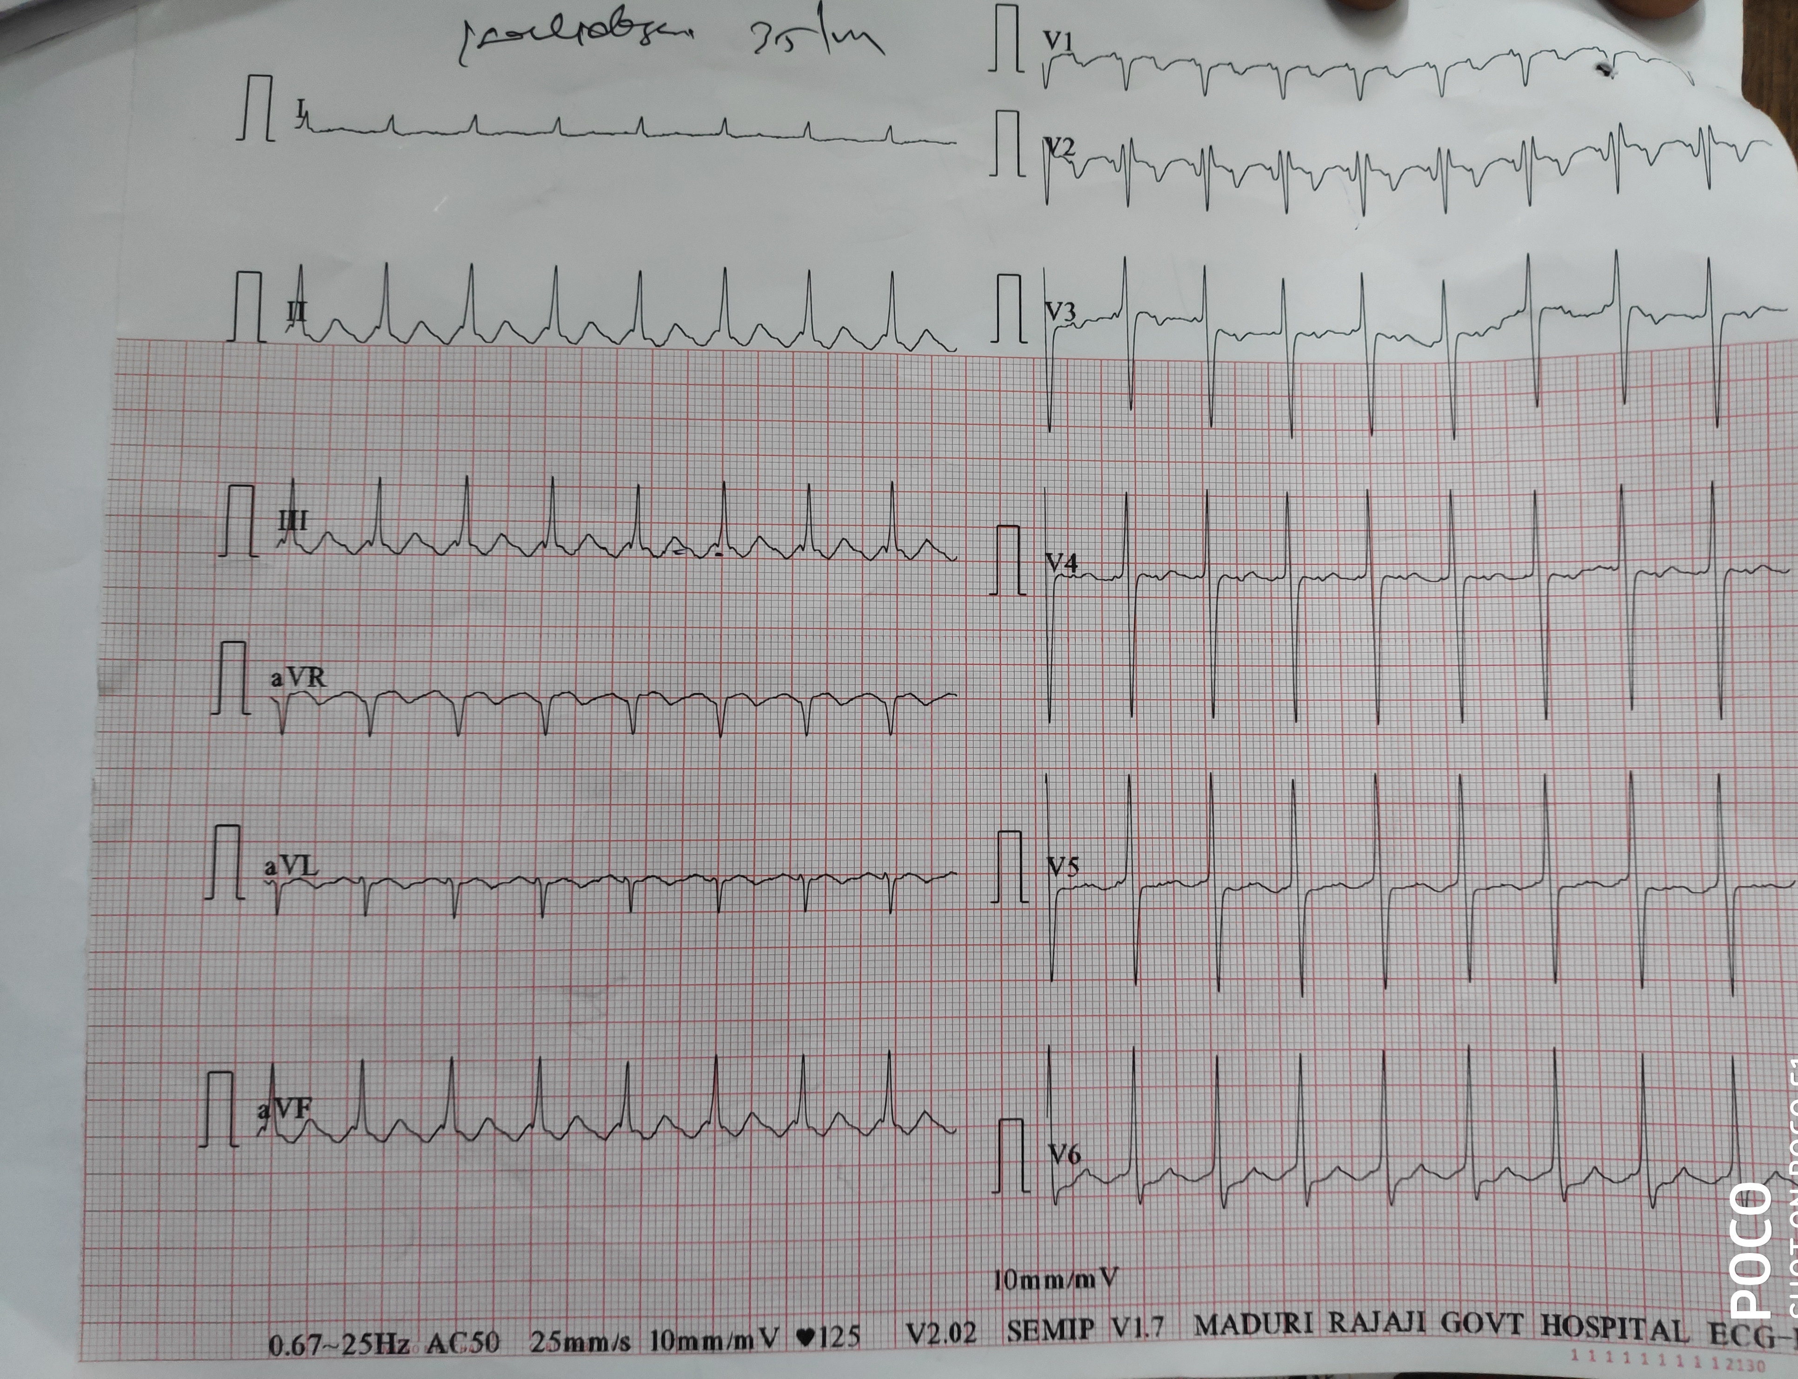

Slide 5
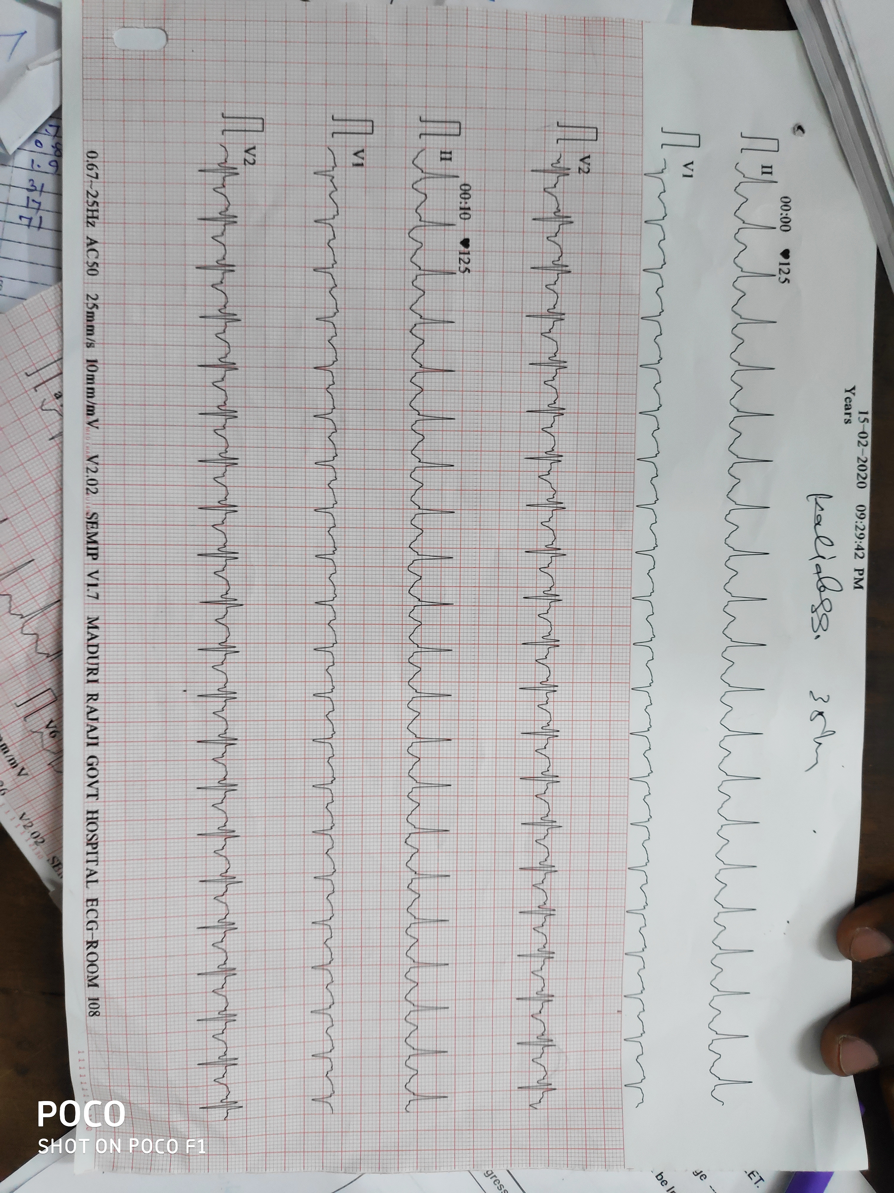

Slide 6
Points favouring
Rate-250/min
Inverted p waves in lead II
Points against
No typical saw tooth pattern
No inverted p waves in II,III,aVf

Slide 7
Points favouring atrial tachycardia with 2:1 AV Block
Atrial rate- 250/min
Isoelecric baseline
Not favouring
Regular RR interval
No PR prolongation

