Slide 1
A case of mixed meningitis in PLHA
MEDICINE UNIT M3
PROF. DR M NATARAJAN M.D.,
ASSISTANT PROFESSORS -
DR SYED BAHAVUDEEN HUSSAINI M.D.,D.N.B.,FICP.,
DR P S VALLIDEVI M.D.,
Presented by DR G SUMATHI

Slide 2
CASE HISTORY
40 years female
homemaker
Madurai
Informant – husband – reliability is good

Slide 3
Chief complaints
Headache and Giddiness for the past 2 days

Slide 4
History of present illness
Apparently normal 1 month back
h/o loss of appetite
h/o significant weight loss +
h/o recurrent oral ulcers
h/o headache and giddiness for the past 2 days

Slide 5
h/o horizontal diplopia +
No h/o difficulty in chewing food
No h/o deviation of angle of mouth / drooling of saliva
No h/o dysphagia

Slide 6
No h/o weakness of limbs
No h/o sensory disturbances
No h/o bladder and bowel incontinence
No h/o fever
No h/o seizures
No h/o cough
No h/o vomiting
No h/o trauma
No h/o genital ulcers

Slide 7
Past history
Not a k/c/o Diabetes/ hypertension/ tuberculosis/seizures
h/o blood transfusion – 20 years back
No h/o similar illness in the past

Slide 8
Personal history
No h/o substance abuse
Takes mixed diet
Bowel bladder habits normal
No h/o extramarital contact

Slide 9
MARITAL AND MENSTRUAL HISTORY
Married
2 children
Regular menstrual cycles
LMP 3 weeks back

Slide 10
GENERAL EXAMINATION
Conscious
oriented
Afebrile
Generalised wasting +
Not dyspnoeic / not tachypnoeic
No pallor/ icterus/ cyanosis/ clubbing/ pedal edema
No generalised lymphadenopathy
Oral candidiasis +

Slide 11
VITALS
PULSE – 90 per minute, regular, normal in volume and rhythm, all peripheral pulses felt, no radioradial / radiofemoral delay
bilateral carotids equally felt
RESPIRATORY RATE – 14 per minute
BLOOD PRESSURE – 130/90 mm Hg in right upper limb in supine position
Spo2 – 98% in room air

Slide 12
CNS EXAMINATION
Conscious, oriented
Speech -normal
Cranial nerve examination - bilateral lateral rectus palsy
Fundus normal

Slide 13
MOTOR SYSTEM EXAMINATION | RIGHT | LEFT
BULK | Wasting + | Wasting +
TONE UPPER LIMB LOWER LIMB | NORMAL NORMAL | NORMAL NORMAL
POWER UPPER LIMB LOWER LIMB | 4/5 4/5 | 4/5 4/5
DTR | + | +
PLANTAR | FLEXOR | FLEXOR

Slide 14
Systemic examination CNS cont:
Neck stiffness +
Kernigs sign and Brudzinski sign +
No cerebellar signs
Sensory system -normal

Slide 15
SYSTEM EXAMINATION
CARDIOVASCULAR SYSTEM
JVP not elevated
Apical impulse in left 5th intercostal space half an inch medial to midclavicular line
Bilateral carotids equally felt. No bruit
Mitral, tricuspid, pulmonary , aortic area – s1s2 +
no murmur

Slide 16
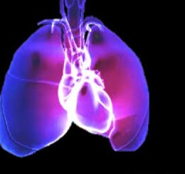
RESPIRATORY SYSTEM
Trachea in midline
bilateral air entry equal
normal vesicular breath sounds +

Slide 17
ABDOMEN
soft
umbilicus in midline
no distension
no organomegaly

Slide 18
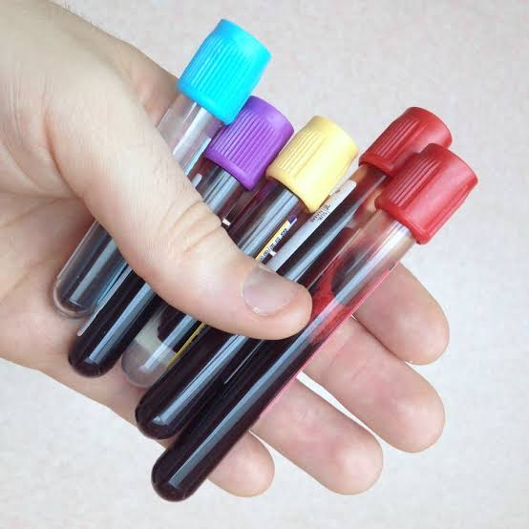
INVESTIGATIONS
COMPLETE HEMOGRAM
Hb – 11.2 gm/dl
TC – 7200 cells/cu.mm
DC- neutrophils- 82%
lymphocytes 10%
monocytes 8%
Platelets – 1.58 lakhs/cu.mm
PCV – 31%
ESR – 25 mm/hr

Slide 19
Biochemistry
RBS | 132 mg/dl
S.Urea | 24 mg/dl
S. Creatinine | 1.1 mg/dl
Serum electrolytes | Meq/l
sodium | 148
potassium | 3.5
chloride | 111

Slide 20
LFT
Bilirubin (T)-0.7mg/dL
D.Bilirubin-0.4mg/dl
I.Bilirubin-0.3 mg/dl
SGOT 27 U/L
SGPT 23 U/L

Slide 21
URINE R/E
Sugar-nil
Albumin- nil
Deposits-1-4 pus cells

Slide 22
VCTC – REACTIVE
CD4 count – 66 cells
VDRL - non reactive
HbsAg and anti HCV – NA
ECG – normal
CT brain – normal study

Slide 25
CXR normal study
Sputum AFB negative

Slide 26
CSF analysis
CSF cell count – 2-3 RBC’s seen/ hpf
2 polymorphs/10 hpf
CSF protein – 75 mg%
CSF sugar – 53 mg%

Slide 27
NEURO OPINION
PLHA / ? TB meningitis
Empirical ATT
Meningitic dose of antibiotics
MRI brain

Slide 28
IMAGING
MRI BRAIN showed dilated perivascular spaces in bilateral basal ganglia – suggested contrast study
MRA / MRV - normal

Slide 33
CSF reports
CULTURE - Citrobacter Koseri – sensitive to piperacillin, amikacin and gentamycin
CSF India ink preparation showed capsulated budding yeast cells – resembling Cryptococcus species
CSF gene xpert - negative

Slide 34
Diagnosis
PLHA / MIXED MENINGITIS

Slide 35
Treatment
Empirical antibiotic therapy with Ceftriaxone and Ampicillin
Antiedema measures with mannitol – 5 days
PCP and MAC prophylaxis
empirical ATT
After CSF culture report, ATT stopped and was treated with Inj. Amphotericin B given at a dose of 0.7mg/kg iv infusion od

Slide 36
After 45 minutes of Amphotericin B infusion , patient developed hypotension and collapsed
Inspite of resuscitation, patient could not be revived

Slide 37
Aim of presentation
To insist that investigations related to multiple pathogens including bacteria, mycobacteria, fungal and viral should be done in a c/o suspected meningitis in a PLHA patient
To discuss the therapeutic options in fungal meningitis
To get opinion from the audience regarding the killer in this case (?disease , ?drug)

Slide 38
THANK U ☺☺☺

