Slide 1
An interesting case of compressive myelopathy
BY FIRST MEDICAL UNIT
CHIEF: PROF.DR.M.NATARAJAN MD.,
ASST PROF: DR.PALANIKUMARAN MD.,DDIAB.,
DR.VASANTHA KALYANI MD.,DCP
DR.SURESH KUMAR MD.,
PRSENTOR: DR.S.K.NAGARAJAN

Slide 2
History of presenting illness
An 80 years old female Mrs. Krishnammal, a right handed person hailing from Theni was brought to our hospital with
CHIEF COMPLAINTS of
Difficulty in moving both legs for 3 days

Slide 3
HISTORY OF PRESENTING ILLNESS
The patient was apparently normal 3 days back then she started developing difficulty in using both lower limbs
H/O numbness of both lower limbs +
H/O constipation +
H/O abdominal pain +
H/O nausea +
H/O backpain - continuous, aggravated on straining

Slide 4
NO H/O difficulty in perception of hot and cold sensation while taking bath
NO H/O shock like sensation while flexing neck
NO H/O bowel and bladder incontinence
NO H/O difficulty in perception of smell
NO H/O double vision
NO H/O loss of sensation over face
NO H/O difficulty in chewing food
NO H/O deviation of angle of mouth
NO H/O hard of hearing, tinnitus, vertigo
NO H/O difficulty in swallowing

Slide 5
NO H/O nasal regurgitation
NO H/O hoarseness of voice
NO H/O difficulty in protrusion of tongue
NO H/0 difficulty in turning side to side in bed
NO H/O loss of memory
NO H/O head ache
NO H/O chest pain, palpitation
NO H/O fever
NO H/O loose stools
NO H/O dog bite and recent vaccination

Slide 6
PAST HISTORY
Known case of SHTN for 3 months skipped medications for 1 month
Not a known case of T2DM /BRONCHIAL ASTHMA/CAD/TB/EPILEPSY/THYROID DISORDER
No h/o trauma

Slide 7
PERSONAL HISTORY
Consumes mixed diet
Altered bowel habits
Normal bladder habits
Sleep pattern – Normal
No adverse social habits

Slide 8
General examination
Conscious
Oriented
Afebrile
Pallor ++
No cyanosis
No clubbing
No pedal edema
No icterus
No generalized lymphadenopathy
No neurocutaneous markers

Slide 9
VITALS
BP-160/80 mmHg measured in left arm in supine posture
PR-96/min - regular rhythm, normal volume, no specific character, felt equally in all peripheral vessels, no radio radial and radio femoral delay
SPO2-97% on RA
RR-16/min

Slide 10
CNS EXAMINATION
HIGHER MENTAL FUNCTIONS- conscious, oriented
Speech, language, memory – intact
CRANIAL NERVE EXAMINATION- all cranial nerves intact
MOTOR SYSTEM EXAMINATION
BULK | U/L | NORMAL
 | L/L | NORMAL
TONE | U/L | NORMAL | NORMAL
 | L/L | INCREASED | INCREASED
POWER | U/L | 5/5 | 5/5
 | L/L | 3/5 | 3/5
REFLEXES | U/L | + | +
 | L/L | ++ | ++

Slide 11
B/L PLANTAR EXTENSOR
BEEVOR’S SIGN- NEGATIVE
SENSORY SYSTEM EXAMINATION – NORMAL
NO CEREBELLAR SIGNS
SPINE AND CRANIUM- VERTEBRAL TENDERNESS + OVER OVER DORSAL SPINE

Slide 12
OTHER SYSTEMS EXAMINATION:
CVS - S1S2 +, NO MURMUR
RS - NVBS +, NO ADDED SOUNDS
ABDOMEN - SOFT, BOWEL SOUNDS +

Slide 13
CBC | 21/3
TOTAL COUNT | 4900
DIFF COUNT | 64/30/6
HB | 7.8
PCV | 24
PLT | 2.52
ESR | 140 MM/HR
RFT | 21/3 | 29/3
SR UREA | 45 | 68
SR CREAT | 1.3 | 2.3
SR PROTEIN
TOTAL PROTEIN | 6.8
ALBUMIN | 2.8
GLOBULIN | 4.0
SR CALCIUM – 7.1 | CORRECTED CALCIUM – 8.1
URINARY BENCE JONES PROTEIN | NEGATIVE

Slide 14
PERIPHERAL SMEAR
RBC SHOWS OCCASIONAL ROULEAUX FORMATION
NO HEMOPARASITES SEEN
WBC COUNT NORMAL
DIFFERENTIAL COUNT
Neutrophil-60%
Eosinophils-1%
Lymphocytes-38%
Monocyte-1%
Platelets are normal in number and morphology

Slide 15
FUNDUS EXAMINATION:
B/L FUNDUS – GROSS TESSELLATIONS +

Slide 16
MRI DL SPINE WITH SCREENING OF SKULL/AXIAL & APPENDICULAR SKELETON
Expansile destructive lesion and pathological fracture seen at T4 level with cord compression and compressive myelopathy measuring 4.9*4.15cm
Multiple destructive lesions involving skull vault
Large destructive lesion involving posterior aspect of right side 8th and 9th ribs
Destructive lesion at manubrium sternum measuring 2.3*3cm
Tiny subcms destructive lesions involving both humeri & femur
POSSIBLITY OF MULTIPLE MYELOMA IS MORE LIKELY

Slide 21
SERUM ELECTROPHORESIS
M BAND +

Slide 22
BONE MARROW ASPIRATION - CYTOLOGY
Hypercellular marrow
Myeloid : Erythroid ratio = 4:1
Erythropoiesis shows micronormoblastic and normoblastic maturation
Leucopoiesis shows increased plasma cells upto 16%
Megakaryocytes seen
Bone marrow picture in correlation with clinical history is suggestive of PLASMA CELL MYELOMA

Slide 23
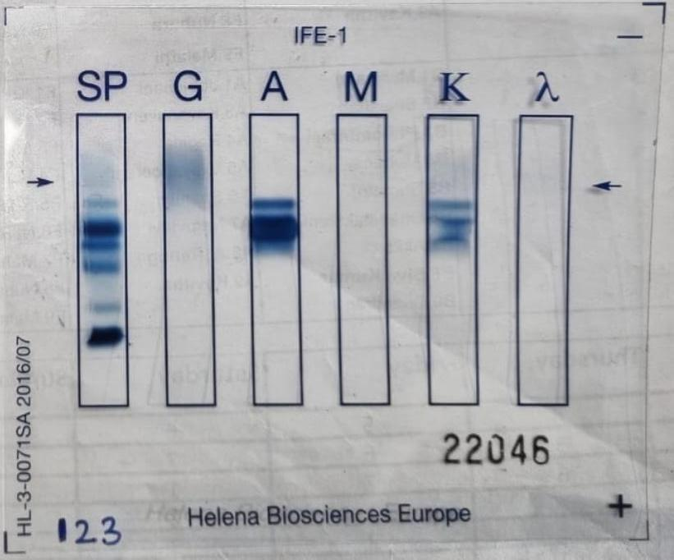
IMMUNOFIXATION ELECTROPHORESIS
IgA KAPPA - Positive

Slide 24
Medical oncology opinion
RT opinion regarding emergency radiotherapy for compressive myelopathy
Patient went against medical advice discharge to Trivandrum regional cancer institute for further management
{not under follow-up now}

Slide 25
Aim of the presentation
To highlight that the initial presentation itself can be compressive myelopathy in multiple myeloma
To discuss oncological emergencies
Ig-a myeloma is relatively uncommon

Slide 26
Thank you!!!

