Slide 1
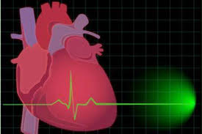
A RARE CAUSE FOR COMPLETE HEART BLOCK
PROF – DR.M.NATARAJAN M.D
ASST PROF – DR. SYED BAHAVUDEEN HUSSAINI M.D
DR VALLI DEVI M.D

Slide 2
Chief complaints
50 year old male, a known case of type 2 diabetes mellitus
Presented with c/o recurrent episodes of syncope

Slide 3
History of presenting illness
c/o syncopal attacks –
4 episodes in the last 2 weeks
each episode lasts for 2-3 minute
regained consciousness immediately after the episode
Not associated with exertion/ cough/ micturition
No aggravating/relieving factors

Slide 4
No h/o seizures
No h/o involuntary micturition/ defecation
No h/o headache
No h/o tinnitus / hard of hearing
No h/o chest pain
No h/o palpitations
No h/o breathlessness
No h/o decreased urine output/ abdominal distension / leg swelling

Slide 5
No h/o cough with expectoration
No h/o fever
No h/o head injury
No h/o weakness of limbs
No h/o difficulty in walking
No h/o tremors
No h/o loss of weight /loss of apetite
No h/o rashes

Slide 6
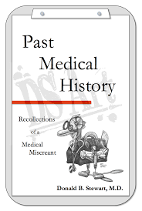
Past history
H/o chicken pox – 20 days back, not treated
k/c/o type 2 diabetes mellitus on T.Metformin 1 BD for the past 8 years
Not a k/c/o SHTN/ TB / Bronchial asthma / CAD/ seizures

Slide 7
Personal history
Not a smoker
Not an alcoholic
Bowel and bladder habits normal

Slide 8
Family history
h/o chicken pox infection in the family members in the recent past.

Slide 9
GENERAL EXAMINATION
Conscious
Oriented
Afebrile
Not dyspnoeic / not tachypnoeic
No pallor
No icterus/ cyanosis/ clubbing/ pedal edema
No generalised lymphadenopathy

Slide 10
Hyperpigmented scars present in face, trunk and limbs sparing palms and soles
Keloid + over the anterior chest wall

Slide 11
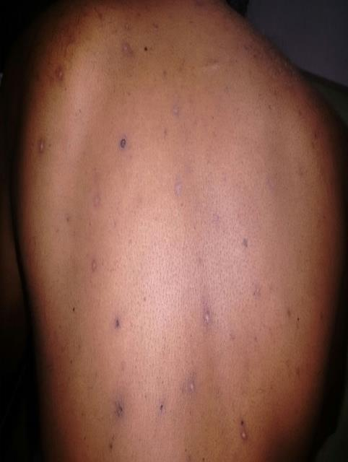

Slide 13
VITALS
PULSE – 38 per minute, regular, large volume , all peripheral pulses felt, no radio radial / radio-femoral delay
RESPIRATORY RATE – 16 per minute
BLOOD PRESSURE – 100/80 mm Hg in right upper limb in supine position, 100/80 mm Hg in standing
Spo2 – 96% in room air

Slide 14
SYSTEM EXAMINATION
CARDIOVASCULAR SYSTEM
JVP elevated
Cannon a wave +
Apical impulse in left 5th intercostal space half an inch medial to midclavicular line
Mitral, tricuspid, pulmonary , aortic area – s1s2 +
s1 variable
no murmur

Slide 15
RESPIRATORY SYSTEM
Trachea in midline
bilateral air entry equal
normal vesicular breath sounds +
ABDOMEN – soft, no organomegaly
CNS - NFND

Slide 16
INVESTIGATIONS
COMPLETE HEMOGRAM
Hb – 13.6 gm/dl
TC – 17500 cells/cu.mm
DC- neutrophils- 68%
lymphocytes 28%
monocytes 4%
Platelets – 3.45 lakhs/cu.mm
PCV – 39%
ESR – 13 mm/hr

Slide 17
Biochemistry
RBS | 139 mg/dl
S.Urea | 33 mg/dl
S. Creatinine | 1.2 mg/dl
Serum electrolytes | Meq/l
sodium | 129.8
potassium | 4.9
chloride | 94.9

Slide 18
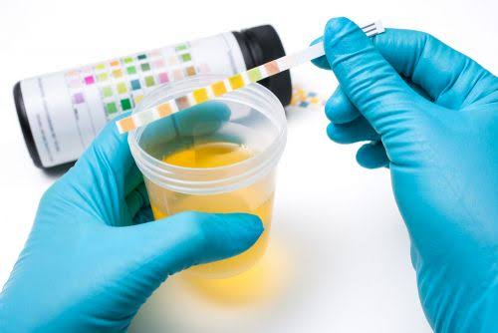
Urine analysis
Urine albumin nil
sugar nil
deposits 2-4 pus cells
ANA - Negative

Slide 19
ECG on admission

Slide 21
Fasting blood sugar – 67 mg/dl
Post prandial blood sugar – 75 mg/dl
Thyroid function tests – Euthyroid
Echocardiogram –
ejection fraction – 76%
bradycardia during study
no regional wall motion abnormality
other parameters normal

Slide 22
Provisional Diagnosis
COMPLETE HEART BLOCK – STOKES ADAM ATTACK
POSSIBLY DUE TO ?MYOCARDITIS FOLLOWING VARICELLA

Slide 23
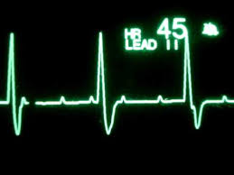
TREATMENT
T. Orciprenaline 10 mg 6th hourly
Inj. Dexamethasone 8 mg i.m BD
Inj. Atropine 2cc i.v S.O.S

Slide 24
Follow up
No further syncopal attacks

Slide 25
REPEAT ECG

Slide 29
AIM OF THE PRESENTATION
RARITY OF THE CASE .

Slide 30
THANK YOU ☺☺☺

