Slide 1
DECEASED WHO ALERTED THE DISEASED PATIENT’S DECEASE
IV MEDICAL UNIT
CHIEF : DR. DAVID PRADEEP KUMAR, M.D.,
ASST : DR. N. RAGAVAN , M.D.,
DR. K. RAM KUMAR , M.D.,
DR. R. PONRAJ , M.D.,

Slide 2
A 39 yr old female presented with breathlessness 3 days following her brother’s death
History of present illness :
Apparently normal 3 days back - developed breathlessness – acute onset, NYHA Grade II worsened to IV, chest discomfort and palpitations

Slide 3
Palpitations 3 days, irregularly irregular with giddiness and profuse sweating
Orthopnea
No h/o chest pain/ fever
syncope/ seizures
swelling of legs
yellowish discolouration of eyes,skin
weakness of limbs
decreased urine output
abdominal pain/distension

Slide 4
Past history :
Not a k/c/o DM/SHTN/CAD/BA/CKD/TB/epilepsy
- PAOD thrombectomy done
Personal history : mixed diet
bowel and bladder habits N
Menstrual History : LMP – 20 days before admission
Family history : SCD - younger brother 28 yrs, 3 days back

Slide 5
PEDIGREE CHART

Slide 6
Condition on admission :
O/E - Pt conscious
tachypnoic
no pallor
anicteric
no cyanosis
no clubbing
no pedal edema
no lymphadenopathy
fundus-normal
JVP – 3 cms above clavicle at 45 degree

Slide 7
Systemic examination :
CVS : S1 S2, variable S1, no murmur
RS : Bil AE, basal inspiratory crepts
PA : Soft
CNS : Conscious
oriented
Bil pupil 2.5mm RTL
NFND

Slide 8
Vital signs :
ECG : absent P
irregular RR
fibrillatory waves
BLOOD PRESSURE | 70/40 mmHg
SATURATION | 95 % on RA
PULSE RATE | 106/min
HEART RATE | 136/min
PULSE DEFICIT | 30
TEMPERATURE | Afebrile

Slide 9
Investigations
COMPLETE BLOOD COUNT
TC | 10,700
DC | 76/17/7
Hb | 13.0
PCV | 40
Plt | 3 lakhs
RENAL FUCNTION TESTS
UREA | 35
CREAT | 1.7
RBS | 132
SERUM ELECTROLYTES
Na + | 123
K + | 3.2

Slide 10
LIVER FUCNTION TESTS
T.B | 2.2
D.B | 1.0
I.B | 1.2
OT | 16
ALP | 87
SERUM PROTEINS
TOTAL PROTEINS | 8.3
ALBUMIN | 3.5
GLOBULIN | 4.8

Slide 11
URINE ROUTINE
SUGAR | NIL
ALBUMIN | TRACE
DEPOSITS | 2 TO 4 PUS CELLS 6 TO 8 EPITHELIAL CELLS
URINE SPOT PCR
PROTEIN | 160
CREATININE | 170
PCR | LESS THAN 3

Slide 12
Viral markers – Negative
VCTC – Non reactive
TFT – Normal
Sr. Iron studies :
Sr. iron - 60 mcg/dL
Sr. ferritin - 28 mcg/L
TIBC - 300 mcg/dL

Slide 13
Sr. calcium – 9.0 mg/dL
Vit D3 levels – within normal range
CXR PA view – Increased cardiothoracic diameter and no perihilar lymphadenopathy

Slide 14
USG ABD & PELVIS
LIVER : NORMAL
GB : DISTENDED
PANCREAS : NORMAL
SPLEEN : NORMAL
KIDNEYS : RK – 9.7 X 4.2 WITH N ECHOES
LK – 9.5 X 4.3 WITH N ECHOES
CMD MAINTAINED
IMP : NO SIGNIFICANT ABNORMALITY

Slide 15
ECHO

Slide 18
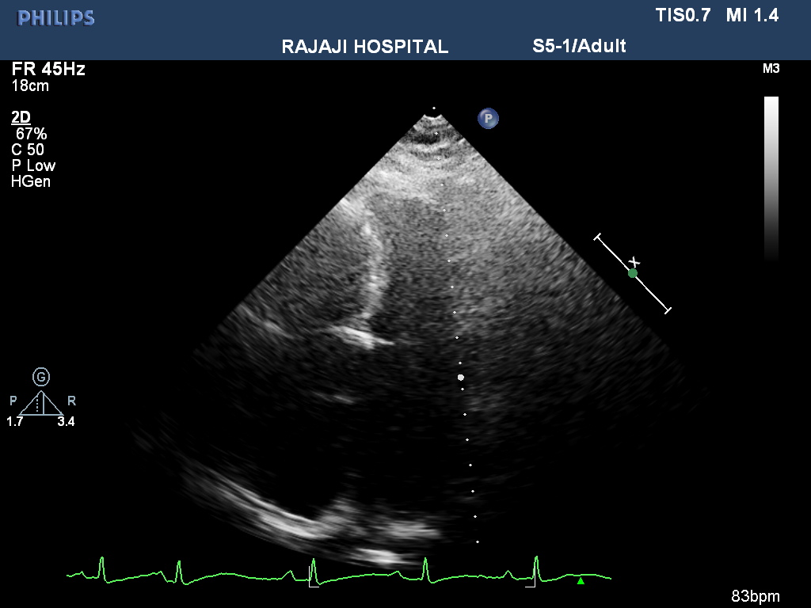

Slide 19
CARDIAC MRI : Biatrial enlargement
Ventricular hypertrophy
Altered diastolic filling
S/o RCM

Slide 20
ABDOMINAL FAT BIOPSY
PARAFFIN WAX TISSUE BLOCK TO LOOK FOR AMYLOID DEPOSITS SECTIONS SHOWED FIBROCOLLAGENOUS AND ADIPOSE TISSUE. PALE EOSINOPHILIC HOMOGENOUS AREAS NOTED. ON CONGO RED STAINING – ON POLARISING MICROSCOPE - GREENISH BIREFRINGENCE NOTED IN MANY AREAS INDICATING PRESENCE OF AMYLOID IMPRESSION : PARAFFIN BLOCK RECEIVED FROM ABDOMINAL FAT BIOPSY – BIREFRINGENT AMYLOID DEPOSITS DETECTED

Slide 21
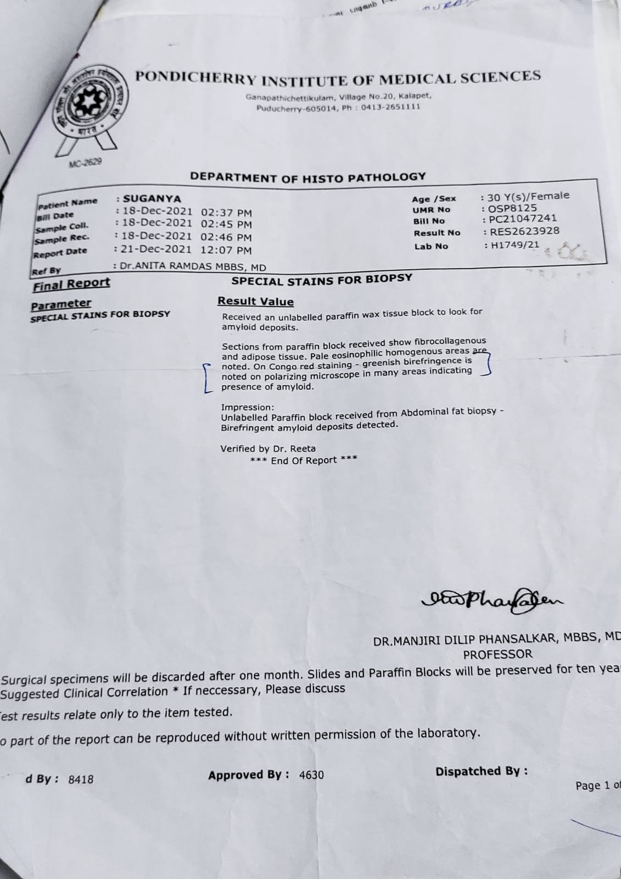

Slide 22
FINAL DIAGNOSIS
AMYLOIDOSIS / RCM / AF WITH RVR / CARDIOGENIC SHOCK

Slide 23
TREATMENT GIVEN
Nasal O2 at 4lts/min
SRD
FRD
Inj amiodarone 150 mg iv over 10 mins fb 1mg/min in infusion
Inj. Heparin 5000 u iv q6hrly
Tab amiodarone 100mg bd
Tab lasix 40mg ½ - ½ - 0
BP/TPR/IO CHART

Slide 24
AIM OF THE PRESENTATION
TO PRESENT A RARE CASE OF AMYLOIDOSIS
TO HIGHLIGHT THE DIFFERNCE IN MANAGEMENT OF AF IN AMYLOID PATIENTS

Slide 25
After control of AF, pt was discharge home with T. amiodarone 100 mg bd
After 2 weeks, pt presented with volume overload state and succumbed to sepsis

