Slide 1
A case of male infertility
III MEDICAL UNIT
PROF.Dr.M.NATARAJAN M.D
ASST PROF:Dr.P.S.ARULRAJAMURUGAN M.D.,D.M
Dr.B.PALANIKUMAR M.D
PG:Dr.S.Sugadev

Slide 2
A 25 yr old male has been evaluated for primary infertility
Farmer by occupation
No h/o loss of libido
No h/o erectile dysfunction
No history suggestive of any other systemic illness

Slide 3
Past history
No h/o –TB -MUMPS -T2DM -SHT -IRRADIATION
PERSONAL HISTORY: occasional smoker and alcoholic

Slide 4
General examination
conscious
oriented
afebrile
No pallor/icterus/cyanosis/clubbing/pedal edema/ gen.lymphadenopathy/
Secondary sexual characters normal
Testis – 3*2*1cm, sensation normal
Vitals
PR- 82/min
BP- 130/90 mm Hg
SpO2 – 96% in room air
RR -20/min

Slide 5
systemic examination
CVS:
S1 S2 +, no murmur
RS:
NVBS+, BAE +, No added sounds
ABDOMEN:
Soft, not tender, no organomegaly
CNS:
No FND

Slide 6
investigations
Hb % | 14.8g%
TC | 7,700
DC | P64/L30/M6
ESR | 16mm in 1 hr
Platelet count | 3.14 l/mm3
PCV | 38
RBS | 118 mg%
Bl. urea | 26 mg%
Sr. creatinine | 0.9g%

Slide 7
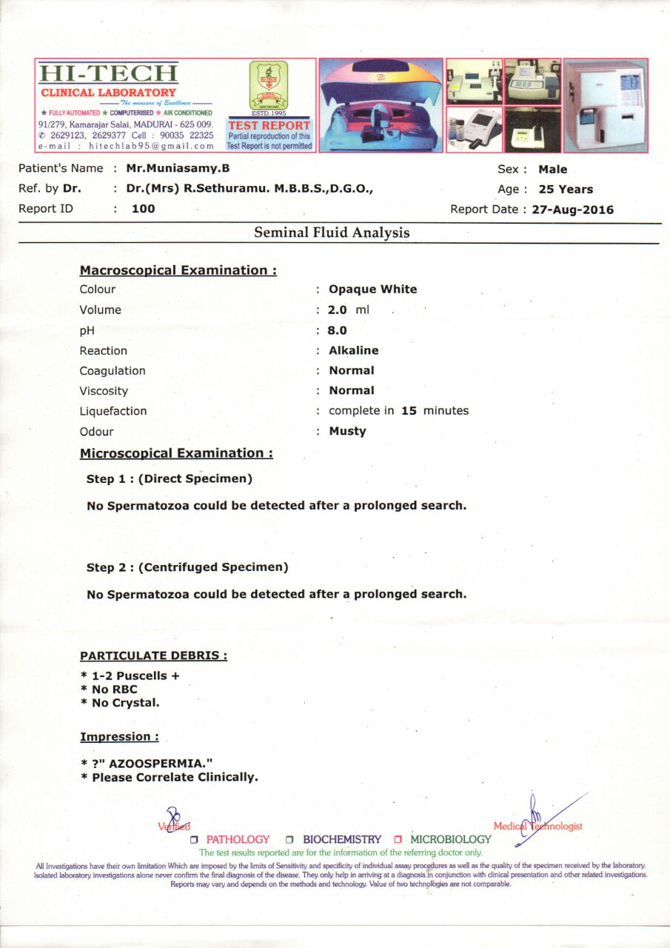

Slide 8
HORMONE ASSAY
Sr. LH - 7.89 microIU/L (N-1.24-8.62)
Sr.FSH -33.94 microIU/L (N- 1.27-19.26)
Sr.PROLACTIN -7.81ng/ml (N-2.64-13.13)
Sr. Total testosterone-3.82ng/ml (N-1.75-7.81)

Slide 9
USG SCROTUM:
NORMAL STUDY
BUCCAL SMEAR :
BARR BODY not detected

Slide 10
Diagnostic possibilities
?

Slide 11
Thank you

