Slide 1
An interesting case of bone fracture V Medical unit Chief: Dr J Sangumani m.d.,d.diab(aus) Assistant professors:Dr R Sundaram m.d., Dr k.S Raghavan m.d.,d.diab.,

Slide 2
History of present illness
34 years old female patient admitted with
c/o giddiness for 2 days
h/o increased frequency of urination
h/o difficulty in walking
h/o swelling of both legs
h/o loss of appetite
h/o bone pain

Slide 3
h/o easy fatigability
h/o nausea , vomiting
No h/o syncope
No h/o bleeding manifestations
No h/o constipation/loose stool
No h/o fever
No h/o palpitations
No h/o ear discharge

Slide 4
History of past illness
*Typhoid
*Usg abdomen : tiny intra renal calculus left kidney
*Pain in both the hip joints
*Fracture left proximal humerus ( conservatively)
*Difficulty in walking
*X-Ray Thoracolumbar spine AP and Lateral views:loss of lumbar lordosis, degenerative changes involving both SI joints (R>L)
Difficulty in walking
left subtrochanteric femur fracture-pathological fracture
Sustained trivial injury in GRH
2009
2013
2014

Slide 5
2014
Serum calcium :12.4mg%
Serum phosphorus :4.5mg%
Serum ALP:322 U/L
i-Parathyroid hormone :667.8 pg/ml
Bone Biopsy
Destroyed bony trabeculae, proliferation of fibrous tissue.
no malignancy or tuberculous lesion in biopsy received
-Suggestive of fibrous dysplasia
Endocrinologist opinion:
Subtrochanteric fracture following trivial trauma
Skeletal survey :X-Ray skull, LS Spine
Serum calcium, phosphorus, albumin, s.ALP, PTH, USG neck, Tc sestambi scan
-likely primary hyperparathyroidism

Slide 6
2014
MRI NECK
Parathyroid adenoma
MRI WHOLE SPINE SCREENING numerous lytic lesions noted in bilateral iliac bone. b/l iliac bones appear expansile.
Possibility of hyperparathyroidism
Possibilities of secondaries in vertebra and iliac bone

Slide 7
Personal history
Unmarried
Normal and regular menstrual cycle
Non smoker ,non alcoholic
Sleep pattern not disturbed
Normal bowel habits
No history of any drug intake for prolonged period

Slide 8
General examination
Patient was conscious ,oriented to time place and person
afebrile
pallor +
no cyanosis
No dehydration
No icterus
No goitre
No clubbing
No lymphadenopathy

Slide 9
B/l pitting pedal oedema
Swelling on anterior aspect of middle part left leg (3*3cm)
Swelling on the medial aspect of right arm( 2*2cm)
BP=90/60 mmHg
PR=86/min
SpO2= 99% at room air

Slide 10
Systemic examination
CVS : s1s2 heard , no murmur
RS: NVBS heard, no added sound
P/A : soft, non tender, BS+ , no organomegaly
CNS : patients conscious ,oriented
bulk : normal in all 4 limbs
tone : could not be tested
power : could not be elicited
DTR : could not be elicited

Slide 11
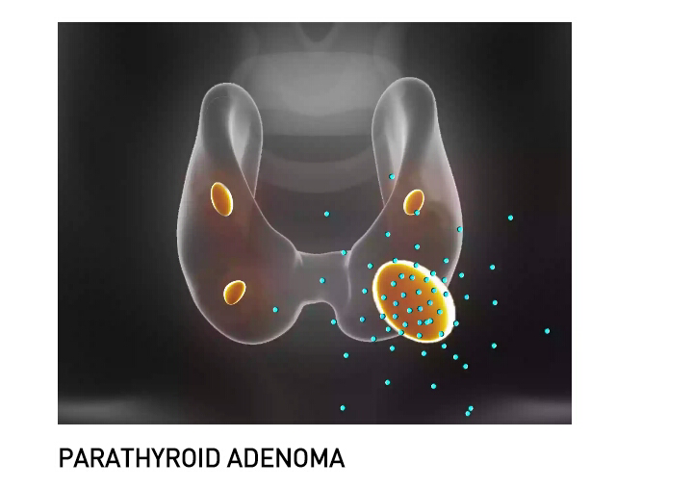
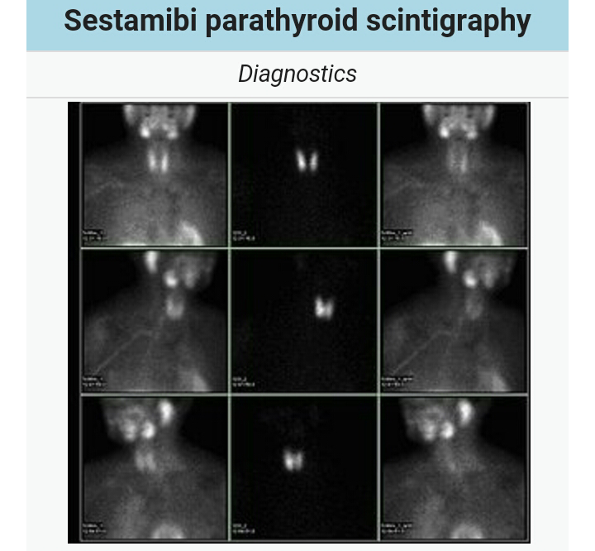
Endocrinologist opinion:
Likely primary hyperparathyroidism
Adviced:
skeletal survey: X-ray skull lateral view
LS spine AP view
Serum cal/phosphorus/albumin/ALP/i PTH
USG Neck and abdomen
Tc 99m-sestamibi scan

Slide 12
Surgical endocrinologist
Diagnosis ; Parathyroid adenoma
IVF: NS 3 units
Inj frusemide 20 mg iv bd
Serum electrolytes
PLAN:
surgery

Slide 13
Investigations
Hb=9.6gm%
PLC=1.6 lakhs
PCV=23%
TC=13,100 cells
DC:P86%L11%Mx3%
RBS=90mg/dl
S.Urea=57mg/dl
S.Creatinine=1.7mg/dl
Na=130 mEq/L
K=5.7 mEq/L
Cl=105 mEq/L
T.Bil =1.2mg%
SGOT=43 IU/L
SGPT=40 IU/L
ALP=506 IU/L

Slide 14
Investigations
Serum cal: 13.4 (8.5-10.1mg/dl)
Ser P:2.3 (2.5-4.9 mg/dl)
Ser ALP:
Parathyroid hormone: 1673.1 pg/ml
25 hydroxyvitamin D: 6.54 ng/ml (30-100)
ECG : WNL
Echo: normal study
T. protein: 8.9 g/dl
Alb=4.5 g/dl
Globulin=4.4 g/dl

Slide 15
USG Abdomen
RK=11.6*6cm
LK=8*3cm
B/L cortical echoes increased
CMD maintained
e/o 7mm calculus in upper pole of right kidney

Slide 16
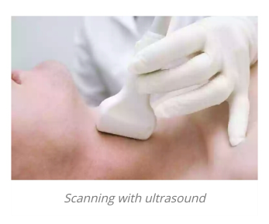
USG Neck
e/o 1.2*1.8 cm measuring well defined hypo echoic lesion posterior to right lobe of thyroid
p/o- parathyroid adenoma

Slide 17
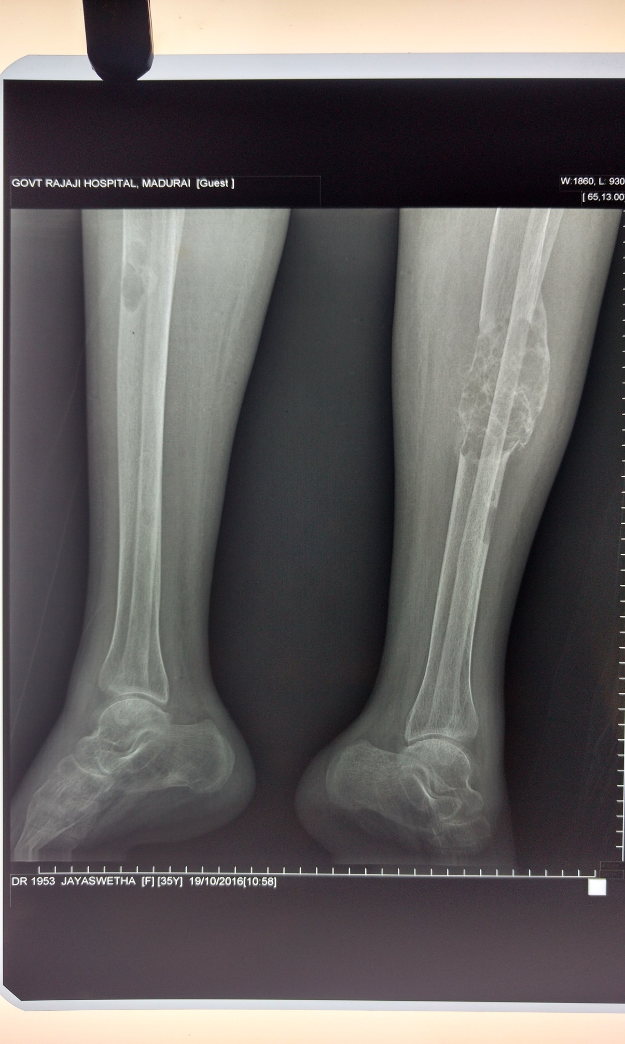
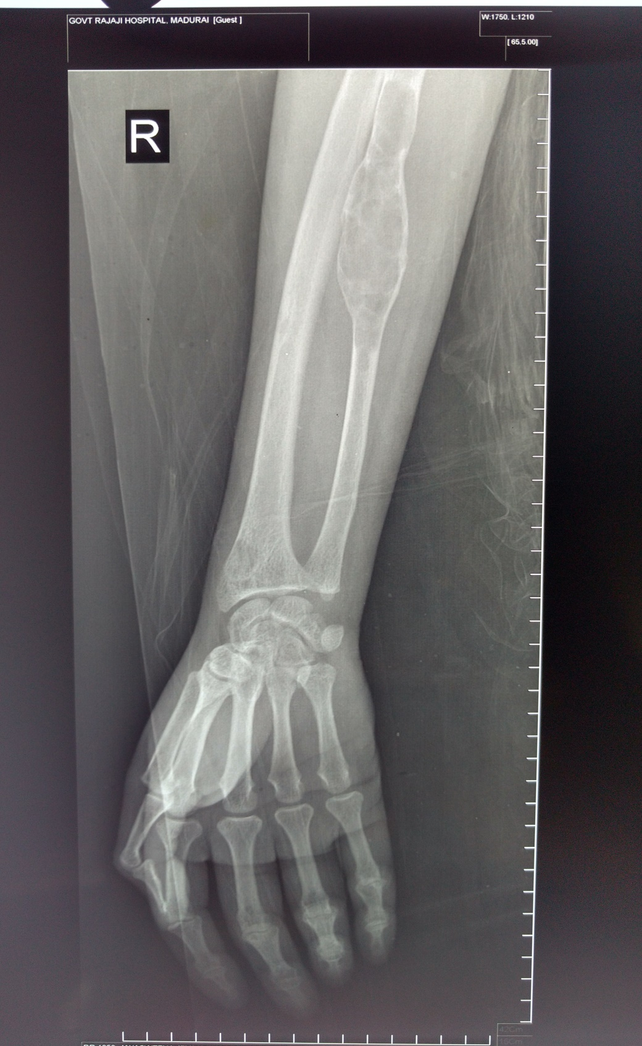

Slide 18
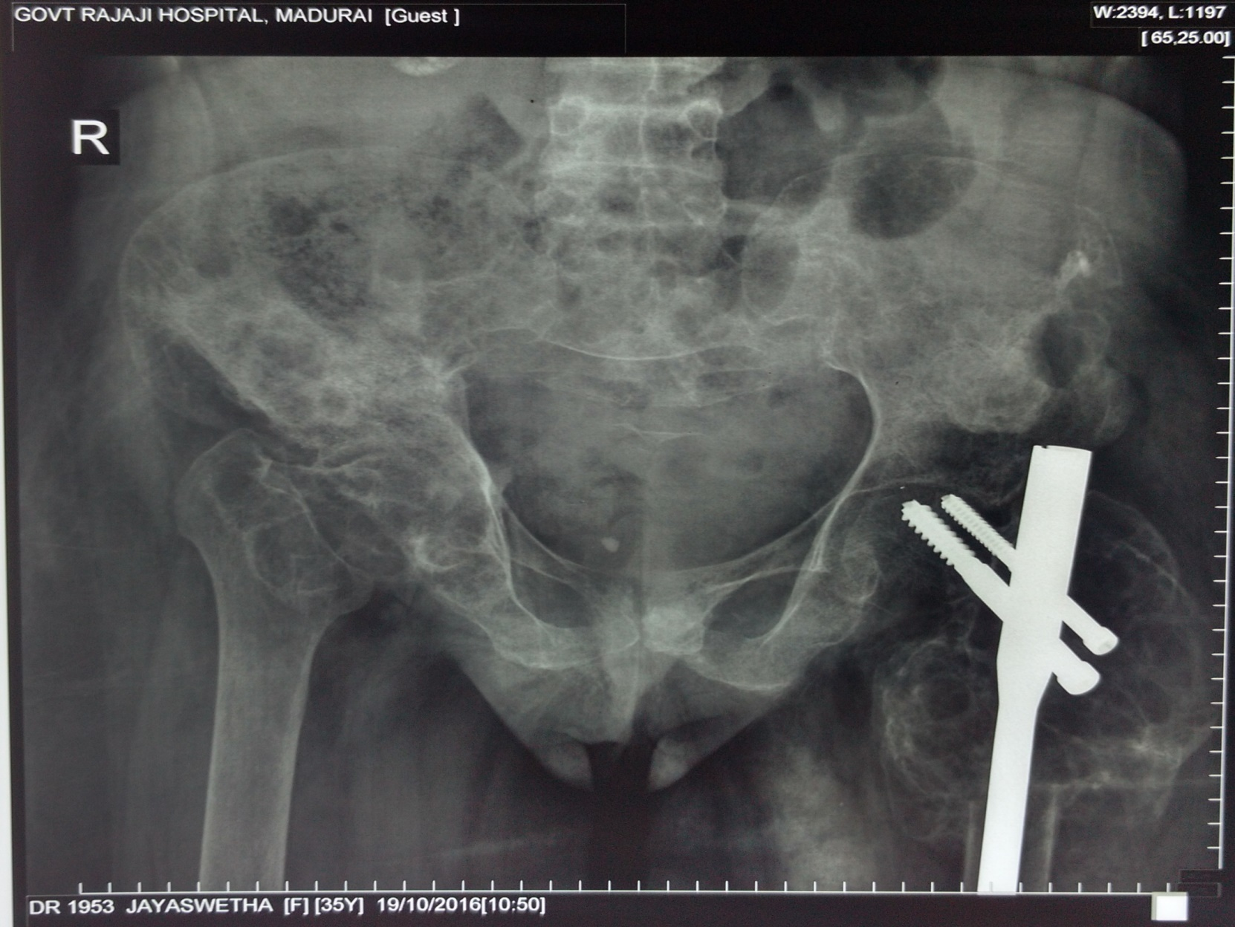

Slide 19
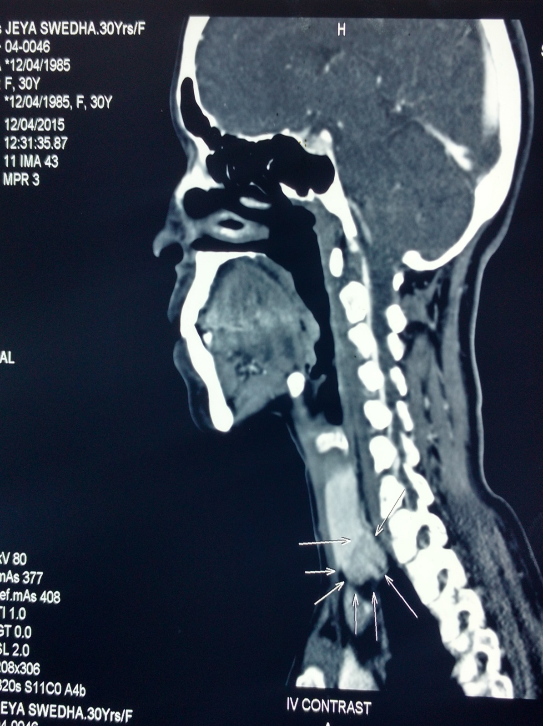

Slide 20
Treatment
IVF : 4 units NS @ 100 ml/hr
Inj Pantoprazole 40 mg iv bd
Inj ondansetron 8mg iv tds
BCT/FST 1 OD

Slide 21
Take home message
Recurrent non-traumatic fracture: hyperparathyroidism
Most common cause of hyperparathyroidism Parathyroid adenoma

Slide 22
Thank you !

