Slide 1
Clinicopathological conference
Dr. c. vignesh md

Slide 2
Initial impressions
History - Congestive cardiac failure
Echo – good LV function
Urine analysis – massive proteinuria ; borderline creatinine
Can cardiorenal syndrome result in proteinuria ?

Slide 3
Can it be budd chiari syndrome?
for
against
In Asians – slight male predominance
Pure IVC obstruction or combined IVC and hepatic vein obstruction
Chronic budd chiari can present as cirrhosis
Sub acute budd chiari – only minimal ascites
Chronic budd chiari – caudate hypertrophy and atrophy of all other lobes
All 3 hepatic veins visulaised
Confluence with IVC visualized
No splenomegaly
Portal vein 9mm

Slide 5
Can cirrhosis explain the presentation ?
for
against
Usg – liver smaller in size, coarse echos, gross ascites
Reformed alcoholic
LFT – normal
Only hypoalbuminemia
No AG reversal
No splenomegaly
Portal vein diameter – 9mm
Renal vein thrombosis uncommon

Slide 6
Nephrotic syndrome
IVC, renal vein and iliac vein thrombosis
Chronic liver disease
CAD
Old PTB
Subclinical hypothyroidism
anemia

Slide 7
Minimal change disease
Focal segmental glomerulosclerosis
Membranous glomerulonephritis
Diabetic nephropathy
Glomerular deposition disease- light chain deposition, monoclonal plasma cell disorders, renal amyloidosis

Slide 8
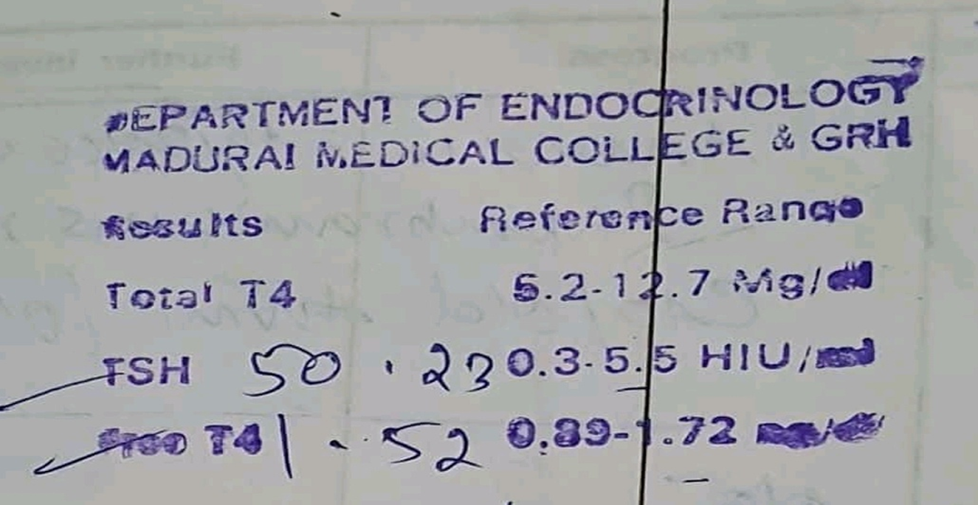
Thyroid profile in nephrotic syndrome
Urinary loss of TBG, transthyretin, albumin leads to low total T4 and T3 levels
Free T4 and free T3 levels are more reliable
In patients on steroids – TSH and T3 are decreased.
Our patient has marked elevation of TSH and normal free T4

Slide 9
Hypochromic microcytic anemia in a 60 year old
We expect a rise in hematocrit in nephrotic syndrome
Nutritional
GI malignancy
CECT abdomen, stool occult blood, endoscopy

Slide 10
Renal vein thrombosis
Rare
Adults – nephrotic syndrome or renal cell CA
Newborn and infants – inherited thrombophilia or dehydration
Acute and chronic RVT
Can chronic renal vein thrombosis increase proteinuria ?
Routine evaluation for RVT is not necessary in nephrotic syndrome

Slide 11
Minimal change disease
More common in children
10 -15% of adult nephrotic syndrome
Selective proteinuria
In adults >60 yrs, MCD can present with hypertension and renal insufficiency
Urinary CD80 levels increased in MCD; can differentiate from FSGS

Slide 12
FSGS
35% of adult renal biopsies done for evaluation of proteinuria show FSGS
This increases to 80% in African-Americans
Generally results in progressive kidney injury

Slide 13
Secondary FSGS
Adaptive response to hyperfiltration – reduced renal mass, obesity
Viruses- HIV, hepatitis B, parvovirus
Hypertensive nephropathy
Reflux nephropathy
Drugs – analgesics, bisphosphonates, heroin
Sickle cell disease
Radiation nephropathy

Slide 14
Membranous glomerulonephritis
Most common cause of nephrotic syndrome in the elderly
Highest reported incidence of renal vein thrombosis, pulmonary embolism and deep vein thrombosis – 30 %

Slide 15
Secondary membranous glomerulonephritis
Infection – hepatitis B & C, syphilis, malaria, leprosy
Cancer – breast, lung, colon, stomach
Autoimmune diseases- SLE, RA, Hashimoto thyroiditis, Sjogren syndrome
Others – sarcoidosis, IGg4 disease, diabetes, sickle cell disease

Slide 16
Most likely diagnosis
Membranous nephropathy with nephrotic syndrome and renal V, IVC and iliac V thrombosis
? Alcoholic liver disease / CAD
Hypochromic microcytic anemia
Subclinical hypothyroidism

Slide 17
Further investigations
Renal biopsy
Work up for secondary causes of nephrotic syndrome
Serum iron studies
Stool occult blood
Upper and lower GI endoscopy
Anti TPO antibodies
Fibroscan of liver

Slide 18
THANK YOU

