Slide 1
An incidental finding in X-ray pelvis for discussion
III MEDICAL UNIT
PROF.Dr.M.NATARAJAN M.D
ASST PROF:Dr.P.S.ARULRAJAMURUGAN M.D.,D.M
Dr.B.PALANIKUMAR M.D
PG:Dr.S.Sugadev

Slide 2
A 70 yr old female
Diabetic for past 10 yrs
Subacute onset of weakness of left upper and lower limbs
Diagnosed as CVA – Left hemiplegia
CT showed infarct in Rt. Internal capsule

Slide 3
Treated with routine management
She slowly improved
Complaints of persistent pain in right hip for which x-ray has been taken which had an incidental finding

Slide 4
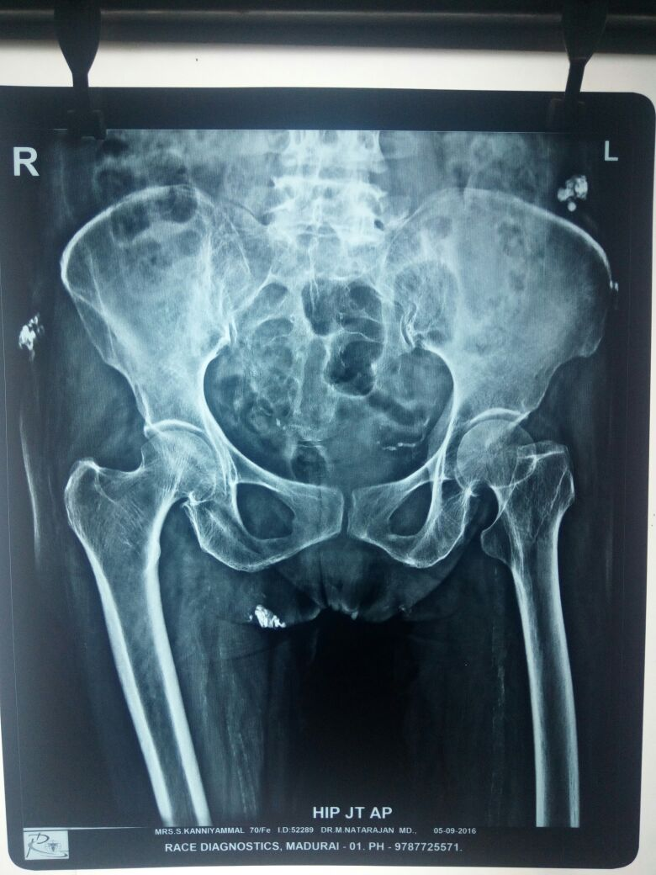

Slide 5
Differential diagnosis
?

Slide 6
Thankyou

