Slide 1
CASE DISCUSSION
PROF&HOD:DR.S.PEER MOHAMED MD
ASSOCIATE PROF . Dr.K .MURALIDHARAN MD
Assistant Proff:
DR.V.MANIKANDAN MD
DR . R. JAGATHEESH MD
DR.D.VASANTHA KALYANI MD
DR.M.SURESH KUMAR,MD
DR.M.SATHEESH KUMAR MD
PRESENTOR :DR.NANDIKURALI MAHALAXMI

Slide 2
Chief complaints:
60/M came to GRH from vadipatti gh
C/o difficulty in using both lower limbs for past 3 days
H/o presenting illness
The patient was apparently normal 3 days back then he Developed
H/o difficulty in using both lower limbs since past 3 days
Insidious in onset
Progressive in nature
Difficulty to stand from squatting position
Difficulty to wear slippers

Slide 3
H/o difficulty in walking
H/o giddiness on standing up
No h/o vomiting
No h/o loose stools
No h/o difficulty in swallowing
No h/o neck muscles weaknes
PAST HISTORY:
Pt is a not a k/c/o SHTN/T2DM/Hypothyroidism
H/0 abdominal surgery 10 yrs back (records N/A)
Personal history :
Chronic alcoholic for 10yrs

Slide 4
VITALS:
BP- 120/90 mm hg
PR- 86/ min
Spo2 – 98% at room air
RR – 16/min
O/E
conscious
oriented
Not dyspneic
Not tachypneic
No pallor/icterus/ cyanosis/ clubbing/
No Pedal edema

Slide 5
.
Systemic examination:
CVS: S1 S2 Present
No murmur
RS – BAE present, NVBS
PA - vertical scar present 3cm lateral to R side of umbilicus
soft, bowel sound present
CNS- Conscious, oriented , NFnd
Tone:
Dtr:
Power:
Plantar: decreased on both sides
B/l prtl +
No neck muscle
No neck. Muscle weakness
SBc>20
Decreased sensory response to Touch,pain, temperature
Vibration below knee and elbow
R | L
Biceps + | Biceps +
Triceps + | Triceps +
Supinator + | Supinator +
Knee jerk - | Knee jerk -
Ankle jerk - | Ankle jerk -
R | L
Normal | Normal
Normal | Normal
R | L
5/5 | 5/5
4/5 | 4/5
UL
LL

Slide 6
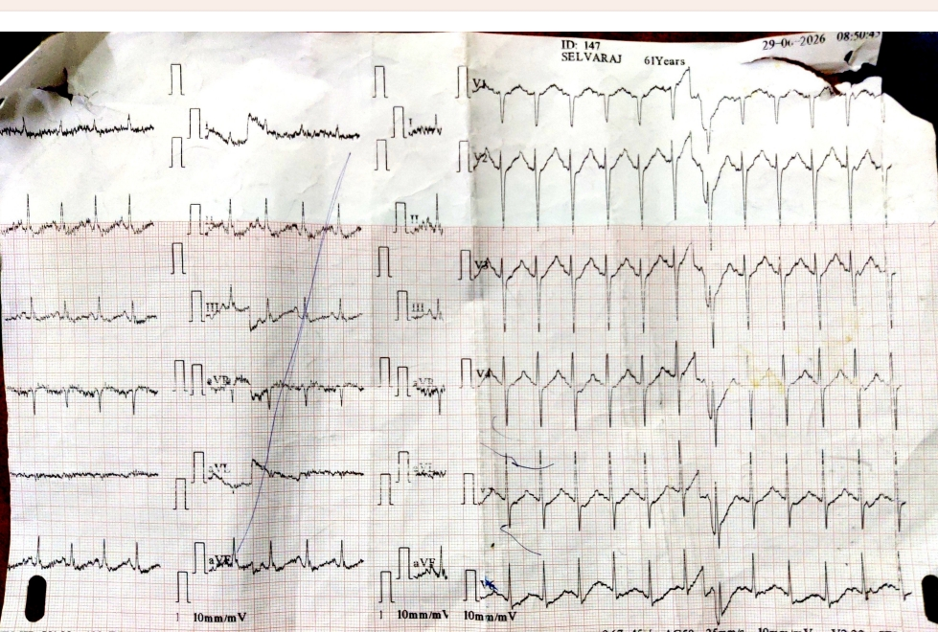
Ecg

Slide 7
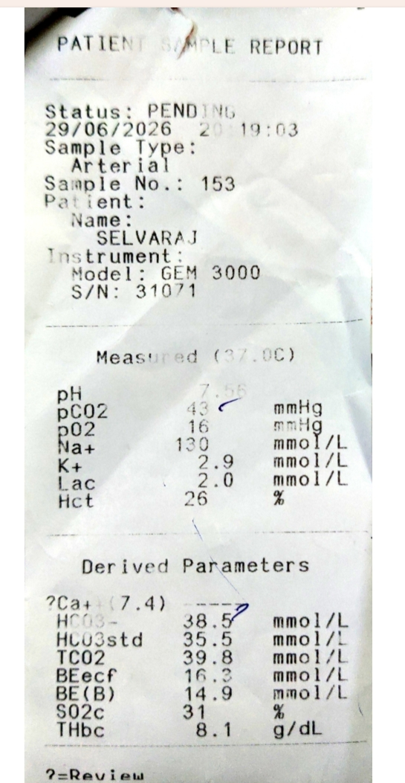
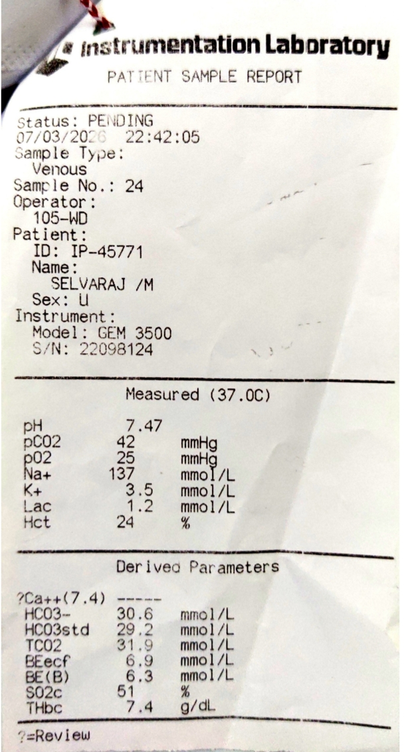
ABG

Slide 8
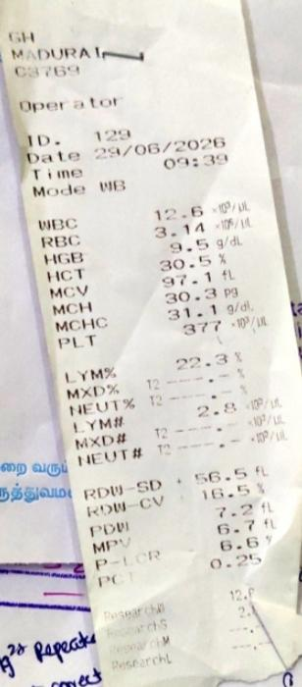
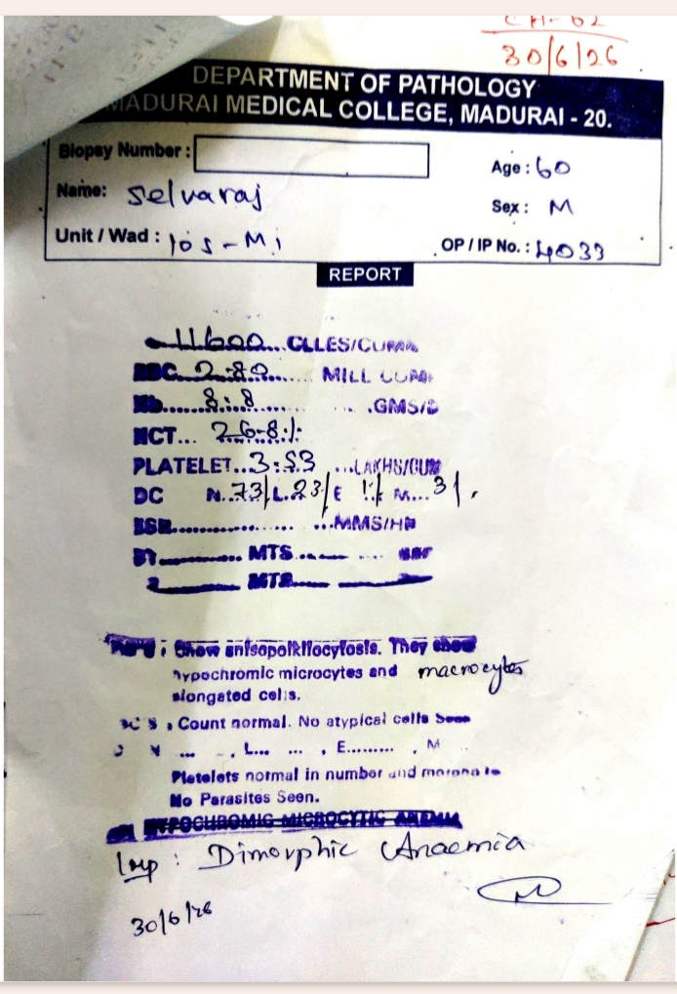
Cbc with complete heamogram

Slide 9
 | ON ADMISSION 29/06/2026
HB | 8.9
TC | 12,600
PLT | 3,73,000
PCV | 26.8%
Sr.Sodium | 129
Sr.Potassium | 2.0
Sr.Magnesium | 1.4

Slide 10
Investigations
Urine calcium | 9.78
Urine chloride | 162
Urine creatinine | 225
RBS | 126
Urea | 24
creatinine | 0.9
Sr electrolytes
Urine electrolytes
Sr.osm | 267
Urine.osm | 511
TTKG | 4
Calcium | 7.7
Phosphorus | 2.5
Sr cholesterol | 228
Sr HDL | 31
Sr LDL | 116
Sr TGL | 233
sodium | 233
potassium | 34.3
CK | 42
CKMB | 22

Slide 11
Neuro medicine Opinion
Impression:
Acute flaccid quadriperesis/Hypokalemic periodic paralysis ? T/o Ro gbs
Rx :
ADEQUATE HYDRATION
INJ KCL 40 meq in 250 ml NS OVER 4 HRS
INJ VIT B12 1000 microgm in 100 ml NS IV OD
INJ THIAMINE 300 mg IV OD

Slide 12
Ncs report
Impression
Bilateral (B/L) peroneal motor axonal neuropathy
Bilateral (B/L) upper limb (UL) and lower limb (LL) sensory axonal neuropathy
Bilateral (B/L) sural nerves not stimulatable
Bilateral (B/L) peroneal F-wave absent
Clinical correlation is advised.

Slide 13
LET’S DISCUSS…

