Slide 1
Chest X – ray For Discussion
5th MEDICAL UNIT

Slide 2
A 13 year Old Male from Chozhavanthan admitted with complaints of gum bleeding for past 5 days
HOPI :
Patient was apparently normal before 5 days ,Then he developed bleeding gums
H/o Fever
low grade, intermittent, not associated with chills and Rigor, No diurnal variation, No night sweats
H/o Purpuric spots over arm and back
H/o Abdominal pain
H/o Vomiting – 2 Episodes, Non bilious, Not blood stained
H/o Cough with Expectoration

Slide 3
No H/o Chest pain
No H/o Palpitation
No H/o Leg swelling
No H/o Hematuria /Hematochezia
No H/o Reduced Urine output
No H/o Breathlessness
No H/o Headache/Altered sensorium/Seizure
No H/o Loss of Consciousness
No H/o Trauma

Slide 4
No H/o Abdominal distension
No H/o Malena
No H/o Hemoptysis
No H/o Hematemesis
No H/o Yellowish discoloration of urine
No H/o Loose stools
No H/o Stiffness of Neck

Slide 5
Past History :
Not a K/c/o DM/SHTN /TB /Bronchial Asthma /Seizure disorder /Thyroid dysfunction.
No H/o Blood transfusion
No H/o Previous Surgery
Personal History :
Mixed Diet
Not a Smoker and Alcoholic
Bowel and bladder habits – Normal
Sleep – Normal

Slide 6
FAMILY HISTORY
NON CONSANGUINOUS MARRAIGE

Slide 7
GENERAL EXAMINATION
Patient Conscious
Oriented , JVP – Not elevated, No facial puffiness
No dilated veins , No Scars
Afebrile
No pallor,No Cyanosis,No clubbing,No icterus ,No Generalized Lymphadenopathy,No Pedal edema
External genitalia – Normal
Hernial orifice – Normal

Slide 8
VITALS
BP – 120/70mmHg (Rt Upper limb)
PR – 84/min
Regular rhythm, Normal volume, Felt in all pheriphral vessels, No specific character
SPO2 – 98% with Room Air

Slide 9
SYSTEMIC EXAMINATION
CVS :
S1S2 heard,No murmur
RS : NVBS heard, BAE + , No added sounds.
P/A :
Soft ,Non tender,
Palbable mass 6cm from Left costal margin, firm in consistency, moves with inspiration probably spleen
No Hepatomegaly, No bruit, Bowel Sounds Heard.
CNS : NFND
Able to move all 4 limbs

Slide 10
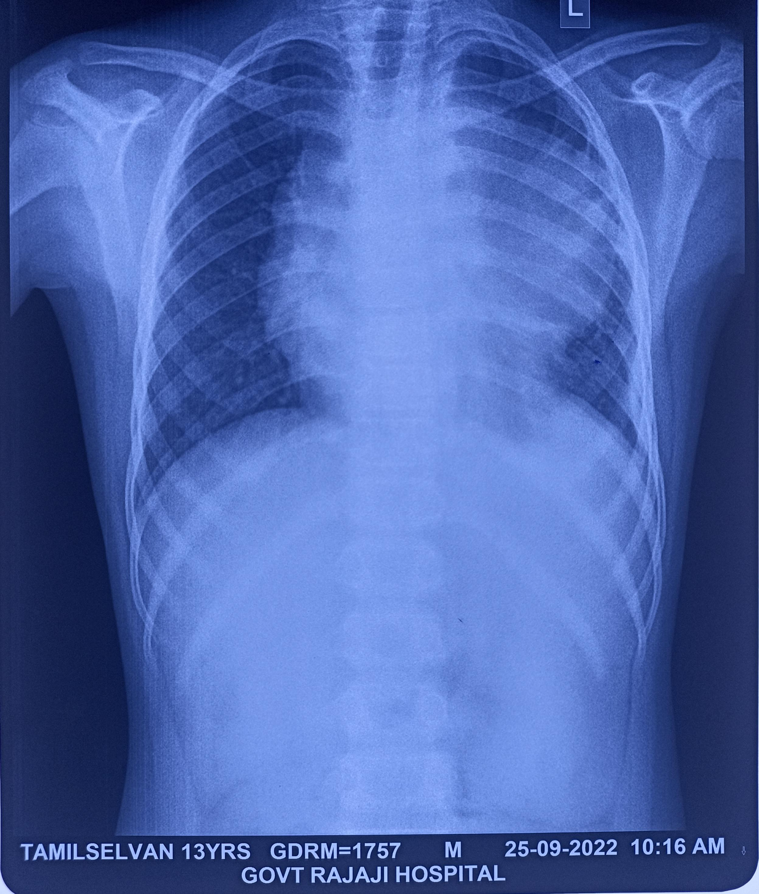
CXR

Slide 11
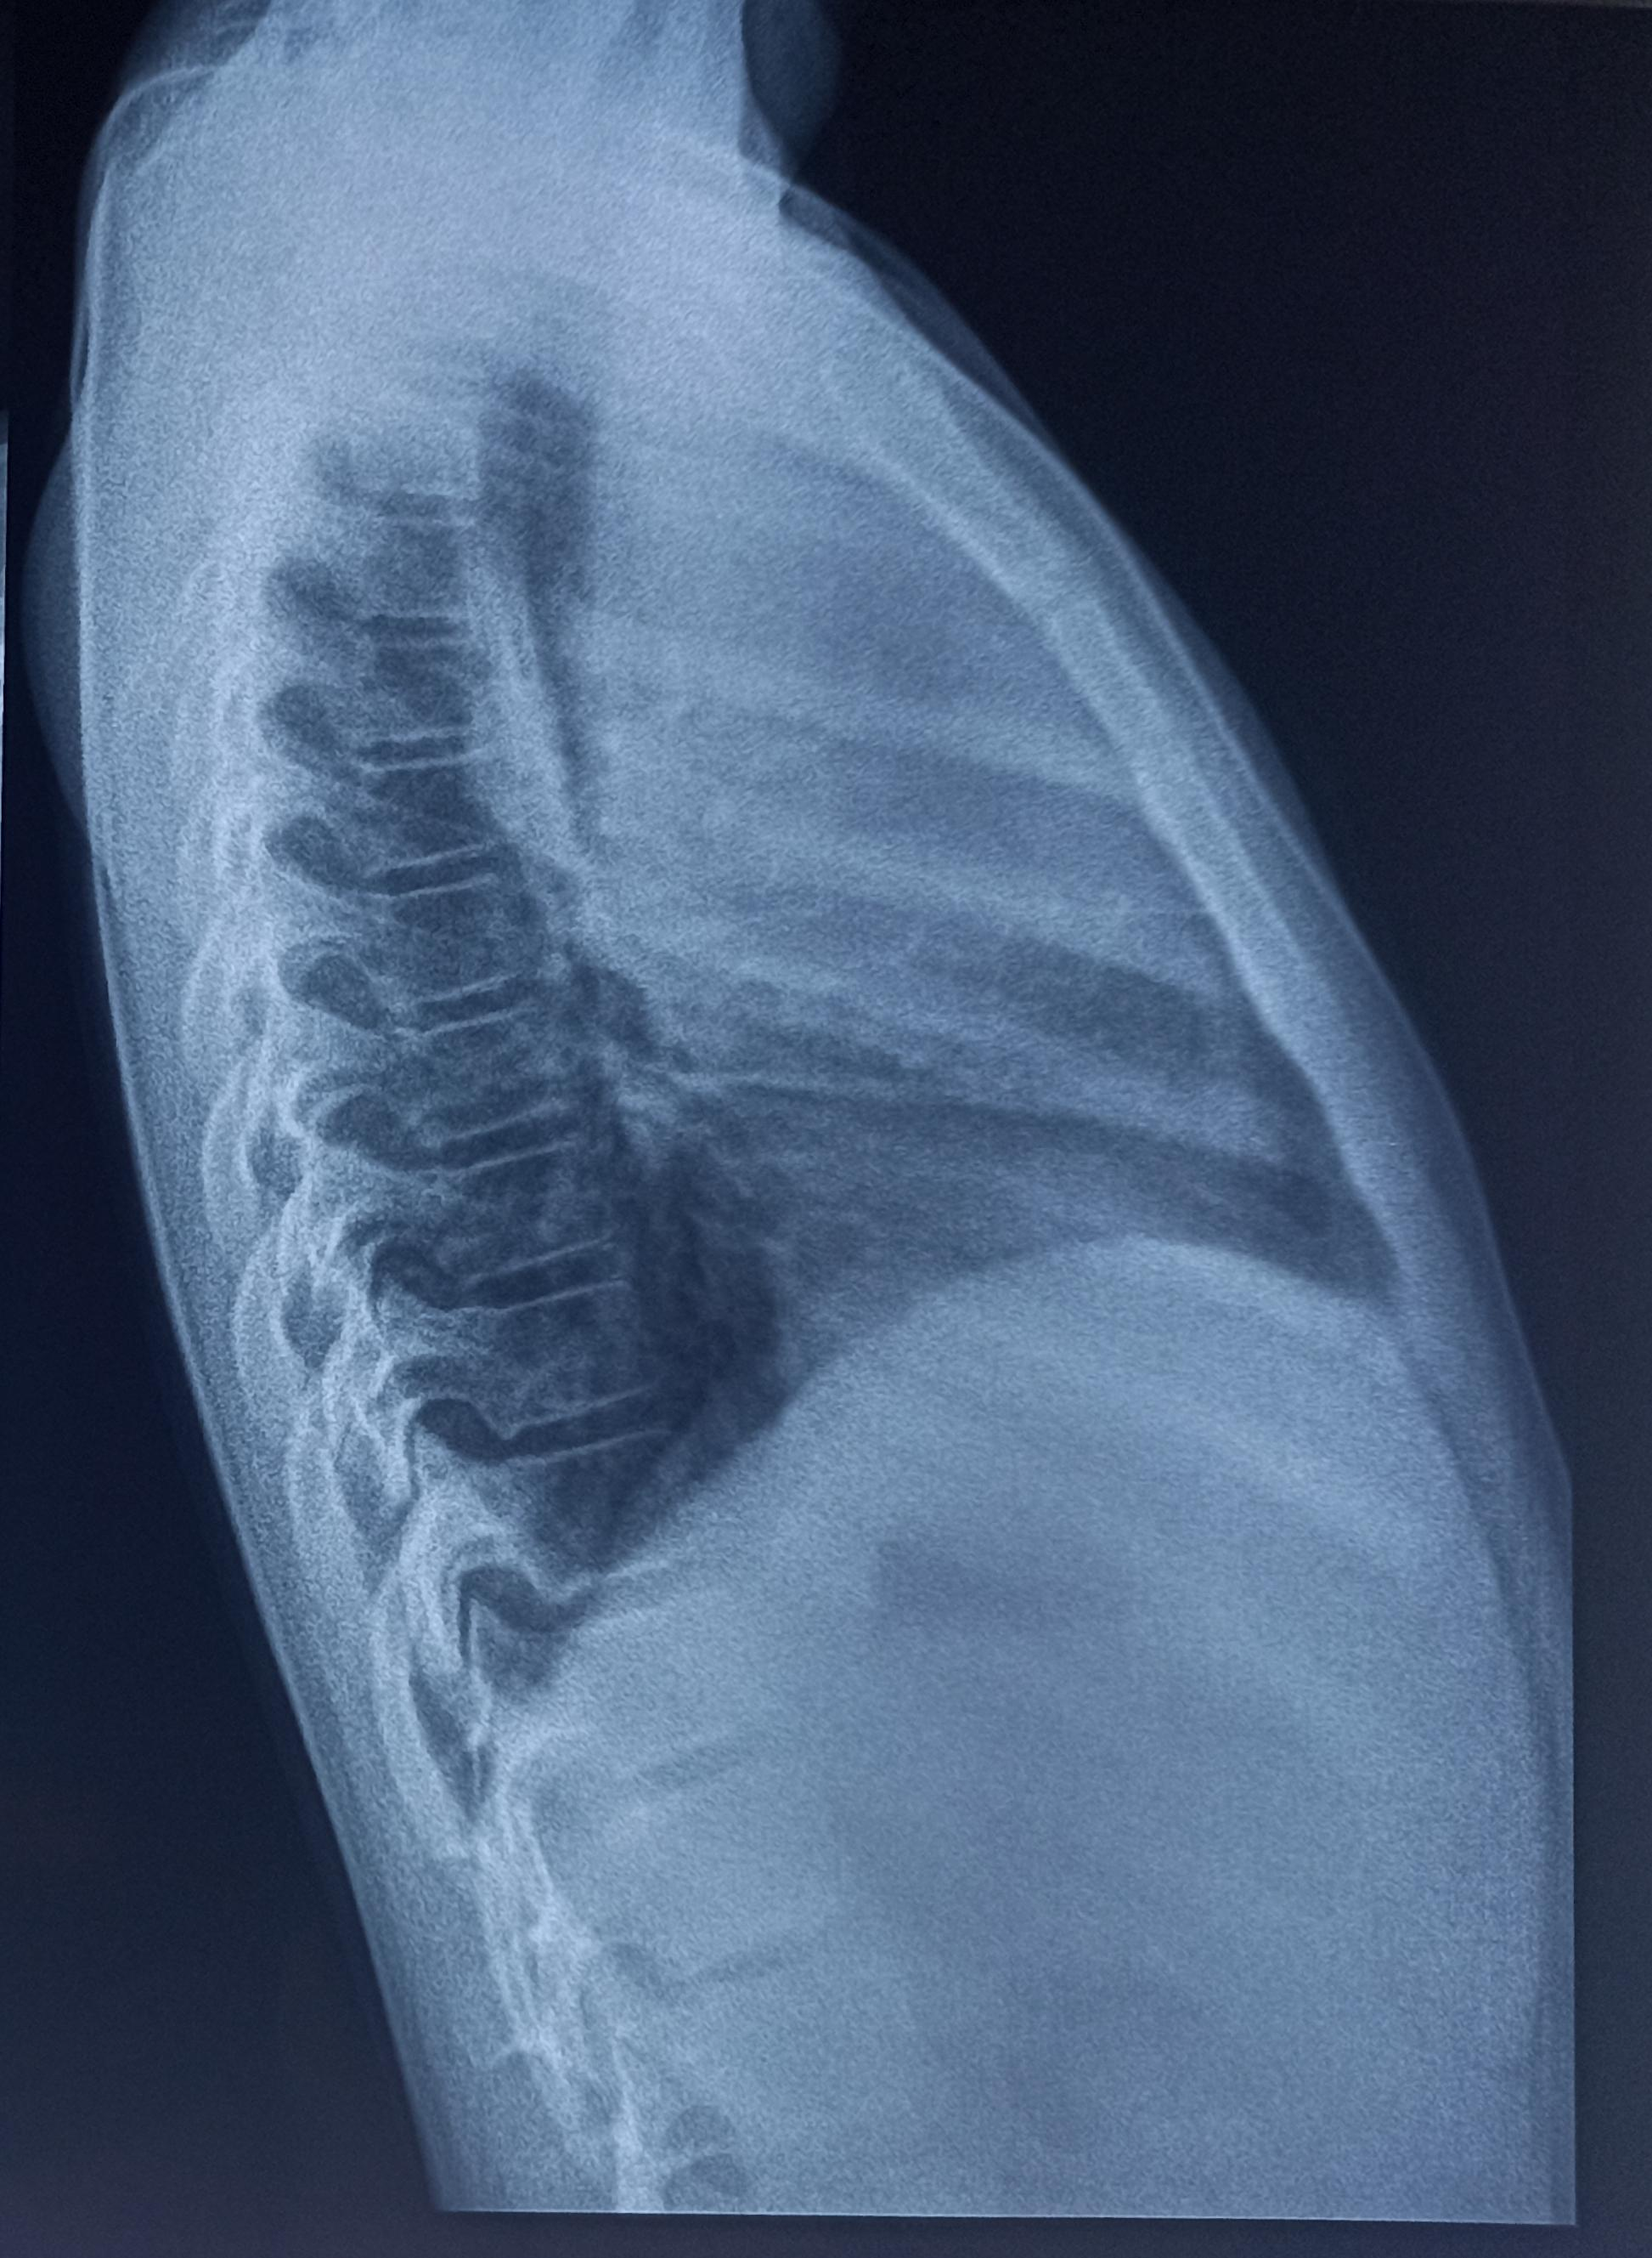
LATERAL CXR

Slide 12
WHAT NEXT

