Slide 1
Physicians Pandora box
Opening by 1st medical unit
Prof and hod: Dr.m.natarajan Md
Asst prof : Dr.palanikumaran MD., ddiab
Dr.vasanthakalyani MD., dcp
Dr.sureshkumar MD
Presenter : Dr.vengadesan Pg final year

Slide 2
History is not a science but an art
A 60 year old female lakshmiyammal working as daily cooly presented with complaints of breathing difficulty for past 2weeks
History of presenting illness:
The patient was apparently normal 2weeks back then she developed breathing difficulty, insidious onset and progressive nature Grade-3 MMRC
H/o orthopnea
No H/o PND
H/o cough expectoration for 3weeks mucoid and scanty, not blood stained, not foul smelling

Slide 3
No H/o fever
No H/o chest pain
No H/o palpitations/ excessive sweating
No H/o reduced urine output
No H/o abdominal distention/ leg swelling
No H/o Trauma
No H/o altered sensorium

Slide 4
Past history
Not a known case of HTN/DM/BA/TB/COPD/CAD/CLD/CKD/Thyroid disorder
Patient initially went to Sivagangai medical college then came to GRH
Personal history
Mixed diet
No bladder/ bowel disturbance
Family history
No H/o PTB or ATT intake in family members

Slide 5
Examination is a game of skills
General examination
O/E
Pt conscious
Oriented
Afebrile
ill built and nourished
No pallor/ icterus/ clubbing/ cyanosis/ Pedaledema/ lymphadenopthy
No thyromegaly
Tattooing Over both forearm

Slide 6
Vitals:
PR: 86/min, normal volume, regular rhythm
BP: 110/70mmHg
RR: 22/min
Temp: 98.6°F

Slide 7
Systemic examination
RS: Drooping of right shoulder
Decreased chest expansion on right side
Trachea deviated to right side
Stony dullness on right hemithorax except supra clavicular and suprascapular region
Air entry absent as described above
CVS:S1S2 heard
P/A: Soft, Bowel sound heard, no palpable organomegaly
CNS: Conscious, oriented

Slide 8
INVESTIGATIONS
Hb: 11.6/ 11.1
TC: 8,600/ 5500
DC 55/28/07; 52/32/16
ESR:69@1hr
Urea: 28/ 13
Creatinine: 0.9/0.8
Bilirubin : 0.8/1.1
ALT: 32/ 36
AST:28/42
ALP: 146/ 92
HBsAg: positive
HCV and HIV: Negative

Slide 9
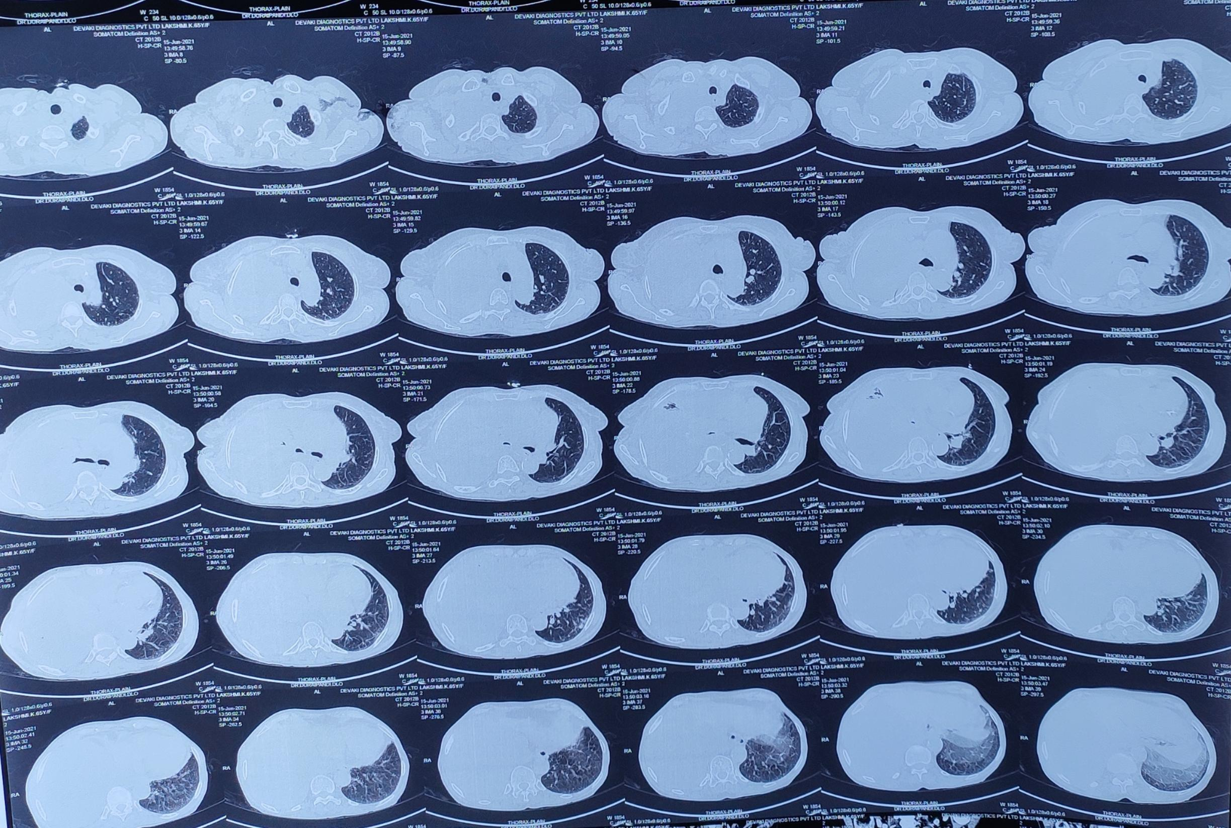
CXR and CT CHEST

Slide 11
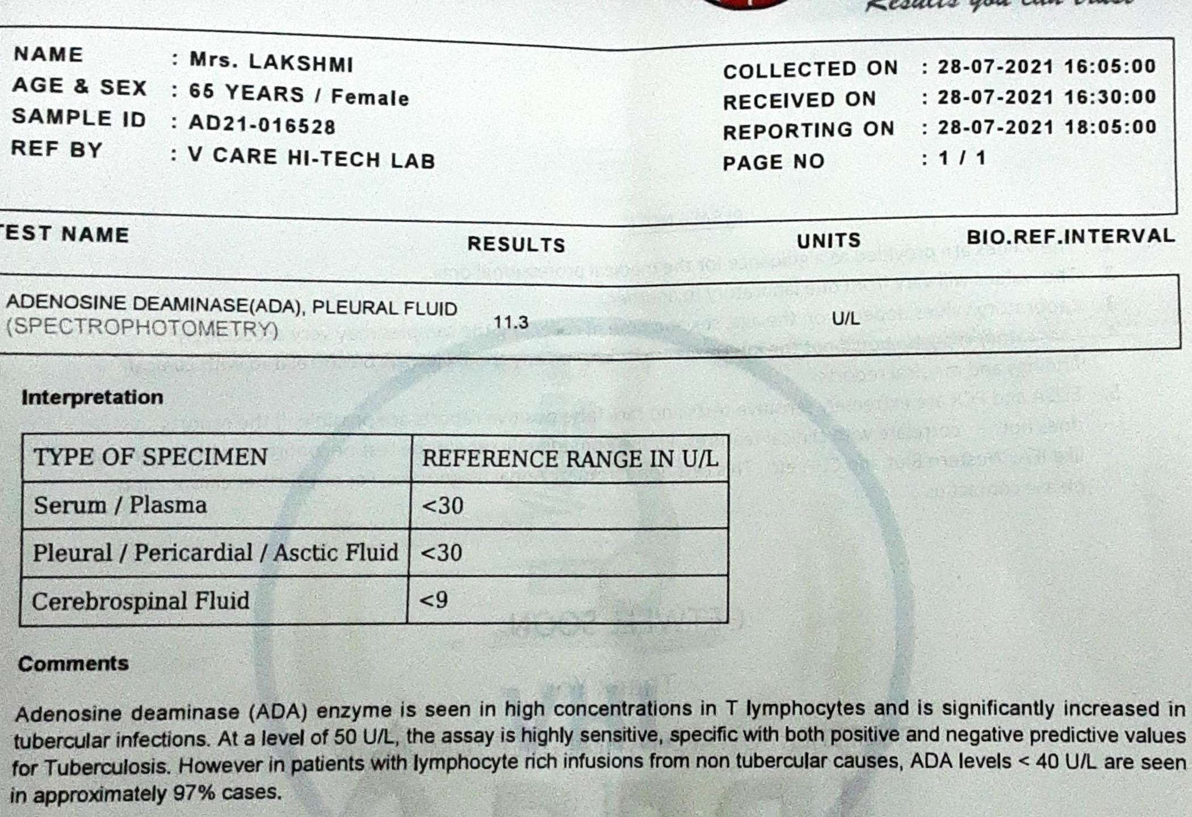
Exploring pandora box

Slide 12
Right sided exudative massive pleural effusion

Slide 13
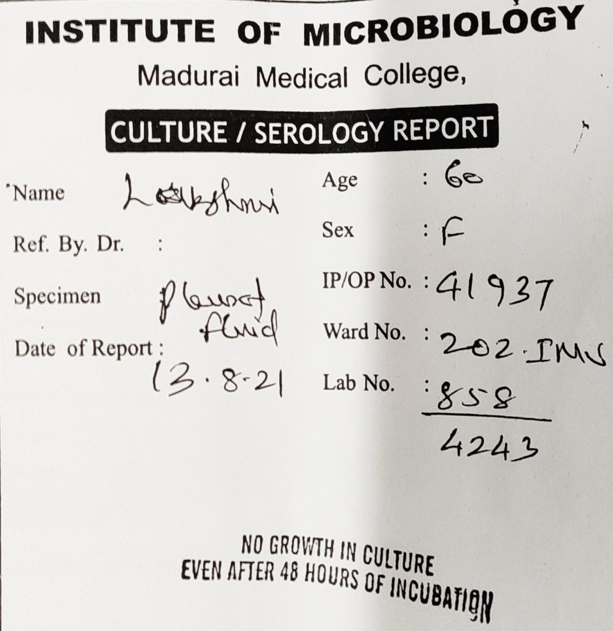
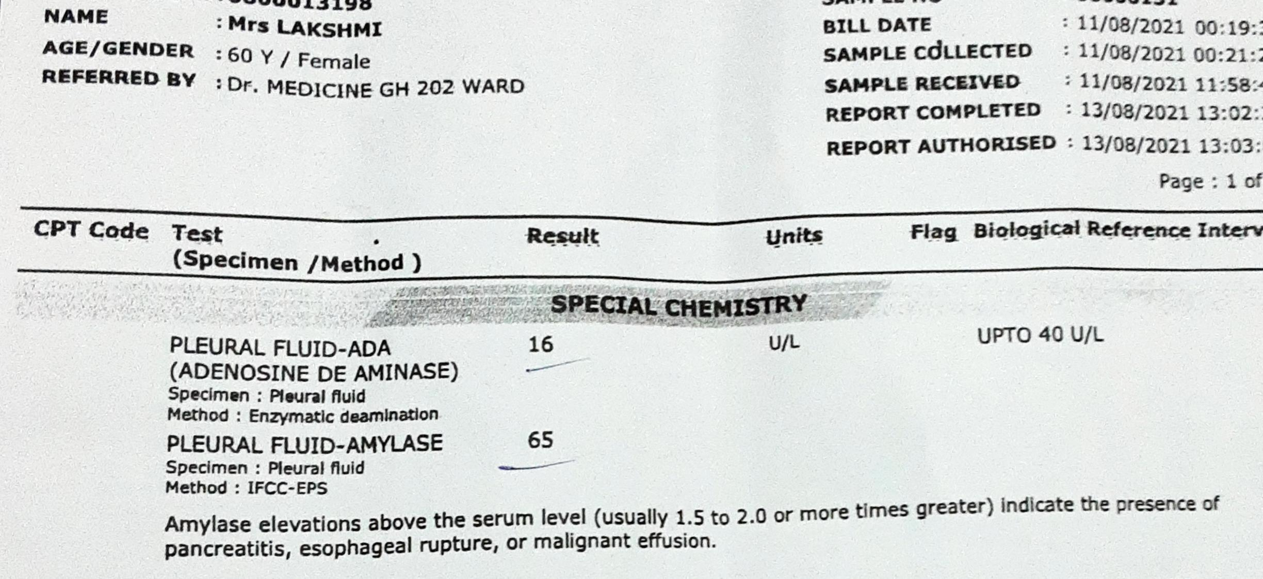
Sputum culture/ sensitivity: No growth
Sputum AFB: Negative

Slide 14
USG ABDOMEN and PELVIS: No significant pathology
ECHO: No RWMA, with EF: 60%
COVID RT-PCR: Negative
ANA: Negative

Slide 15
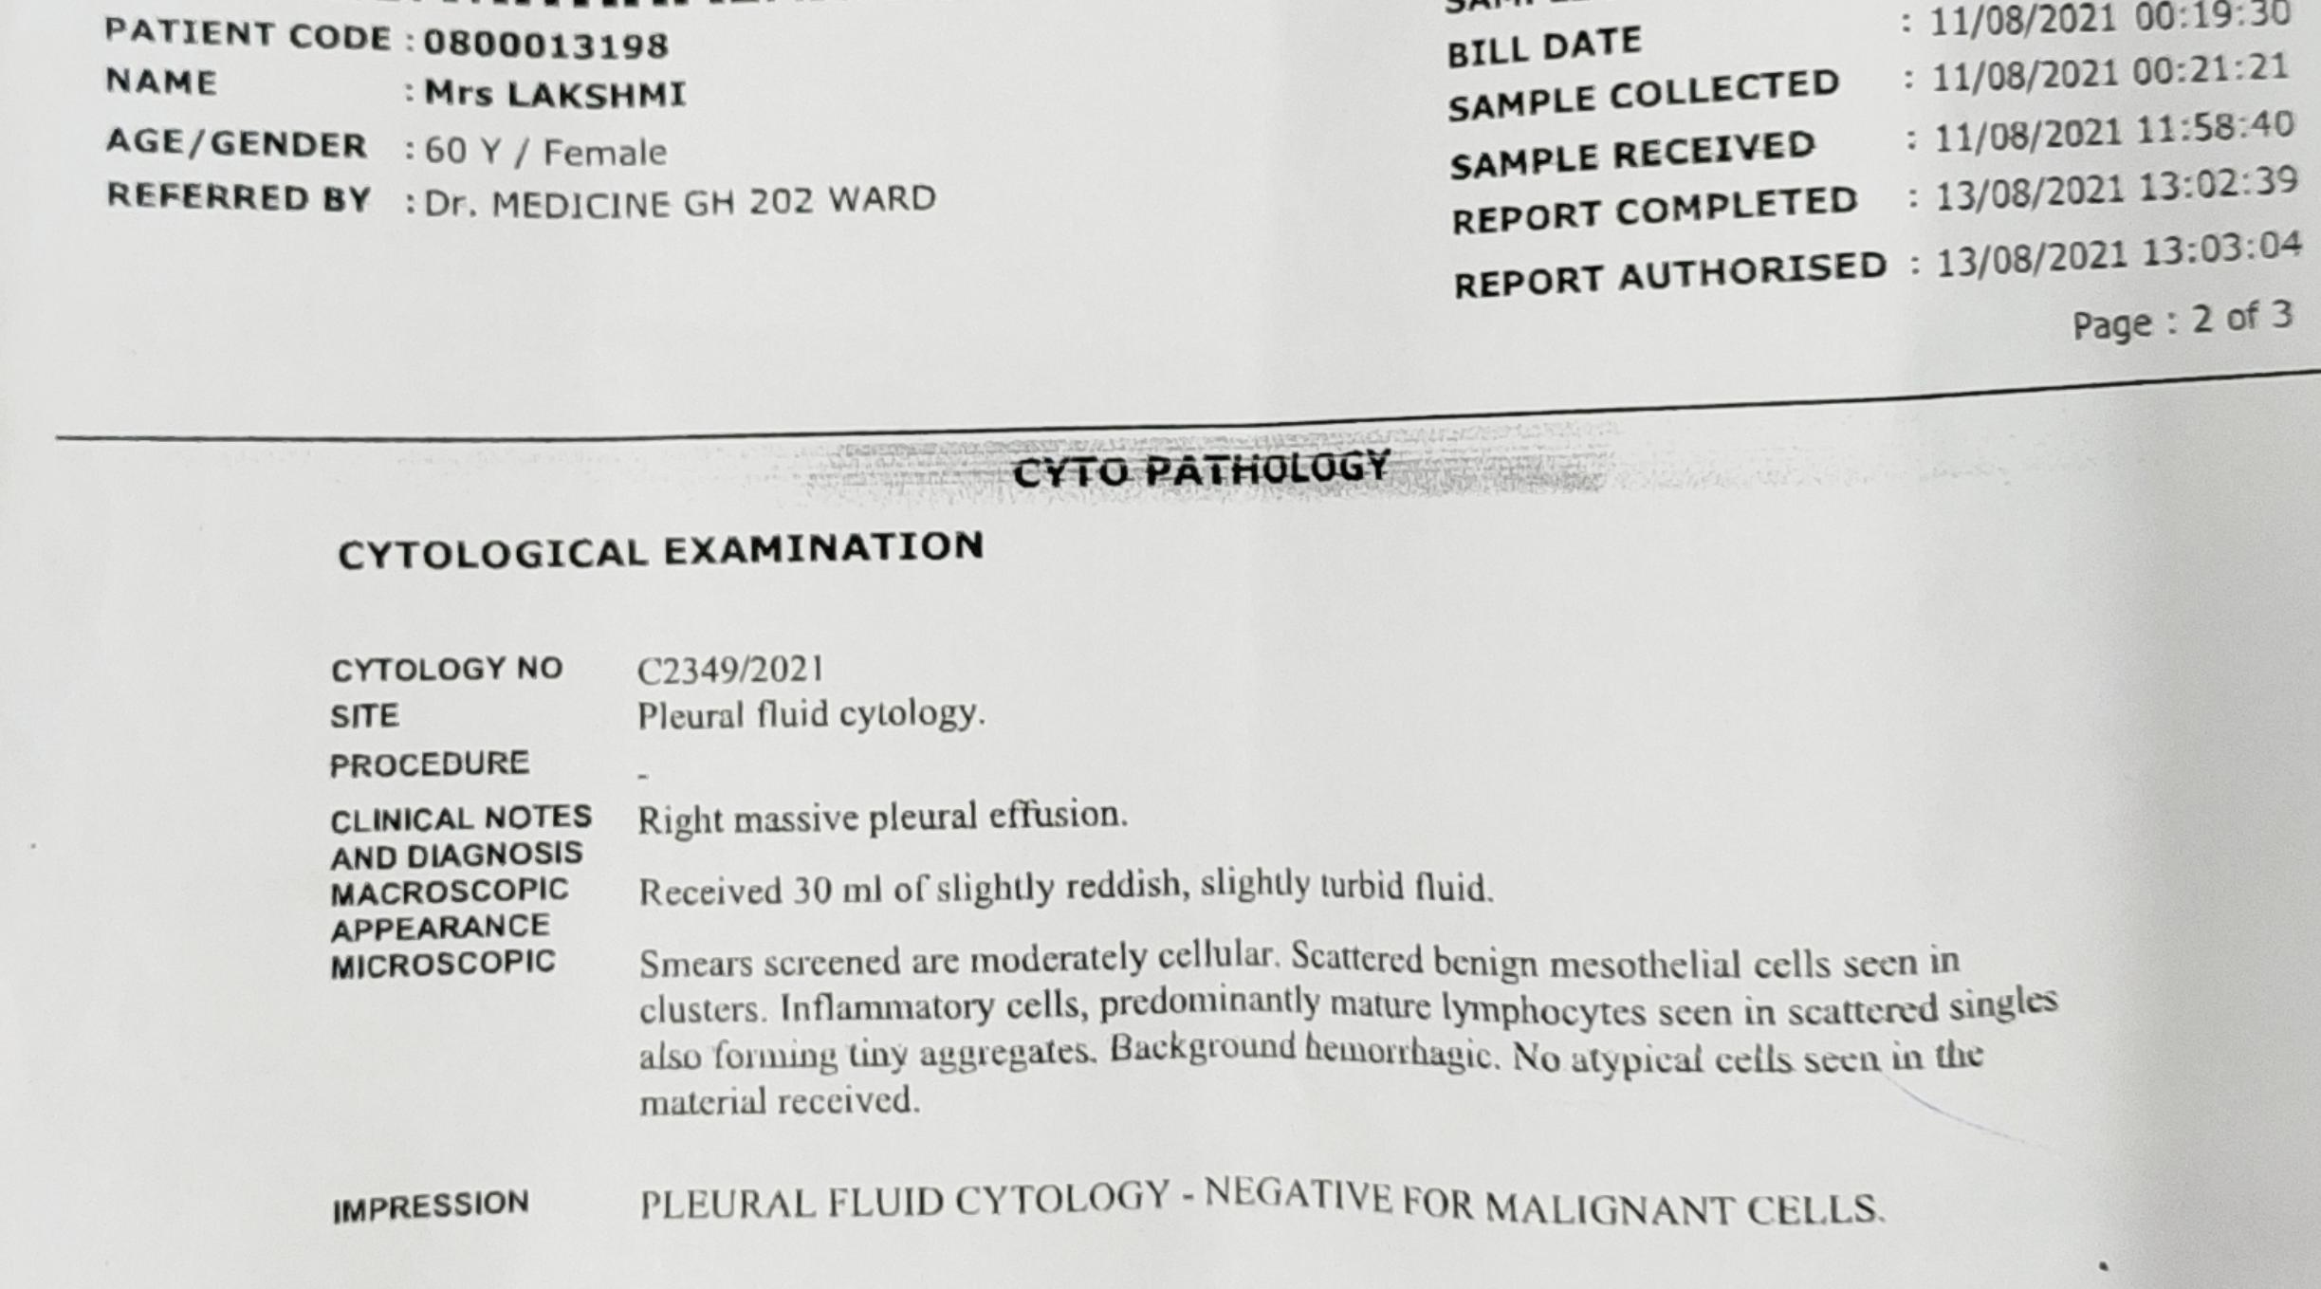
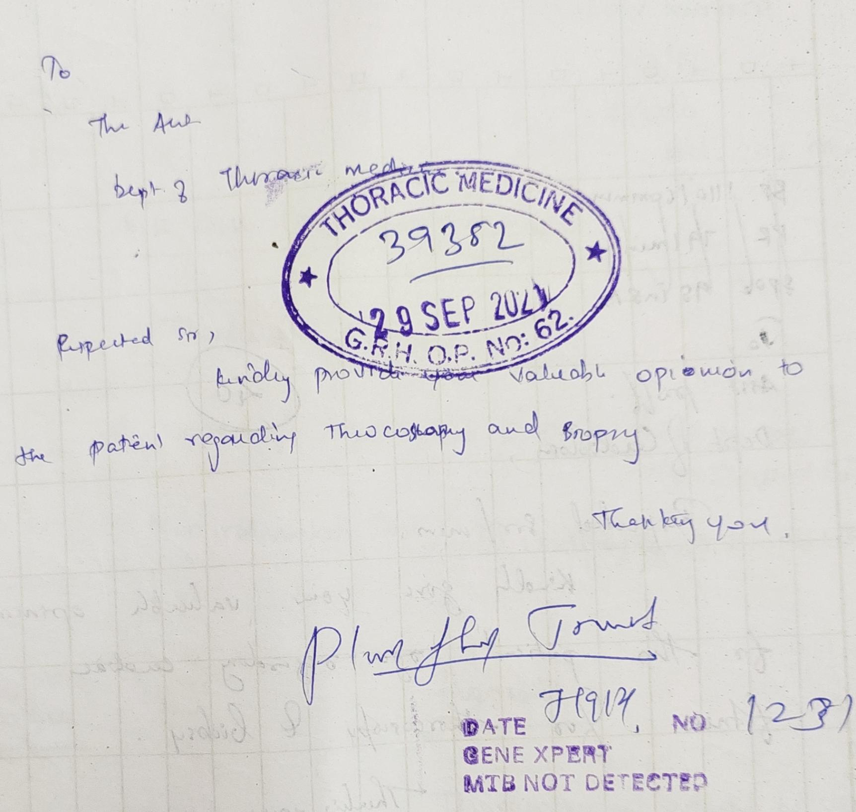
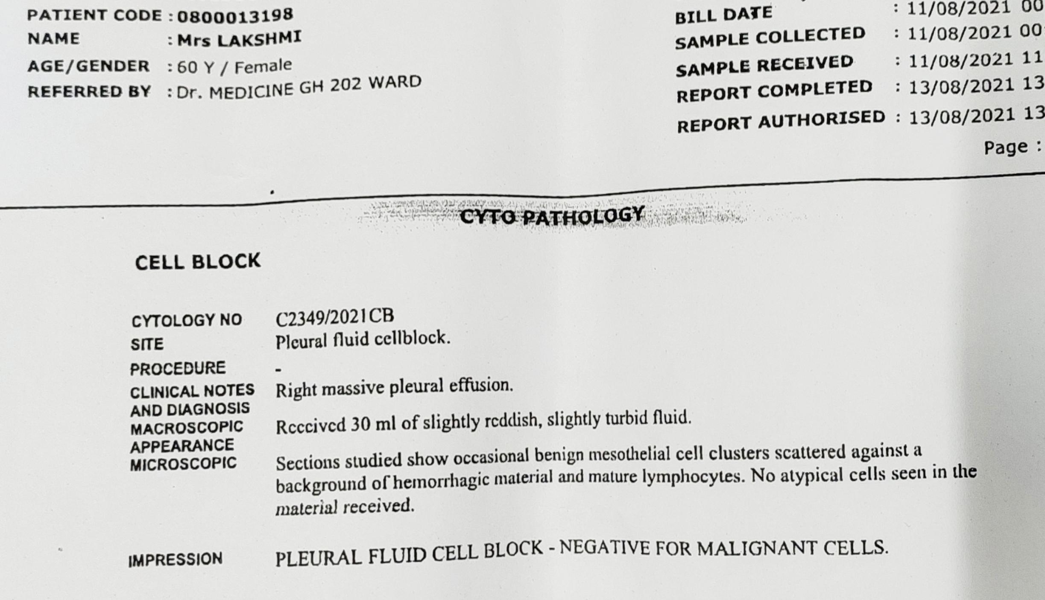
Box with disappointments

Slide 16
BRONCHOSCOPY

Slide 17
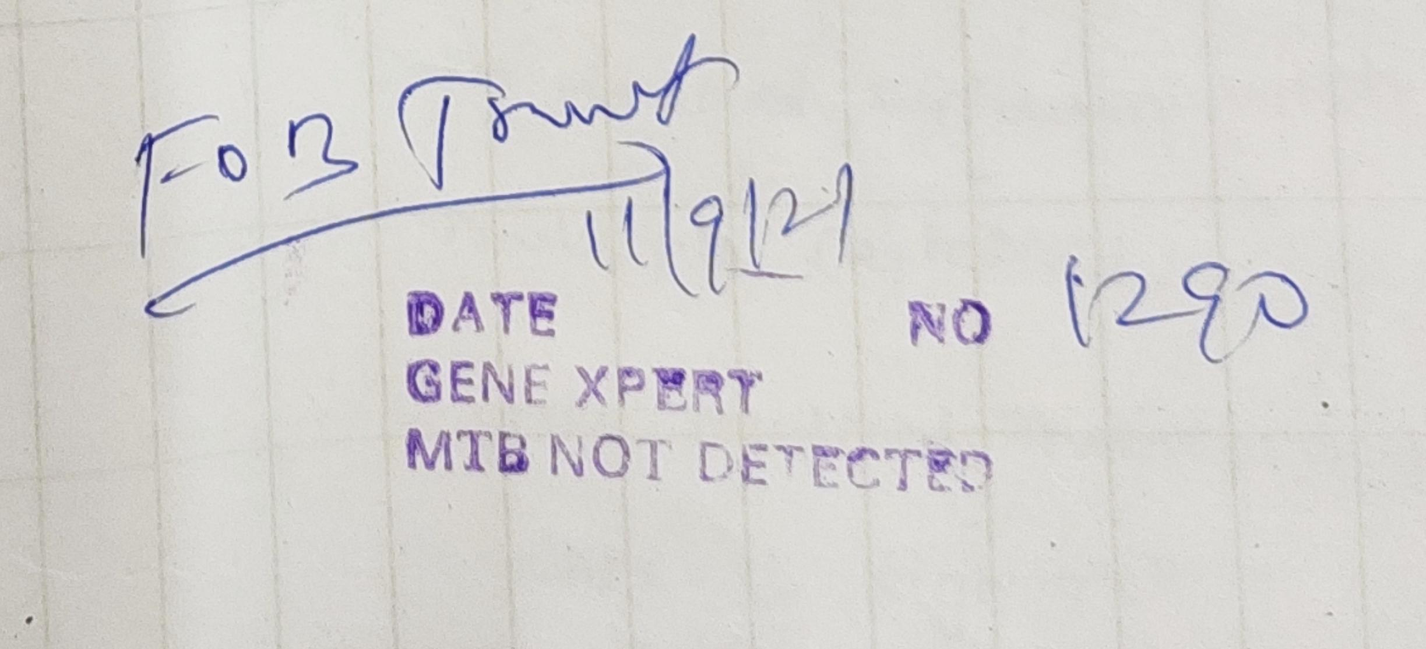

Slide 18
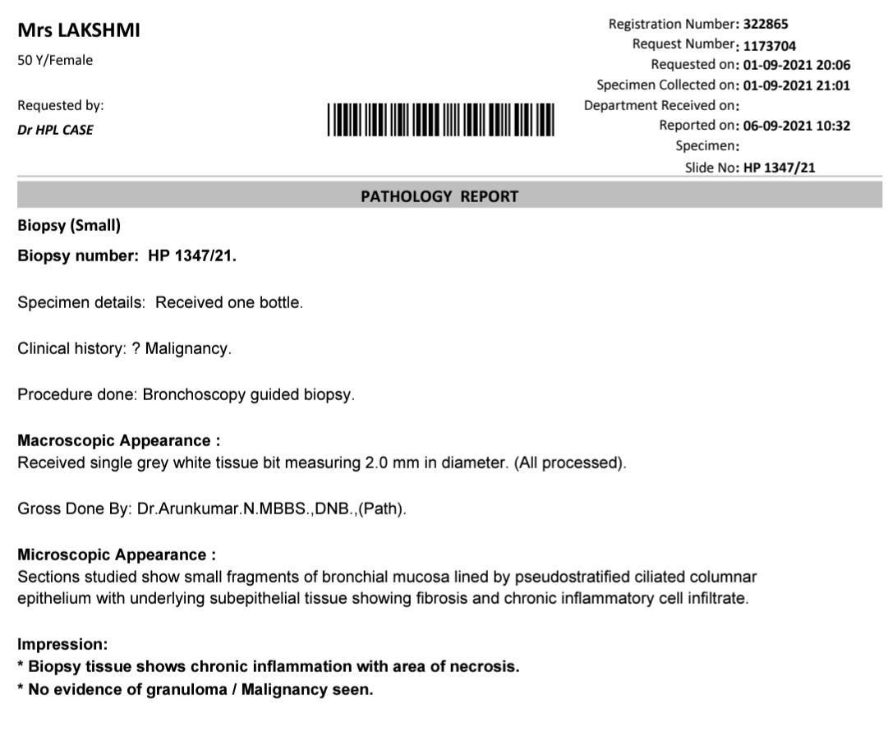

Slide 19
The end…
Right exudative massive pleural effusion
Cavity with consolidation in right lower lobe
Klebsiella pneumoniae in BAL culture sensitivity
BAL fluid and brush biopsy Negative for TB and malignancy

Slide 20
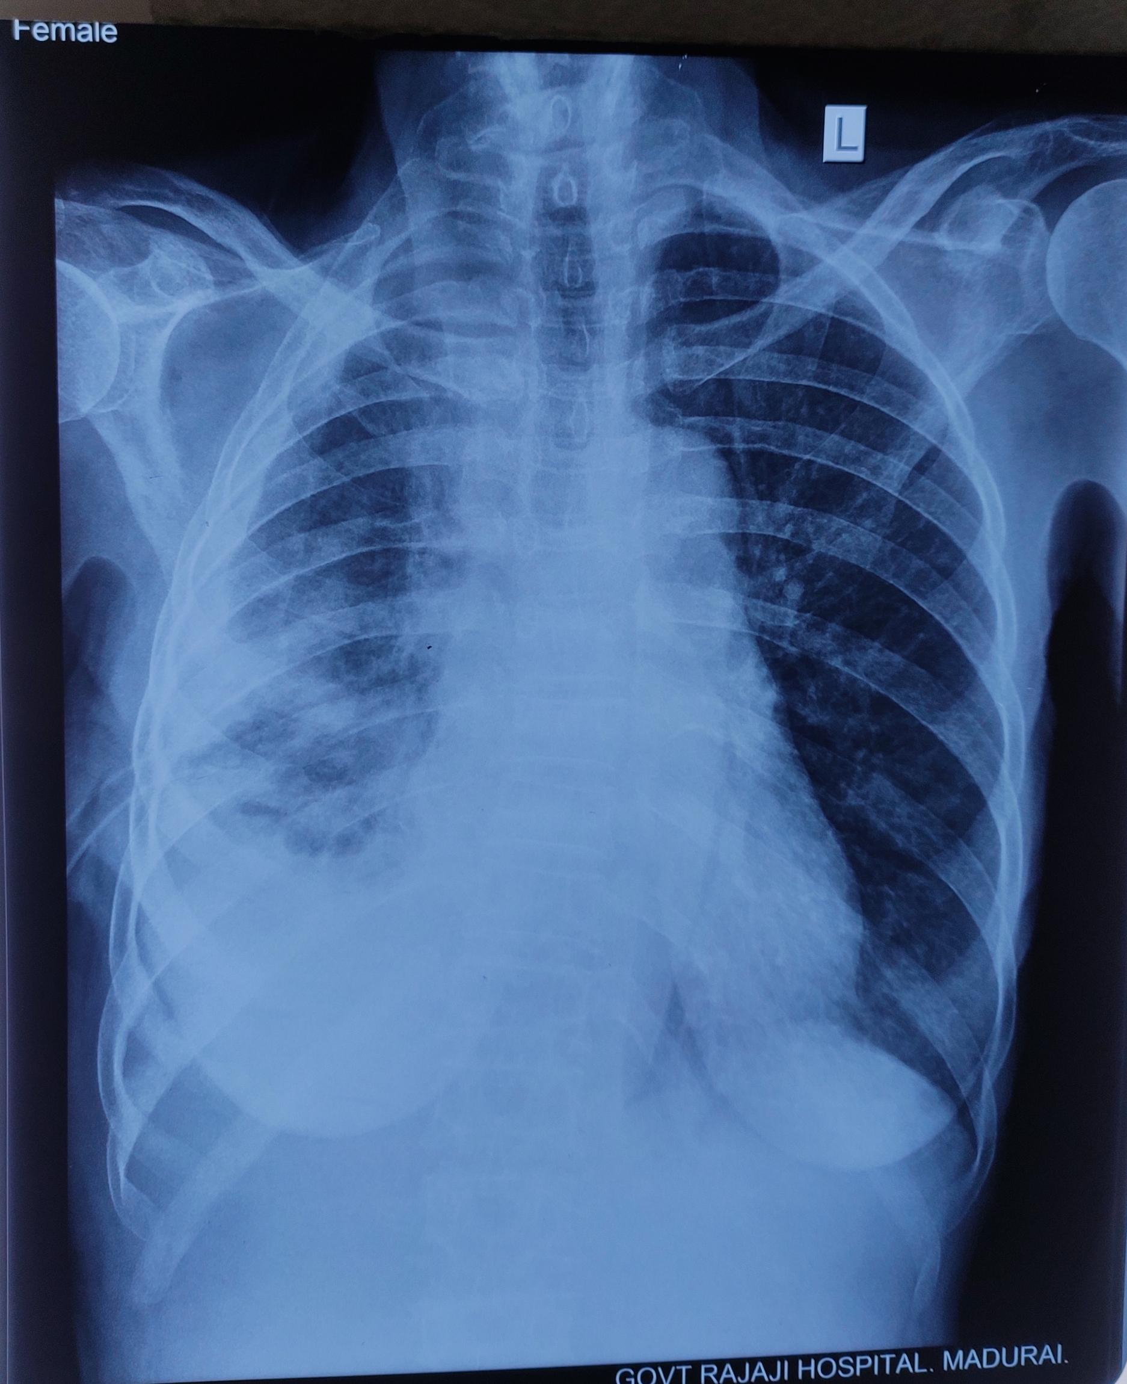
Finally patient treated with ciprofloxacin as it showed sensitivity to klebsiella
Patient improved clinically and discharged after ICD removal

Slide 21
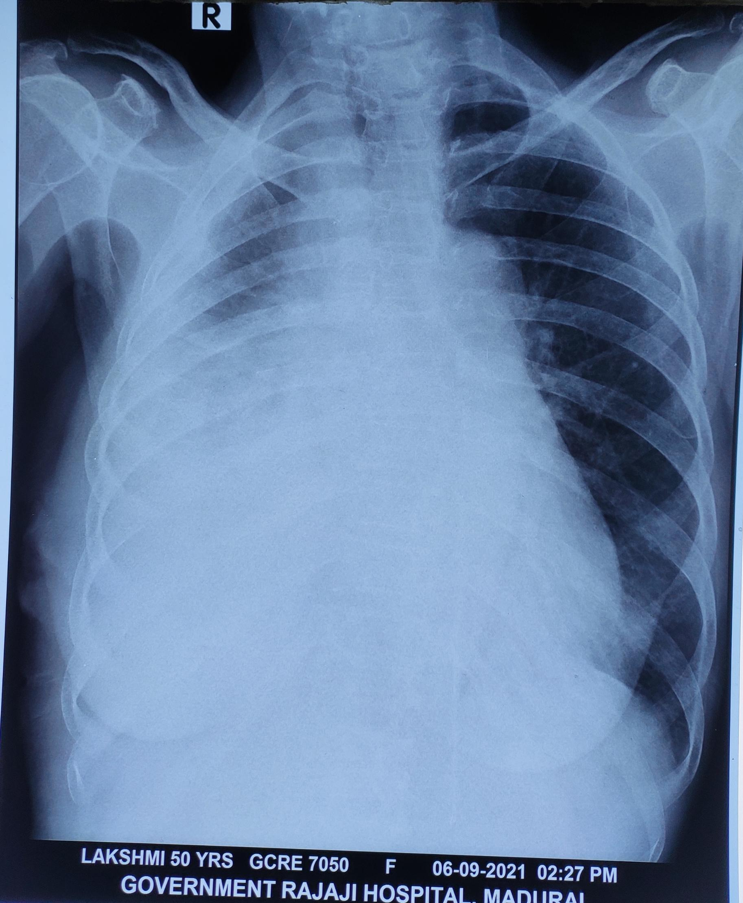
The endless story
After 4weeks of discharge again patient presented with moderate to massive pleural effusion

Slide 22
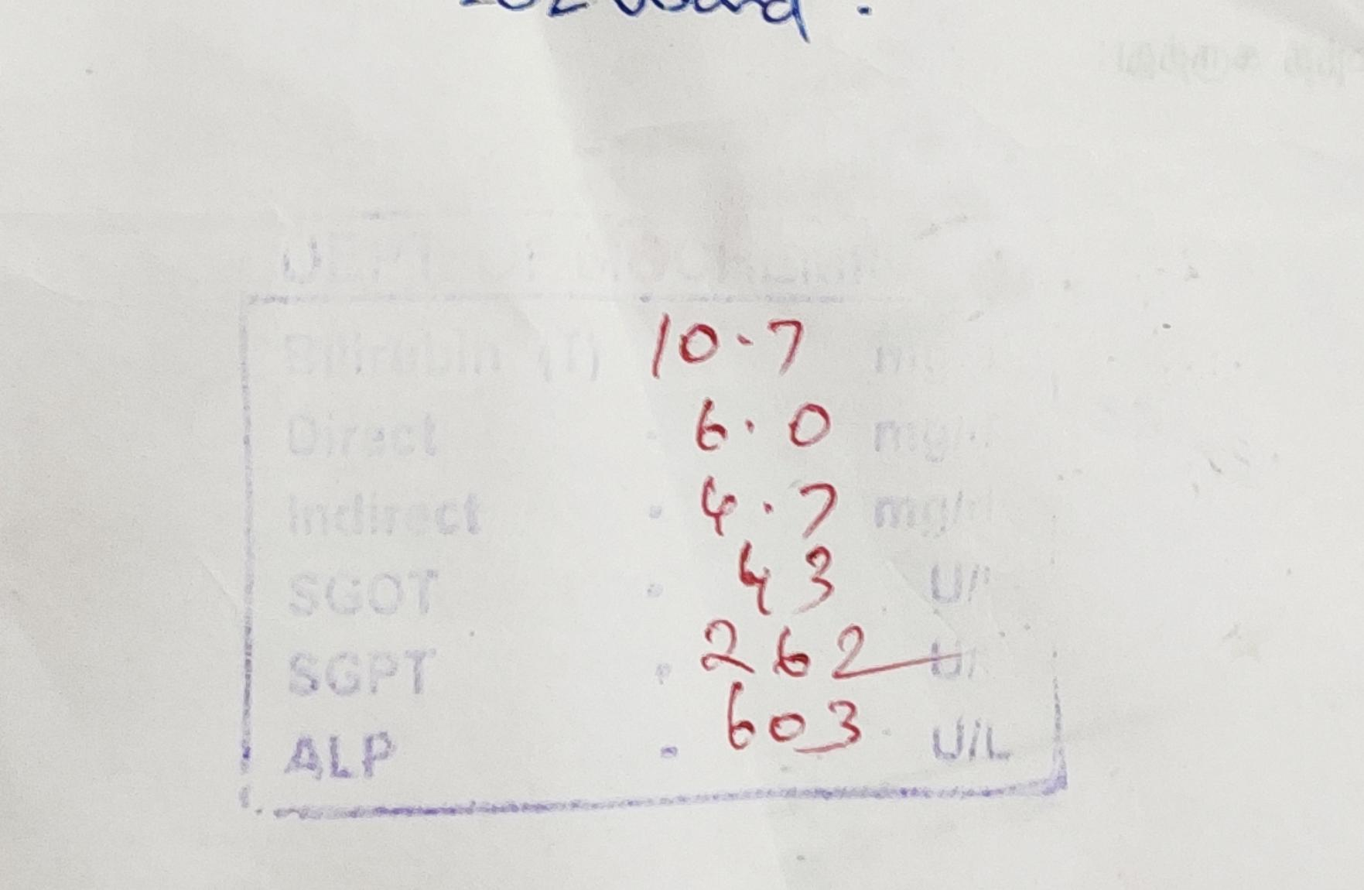
A new key for the box
This time patient had jaundice
And remaining investigations normal including USGabdomen

Slide 23
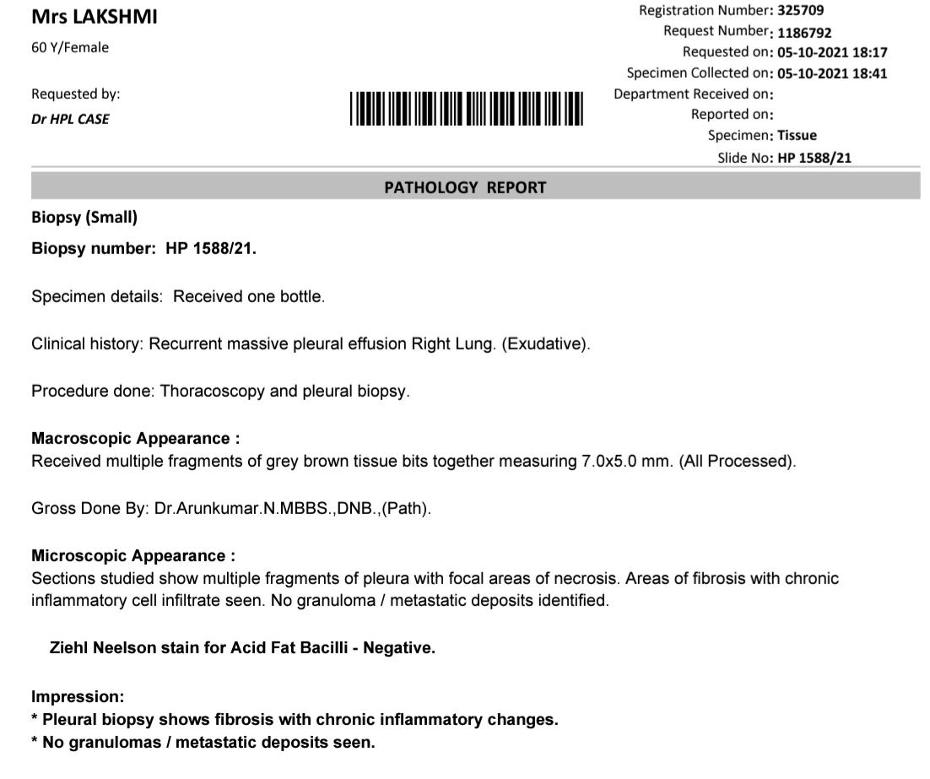
What left!!?
Patient taken for thoracoscopy and pleural biopsy Was done

Slide 24
Can you help me to proceed this??!!

