Slide 1
AN INTERESTING ECG
From: IIIrd Medical Unit
Chief Professor:
Dr. B. Palani Kumar, M.D.
Assistant Professors:
Dr. S. Ponsenthil Kumar, M.D.
Dr. M. Ilamaran, M.D.

Slide 2
CHIEF COMPLAINTS:
A 57-year-old female presented with spasm of left hand for 1 month
PRESENTING COMPLAINTS:
h/o spasm of left hand for 1 month
insidious in onset, progressive ass with tremors.
No h/o chest pain , palpitation
No h/o dyspnea
No h/o giddiness
No h/o abdominal pain

Slide 3
PAST HISTORY:
k/c/o CAD/ DCM/ Hfref 60%/ hypoparathyroidism
The patient was admitted one month ago and treated for hypocalcemia.
On discharge, she was advised calcium supplements and vitamin D,
but she had not been on treatment for the past 15 days.

Slide 4
ON EXAMINATION:
VITALS:
Patient GC fair
Afebrile
Hydration fair
No pallor/icterus/cyanosis/clubbing
Chovstek sign +ve
Trosseau sign +ve [left > right]
BP -100/70 mmHg
PR- 90/ min
Spo2- 100% RA
CVS- S1 S2+ no murmur
RS- B/L AE+ no added sounds
P/A- Soft, BS +
CNS- NFND

Slide 5
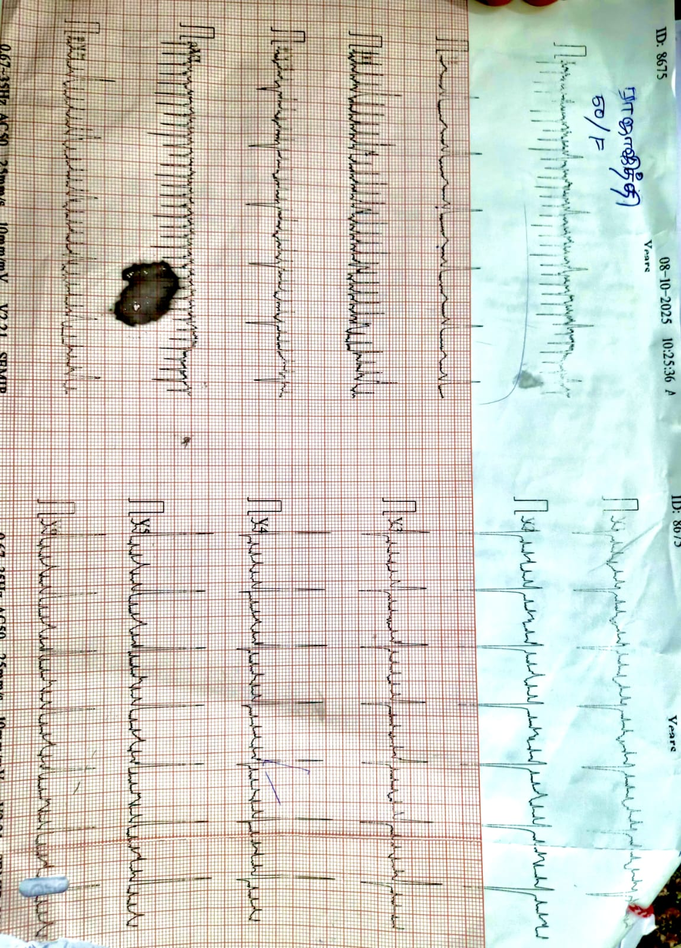
ECG

Slide 6
INVESTIGATIONS:
RFT:
Urea- 12 mg/dl
Creatinine – 0.9 mg/dl
Sr. sodium- 140 meq/l
Sr. potassium- 4.0 meq/l
LFT:
Total bil- 1.0 mg/dl
Direct bil- 0.5 mg/dl
Indirect bil – 0.5 mg/dl
ALP- 70 IU
Sr. calcium – 3.6 mg/dl
Sr. albumin – 3.5g/dl
Sr. magnesium – 1.1 mg/dl [low]
Sr. PTH – 6 pg/ml [low]
CBC:
WBC- 9000 cells/mm3
Hb- 12.0 g/dl
Plt- 3.00 lakh

Slide 7
Post shock ECG…

Slide 8
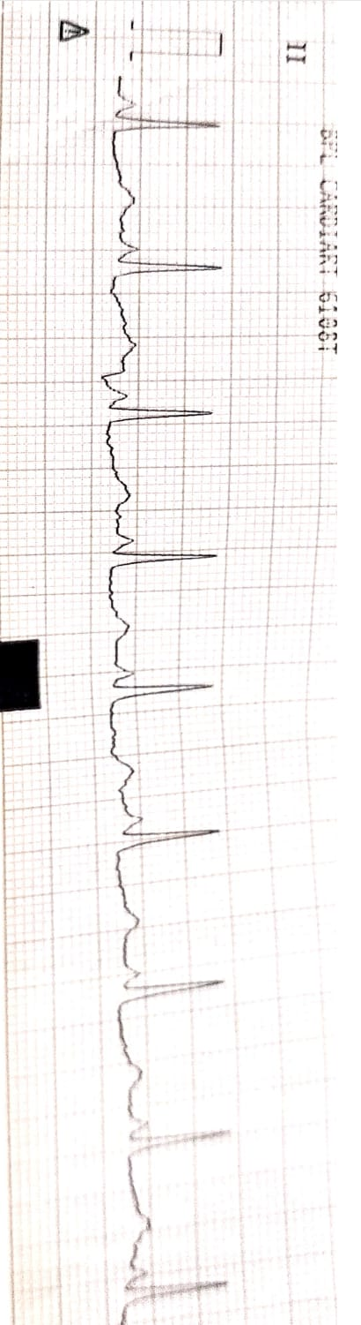
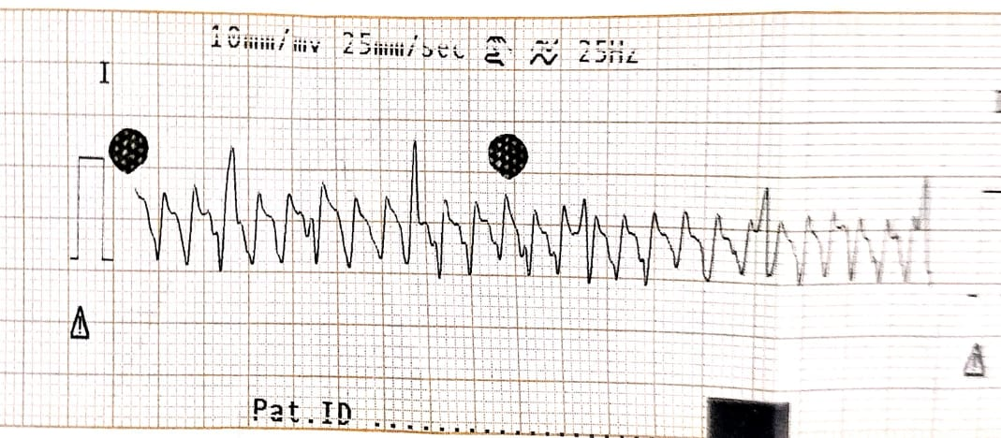
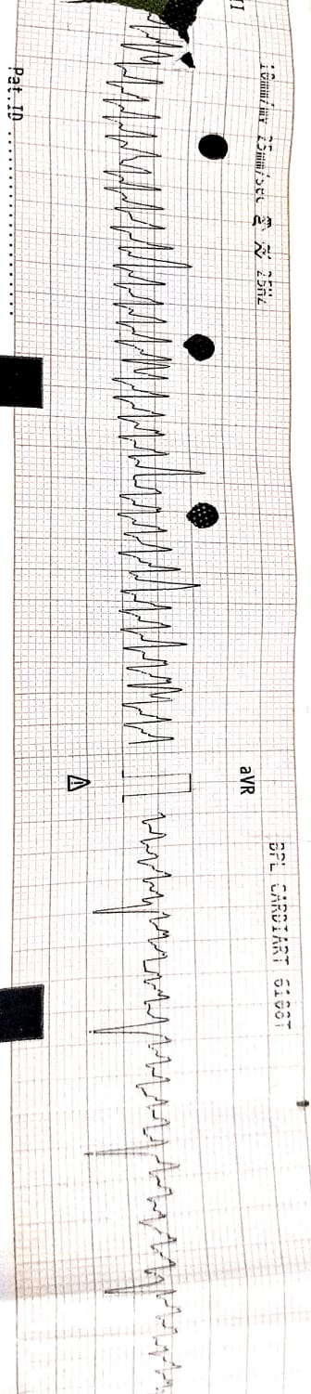
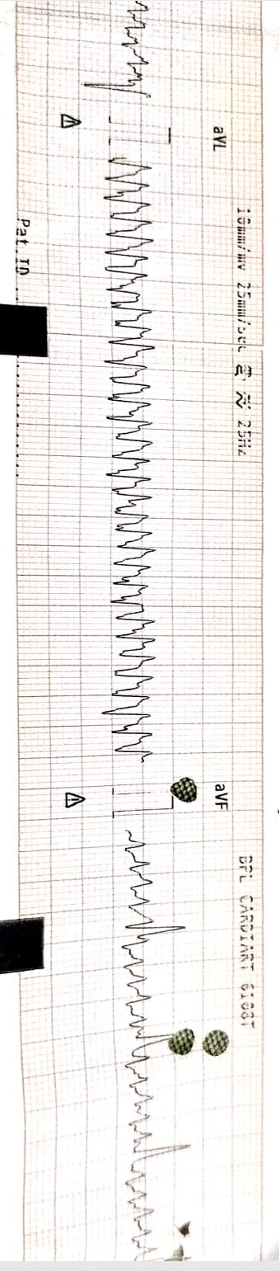

Slide 9
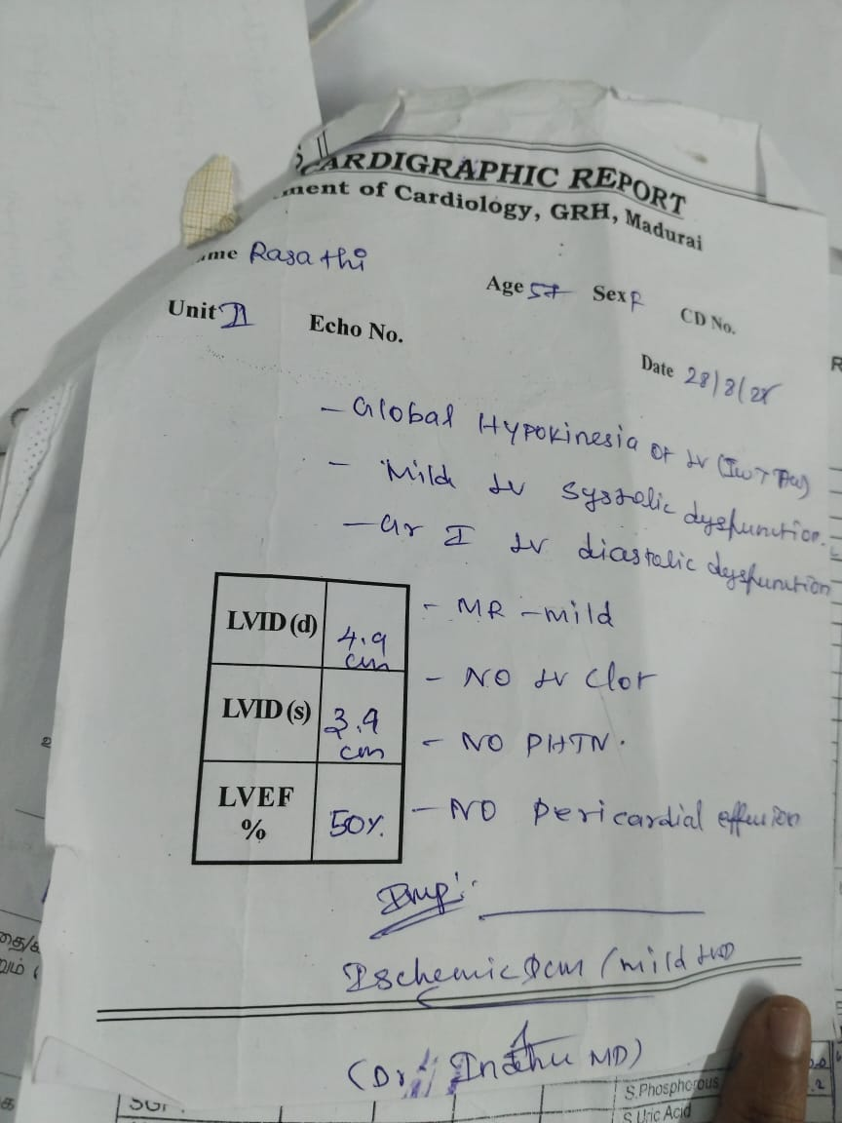
ECHO
EF- 50%
GLOBAL HYPOKINESIA OF LV
IMP : ISCHEMIC DCM
ENDOCRINOLOGIST OPINION
INJ.CALCIUM GLUCONATE AND MAGNESIUM SULPHATE
T. CALCITRIOL
T. VIT D AND CALCIUM LACTATE

Slide 10
3 DAYS LATER…

Slide 11
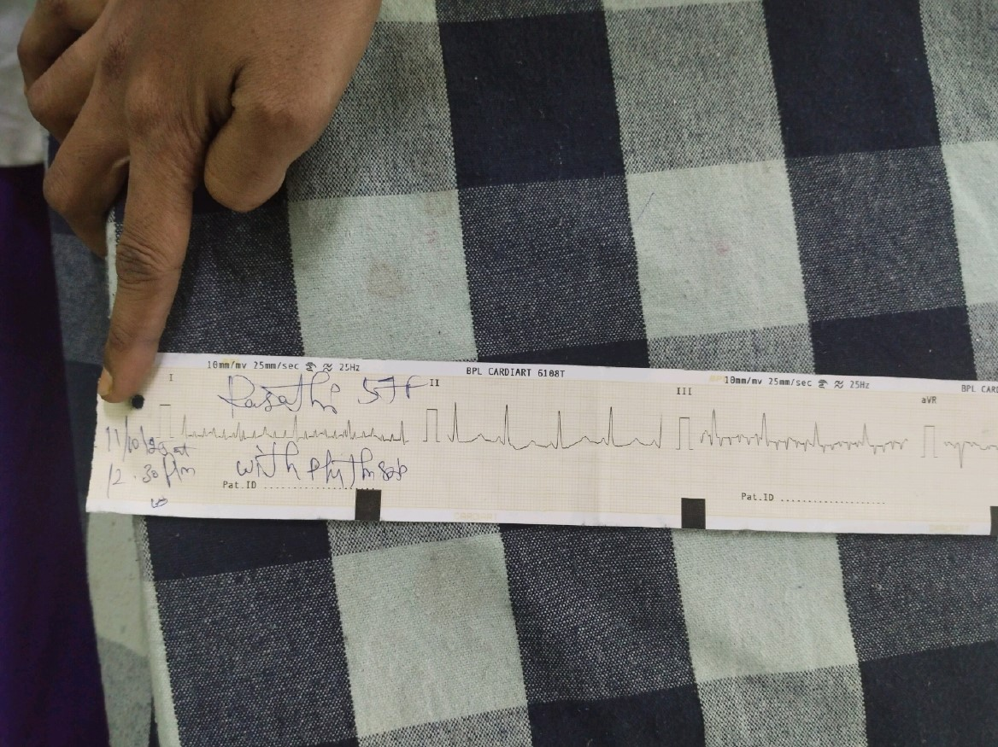
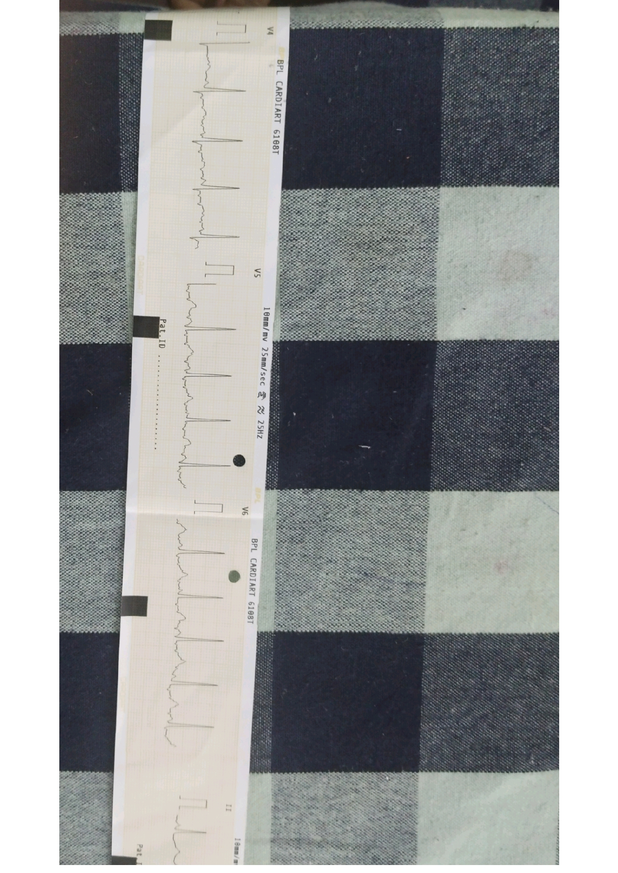
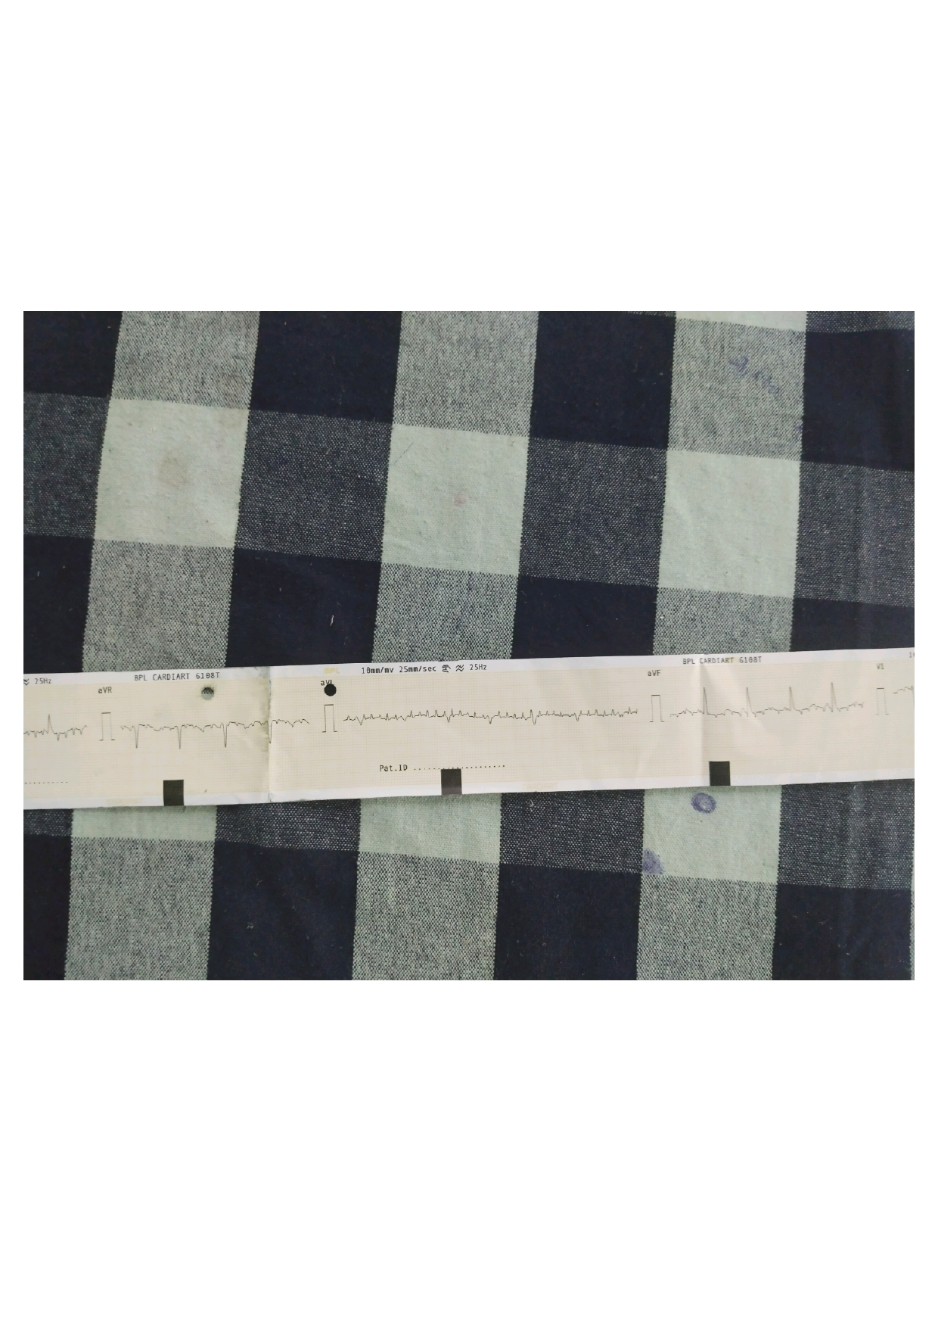
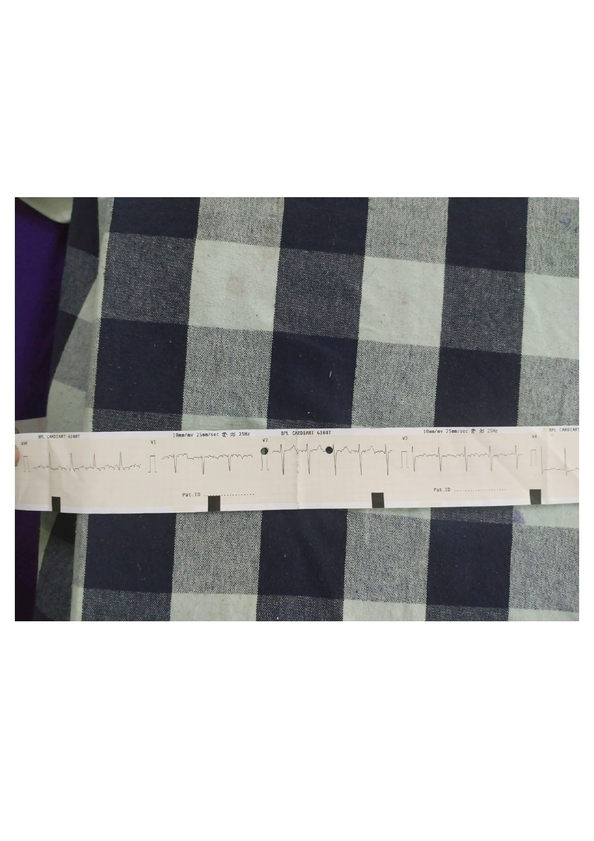

Slide 12
DISCUSSION…

Slide 13
ECG

