Slide 1
AN INTERESTING CASE OF TAKAYASU ARTERITIS
CHIEF:Dr.G.Bagialakshmi.MD ASST.PROF -Dr.N.Ragavan. MD
Dr.S.Krishnasamy Prasad .MD

Slide 2
CHIEF COMPLAINTS
43YEAR OLD MALE
Gradually progressive painless loss of vision both eyes- 30 days
Headache - 30 days

Slide 3
H/O:PRESENTING ILLNESS
H/O gradually progressive painless loss of vision both eyes
H/O Headache-B/L throbbing type, moderate intensity , persistent
No H/O fever
No H/O head injury/seizure/LOC
No H/O claudication of jaw

Slide 4
H/O:PRESENTING ILLNESS
No H/o vomiting/chest pain/dyspnea
No H/O joint pain/skin rashes/oral ulcer
No H/O urinary/ faecal incontinence
No h/o photophobia/ phonophobia
No h/o watering of eyes

Slide 5
H/O:PRESENTING ILLNESS
No h/o glare/halos
No h/o weakness of limbs
No h/o tremor /involuntary movements

Slide 6
PAST HISTORY
No H/o Diabetes/Hypertension/PTB/CAD

Slide 7
PERSONAL HISTORY
Mixed diet
Smoker
Non alcoholic
Bladder/bowel habits normal

Slide 8
TREATMENT HISTORY
He was on treatment outside in a private hospital for the same complaints the records of which were not available.

Slide 9
GENERAL EXAMINATION
Pt conscious ,oriented
No Pallor ,
Clubbing[+]
No icterus, no cyanosis
No generalized lymphadenopathy
No pedal edema
No skin Rashes
No neurocutaneous markers

Slide 10
VITALS
Pulse-84/minute in rt dorsalis pedis
BP220/110mm of Hg in rt lower limb
SpO2-96% with room air
Respiratory rate
16/min

Slide 11
PERIPHERAL PULSES
PERIPHERAL PULSES | RIGHT | LEFT
CAROTID | ABSENT | ABSENT
AXILLARY | ABSENT | ABSENT
BRACHIAL | ABSENT | ABSENT
RADIAL | ABSENT | ABSENT
ULNAR | ABSENT | ABSENT
FEMORAL | PRESENT | PRESENT
POPLITEAL | PRESENT | PRESENT
ANT TIBIAL | PRESENT | PRESENT
POST TIBIAL | PRESENT | PRESENT
DORSALIS PEDIS | PRESENT | PRESENT

Slide 12
Not recordable
Not recordable
220/110mmhg
220/100mmhg
BP

Slide 13
SYSTEMIC EXAMINATION
CARDIO VASCULAR SYSTEM
JVP not elevated
S1, S2 +
No murmur
Left Subclavian bruit +
RESPIRATORY SYSTEM
Normal vesicular breath sounds heard bilaterally
No added

Slide 14
SYSTEMIC EXAMINATION CONTD.
GASTROINTENSTINAL SYSTM
P/A soft,
No organomegaly,
B/L Renal artery Bruit +

Slide 15
SYSTEMIC EXAMINATION CONTD.
CNS
Conscious, oriented
Speech -normal
Cranial nerve examination -normal except for 2nd cranial nerve

Slide 16
2nd cranial nerve examination:-
Rt Eye – Perception of light
Lt Eye - 6/60
Field of vision -decreased in both eyes
Fundus examination:-
Rt eye – Hyperemic disc,
- Panretinal photocoagulation marks
Lt eye – Hyperemic disc, suprficial hemorrhage and dot blot hemorrhage

Slide 17
PARAMETER | RIGHT | LEFT
BULK | NORMAL | NORMAL
TONE UPPER LIMB LOWER LIMB | NORMAL NORMAL | NORMAL NORMAL
POWER UPPER LIMB LOWER LIMB | 5/5 5/5 | 5/5 5/5
DTR | + | +
PLANTAR | FLEXOR | FLEXOR

Slide 18
Systemic examination CNS cont:
No cerebellar signs
No signs of meningeal irritation
Sensory system -normal

Slide 19
PROVISIONAL DIAGNOSIS
SHT
Sub Acute painless loss of vision for Evaluation
? Vasculitis- ?Takayasu arteritis
? Renal Artery stenosis

Slide 20
INVESTIGATIONS
HB-15.2g%
TC
9400cells/cumm
DC
P-56 L-30 E-4 M-4
ESR-30mm/hr

Slide 21
INVESTIGATIONS
RBS -113mg%
BLOOD UREA- 59mg%
S.CREATININE -3.3mg%

Slide 22
ELECTROLYTES
SODIUM-136 MEq/L
POTASSIUM-3.9 MEq/L
CALCIUM -10.2 mg%

Slide 23
URINE R/E
Sugar-nil
Albumin-loaded
Deposits-1-2 pus cells

Slide 24
Urine PCR -2.5
24 hr urinary protein – 760 mg %

Slide 25
RENAL PARAMETERS
DATE | 18/02/2016 | 19/02/2016 | 22/02/2016 | 24/02/2016 | 27/02/2016 | 02/03/2016 | 07/03/2016 | 15/03/2016 | 02/04/2016
BLOOD- UREA | 57mg | 96mg | 101mg | 76mg | 40mg | 41mg | 43mg | 46mg | 22mg
Sr CREATININE | 3.3mg | 4.8mg | 4.4mg | 3.3mg | 3.3mg | 2.7mg | 2mg | 2.2mg | 1.9

Slide 26
LFT
Bilirubin (T)-0.6mg/dL
D.Bilirubin-0.3mg/dl
I.Bilirubin-0.3 mg/dl
S.Albumin 3.5g/dl
S.globulin-3.0g/dl
S.proteins-6.5g/dl

Slide 27
ECG -WNL
ECHO:CONCENTRIC LVH , LVEF-68%

Slide 28
VIRAL MARKERS
HBsAg -NEGATIVE
HCV -NEGATIVE
RAPID CARD TEST FOR HIV 1&2 –NON REACTIVE

Slide 29
USG ABDOMEN& PELVIS
Right Kidney -7.1 * 3cm
Left Kidney -7.0* 3.2cm
cortical echoes increased
-FATTY LIVER

Slide 30
Renal Artery Doppler
B/L Renal Artery Stenosis

Slide 31
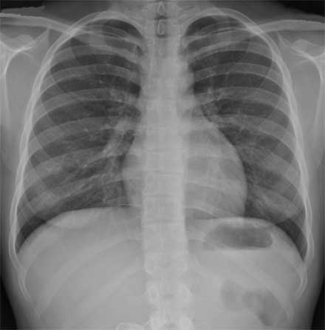
CHEST XRAY-NORMAL
MANTOUX TEST-negative

Slide 32
CT ABDOMEN
LEFT KIDNEY -6.3x3.7cms
RIGHT KIDNEY -6.5x4.3cms
ABDOMINAL AORTA shows reduction in caliber below the Renal Artery level

Slide 33
After Investigations..
SHT
B/L RENAL ARTERY STENOSIS
CKD
SUBACUTE PAINLESS LOSS OF VISION-
? VASCULITIS-TAKAYASU ARTERITIS

Slide 34
Ophthalmology opinion
INITIAL OPHTHALMOLOGY EVALUATION
Vision & Fundus findings were confirmed
And was asked to review for further evaluation.
Provisional diagnosis of B/L retinal vasculitis was made

Slide 35
Ophthalmology opinion contd
During the course patient developed pain &
Congestion in both eyes.
In Review ophthalmology evaluation GONIOSCOPY & tonometry was done and glaucoma was ruled out.
Fundus fluorescein angiography was suggested after getting nephro opinion

Slide 36
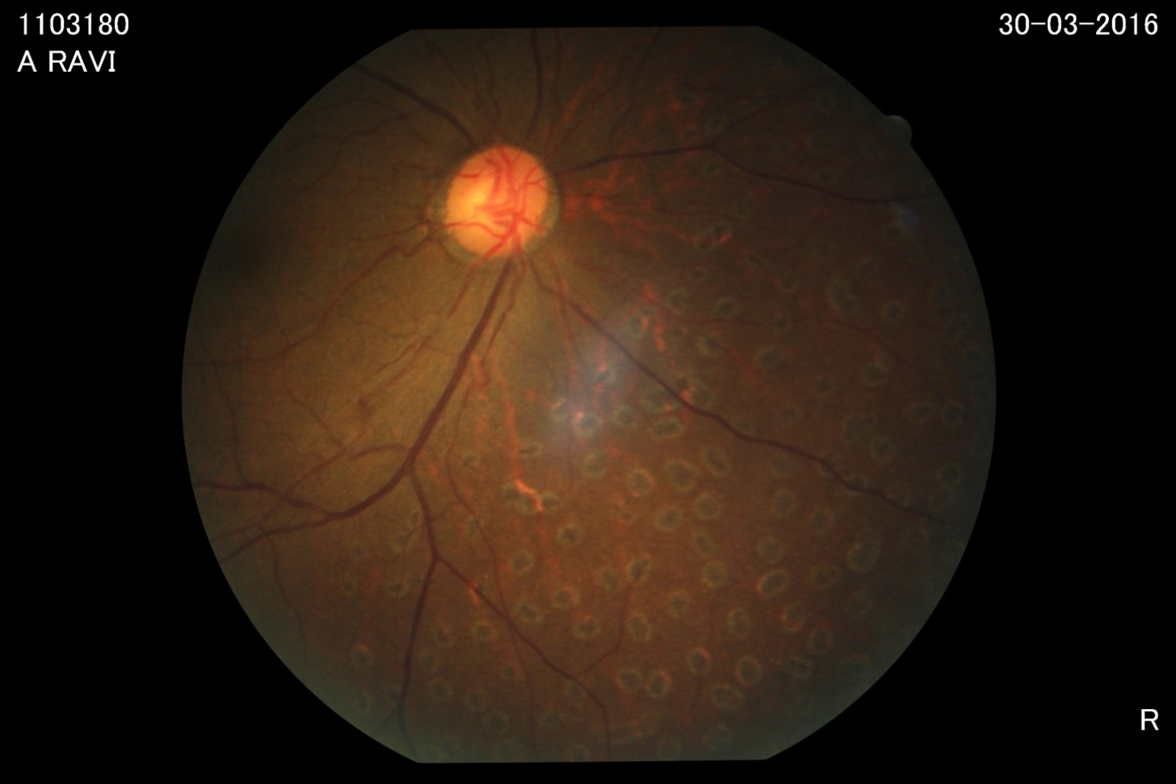
Right eye

Slide 37
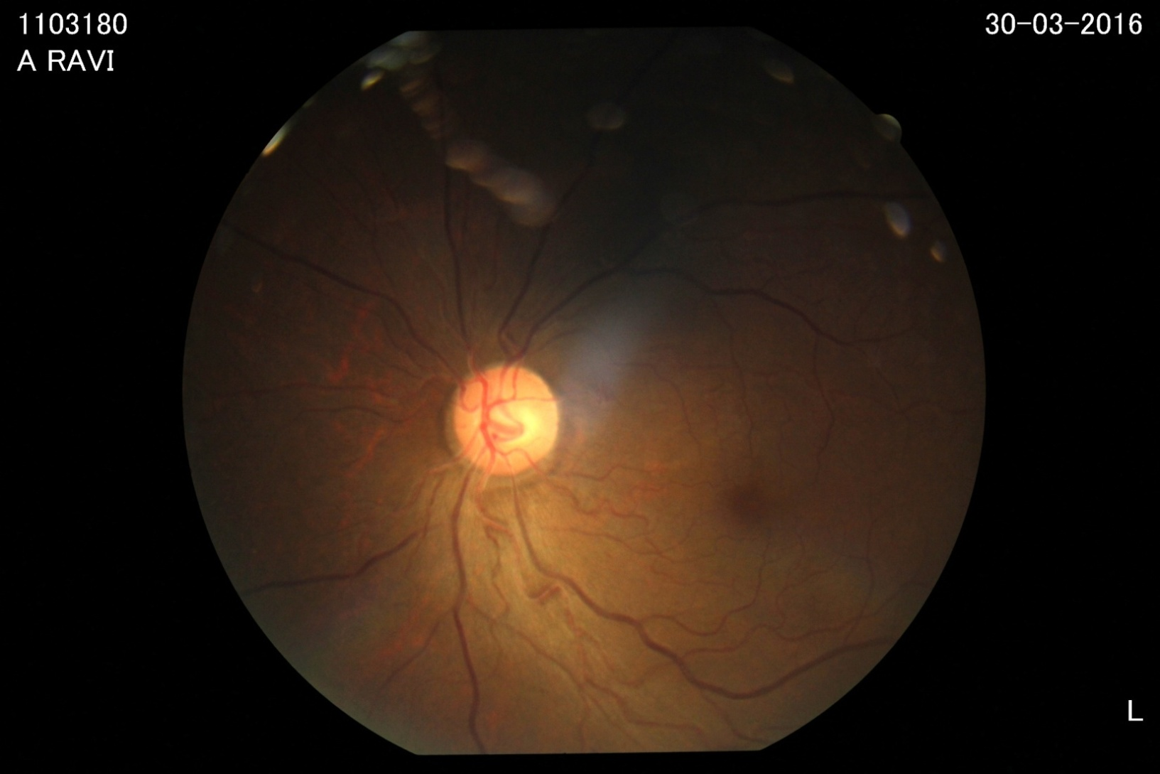
Left eye

Slide 38
Nephrology opinion
To do FFA under medical risk
DTP scan
Serial RFT
Vascular opinion

Slide 39
Vascular opinion
CT Angiogram- arch of aorta, both upper limb and vessels of neck with intra cerebral artery angiogram
Rheumatology opinion
ESR and CRP
INJ. Heparin 5000u sc bd
X ray neck AP and lateral
were suggested

Slide 40
Rheumatology opinion
Systemic hypertension
Defective vision
Pulseless disease

Slide 41
contd
CT Angiography – aorta and its branches
CRP and ASO titer
Lipid profile
Nephrology opinion
T. Mycophenolate mofetil 500 mg BD
T. prednisolone 5mg 10 OD

Slide 42
RHEUMATOLOGICAL PROFILE
ANA -NEGATIVE
CRP -NEGATIVE
RHEUMATOID FACTOR-NEGATIVE

Slide 43
During the course…
During the hospital stay patient had a fluctuating clinical course
He developed mild difficulty in walking
On Examination:-
Higher Mental Functions -Normal
Visual acuity decreased
Other cranial nerves normal

Slide 44
PARAMETER | RIGHT | LEFT
BULK | NORMAL | NORMAL
TONE UPPER LIMB LOWER LIMB | INCREASED INCREASED | INCREASED INCREASED
POWER UPPER LIMB LOWER LIMB | 4/5 4/5 | 4/5 4/5
DTR | ++ | ++
PLANTAR | EXTENSOR | EXTENSOR

Slide 45
Sensory system normal
No cerebellar signs
No meningeal signs

Slide 46
Neurology opinion
Retinal vasculitis
Takayasu arteritis
Renal artery stenosis
Renal failure
Quadriparesis non compressive type

Slide 47
contd
Steroids
Mantoux test
Complete hemogram
ESR
MRI C spine with brain screening

Slide 48
Rheumatology Review.
MRI spine with screening of brain
Inj. Methyl Prednisolone 1g iv OD *3 days
To continue MMF

Slide 49
MRI brain and neck / aorta
Multiple chronic infarcts involving both MCA and ACA , both MCA –PCA water shed areas
No evidence of hemorrhage or SOL or midline shift
Possiblity of vasculitis:
( TAKAYASU ARTERITIS )with involvement of arch, Right innominate artery and Left Subclavian artery with significant involvement of Left CCA, ICA ,MCA, Right Renal artery and moderate Left Renal Artery.

Slide 50
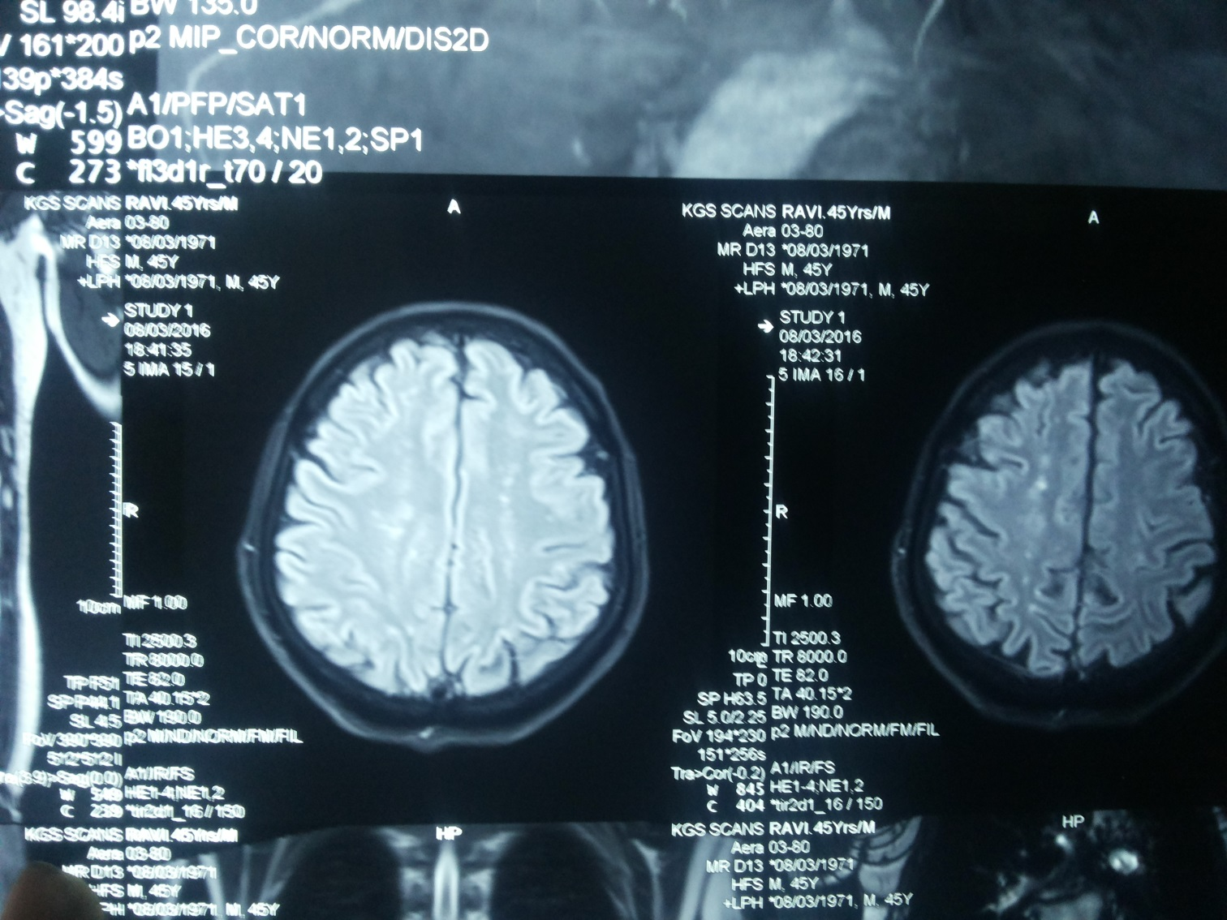

Slide 51
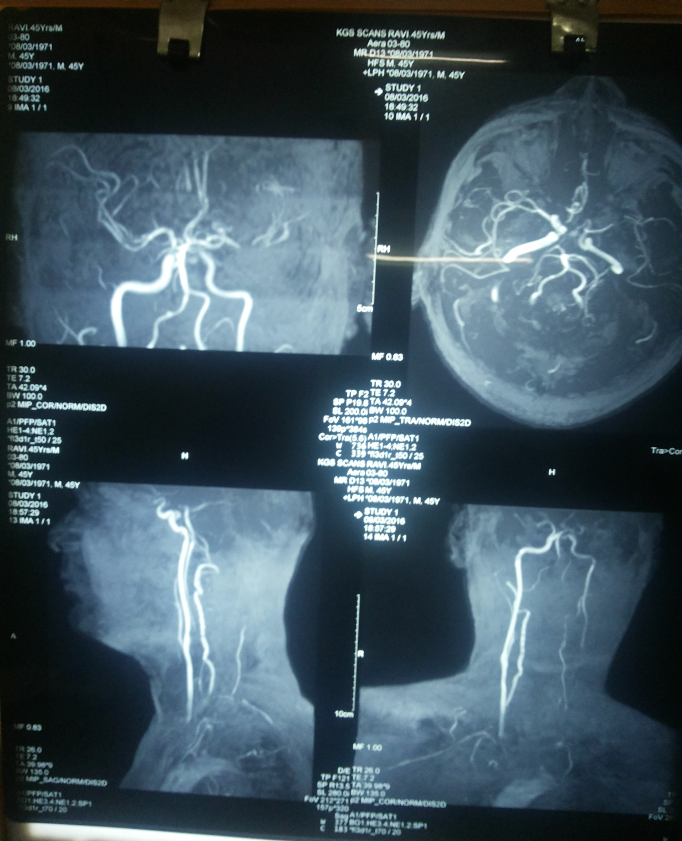

Slide 52
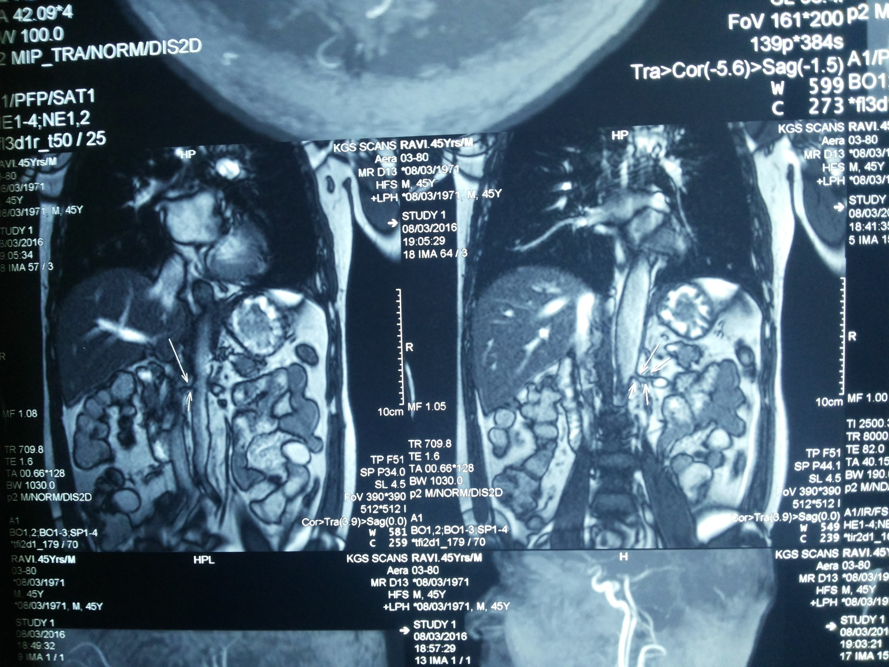

Slide 53
MRI CERVICAL SPINE
E/O annular disc bulge with indendation of anterior thecal sac noticed at c3-c4 & c4-c5 causing B/L neural foramen narrowing with exiting nerve root compression
IMP:-DEGENERATIVE DISC DISEASE

Slide 54
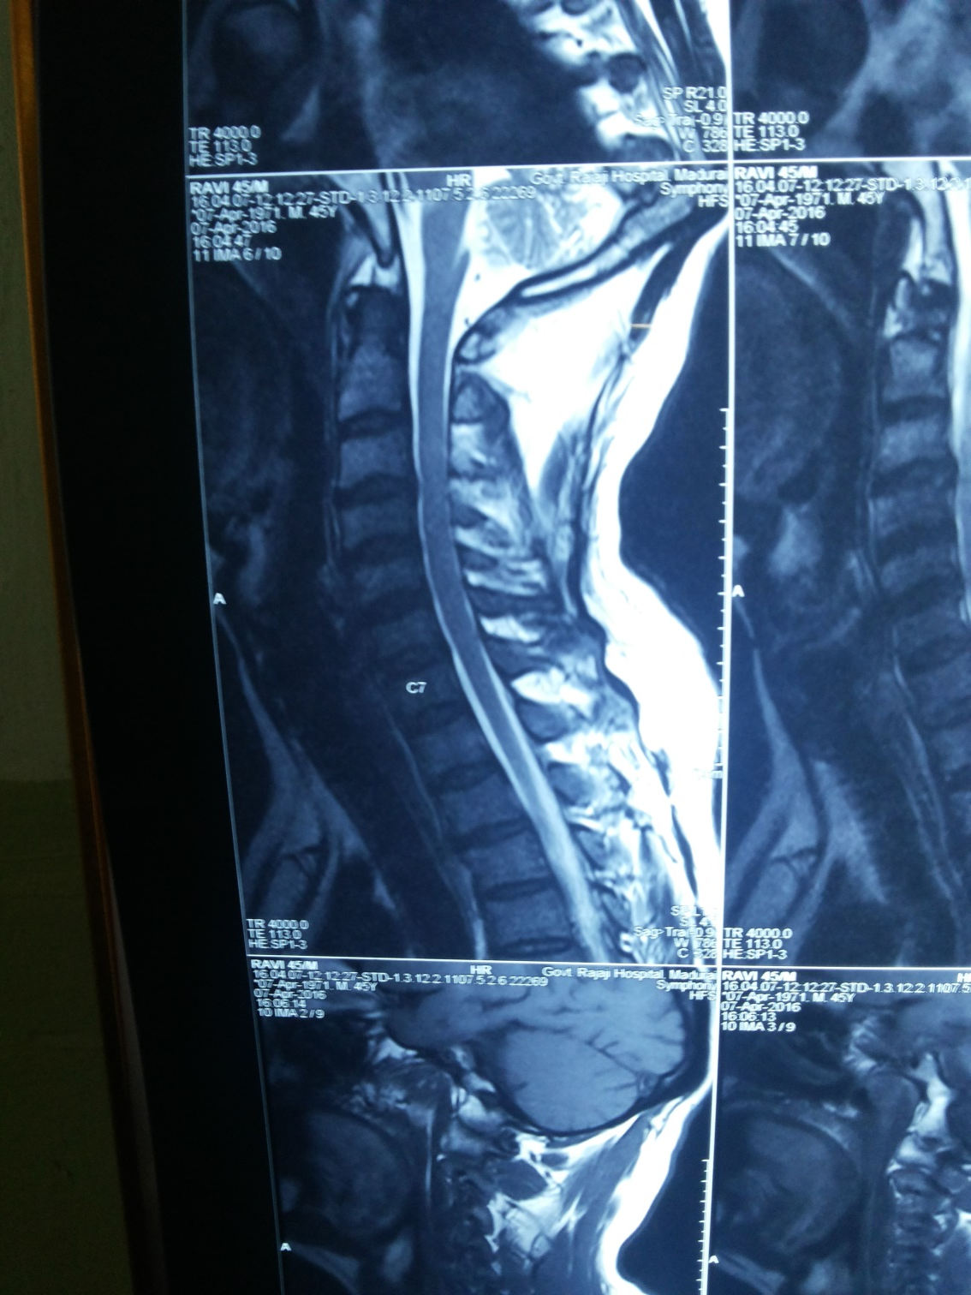

Slide 55
Fundus Fluorescein Angiography was done
Ophthalmology review obtained
DIAGNOSIS: B/L RETINAL VASCULITIS
Suggested:-
Nil ophtalmology intervention at present
Review after 2 months

Slide 56
Fundus fluorescein angiography
RE: delayed venous filling , multiple MA[+]superiorly, anomalous VASCULAR LOOP[+]in superotemporal branch artery, areas of capillary non perfusion[+] superiorly PRP marks[+]in nasal quadrent superotemporal artery sclerosed
LE: Dilated tortuous vessels[+]
IMP:B/L RETINAL VASCULITIS

Slide 57
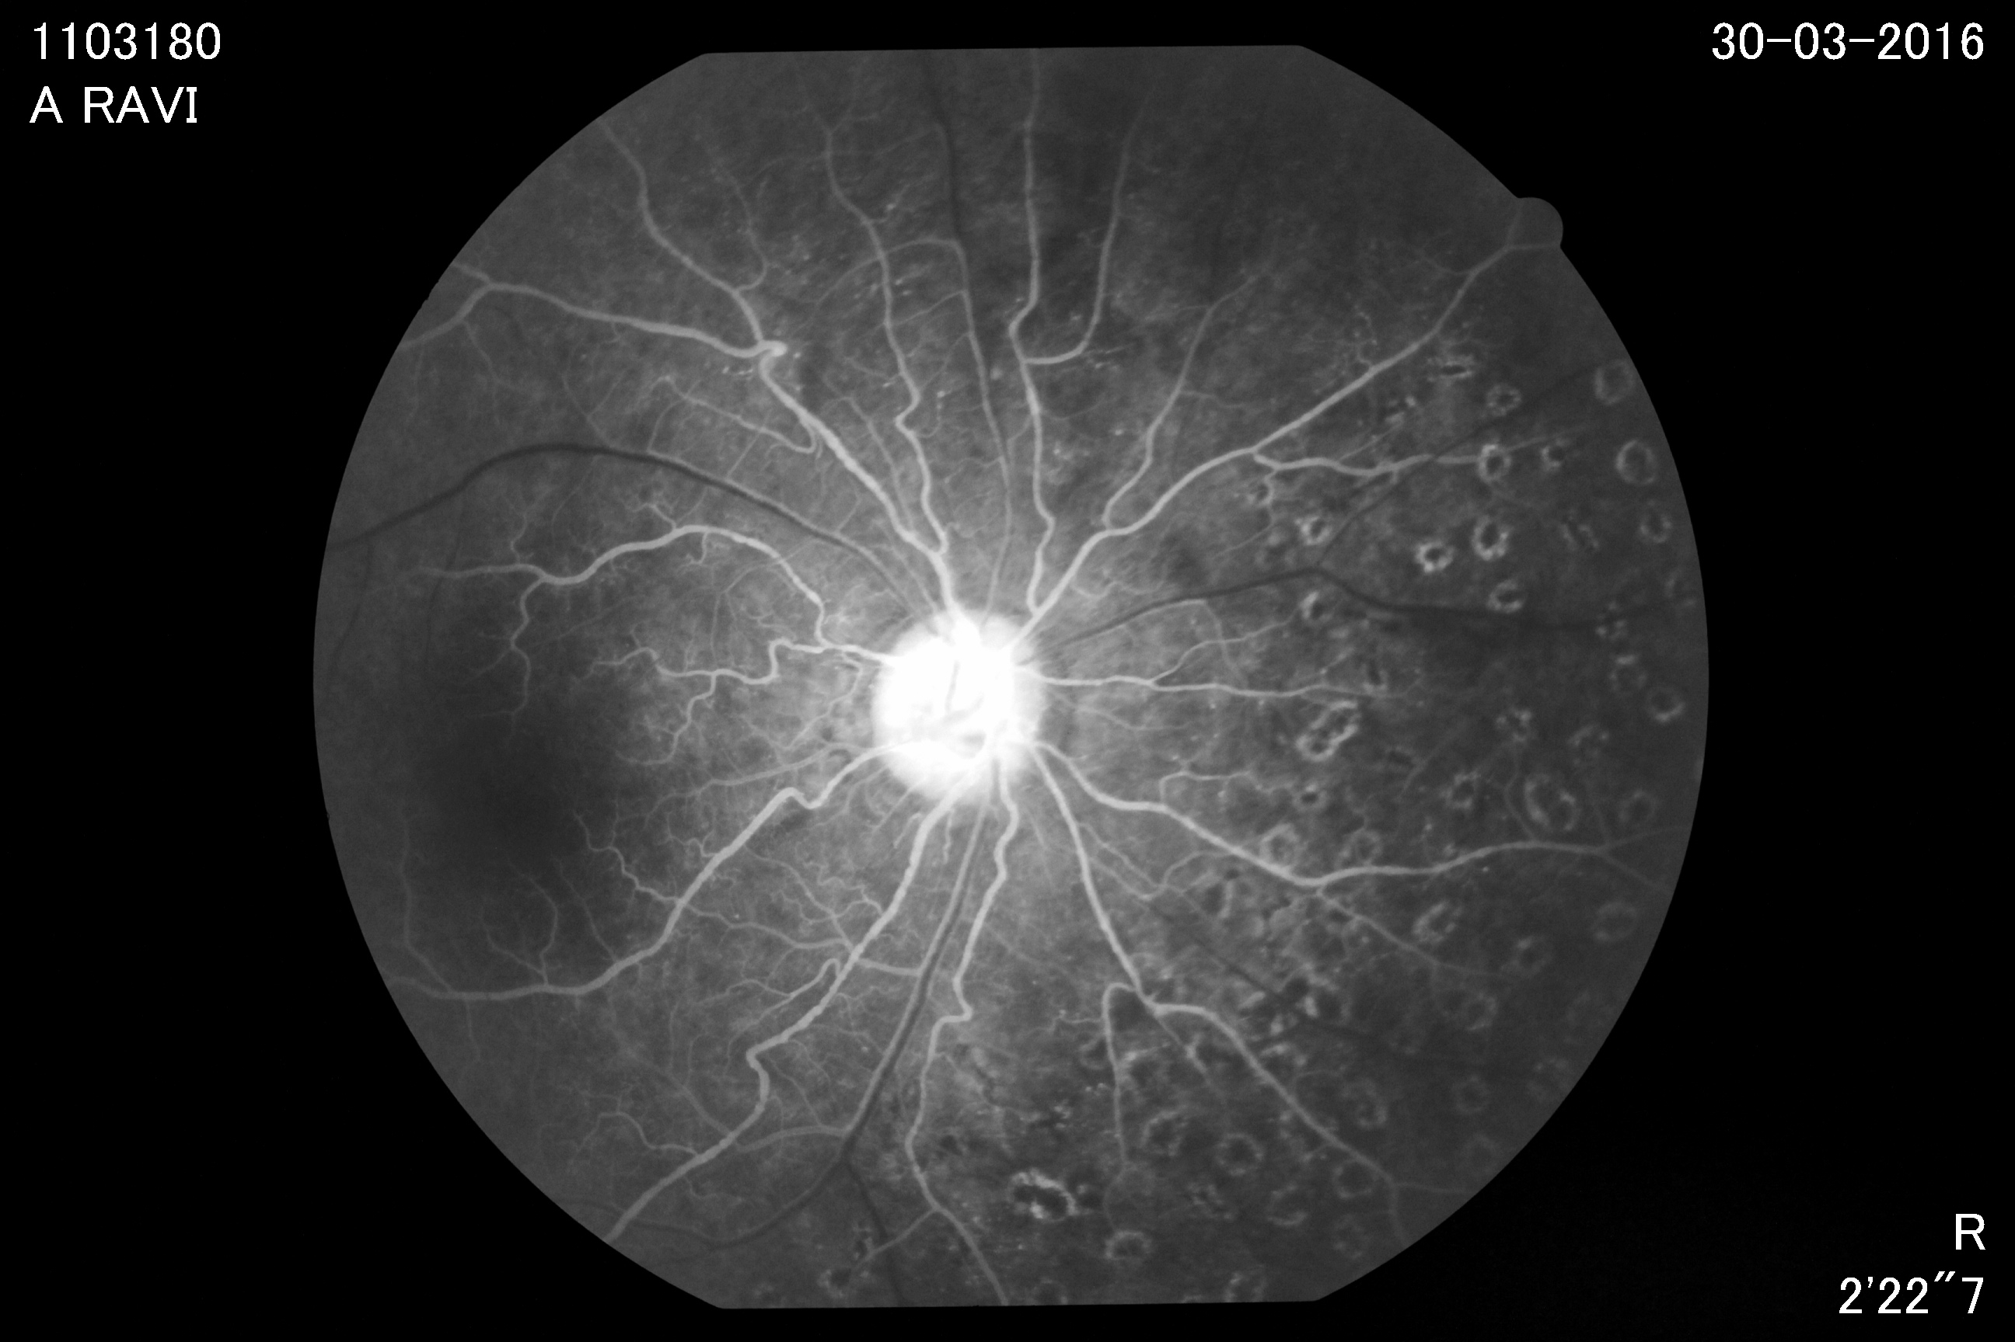
Right eye

Slide 58
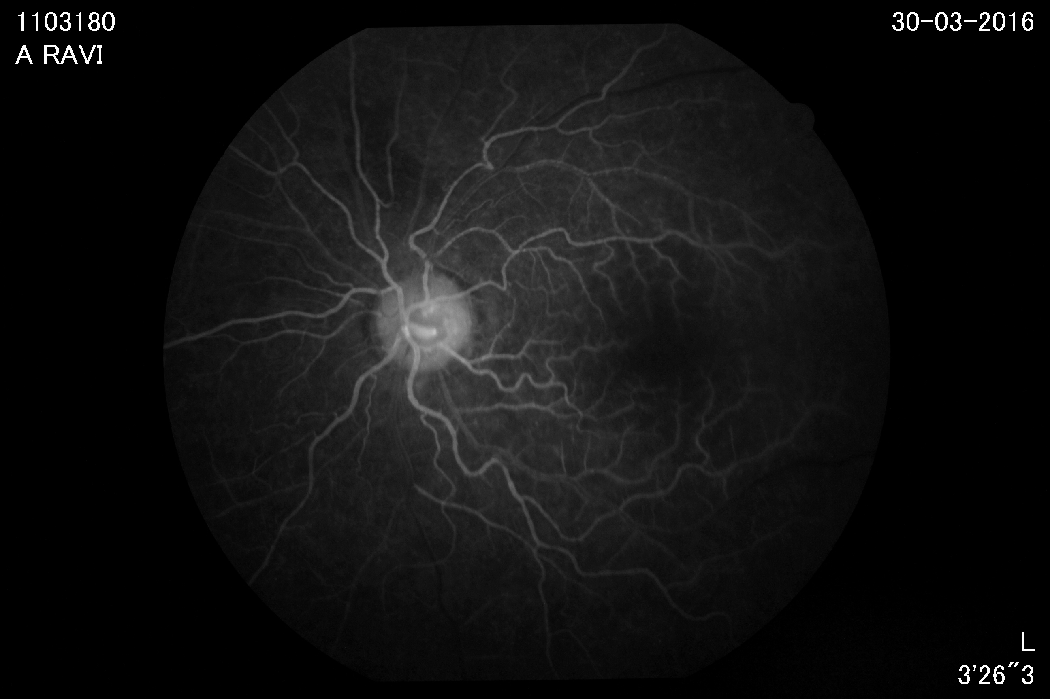
Left eye

Slide 59
Vascular surgeon suggested for renal angioplasty after nephrology opinion
Nephrology Opinion- Nil indication for renal angioplasty as both kidneys are contracted.

Slide 60
FINAL DIAGNOSIS
SYSTEMIC HYPERTENSION
TAKAYASU ARTERITIS
CKD
MULTI INFARCT STATE
QUADRIPARESIS – NON COMPRESSIVE TYPE
B/L RETINAL VASCULITIS
CERVICAL DEGENERATIVE DISEASE

Slide 61
TREATMENT
Anti hypertensive drugs
Tab. Prednisolone 5mg 10 od
Inj. Methyl prednisolone 1gm Iv od x 3days
Tab. Ranitidine 150 mg 1bd
Tab. MMF 500mgbd
Tab. Asprin 150 mg 1od
Tab. Atorvastatin10mg 2hs
Tab. calcium 1bd
Patient improved symptomatically.

Slide 62
THANK YOU

