Slide 1
MRI FOR DISCUSSION
BY IMCU 1
HOD:PROF.DR.M.NATARAJAN MD
CHIEF:DR.ALAGA VENKATESAN MD
ASST PROF:DR.ILAMARAN MD,DM
PRESENTOR: ARYA.O

Slide 2
A 26 yrs old male patient working as an IT professional presented with
complaints of fever and headache for past 30 days.
Complaints of altered sensorium for past 7 days
Fever was intermittent low grade associated with severe headache and neck pain.
Headache episodes were sudden,excruciating, which reach peak intensity within seconds.
H/o multiple substance abuse (incuding amphetamine and cocaine) for past 2 yrs
Alcoholic for past 1 year

Slide 3
o/e,
Patient drowsy
Partially obeys oral commands
CVS-S1S2 heard,no murmer
RS-BAE(+),B/L NVBS
CNS-Pt drowsy, partially obeying commands
Right complete ophtalmoplegia+
Tone – normal all 4 limbs
Power-5/5 all 4 limbs
Deep tendon reflexes- present all 4 limbs
Terminal neck stiffness- present
b/l plantar-withdrwal
PR-98/MIN
BP-140/90MMHG
SPO2-96% RA

Slide 4
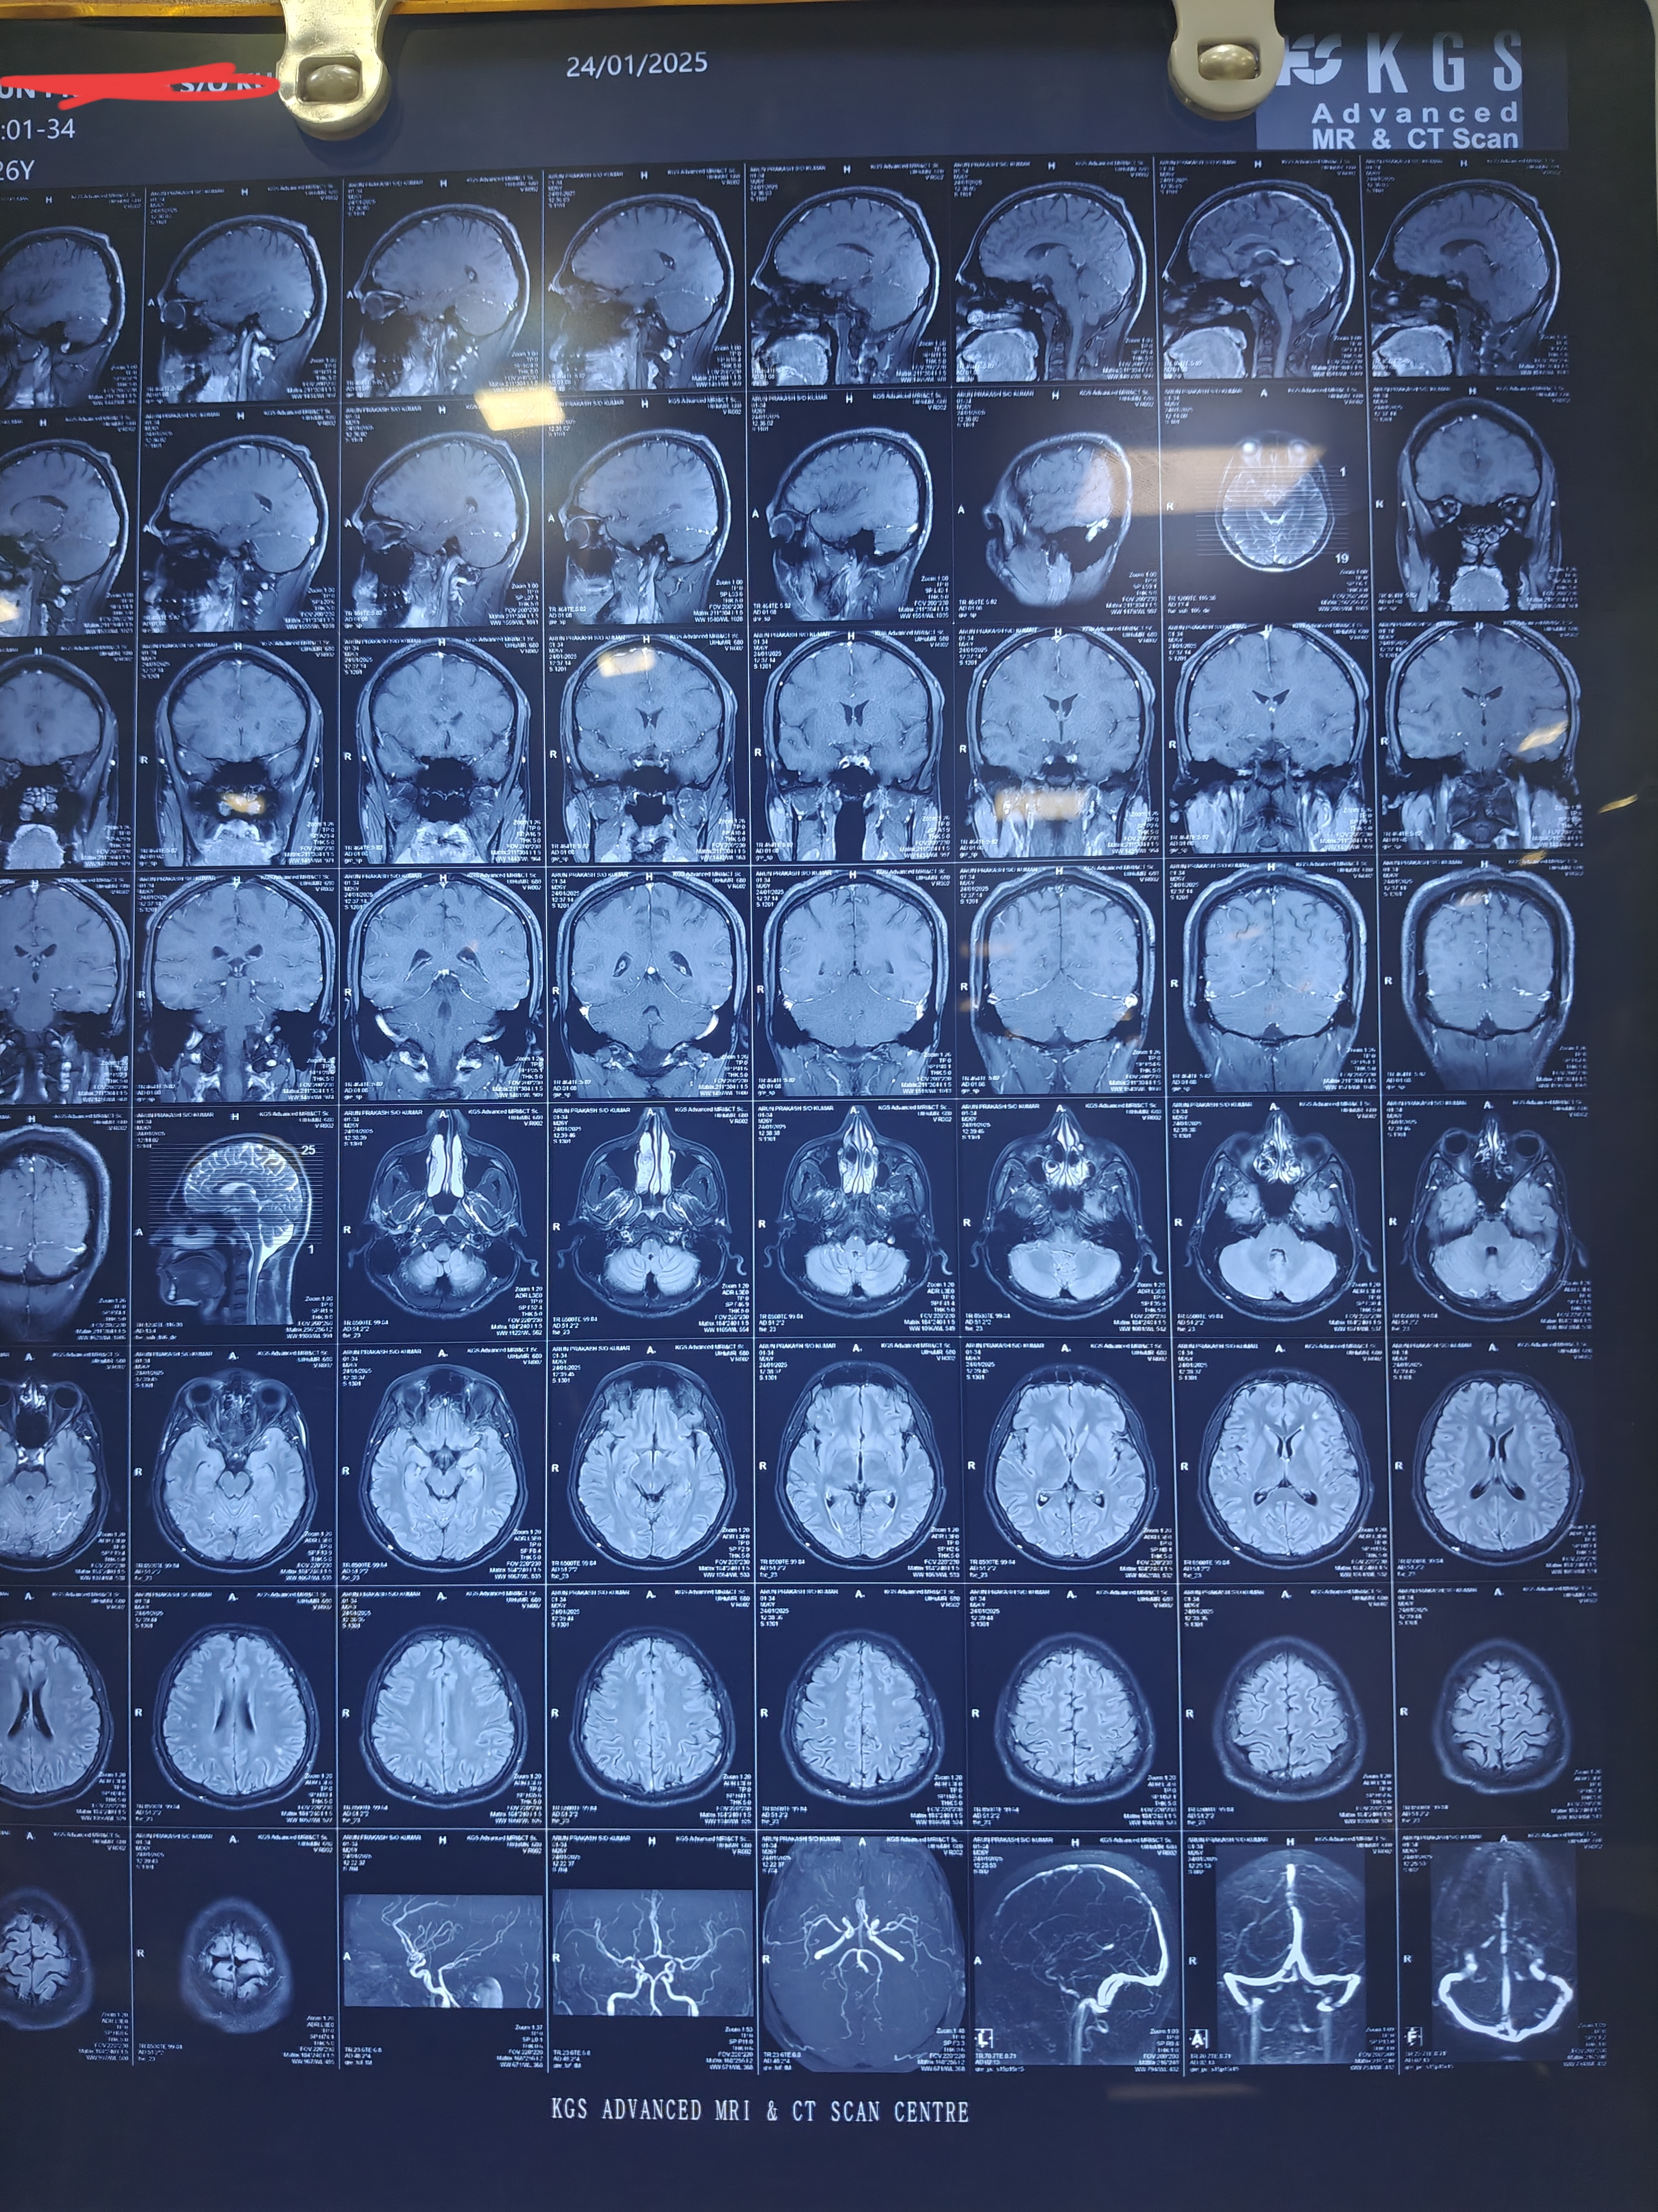

Slide 5
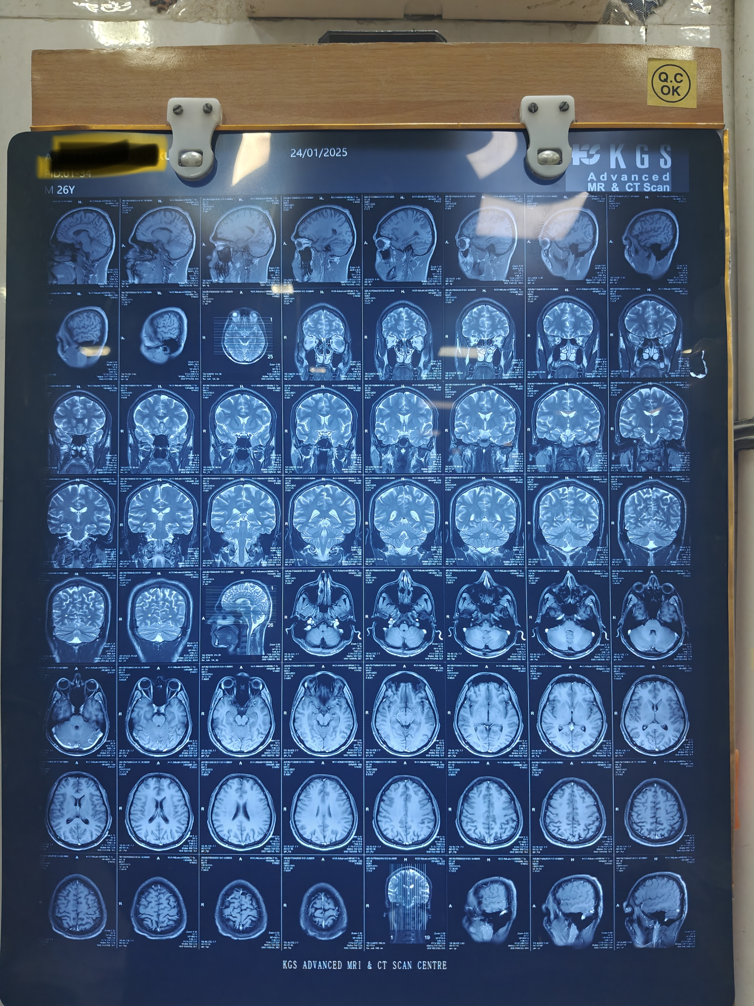

Slide 6
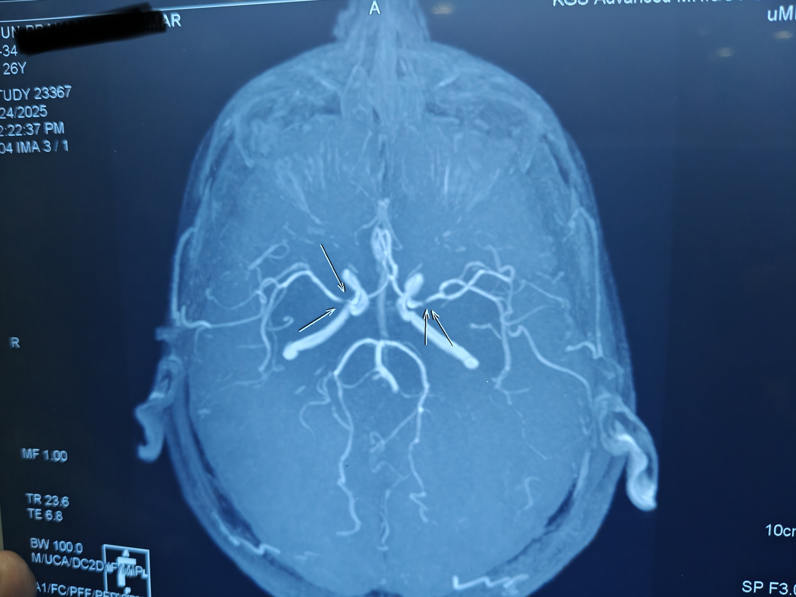

Slide 7
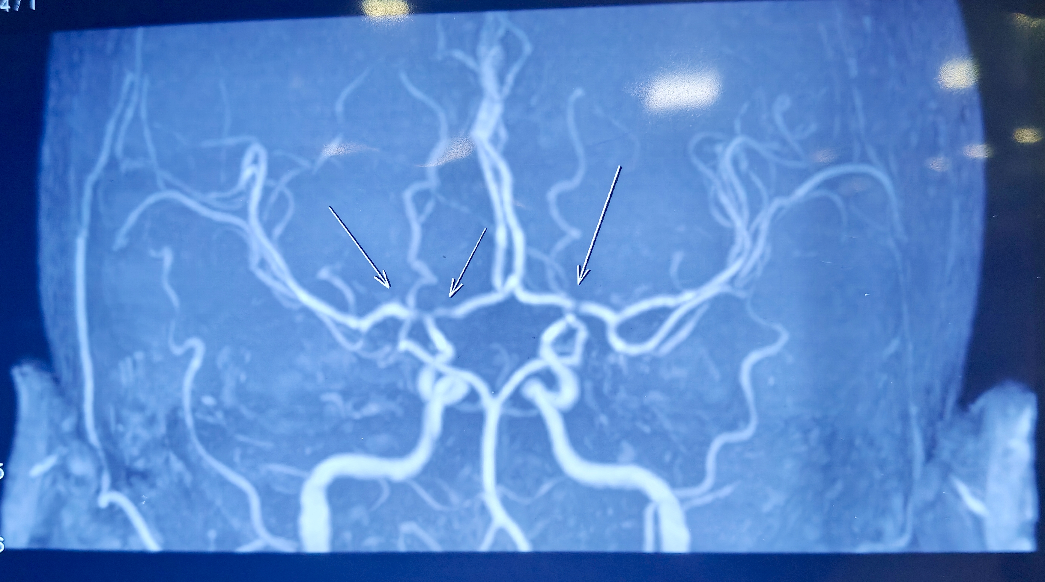

Slide 8
LET’S DISCUSS…..

