Slide 1
A 42 year old female who is a housewife came to GRH Madurai with
C/O weight loss for x 1 year

Slide 2
HISTORY OF PRESENTING ILLNESS
The patient was apparently normal before 1 year after which she developed unintentional weight loss x 1 year(9 kg lost in 1 year)
H/O easy fatiguability x 1 year
No h/o cough
No h/o evening rise of temperature
No h/o loss of appetite
No h/o fever
No h/o night sweats
No h/o chronic diarrhoea
No h/o polyuria/polydipsia/polyphagia
H/O irregular menstrual cycles+
No h/o bleeding manifestations
No h/o abdominal pain/neck swelling

Slide 3
PAST HISTORY
H/O recurrent respiratory tract infections and primary complex present in childhood for which patient got treated (records not available)
H/O jaundice in childhood for which patient undergone CAM treatment
H/O skin rash before 1 year for which patient got treated (Records not available)
The patient went for master health checkup on June 2022 and incidentally found to have B/L axillary lymphadenopathy for which patient took FNAC from R axilla and showed reactive lymphadenitis
No h/o DM/HTN/CKD/CAD/Epilepsy

Slide 4
FAMILY HISTORY
Patient’s mother died of carcinoma breast before 3 years
No other significant family history
PERSONAL HISTORY
Mixed diet
Normal bowel and bladder habits
No h/o similar complaints in the past
MENSTRUAL HISTORY
K/C/O PCOD
LMP: 26.12.23, Irregular cycles
1st child: NVD, Female, 19yrs, alive and healthy
2nd child: LSCS, Male, 16yrs, alive and healthy

Slide 5
ON EXAMINATION
Conscious
Oriented
Afebrile
Pallor+
Not icteric
No cyanosis
No clubbing
No pedal edema
B/L axillary lymphnode enlargement+, largest of measuring 2.5x1.2cm, non matted, discrete, firm, non tender, mobile
B/L cervical lymphnode enlargement+, largest of measuring 2.0x1.1cm, non matted, discrete, firm, non tender, mobile

Slide 6
VITALS
BP: 100/70mmhg
PR: 106/min
Spo2: 99% under RA
CBG: 110mg/dl
BMI: 18.35

Slide 7
SYSTEMIC EXAMINATION
CVS: S1S2+, No murmur
RS: BAE+, No added sounds
P/A: Soft, BS+
Moderate splenomegaly+, firm, non tender
No free fluid
CNS: Conscious,
Oriented,
B/L pupil 3mm ERTL

Slide 8
INVESTIGATIONS
COMPLETE BLOOD COUNT
 | 06/2022 (Mastercheckup) | 12/2023
TC | 7,800 | 6,200
RBC | 4.6million/cumm | 3.65million/cumm
Hb | 12.8 | 10.1
PCV | 39.7 | 28.7
MCV | 85.2 | 78.7
MCH | 27.4 | 27.6
PLT | 2,66,000 | 2,70,000

Slide 9
INVESTIGATIONS
RBS-101mg/dl
UREA- 15
CREATININE-0.5
T.BILIRUBIN-1.8
DIRECT-1.2
INDIRECT-0.6
SGOT-43
SGPT-40
ALP-210
ESR-110mm/hr
AEC-400cells/cumm
CRP-80
HbA1C-5.0
HbsAg -Negative
Anti HCV-Negative
VCTC-NR
URINE ROUTINE
Colour-Straw yellow
Appearance-Clear
Sugar-Nil
Albumin-1+
URINE DEPOSITS
Pus cells-2 to 4 cells/hpf
Epithelial cells-1-2 cells/hpf
RBC’s- Nil
Casts-Absent
Free T3-1.33
Serum T3-1.28
Serum T4-9.15
TSH-2.56
IGRA-Negative
Mantaux-8mm
ANA-Negative

Slide 10
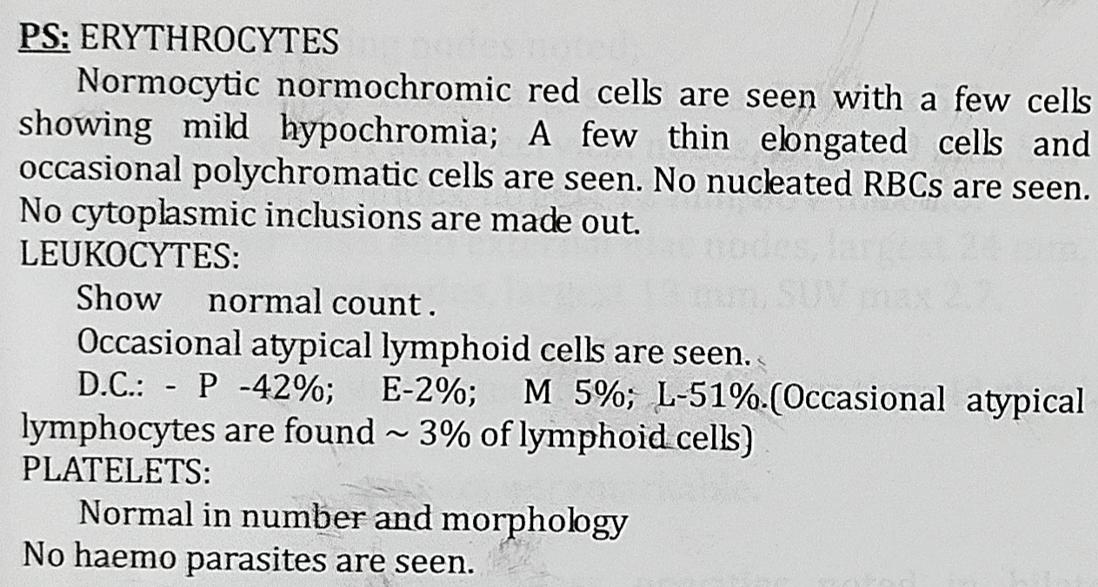
PERIPHERAL SMEAR
IMPRESSION: Mild hypochromic Anemia

Slide 11
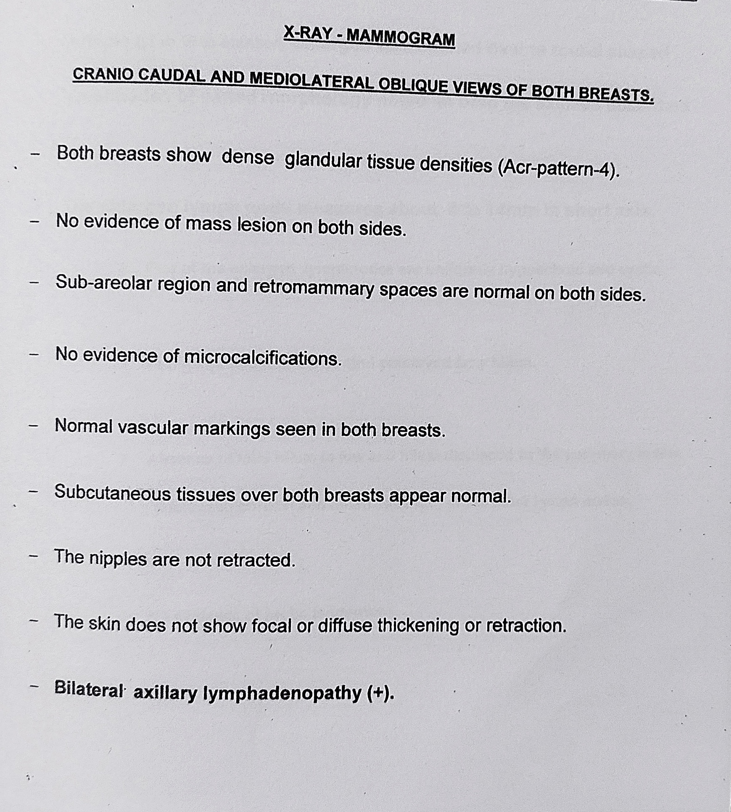

Slide 12
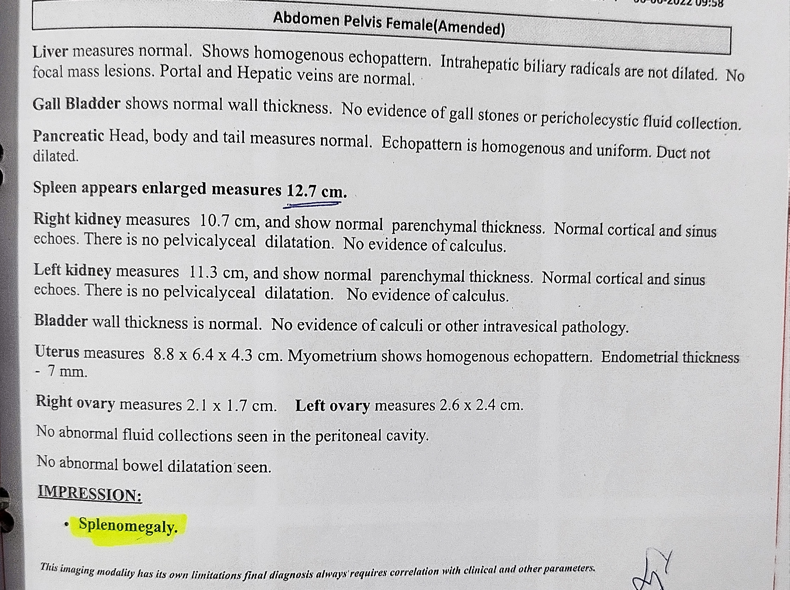

Slide 13
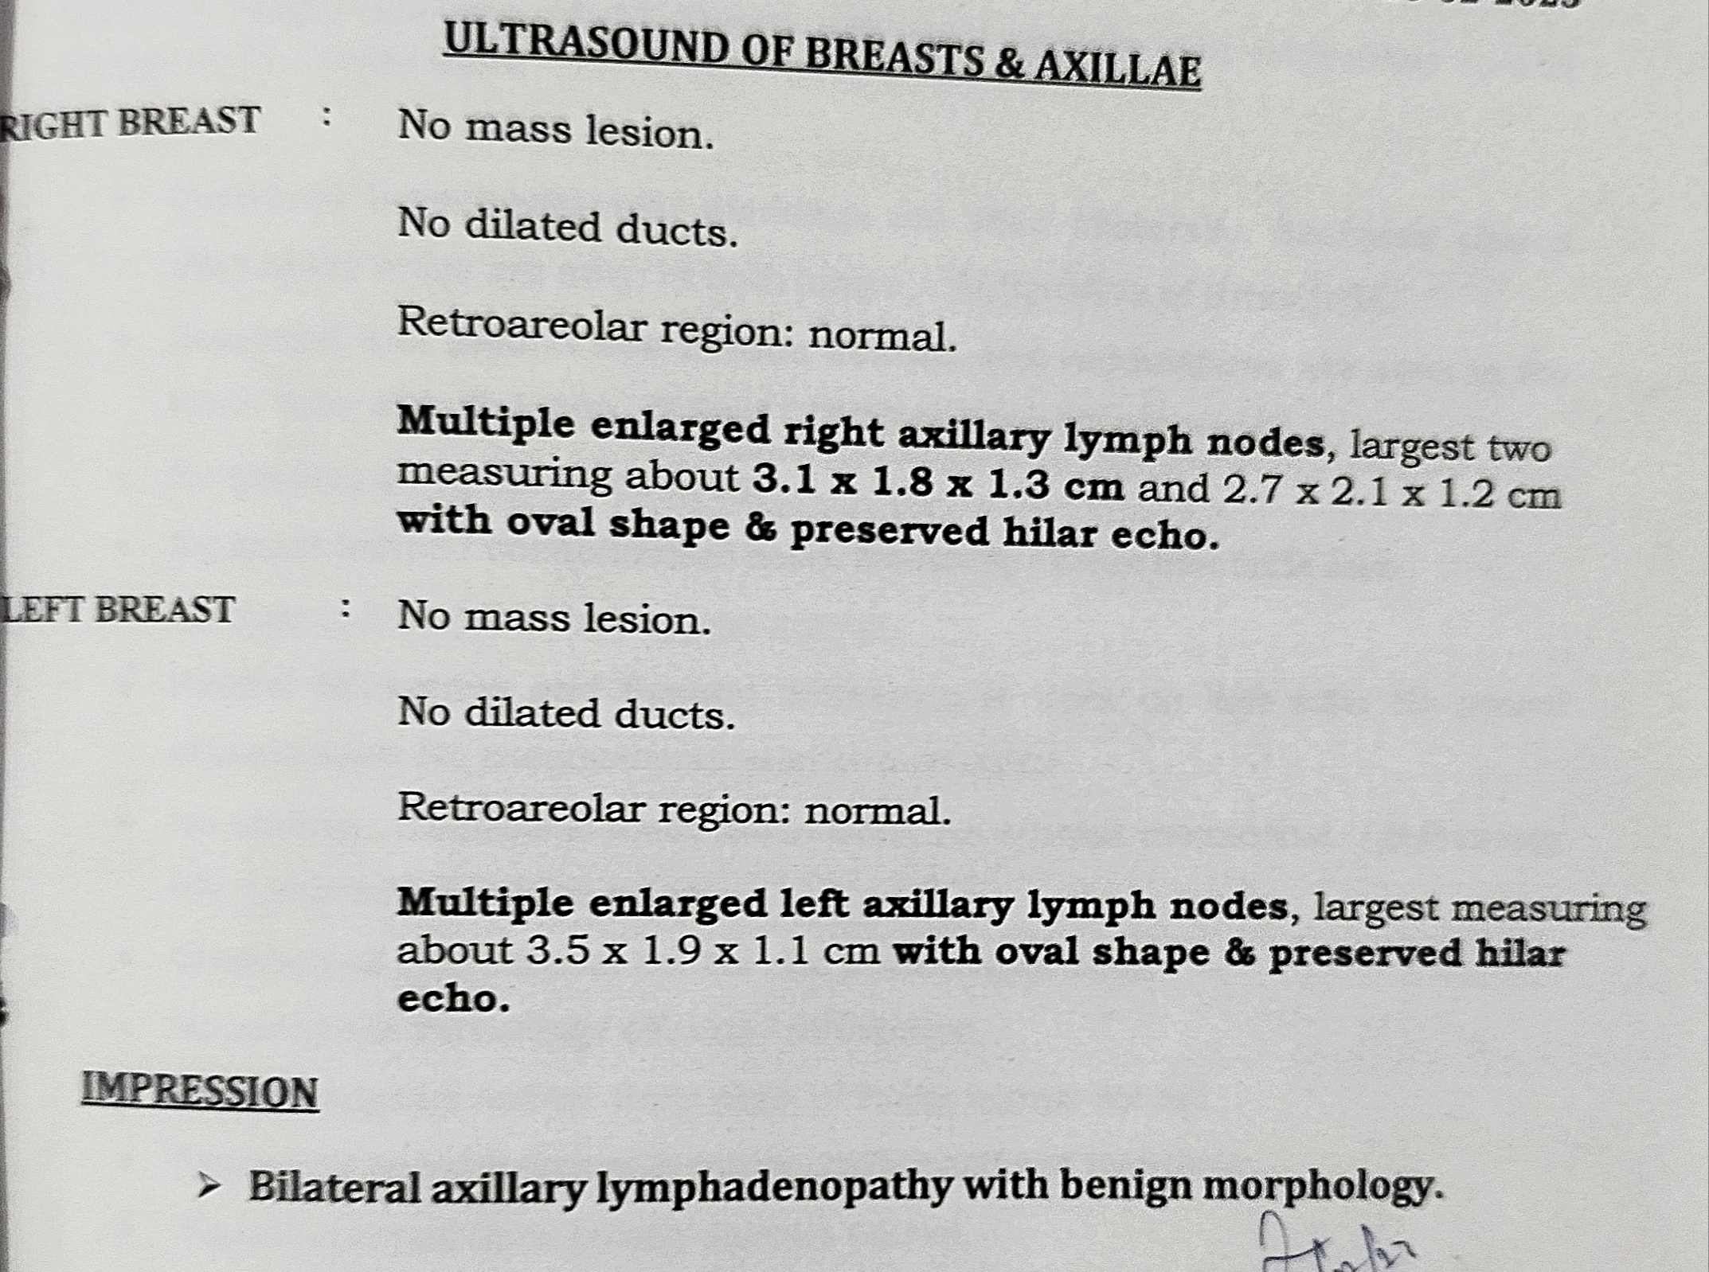

Slide 14
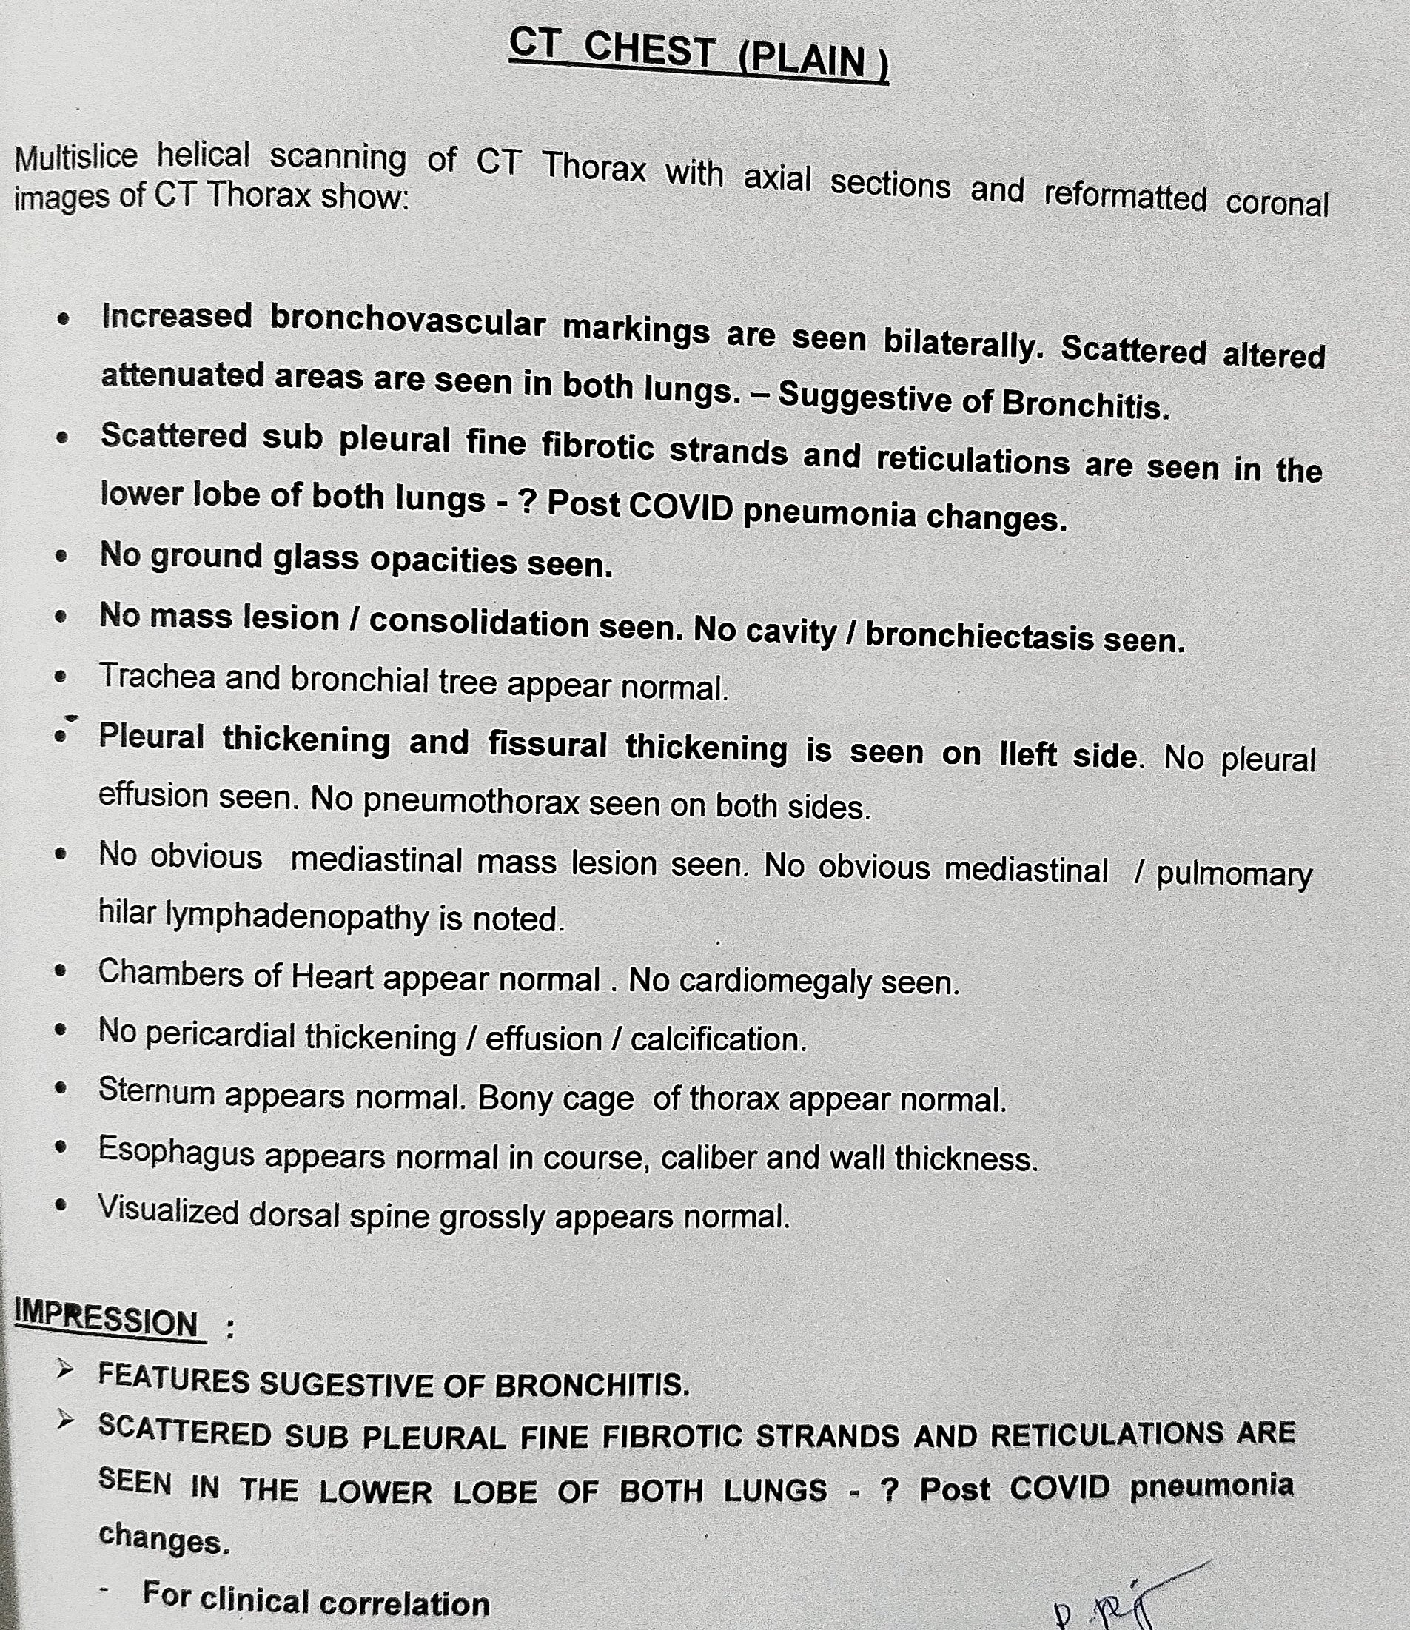

Slide 15
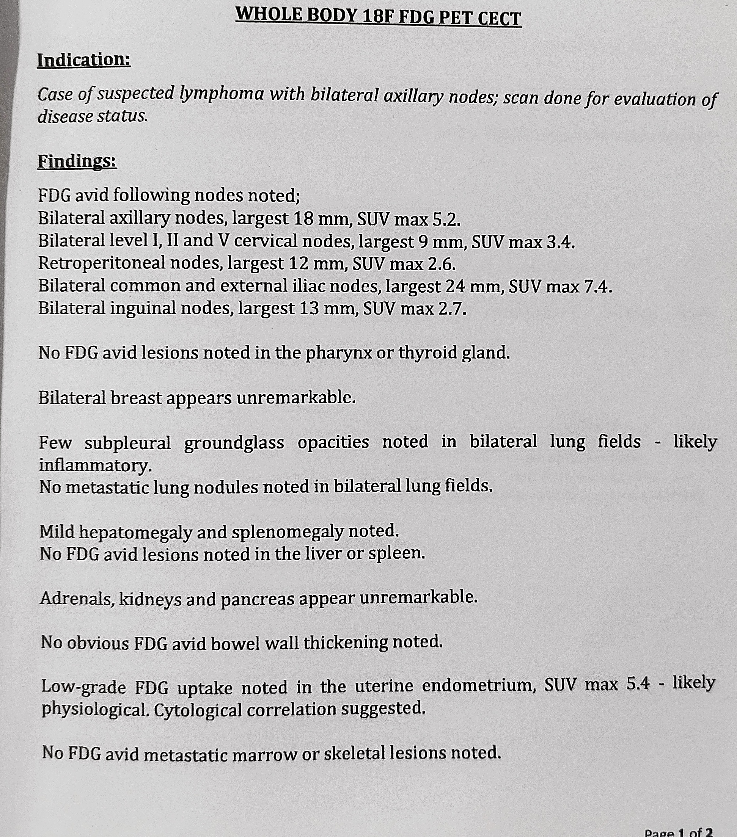
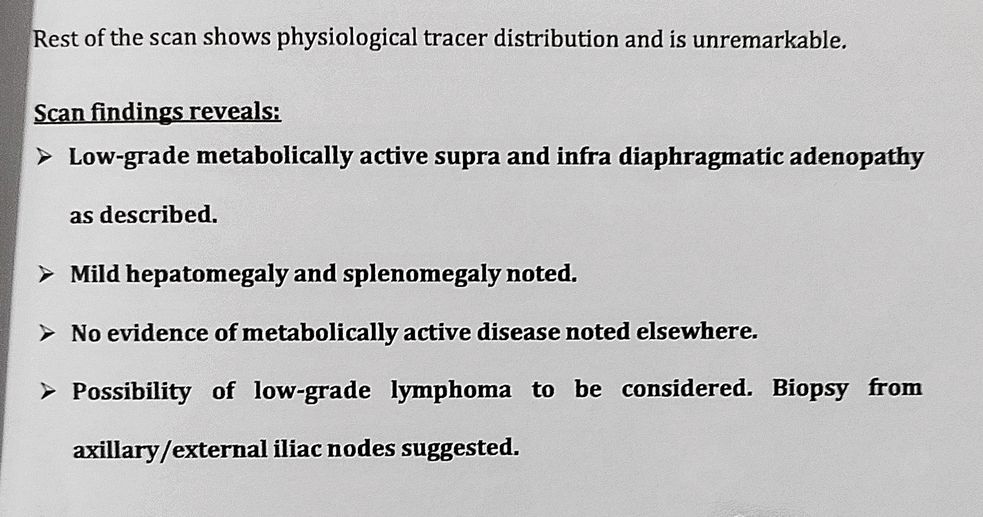

Slide 16


