Slide 1
An unusual cause of stroke
I MEDICAL UNIT
CHIEF:PROF.DR.V.T.PREMKUMAR MD
ASSTS: DR.PEER MOHAMMED MD
DR .S.MURUGESAN MD
DR.K.MURALIDHARAN MD
DR.SIVARAMASUBRAMANIAN MD

Slide 2
60 year old female patient presented with history of weakness of left upper limb and lower limb for 1 week

Slide 3
History of present illness
Patient was apparently asymptomatic 1 week ago when she developed weakness of left upper limb and lower limb
Sudden onset weakness
Non progressive
History of difficulty in mixing food +
History of difficulty in combing hair+
History of difficulty in walking +
History of difficulty in holding slippers +
Deviation of angle of mouth to right +

Slide 4
No history of neck muscle weakness
No history of difficulty in rolling over bed
No history of heaviness of limbs
No history of any involuntary movements

Slide 5
No history of headache
No history of vomiting
No history of behavioural disturbances
No history of convulsion
No history of LOC
No history of memory disturbances
No history of speech disturbances

Slide 6
No history of loss of smell
No history of visual disturbances/diplopia/drooping of eyelids
No history of difficulty in chewing food
No history of sensory disturbance over face
No history of difficulty in closing eyelids
No history of hearing loss/vertigo /tinittus
No history of Nasal regurgitation /nasal twang/dysphagia

Slide 7
No history of turning head side to side
No history of difficulty in shrugging shoulders
No history of difficulty in mixing food inside mouth

Slide 8
She is able to feel cloth on her body
She is able to differentiate hot and cold sensation
No history of paresthesia
No history of cotton wool sensation/ wash basin sign

Slide 9
No history of head nodding /scanning speech
No history of bowel and bladder involvement
No history of trauma/ neck pain
No history of fever/ cough
No history of chestpain/ palpitation/dyspnoea/platypnoea

Slide 10
She was taken to a nearby hospital from where she was referred to GRH
Patient reports improvement of symptoms since then

Slide 11
Past history
No history of similar episodes in past
She is a k/c/o Type 2 DM for past 15 years on OHA
No history of SHTN/TB/STD/CAD/BA/epilepsy /bleeding disorder
Personal history
On mixed diet
Bowel and bladder habits normal
No addictions
Attained menopause
Family history
no significant family history

Slide 12
General examination
Conscious & oriented
Febrile
Pallor +
No icterus
No cyanosis
Grade 1 pan-digital clubbing +
No pedal oedema
No lymphadenopathy
No neurocutaneous markers
No markers of atherosclerosis

Slide 13
Pulse rate- 88/mt
Regular , no special character
Normal volume
Condition of vessel wall normal
All peripheral accessible vessels palpable
No radio radial or radio femoral delay
Blood pressure- 140/80 mm Hg in RUL in sitting position
RR- 14/mt
SPO2- 99% in room air
JVP- not elevated

Slide 14
CNS Examination
Higher mental functions normal
Cranial nerve examination
Left facial lag +
deviation of angle of mouth to right
Wrinkling of forehead normal

Slide 15
Examination of motor system
Examination of sensory system- normal
Examination of cerebellar system-normal
Skull and cranium normal
 | right | Left
Bulk | n | N
tone | n | Flexor hypertonia in UL Extensor hypertonia in LL
power | 5/5 | 4/5
DTR—UL LL | + + | + ++
Plantar | ↓ | ↑

Slide 16
Cardio-vascular system examination
Apex beat palpated in left 5th ICS medial to MCL- normal character
S1-loud and varying with posture
S2 –normal
A low pitched late diastolic sound heard -tumour plop+

Slide 17
Acute CVA left Hemiparesis
Left UMN facial palsy
Involving Right MCA territory
Lesion at Right Corona radiata
? cardioembolic stroke
Type 2 Diabetes Mellitus

Slide 18
Investigations

Slide 19
Hb- 8.4gm/dl
TC-9600/mm3
PLC-3.39Lakhs/mm3
PCV-24
ESR-110mm/1hr
RBS-109mg/dl
Blood Urea-19mg/dl
S. Creatinine-1mg/dl
Urine albumin-nil,
Sugar-nil
Deposit—1-2 PC/HPF
Peripheral smear: hypochromic microcytic anemia
Reticulocyte count 1%
ANA negative

Slide 20
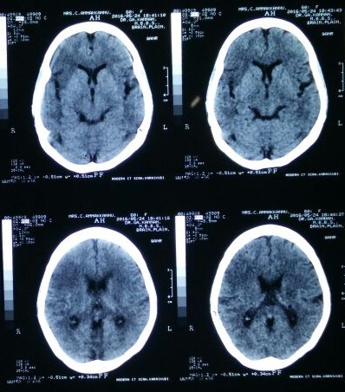
CT brain
Acute infarct right fronto-tempero parietal region

Slide 21
Echo
Normal valves
Normal chamber
No RWMA at rest
V LV systolic function EF60%
Large irregular mobile echogenic mass attatched to the IAS size5.7*1.1 cm prolapsed into the LV during diastole
Imp :LA myxoma

Slide 22
DIAGNOSIS
Acute CVA left Hemiparesis
Left UMN facial palsy
Involving Right MCA territory
Lesion at Right fronto-tempero parietal region
Probably cardioembolic stroke
LA myxoma
Type 2 Diabetes Mellitus

Slide 23
Neurologist opinion
Imp :CVA left hemiplegia
?cardioembolic stroke
Adviced ECHO, MRI Brain,
Inj Heparin 5000IU IV QID
Tab Atorvostatin 10 mg 2 HS
supportive care
Cardiologist opinion
imp :a case of LA myxoma
to fix TEE
Cardiothoracic surgery opinion
Imp :a case of LA myxoma
grade 2 dyspnoea
plan for surgery

Slide 24
Treatment given
Inj Heparin 5000U IV QID
T .Aspirin 150 mg OD
T.Atorvostatin 10mg HS
T.Enalapril 2.5mg BD
Inj HA 8-8-8 s/c TDS
Inj HM 16-0-8 s/c BD
Supportive care

Slide 25
While in hospital, patient developed sudden onset altered sensorium
O/E patient unconsious
Not responding to deep painful stimuli
Decerebrate posturing +
Plantar b/l extensor
Pulse 110/mt
BP -100/70mmHg
SPO2 -97% in room air

Slide 26
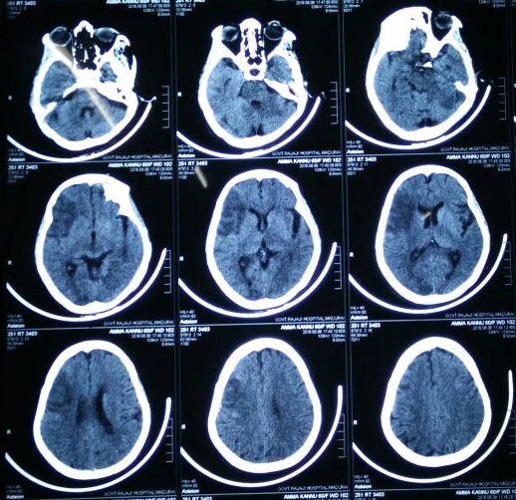
Repeat CT Brain—
acute infarct involving left occipital region and brain stem
Sub acute infarct involving right fronto parieto occipital region
Despite our resuscitative measures we lost the patient

Slide 27
THANK YOU

