Slide 1
HYPOGLYCEMIC PUZZLE -SOLVED
Third medical unit
Prof.Dr.M.Natarajan M.D.,
Asst.prof-Dr.Syed bahavudeen hussaini M.D.,
Dr.P.S.Vallidevi M.D.,
Dr.V.Shanmuganathan M.D., Presentor:S.Sugadev (P.G)

Slide 2
H/O PRESENT ILLNESS
16 yr old boy
h/o GTCS 4-5 times in past 4 months
Started on antiepileptics after the first episode
Hypoglycemia was documented twice during seizures
Evaluated for insulinoma outside- c peptide level normal
On day of admission one episode of seizures-treated outside with dextrose and referred to GRH

Slide 3
h/o post ictal confusion +
h/o lethargy for past 4-5 months
No h/o headache
No h/o vomiting
No h/o fever
No h/o cough with expectoration

Slide 4
PAST HISTORY
RTA 8 months back –sustained fracture in rt.lower limb and operated
h/o LOC for 5-10 min during that RTA+
Developed defective vision in left eye since then
No h/o PT, IRRADIATION,T1DM

Slide 5
GENERAL EXAMINATION
Conscious
Oriented
afebrile
pallor +
No icterus/cyanosis/clubbing/pedal edema/ gen.lymphadenopathy/
Alopecia+
Dry skin+
No hyperpigmentation
Absent axillary and pubic hair,b/l testis +, volume reduced
Height-153cm BMI-13.67
Weight-32kg

Slide 6
vitals
Pulse - 110/min -small volume
BP - 80/60mm Hg in rt.upper limb
SpO2 – 96%
RR -20/min

Slide 7
SYSTEMIC EXAMINATION
CVS:
S1 S2 +, no murmur
RS:
NVBS+, BAE +, No added sounds
ABDOMEN:
Soft, not tender, no organomegaly
CNS:
left eye:acuity-only light perception+
RAPD+
Fundus-?optic atropy+ no pseudomyotonic jerk

Slide 8
Salient features
RTA – Head injury
Recurrent seizures
Recurrent hypoglycemia(normal c-peptide)
Deficient secondary sexual characters
Dry skin
lethargy

Slide 9
Provisional diagnosis
P/O Poly hormone deficiency ?Panhypopituitarism
Left optic atropy
Treatment: iv fluids-NS iv dextrose sos Antiepileptics continued and withdrawn later inj.hydrocortisone 50mg iv tds( after taking sample for hormonal assay)

Slide 10
investigations
urine : albumin- nil
sugar - nil
deposits- 0-2 pus cells
Hb -8.2 g%
TC -6400 cells/mm3
DC - P 52%/L 38% / M 10%
Platelet -3.29 lakhs/mm3
RFT,LFT - WNL
Sr.Na+ -132m.eq
Sr.k+ -4.4 m.eq
USG ABDOMEN- NORMAL SYUDY
EEG -NORMAL RECORD(outside)

Slide 11
Endocrinology opinion
h/o recurrent seizures
h/o hypoglycemic episodes
h/o RTA
Delayed puberty,b/l testis 4ml each
No pubic,axillary hair
ADVICE: FT4,TSH,T4,LH,FSH,PROLACTIN,CORTISOL,
TOTAL TESTOSTERONE Glucose Q4h c-peptide & insulin during hypoglycemia CECT abdomen&adrenal MRI pituitary/brain

Slide 12
HORMONAL ASSAY

Slide 13
TOTAL T4 -0.82 mg/dl (5.2-12.7 mg/dl)
TSH -0.88 IU/ml (0.3-5.5 IU/ml)
FREE T4 -0.14 ng/dl (0.89-1.72ng/dl)
Sr. LH - 1.07 mIU/L (1.8-25mIU/ml)
Sr.FSH -1.49 mIU/L (1.5-11.8mIU/ml)
Sr.PROLACTIN -1.50ng/ml (2.5-16.1ng/ml)
Sr. Total testosterone-7.47ng/dl (220-1050ng/dl)
Sr.cortisol -0.74micro.g/dl (7.26-32.28micro.g/dl)
Growth hormone -<0.05 ng/ml (<=3ng/ml) (fasting&90 min post CLONIDINE)

Slide 14
Endocrinology REVIEW
S/O PANHYPOPITUITARISM -central hypothyroidism - hypocortisolism -hypogonadism -leading to hypotension and hypoglycemia - ?Pituitary tumor

Slide 15
SUGGESTED: INJ.HYDROCORTISONE 100mg st foll. by 50mg iv tds T.THYROXINE 200 microgram OD BLANKETS-AVOID COOL TEMP. IV FLUIDS MRI PIUITARY (CONTRAST)

Slide 16
OPHTHALMOLOGIST OPINION
LEFT EYE: Diffuse pallor sugg. of TRAUMATIC OPTIC ATROPY

Slide 17
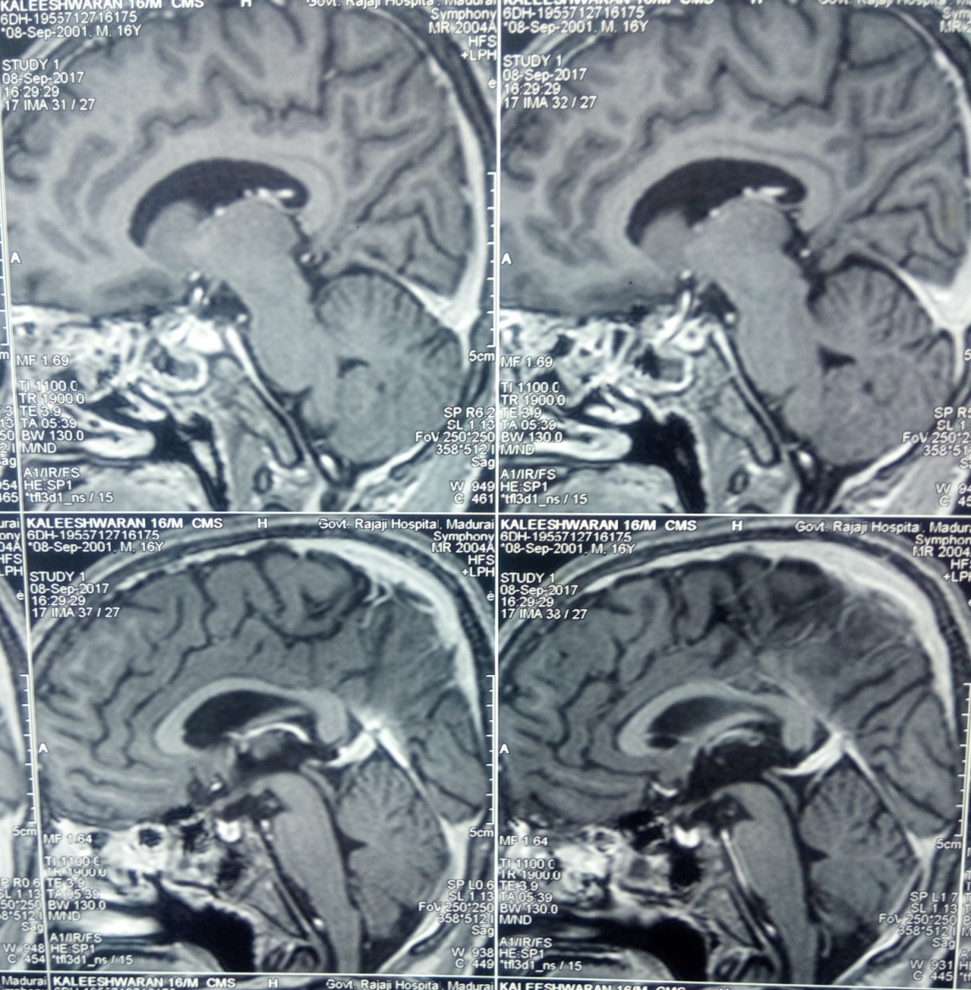
MRI PITUITARY

Slide 18
MRI PITUITARY(P&C)
Pituitary gland measures 0.8*0.6*0.4cm which significantly enhances on contrastwith concave upper margin
Posterior pituitary bright spot normal
Infundibular stalk normal
Impression: hypoplastic anterior pituitary

Slide 19
ENDOCRINOLOGIST REVIEW
- HYPOPITUITARISM
ADVISED: T.PREDNISOLONE 5mg 2OD T.THYROXINE 150microgm OD Inj.TESTOSTERONE 100mg- once in 2 weeks

Slide 20
FINAL DIAGNOSIS
PANHYPOPITUITARISM presenting as hypoglycemic seizures
Possible etiology-post traumatic
TREATMENT: T.PREDNISOLONE 5mg 2OD T.THYROXINE 150microgm OD Inj.TESTOSTERONE 100mg- once in 2 weeks

Slide 21
AIM OF PRESENTATION
TO HIGHLIGHT THE APPROACH TO RECURRENT HYPOGLYCEMIA
TO DISCUSS VARIOUS ETIOLOGIES FOR HYPOPITUITARISM
TO INSIST CT BRAIN ON ALLHEAD INJURY CASES

Slide 22
THANK YOU

