Slide 1
TWO ECGS For Discussion
Presentor
P.muthukrishnan
III Medicine Unit
Chief: Dr. M Natarajan MD
Asst Prof: Dr. Syed Bahavudeen Hussaini MD
Dr. Vallidevi MD
Dr.shanmuganadhan MD

Slide 2
38 years old male not a known case of DM/SHTN, not a smoker , alcoholic presented with complaints of giddiness for 2 days
No h/o chest pain , dyspnoea ,palpitation, syncope
No h/o fever, abdominal distension

Slide 3
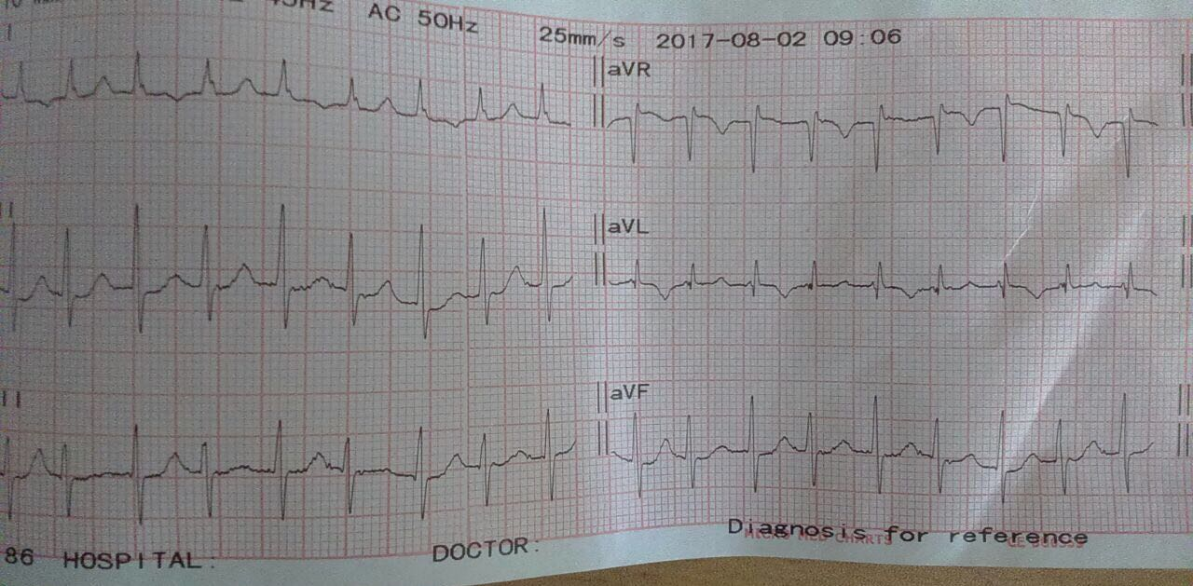

Slide 4
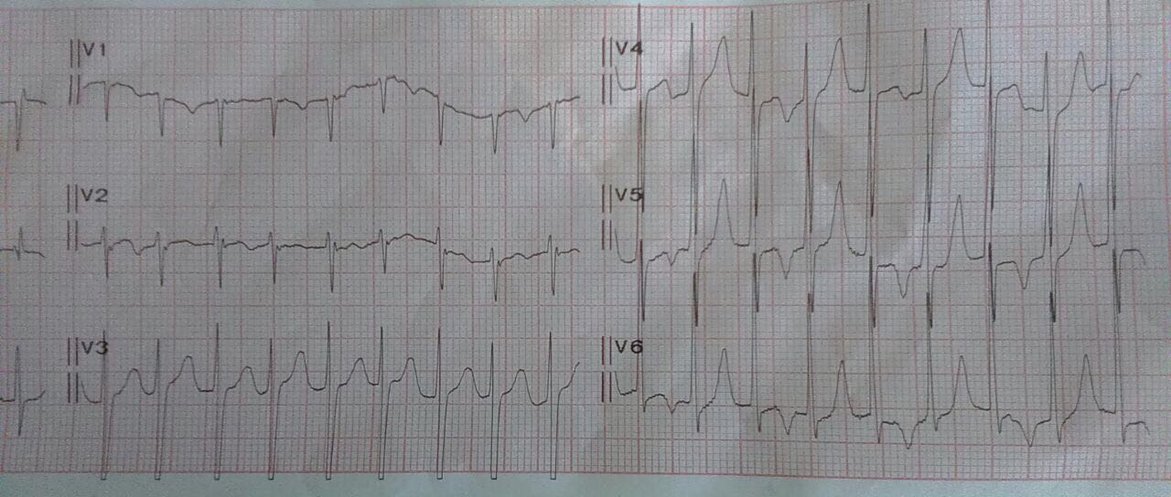

Slide 5
Case 2
43 years old female known case of RHD MS/ PULMONARY HYPERTESION on pencillin prophylaxis came with compilants of breathlessness 4 days
No h/o syncope , palpitation, chest pain

Slide 6
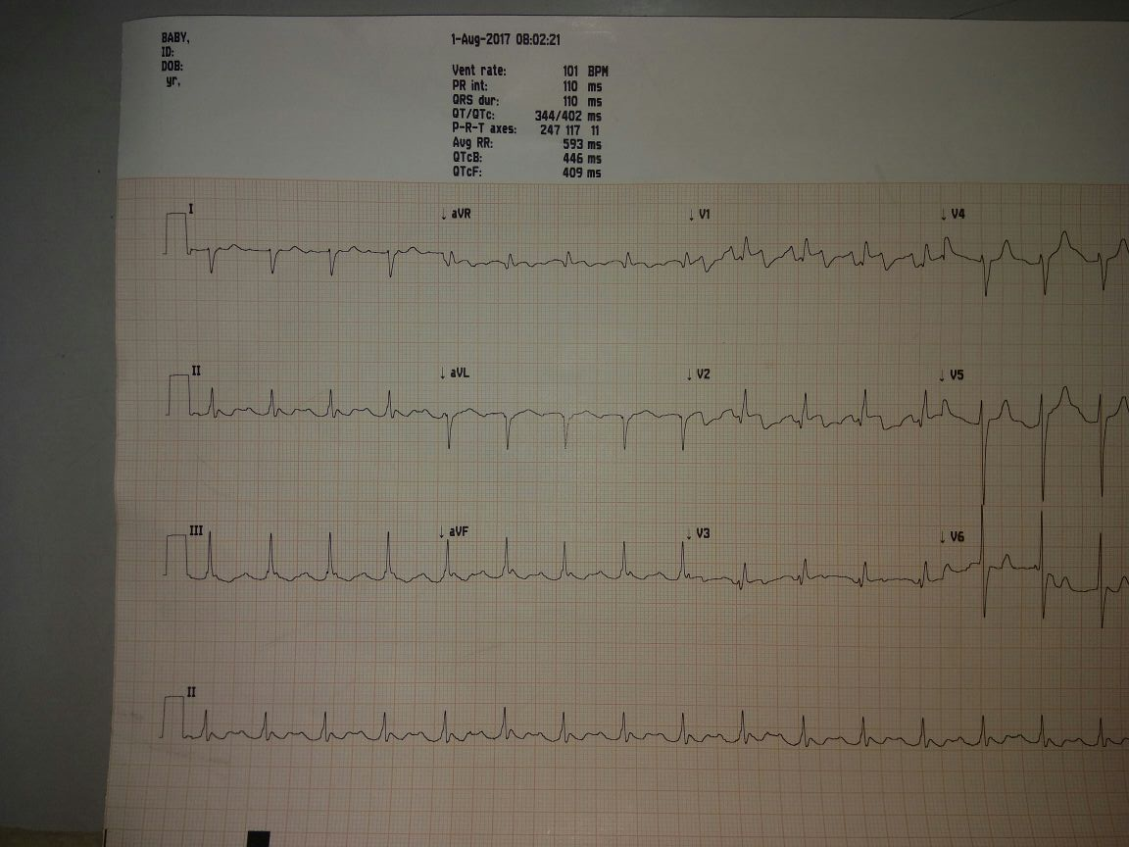

Slide 7
Thank you

