Slide 1


Slide 2
VII MEDICAL UNIT
CHIEF: PROF.DR.K.SENTHIL.MD
ASSOCIATE PROF: DR.K.MURALIDHARAN MD
ASST PROF: DR V.MANIKANDAN MD
DR C. RAMANAN MD
DR.SARAVANA MADAV MD
PRESENTOR – DR.E.GOPINATHAN
SECOND YEAR PG

Slide 3
CHIEF COMPLAINTS
32Years female presenting with complaints of
Pain over left upper limb – 2 months aggravated since 10 days
No h/o difficulty in using lt upper limb
No h/o fever
No h/o headache
No h/o cough
No h/o joint pain
No h/o oliguria
No h/o hematuria
No h/o b/l swelling of legs

Slide 4
No h/o diplopia
No h/o blurring of vision
No h/o chest pain
No h/o dyspnea
No h/o abdominal pain
No h/o skin rash
No h/o oral ulcers
No h/o loss of weight
No h/o loss of appetite

Slide 5
PAST HISTORY
K/C/O Seizure disorder *3 yrs on tab Carbamazepine 200 mg BD
K/C/O SHTN -5yrs / RENAL FAILURE * 3 Yrs
Patient was evaluated in 2018 but lost to follow up
MRI BRAIN done in 2018 – normal
h/o facial surgery for ? Hemangioma/vascular malformation ( Debulking procedure done – HPE – S/O Neurofibroma)
Not a k/c/o T2DM/TB/BA/THYROID Disorder

Slide 6
OLD RECORDS
 | 28/2/2019
P – ANCA | Positive
C- ANCA | Negative
Anti – GBM antibody | borderline
LA SCREEN | 42.0
LA CONFIRM | 32.3
LA SCREEN/CONFIRM RATIO | 1.3

Slide 7
MENSTRUAL H/O
Regular cycles
Once in 30 days

Slide 8
OBSTETRIC H/O
A2L0
Spontaneous abortions in 1st trimester

Slide 9
GENERAL EXAMINATION
Pt concious
Oriented
Afebrile
Not dyspneic
No skin rash
Oral cavity – normal
Thyroid – normal
Pallor +
No icterus
No cyanosis
No clubbing
No pedal edema
No Lymphadenopathy

Slide 10
VITALS
PULSE – 90/MIN
Normal volume
Regular in right limb
Absent pulse in left limb
B/L Carotid Bruit
B/L Supraclavicular Bruit
B/L Femoral bruit
SPO2 – 98% in RIGHT HAND
-
-
Bruit+
Bruit+
+
+
-
+
+
+
Bruit+
Bruit+
+
+
+
+

Slide 11
SYSTEMIC EXAMINATION
CVS : S1 S2 HEARD
NO MURMUR ,JVP – NOT ELEVATED
RS : NVBS
NO ADDED SOUND
P/A : SOFT , BS+
B/L RENAL BRUIT +
CNS : B/L PERL – 2 MM
EOM – FULL
NO MOTOR DEFICIT
B/L PLANTAR – FLEXOR

Slide 12
BLOOD PRESSURE
RIGHT | LEFT
150/80 | NOT RECORDABLE
140/80 | 140/80

Slide 13
INVESTIGATIONS
DATE | 29/12 | 3/1/22
TOTAL COUNT | 11200 | 8200 | T.BIL | 0.5
DIFF COUNT | 82/11/7 | 65/18 | D.BIL | 0.4
HB | 6.6 | 6.0 | I.BIL | 0.1
PCV | 19% | 18 | SGOT | 14
PLATELETS | 2.74 | 1.92 | SGPT | 17
ESR | 98 |  | ALP | 31
RBS | 88 |  | CRP | 70.1
MCV/MCHC | 83.1/32.1 |  | MANTOUX | Negative

Slide 14
DATE | 29/12 | 3/1/22 |  | 30/12
UREA | 55 | 40 | PT | 17.1 S
CREATININE | 2.9 | 3.6 | INR | 1.1
NA | 135 |  | APTT | 38.4 S
K | 5.3 |  | SR ALBUMIN | 3.1
ANA IF | NEGATIVE |  | GLOBULIN | 3.0
Urine spot creatinine | 26mg% |  | TSH | 1.22
Urine spot Protein | 42mg% |  | VDRL | NON REACTIVE
VCTC/VM | Negative |  | RF | NEGATIVE
SR. CALCIUM | 8.0 |  | SR.P04 | 5.0

Slide 15
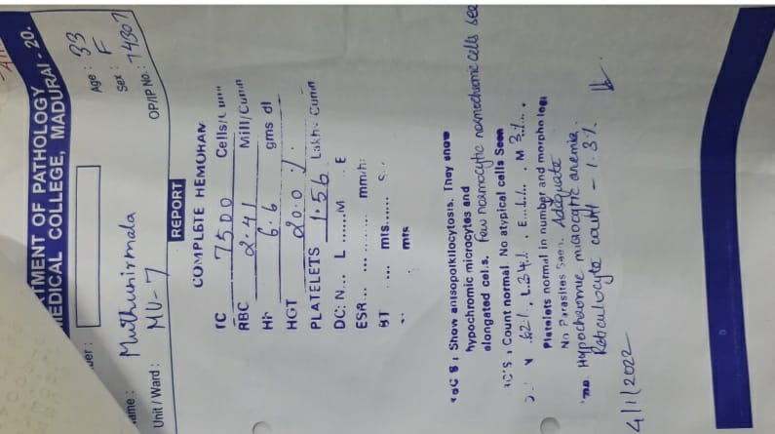
PERIPHERAL SMEAR

Slide 16
PERIPHERAL SMEAR
Microcytic hypochromic and normocytic normochromic cells seen
Platelets adequate
Reticulocyte count – 1.3%

Slide 17
ECHOCARDIOGRAPHY
Concentric LVH
Normal LV systolic function
AR mild
Moderate Pericardial effusion
Anterior – 1.6 mm
Posterior – 1.7 mm
LVID d – 4.2
LVID s – 2.9
LVEF – 60%

Slide 18
USG ABDOMEN AND PELVIS
LIVER – Normal
GB/Pancreas/Spleen – normal
RK : 8.3*3.1 cm Increased echoes CMD Poorly maintained
LK : 7.0*3.0 Increased echoes CMD Poorly maintained
No evidence of calculi
Uterus & B/L Ovaries normal
IMP – B/L Medical renal disease

Slide 19
B/L RENAL ARTERY DOPPLER
RK – RI - 0.8
LK – High resistance flow noted

Slide 20
INVESTIGATIONS
CT BRAIN – NORMAL STUDY
CT CHEST – PERICARDIAL EFFUSION +

Slide 21
B/L CAROTID AND VERTEBRAL ARTERY DOPPLER
RIGHT CAROTID ARTERY | LEFT CAROTID ARTERY
SMOOTH CONCENTRIC VESSEL WALL THICKENING IN CCA FROM ITS ORIGIN TO CAROTID BULB | SEVERE UNIFORM CONCENTRIC WALL THICKENING WITH LUMINAL NARROWING
30% LUMINAL NARROWING RT PSV – 165CM/S | PSV – 250CM/S – INCREASED
MILD SPECTRAL BROADENING NOTED
RT CAROTID BULB – 50% LUMINAL NARROWING | WALL THICKENING SEEN EXTENDING FROM LT CC ORIGIN TO LEFT CAROTID BULB

Slide 22
LT UPPER LIMB ARTERIAL DOPPLER
LEFT SCA | Extensive wall thickening with luminal narrowing Monophasic wave pattern Velocity 57 cm/s
DISTAL SCA | Biphasic wave pattern PSV 57cm/s
LT AXILLARY | Biphasic flow PSV – 57 cm/s Extensive wall thickening
LT BRACHIAL | Biphasic flow Velocity – 74cm/s
LT RADIAL | Monophasic flow With reduced velocity

Slide 23
RT UPPER LIMB ARTERIAL DOPPLER
RIGHT SCA/ AXILLARY | NORMAL CALIBRE AND FLOW
IMPRESSION | S/O VASCULITIC ETIOLOGY WALL THICKENING IN LT SCA EXTENDING UPTO LT AXILLARY/BRACHIAL ARTERY WITH LUMINAL NARROWING WITH REDUCED FLOW IN LT RADIAL AND ULNAR ARTERY INFLAMMATORY WALL THICKENING OF B/L SCA ICA- NO WALL THICKENING

Slide 24
MR AORTOGRAM
ASCENDING AORTA , ARCH & DESCENDING AORTA | MURAL THICKENING MAXIMUM WALL THICKNESS – 1CM
DESCENDING THORACIC AORTA AND ABDOMINAL AORTA | show mural thickening
LT SCA I & II Part | Critical stenosis
III PART /AXILLARY & BRACHIAL ARTERY | Normal calibre
LT RADIAL/ ULNAR | Very narrow in calibre
LT VERTEBRAL ARTERY | Occluded

Slide 25
MR AORTOGRAM
BCA | Mural thickening
RT CAROTID | Significant luminal narrowing of RCA
LT CCA / ICA | Narrow calibre
PULMONARY ARTERY | Appears dilated
B/L RENAL ARTERIES | Severe narrowing of Juxta- renal aorta with critical stenosis of B/L Renal arteries(L>R)

Slide 26
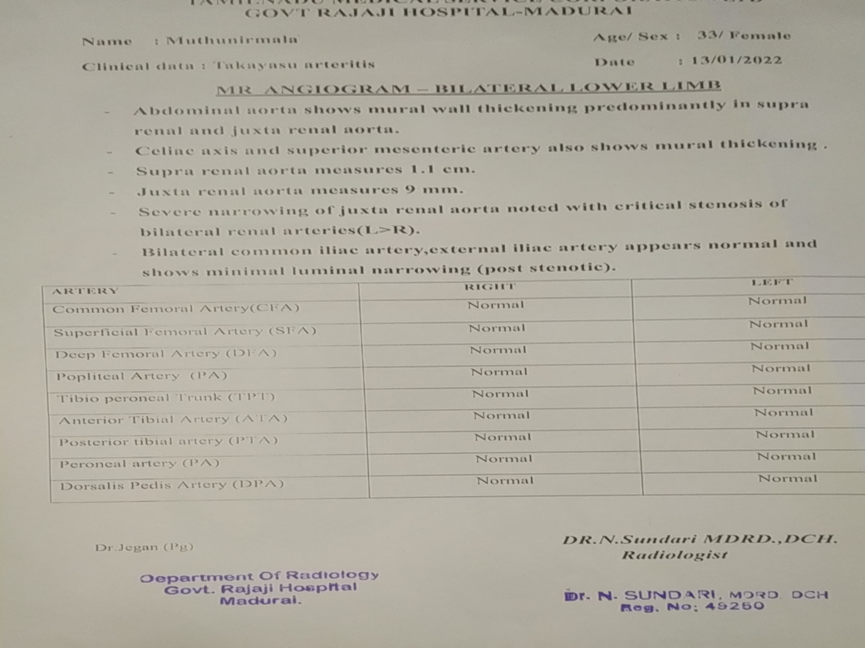

Slide 27
ARTERIES
ASCENDING AORTA , ARCH & DESCENDING AORTA
LT SCA I & II Part
LT VERTEBRAL ARTERY
RT CAROTID
DESCENDING THORACIC AORTA AND ABDOMINAL AORTA
CELIAC PLEXUS AND SMA
B/L RENAL ARTERIES

Slide 28
Imp: LARGE VESSEL ARTERITIS
POSSIBLY TAKAYSU ARTERITIS

Slide 29
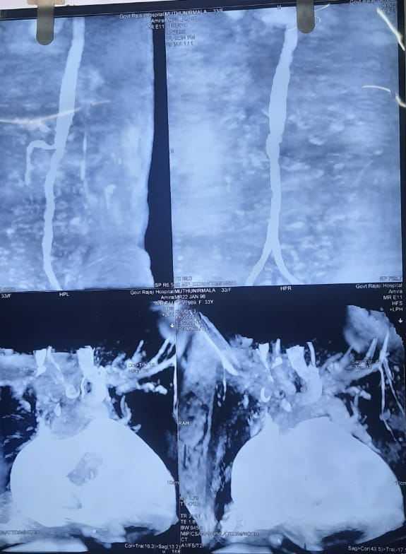
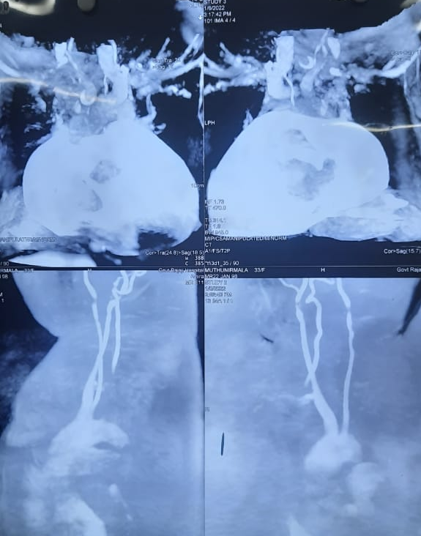

Slide 30
Neurology opinion
Opthalmology opinion
h/o seizure 1 episode yrs back
Adv – EEG
MRI BRAIN – to r/o structural lesion/vasculitic foci
Consider oral steroids
BE GRADE II HYPERTENSIVE RETINOPATHY

Slide 31
EEG REPORT
Background 10-12 Hz alpha waves from posterior head region
No provocative abnormalities
Abnormal record

Slide 32
NEPHROLOGY OPINION
Imp – CKD IV Non oliguric
TAKAYSU ARTERITIS
B/L Renal artery stenosis
Adv : BP control
Avoid ACEI/ARB

Slide 33
RHEUMATOLOGY OPINION
Advised to start
Tab MYCOPHENOLATE MOFETIL 500mg od

Slide 34
TREATMENT GIVEN
T. PREDNISOLONE 5 MG 10 OD
Tab MYCOPHENOLATE MOFETIL 500mg od
T.NIFEDIPINE 10 MG 2 TDS
T.PRAZOSIN 2.5 MG BD
T.CARBAMAZEPINE 200 MG 1 HS
T.ASPIRIN 150 MG ½ OD
T.ATORVASTATIN 10 MG 2HS
T.CILASTAZOLE 50MG 2 BD
T.FST/VITC BD
T.FOLICACID 5MG ½ OD
T.NAHCO3 TDS
T.CALCIUM + VIT D3 BD

Slide 35
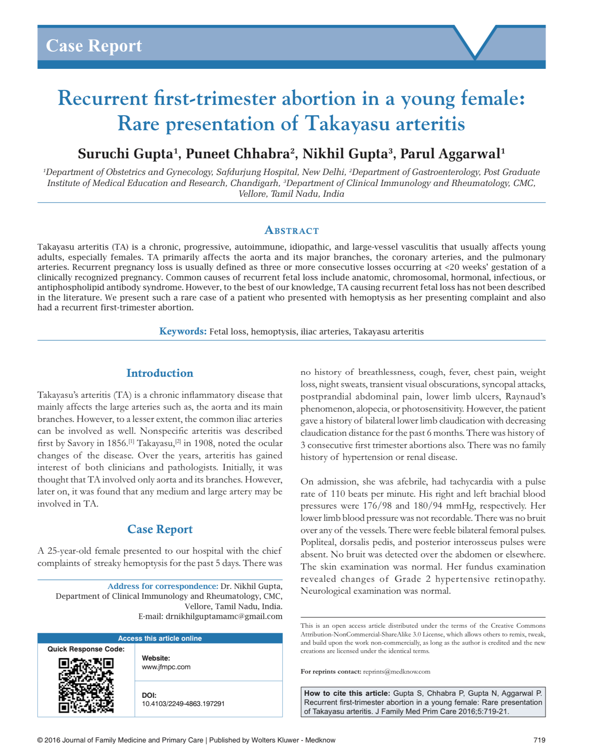

Slide 36
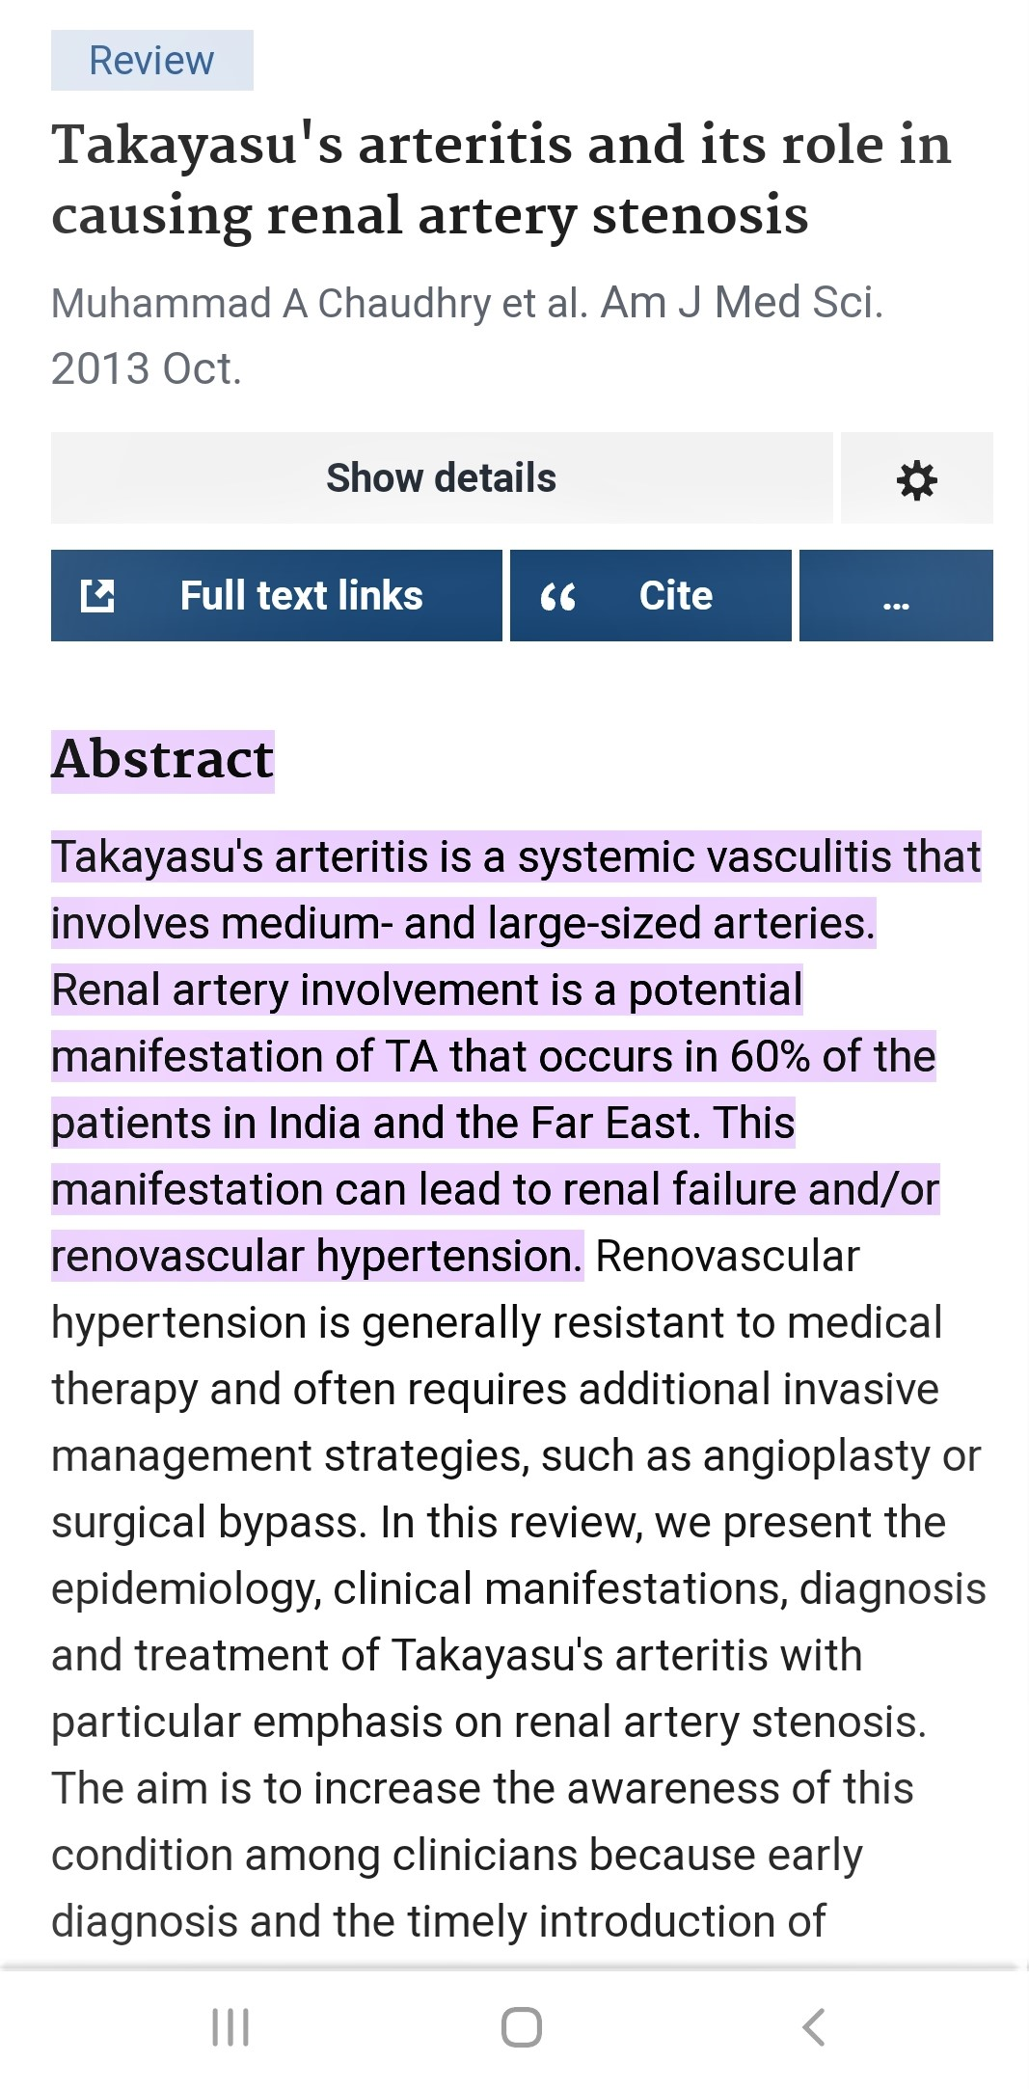

Slide 37
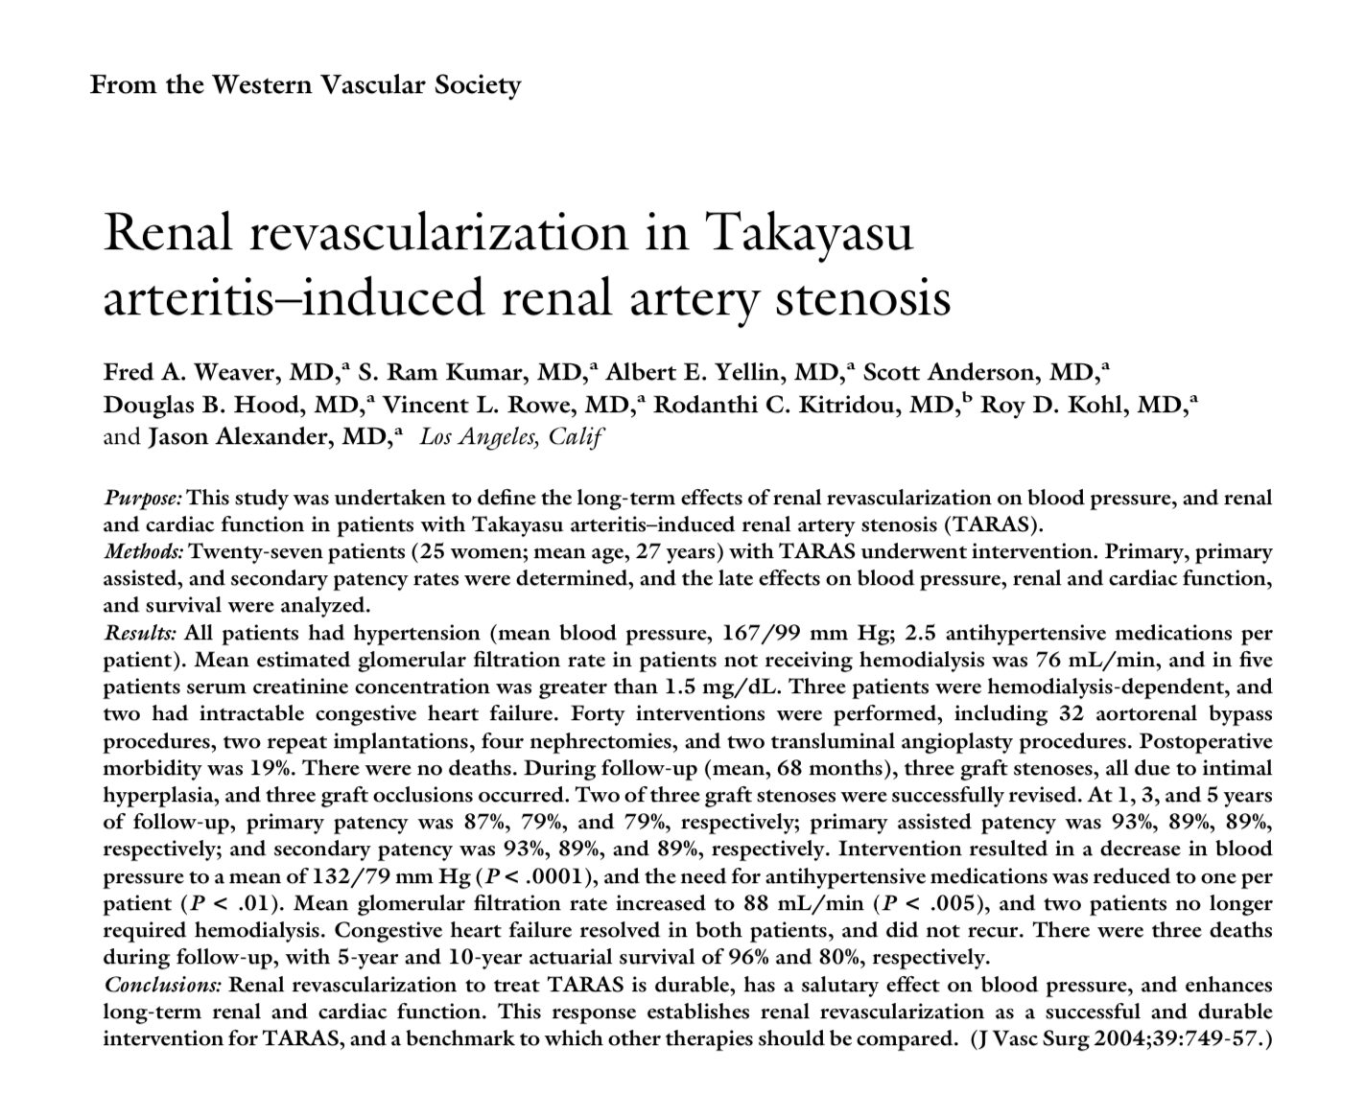

Slide 38
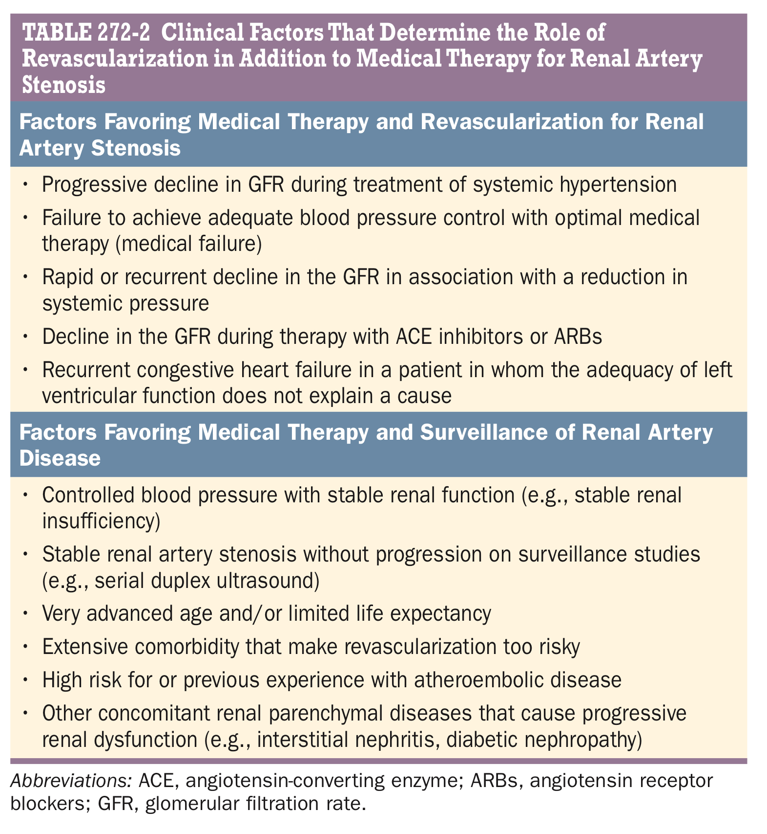

Slide 39
AIM OF PRESENTATION
To emphazise the importance of peripheral pulse in all young hypertension patients .
Importance of renal revasularization
possibilities of abortion

Slide 40
THANK YOU

