Slide 1
PROFESSOR AND HOD DR.V.T. PREMKUMAR MD ASSISTANT PROFESSORS : DR.S. PEER MOHAMED MD., DR.K.MURALIDHARAN.MD., DR.S.MURUGESAN MD.,
STURGE WEBER
KLIPPEL TRENAUNAY
SYNDROME
OVERLAP
Ist MEDICAL UNIT

Slide 2
Presenting illness
20 year old male admitted with c/o
Pain in both eyes
Reduced vision for 8 years

Slide 3
History of present illness
Referred from private hospital as a case of secondary glaucoma both eyes(left >>>right) for further evaluation
h/o pain in both eyes+
h/o reduced vision in left eye followed by right eye for the past 8 years

Slide 4
h/o poor scholastic performance+
h/o abnormal pigmentation over the face since birth
no h/o weakness of any limbs
No h/o any bleeding manifestations
No h/o any swelling on the body
no h/o bowel or bladder incontinence

Slide 5
PAST HISTORY
h/o seizure disorder since 7 months of age
Involving right upper limb
Was on medication till 7 years of age
No further seizure episodes since then
K/c/o glaucoma( left eye followed by right) on treatment for past 7 years
Not a k/c/o DM/SHT/Asthma/TB/CAD

Slide 6
Personal history
Mixed diet
Bowel and bladder habits normal
Non-smoker
Non-alcoholic

Slide 7
FAMILY HISTORY
5TH child of a non-consanguinous marriage
4 females,1 male
no h/o similar illness in the family

Slide 8
BIRTH & DEVELOPMENTAL HISTORY
Home delivery
H/o bluish discoloration of face since birth.
Attained milestones at appropriate ages
Not going to school for the past 3 years
Studied upto 10th standard

Slide 9
GENERAL EXAMINATION
Conscious,
oriented
Afebrile
No pallor
No icterus
No cyanosis
No clubbing
No Generalised lymphadenopathy
No pedal edema
Facial naevi+
Focal alopecia+
Blue sclera+
Bitot’s spots
Palmar erythema +
B/l lower limb varicose veins+
Dilated veins over the abdomen+

Slide 10
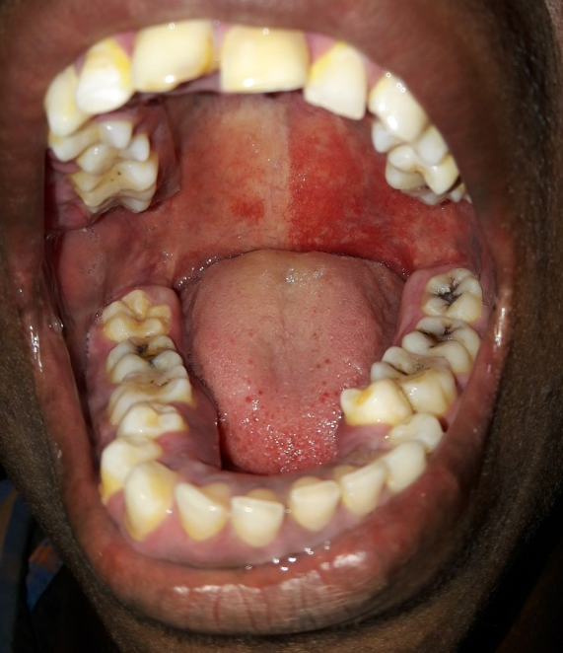
Capillary hemangioma

Slide 11
Port wine stain

Slide 12
Blue sclera

Slide 13
Conjunctival naevus

Slide 15
VITALS
Pulse-88 /min, regular rhythm, normal volume and character, felt in all peripheral accessible vessels, no radiofemoral delay
Blood pressure-110/80 mm of Hg in right upper limb in supine position
Spo2-98 % in room air

Slide 16
Anthropometry
AP diameter of head-20cm
Transverse diameter of head-15 cm
Cephalic index- 75( Dolicocephaly)
Testes and penis – normal size
Pubic and axillary hair- sparse

Slide 17
System examination
CVS S1 S2 heard , no murmurs
RS B/L AE + no added sounds
P/A Soft no organomegaly

Slide 18
Cranial nerve examination
I – olfaction normal
II R L
Visual acuity 6/18 6/24
Pupils 3mm 3mm
reacting to light RTL ( RAPD +)
III, IV,VI – EOM full
V – Normal
VII- Normal
VIII – Normal
IX ,X ,XI ,XII - Normal

Slide 19
Spinomotor Motor System
Bulk - Normal
No limb asymmetry/hypertrophy
Tone - Normal
Power - 5/5 in all four limbs
Reflexes - Normal

Slide 20
Sensory system – Normal
Cerebellar system - Normal
Spine and cranium – Dolicocephaly +
Peripheral nervous system - Normal

Slide 21
Basic investigations
Hb-12.0
TC – 7,000
DC P 65,L-27,M-10
PCV- 34%
PLATELET- 2.05 Lakhs
ESR-5mm/HR
Urea – 16 mg %
Creatinine– 0.8mg %
Sugar – 81 mg %
ECG- within normal limits
USG Abdomen- No abnormality detected

Slide 22
OPHTHALMOLOGY OPINION
Right eye | Examination | Left eye
6/18 | Vision | 6/24
20.6mm Hg | Schiotz tonometry | 30.4 mm Hg
N | Lids | Haemangioma +
Bitots spots + temporally | Conjuctiva | Bitots spots + temporally
Thinning+ | Sclera | Thinning+
Normal | Cornea | Normal
Normal depth | Anterior chamber | Normal depth
Normal | Iris | Normal
RR | Pupils | RAPD +
Clear | Lens | clear

Slide 23
Right eye | Examination | Left eye
Clear | Media | Clear
N | Disc | N
0.4:1 | C:D | 0.8:1 laminar dot sign +
N | Vessel | N
2:3 | A:V | 2:3
N | Macula | N
+ | FR | +
24.33 mm | Mean Axial Length | 27.22mm

Slide 24
Impression :
Left eye Secondary open angle glaucoma due to increased episcleral venous pressure
Scleral thinning +
Conjunctival naevus +
Suggested :
B/E Timolol eye drops bd
Brimonidine eye drops bd
Review with MRI brain reports

Slide 25
CT PLAIN
Tram track calcification

Slide 27
CT BRAIN Report
Hyperpneumatization of frontal sniuses
Diffuse calvarial thickening
Gliotic changes in right parieto-occipital region
Tram track subcortical calcification

Slide 28
MRI BRAIN WITH CONTRAST
B/L FRONTAL CALVARIAL THICKENING NOTED
B/L HYPERPNEUMATIZATION OF FRONTAL SINUSES
CSF INTENSE LESION NOTED IN THE RIGHT PARIETO-OCCIPITAL REGION IN ALL SEQUENCES S/O GLIOSIS
RIGHT CHOROIDAL PLEXUS APPEARS ENLARGED
BLOOMING IN GRE SEQUENCE .
On CONTRAST :
SERPENTINE GYRIFORM ENHANCEMENT NOTED IN THE RIGHT PARIETO-OCCIPITAL REGION.
IMPRESSION: STURGE WEBER SYNDROME

Slide 29
MRI BRAIN

Slide 30
MRI BRAIN

Slide 33
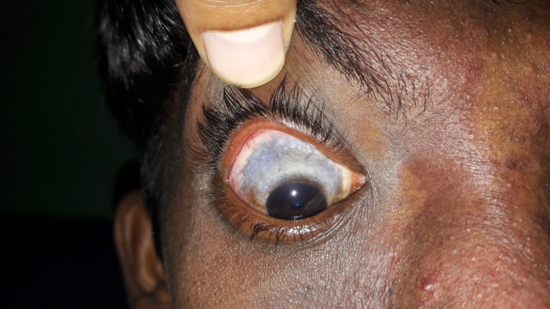
OPHTHAL REVIEW
MRI BRAIN suggestive of
STURGE WEBER SYNDROME
Advised
Continue brimonidine eye drops
Periodic review

Slide 34
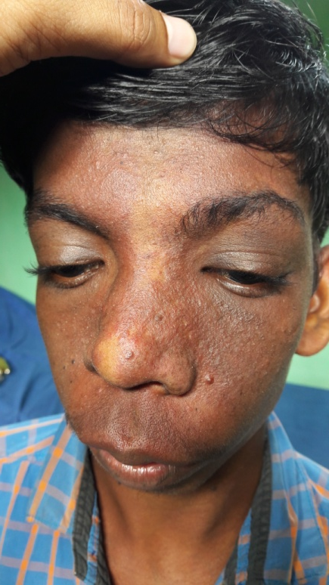
DERMATOLOGY OPINION
IMPRESSION :
STURGE WEBER SYNDROME
Phakomatosis pigmento vascularis
Nil active dermatological intervention at present .

Slide 35
PSYCHIATRIST OPINION
Subjected to intelligence testing
Mental age 10 years 8 months
With IQ – 67
Features suggestive of mild mental retardation

Slide 36
NEUROLOGIST OPINION
Clinical features suggestive of Sturge Weber Syndrome
Suggested :
EEG
Continue same line of management .

Slide 37
EEG
No paroxysmal spikes / sharp wave discharges
Normal study.

Slide 38
ENDROCRINOLOGIST OPINION
No clinical evidence of hypo-gonadism
Penile length normal
Testes normal in size
Suggested :
T4 ,TSH fT4 – 1.04( 0.89 – 1.72 ng/dl)
TSH – 4.04 ( 0.3 – 5.5 IU/ml )
Status --- Eu-thyroidal .

Slide 39
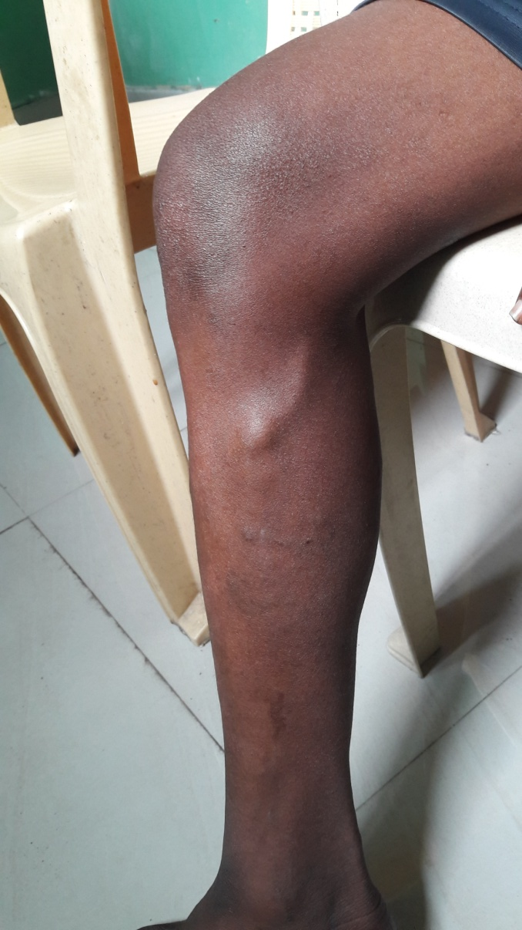
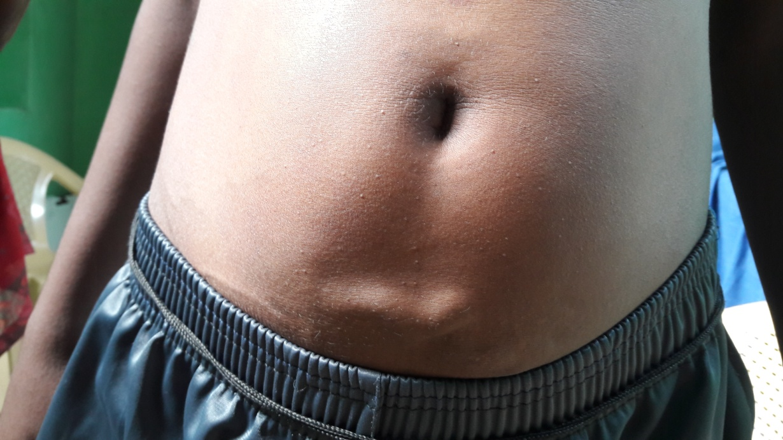
Evaluation of varicose veins
Examination:

Slide 40
Venous doppler
Absence of deep venous system of both lower limbs and infra-renal part of IVC (and its draining veins ) with dilated superficial venous system and varicosities in both lower limbs
Draining of lower limb is via both dilated tortuous GSV which drains into persistent umbilical vein which inturn drain into left portal vein .
Suggested CT Venogram

Slide 41
CT VENOGRAM OF LOWER LIMB VEINS
Complete absence of the deep venous system of both lower limbs
Absence of infrarenal part of IVC , B/L Iliac veins
Venous drainage of the lower limbs is by the superficial system with grossly dilated both GSV which enters into abdominal subcutaneous plane till umbilicus and drain into persistent dilated umbilical vein .

Slide 42
Umbilical vein runs through its fetal course and drains into left portal vein , enhancing / perfusing the left lobe of liver an drains through the hepatic veins into the IVC .
Left portal vein is dilated
e/o dilated tortuous communicating vein seen connecting both GSV in infraumbilical part.
e/o multiple dilated varicosities noted over lower limb .

Slide 43
IMPRESSION
Absence of deep venous system of both lower limbs and infra-renal part of IVC (and its draining veins ) with dilated superficial venous system and varicosities in both lower limbs
Draining of lower limb is via both dilated tortuous GSV which drains into persistent umbilical vein which inturn drain into left portal vein .
P/O B/L KLIPPEL TRENAUNAY SYNDROME

Slide 44
CT VENOGRAM

Slide 45
CT VENOGRAM

Slide 46
Absence of deep venous system
Arcuate vein
Great saphenous vein

Slide 47
Left lobe of Liver
Umbilical vein
Arcuate vein
Great saphenous vein

Slide 48
VASCULAR OPINION
B/L LL varicose veins of GSV
No limb length discrepancy / hypertrophy .
Suggested :
Life long B/L Class II compressive stockings
Limb elevation .

Slide 49
FINAL DIAGNOSIS
STURGE WEBER SYNDROME
KLIPPEL TRENAUNAY SYNDROME

Slide 50
MANAGEMENT
Brimonidine eye drops BD
Grade II compression Stockings
Limb elevation

Slide 51
Thank you

Slide 52
An Trilogy of syndromes
STURGE WEBER
CUTANEOUS
KLIPPEL TRENAUNAY
PORTWINE STAIN
PARKES WEBER
FEATURES OF KLIPPEL TRENAUNAY +
AV malformations
OCULAR
NEUROLOGIC
LOCAL GIGANTISM
ABSENCE OF DEEP VENOUS SYSTEM

Slide 53
Sturge weber Syndrome
Cutaneous
Facial angiomas
Ocular
Glaucoma
Neurologic
Meningeal Angiomas
Seizures
Port wine stain
Iris hamartoma
Choroid angioma
Mental retardation
Homonymous visual field defects

Slide 54
STURGE WEBER SYNDROME KLIPPEL TRENAUNAY OVERLAP
Incidence of Sturge Weber Syndrome – 1/50,000.
Incidence of klippel trenaunay syndrome – 2/50,000.
So far only 39 cases of Klippel Trenaunay syndrome and Sturge weber Syndrome overlap have been reported.
Klippel trenaunay syndrome usually unilateral involvement is present but in our case it is bilateral .

