Slide 1
Interesting Spotter
IMCU I
CHIEF : Dr. Muralidharan MD
ASSISTANT PROFESSORS : Dr. Jegadeesan MD

Slide 2
A 29 year old female patient presented with
C/o Headache for past one week
C/o Nausea for past one week
Past history :
Patient recently diagnosed Hashimoto thyroiditis on Tab Thyroxine 50mcg 1-0-0
Not a k/c/o T2DM,SHTN, Bronchial asthma, Epilepsy

Slide 3
o/e patient conscious
oriented
afebrile
Pallor +, NO PE, non icteric, No cyanosis, No cluubing
Balckish discoloration of Right middle toe
s/e
cvs: s1 s2+
rs: bae+
p/a : soft
cns: conscious oriented
Tone Normal
Moves all 4 limbs
Plantar bilateral flexor
DEM intact
BL Pupil RTL
Bp: 110/80 mmhg
PR: 82 /min regular
SPO2 : 98% room air

Slide 4
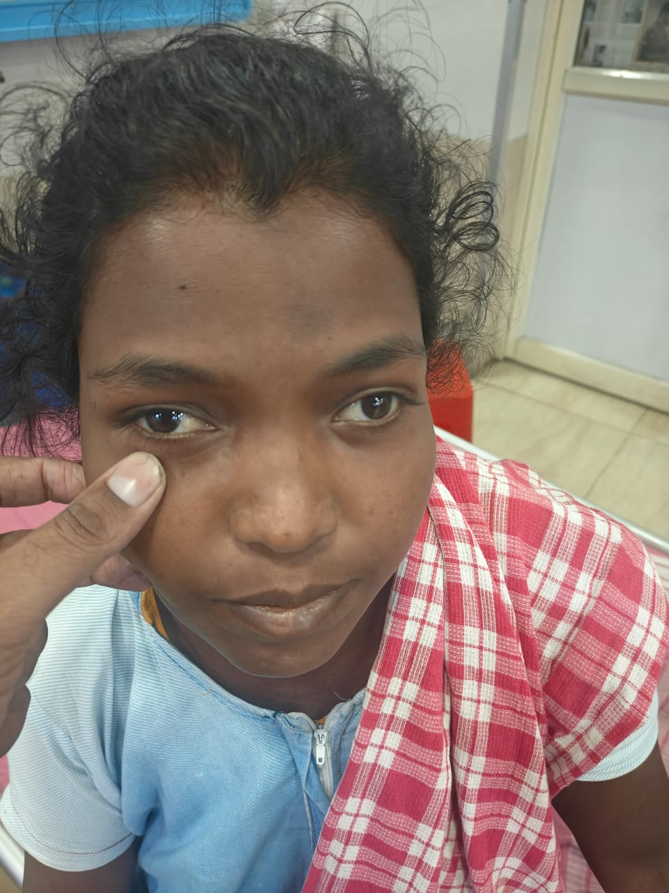
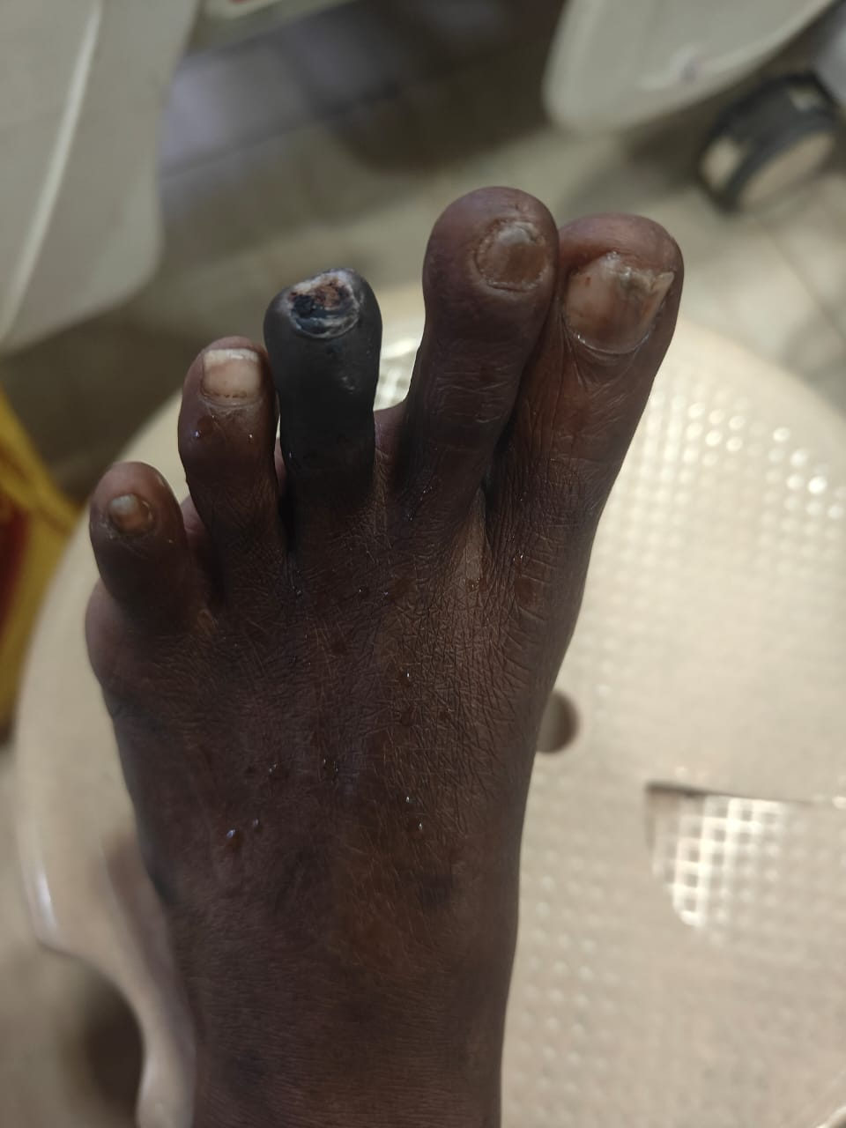

Slide 5
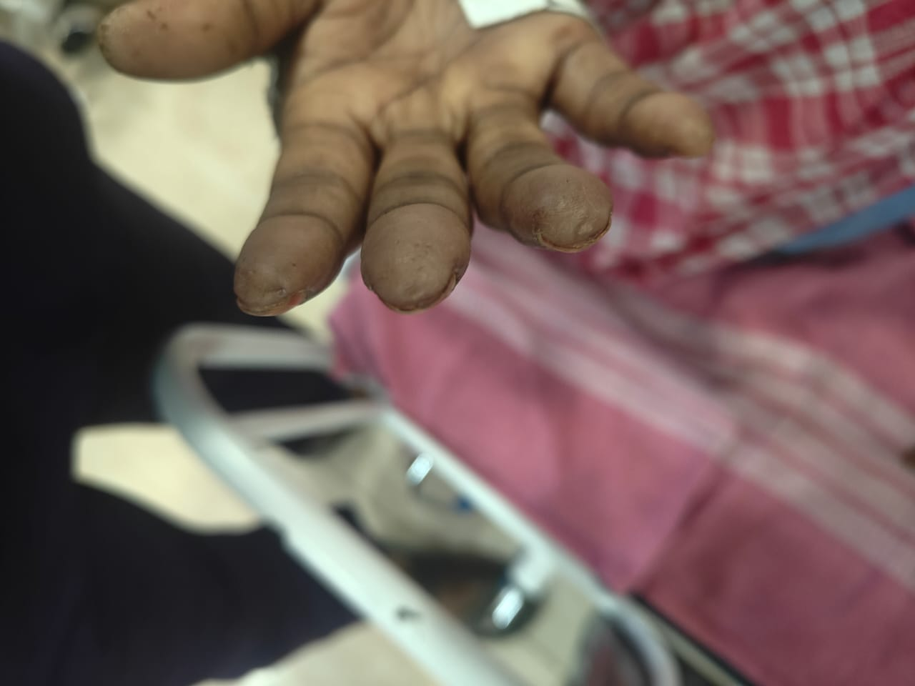
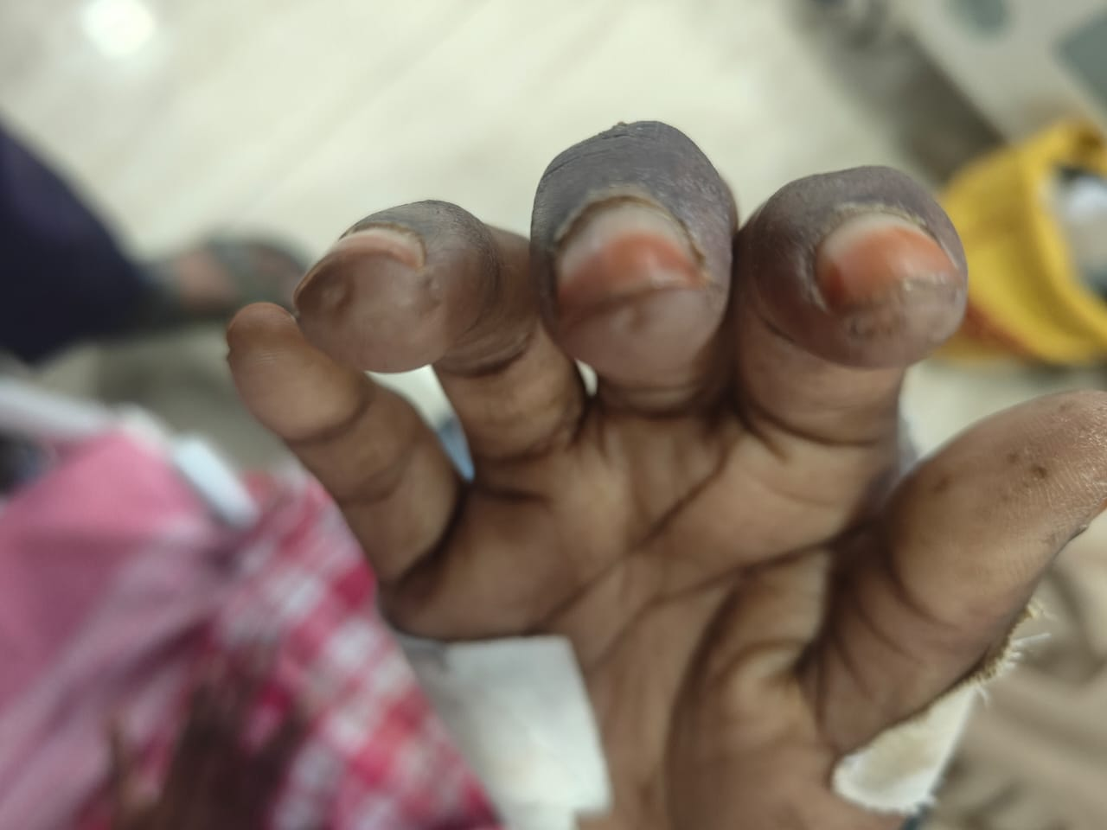

Slide 6
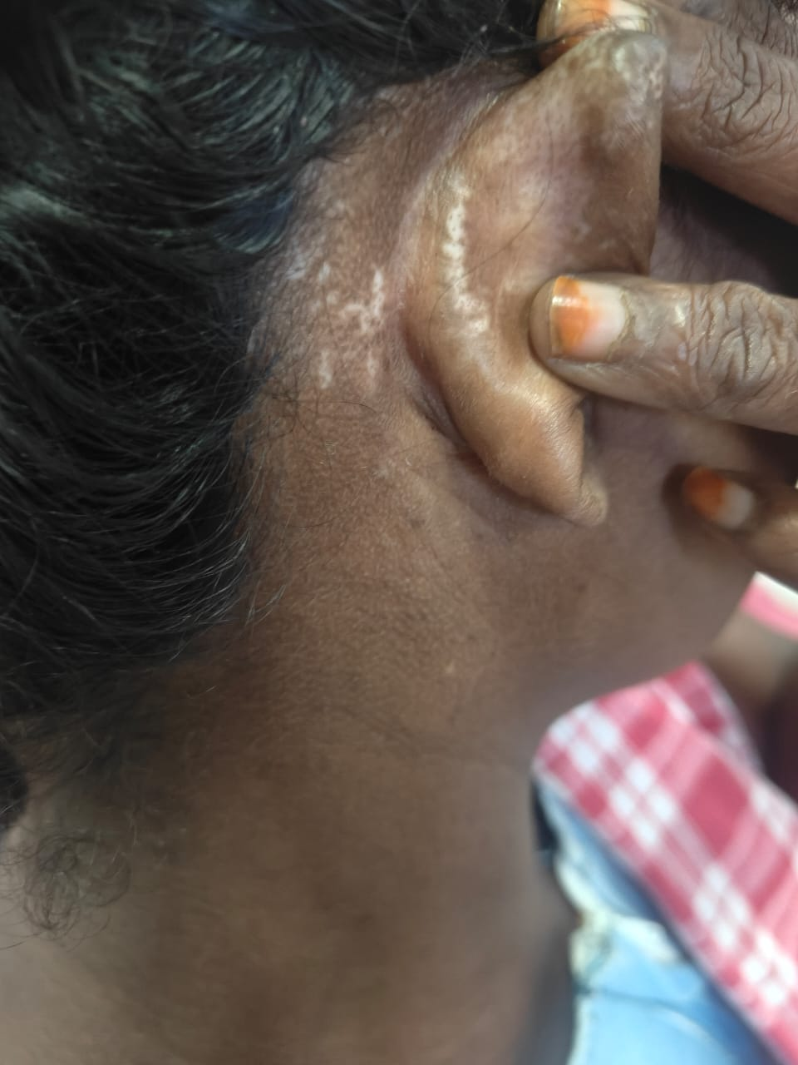
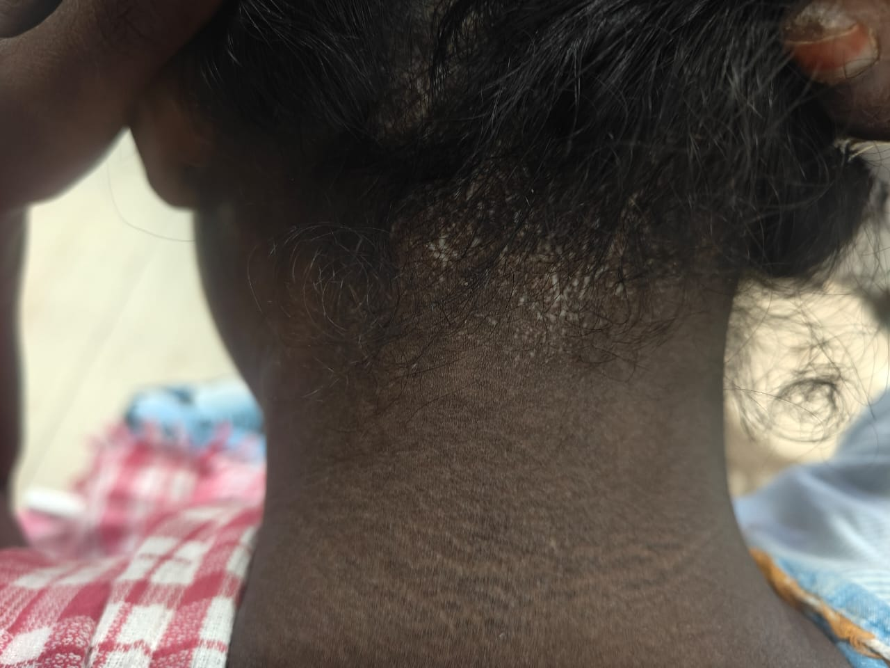

Slide 7
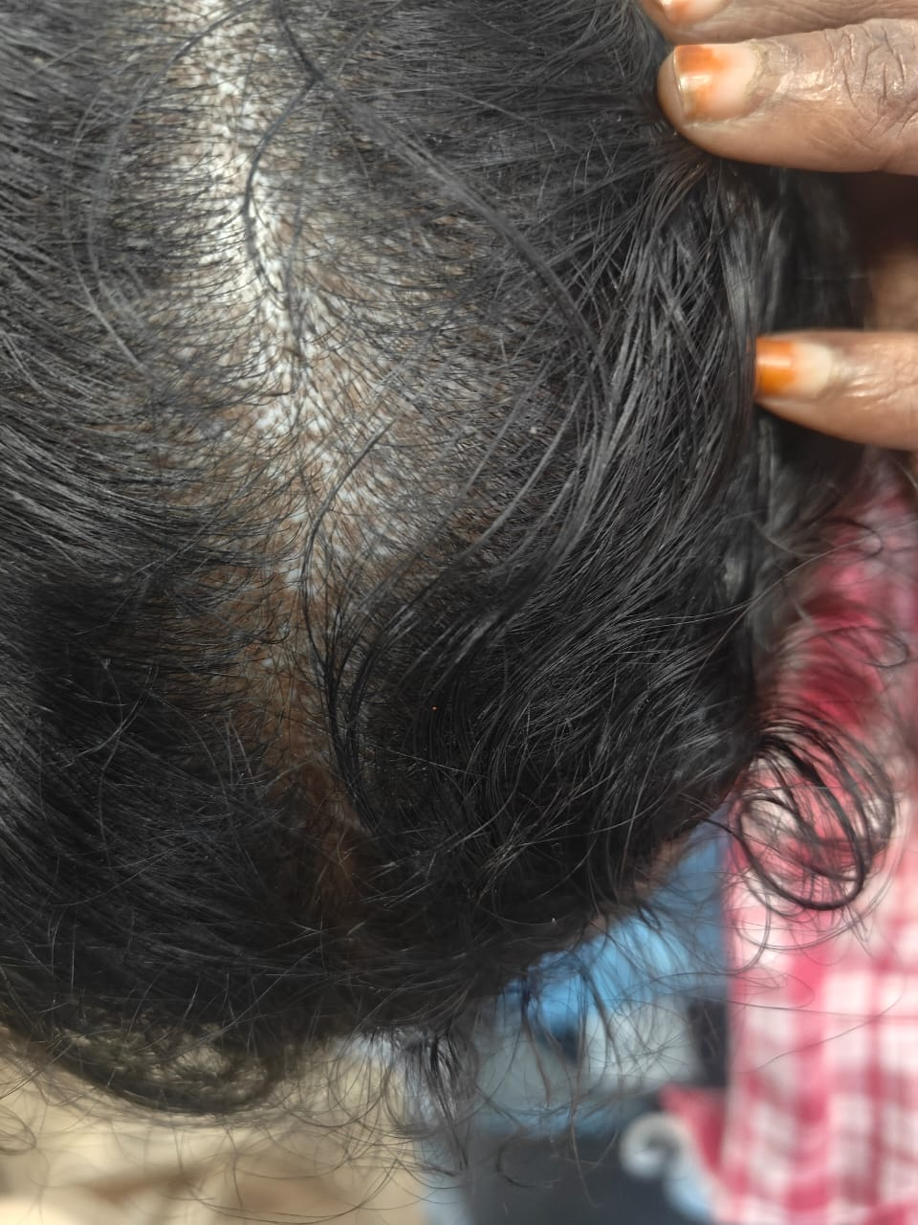

Slide 8
LET’S DISCUSS

