Slide 1
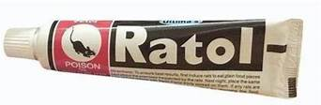
RAT KILLER PASTE POISONING
Chief and professor: Dr.B.Palanikumar MD
Associate professor : Dr.V.Palanikumaran MD
Assistant Professors : Dr.S.Ponsenthil Kumar MD
Dr.S.Saravana Madhav MD
Dr.M.Ilamaran MD
SYMPOSIUM BY 2ND MEDICAL UNIT

Slide 2
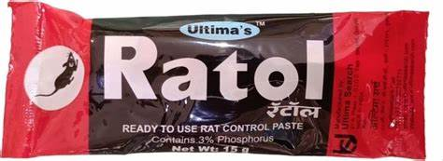
RAT KILLER PASTE-Elemental Phosphorus
Yellow/White phosphorus :2-5%
Highly protoplasmic toxin
Highly lipid soluble
fertilizer,fireworks,rodenticide
Red Phosphorus:
Insoluble,non-absorbable
Non toxic
MINIMUM DOSE-15mg
LETHAL DOSE-1mg/kg (ingestion)
5mg/kg(inhalation)

Slide 3
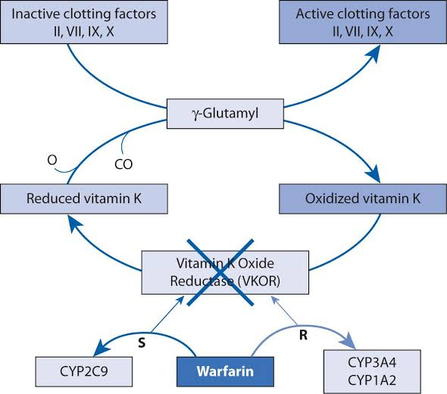
RAT KILLER CAKE- warfarins and superwarfarins
Vit k cycle inhibitors
 | Warfarin | Superwarfarin
Duration of effect | 2-7 days | Weeks-Months
Toxic dose | Chronic repeated ingestion | 1mg smaller doses
Eg | Acenocoumarol | Bromadiolone,brodiafacoum

Slide 4
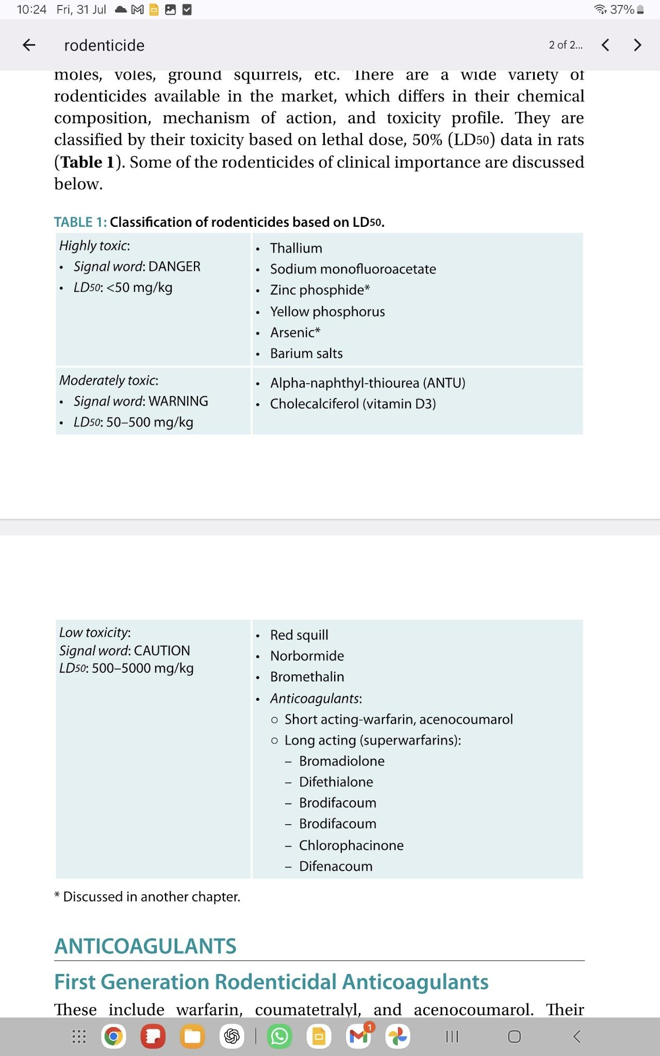
RAT KILLER POWDER
Zinc phosphide- phosphide gastrointestinal in stomach - vomiting, metabolic acidosis, myocarditis
Aluminum phosphide-profound hypotension,refractory shock,severe metabolic acidosis
Calcium phosphide
Yellow phosphorus -hepatotoxic
Anticoagulants
Highly toxic

Slide 5
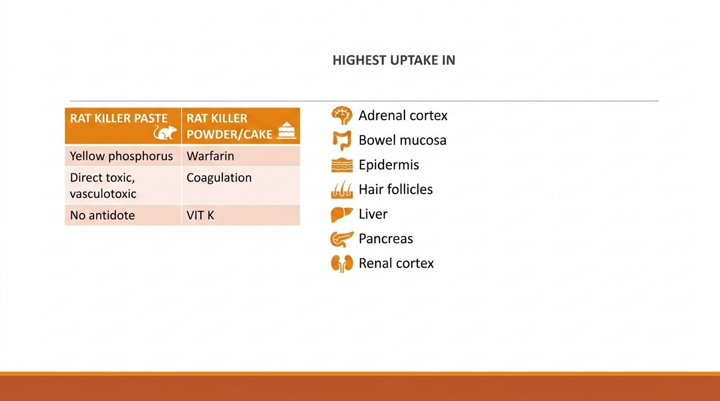

Slide 6
MECHANISM
Uncoupling of oxidative phosphorylation -mitochondrial injury
Phosphoric acid –direct tissue damage due to free radicals produced against organic molecules(exothermic reaction)
Changes ribosomal function,protein synthesis, fatty degeneration of multiple organs
Direct toxicity to heart and vascular tone(fluid loss –cardiovascular collapse)

Slide 7
CLINICAL MANIFESTATIONS:
Acute inhalation
Conjunctivitis
mucosal necrosis
Wheezing
chemical pneumonitis
non-cardiogenic pulmonary edema
Chronic inhalation
mandibular necrosis(phossy jaw),anemia
Skin/Eye contact –Dermal burns(2nd/3rd degree burns—death)

Slide 8
CLINICAL MANIFESTATIONS
Acute ingestion:
Diarrhea with Smoking stool syndrome(luminescent)
GI burns
Abdominal pain,severe vomiting(hemetemesis)-garlic odour
Seizures,Headache,delirium,arrhythmias
Hypocalcemia and hyperphosphatemia
Patients who develop CNS symptoms before other organ systems are affected have mortality rate of 73%

Slide 9
STAGES
STAGE | DURATION | SYMPTOMS | CAUSE OF DEATH
1 | First 24hrs | Local GI irritation | Arrhythmia(severe hypocalcemia)
2 | 24-72hr | Asymptomatic Mild derangement of liver enzymes | -
3 | >72hrs | Acute fulminant liver failure, Coagulopathy,hemolysis, Acute tubular necrosis, CNS effects and cardiac toxicity | Acute Fulminant hepatic failure

Slide 10
INVESTIGATIONS
CBC
LFT
Coagulation profile
RFT
Urine routine
Chest x-ray
S.Electrolytes
ABG and lactate
Serum TGL may fall as hepatic toxicity develops and may be an increase in serum and urinary ketones.

Slide 11
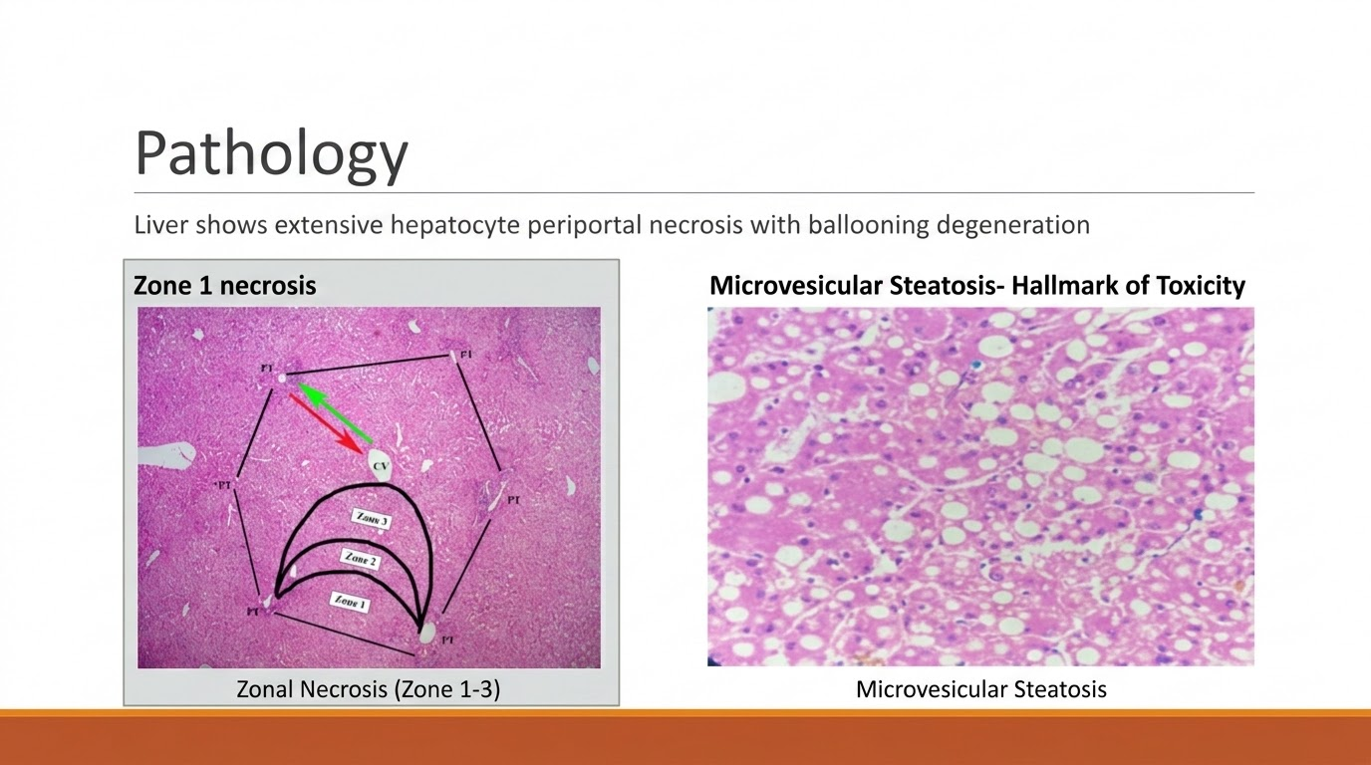

Slide 12
MANAGEMENT
NO specific antidote
Removal of poison and Supportive treatment
Gastric lavage,skin decontamination
Airway management ,If major bleed-treat shock
NAC
Plasma exchange
Liver Transplant
Avoid digestible oils and fats

Slide 13
GASTRIC LAVAGE
Multi dose activated charcoal -1g/kg of body weight
(Contraindication-Presumed GI perforation)
Potassium permanganate-convert phosphorus to harmless oxides
If possible avoid use of nasogastric tubes, endotracheal intubation or central lines

Slide 14
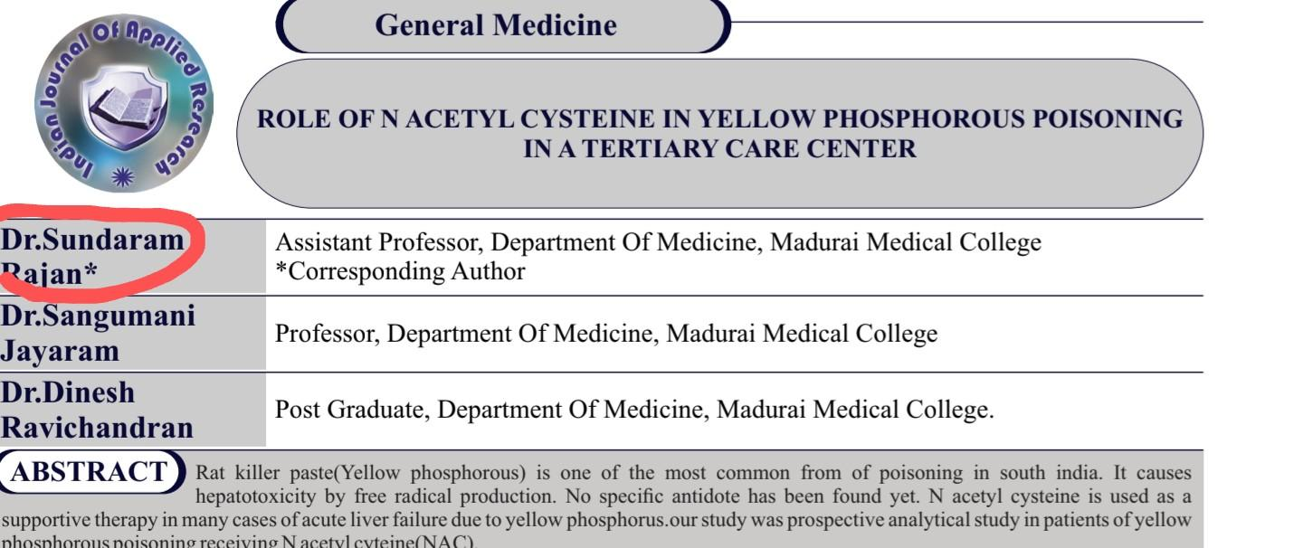
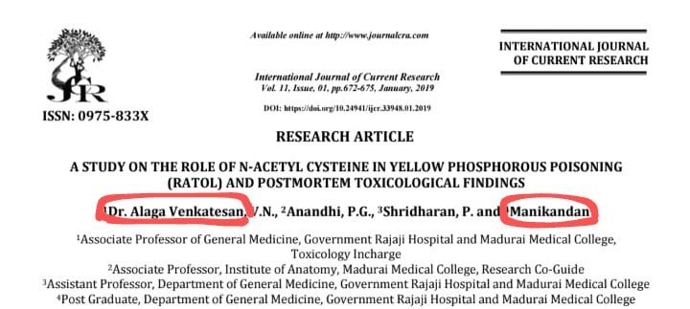

Slide 15
NAC
If early presentation- initiate as early as possible
Acute ingestion: IV CONTINUOUS INFUSION
Loading dose-150mg/kg in 100ml 5%D over 1 hour
50mg/kg in 500ml 5%D over 4 hours
100mg/kg in 500ml 5%D over 16 hours

Slide 16
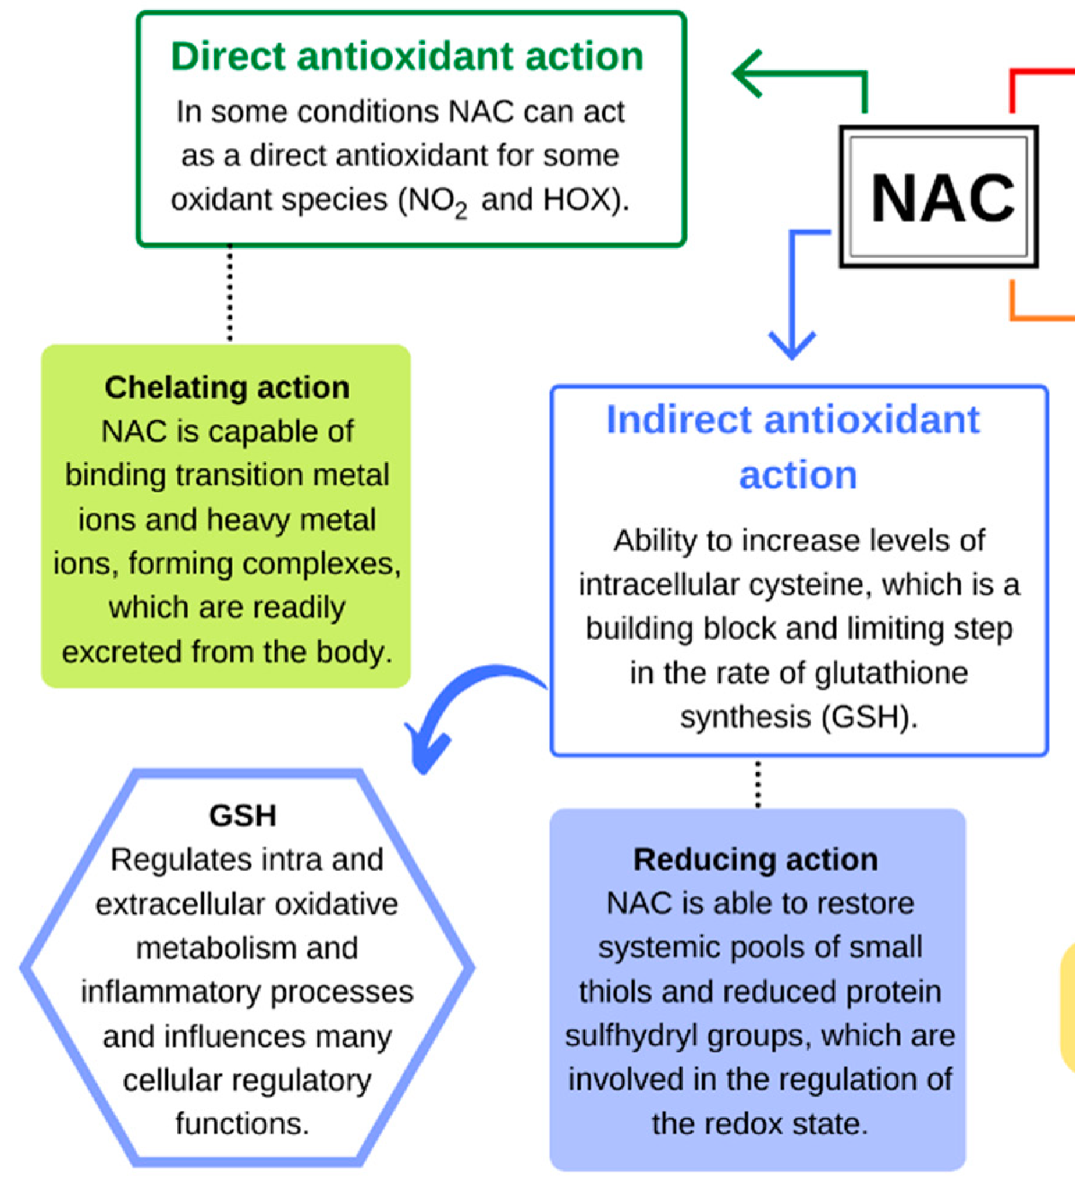

Slide 17
NAC
Oral NAC in chronic presentation
T.NAC 140mg/kg stat -----70mg/kg every 4hours for 3days
Repeat LFT –
If normal-T.NAC 1.2g oral BD for 7days
If deranged-IV NAC for 3 days
Repeat LFT/PT-INR
FFP/Vit K
Plan liver transplant

Slide 18
Role of steroids
Theoretically, corticosteroids may:
Suppress excessive inflammatory response,Reduce cytokine-mediated liver injury,Stabilize cell membranes,Decrease cerebral edema in severe hepatic encephalopathy (theoretically, but not routinely recommended in ALF).
But steroids may:
Increase risk of secondary infections.
Increase gastrointestinal bleeding.
Cause hyperglycemia.
Mask sepsis.
Delay recognition of complications.

Slide 19
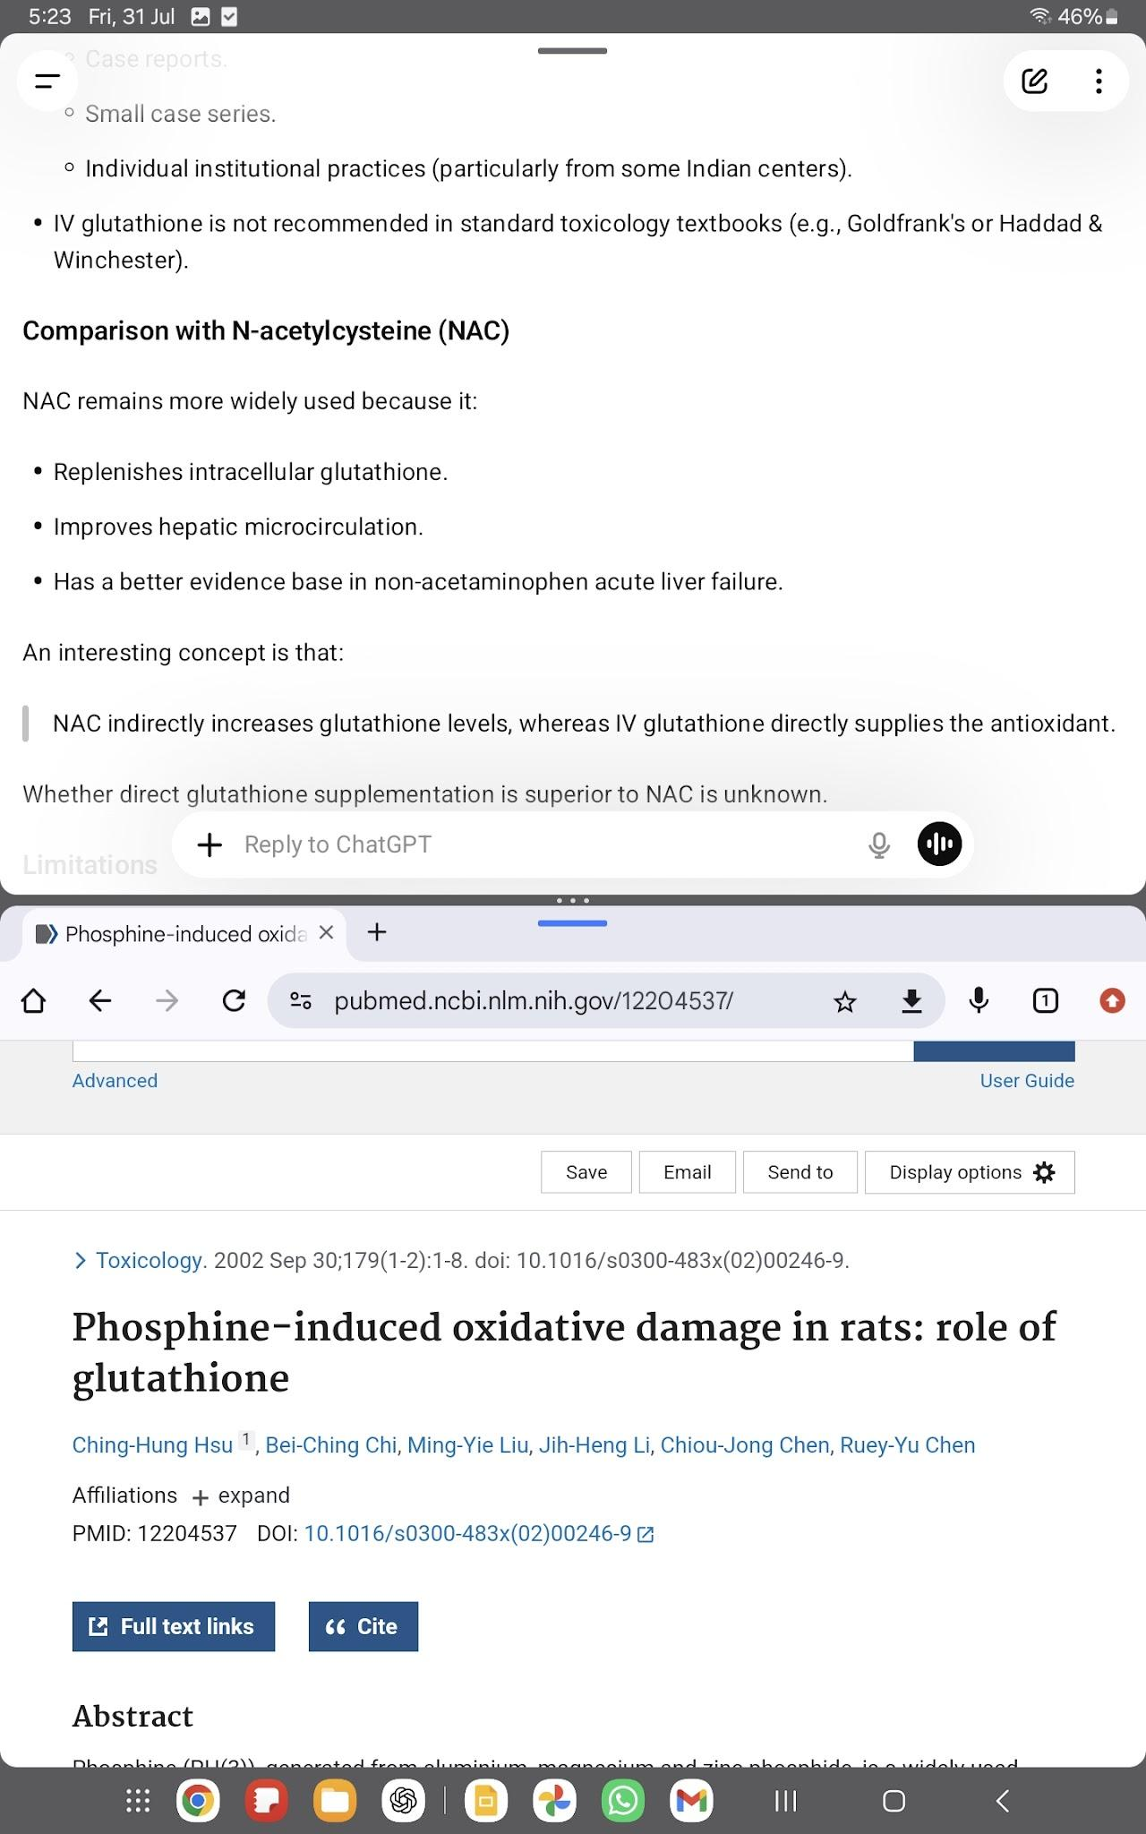
Role of IV Glutathione
Mechanism of Action Combats Oxidative Stress:
IV glutathione directly neutralizes these highly reactive oxygen species.
Protects the Liver
Multi-Organ Damage: (Combination with NAC: It is frequently administered alongside N-acetylcysteine (NAC). NAC serves as a cellular precursor that helps the body synthesize its own internal glutathione, creating a dual-action defense.
Adjunct to Plasmapheresis:

Slide 20
METABOLIC IMBALANCES
Acidosis -ALF
THAM solution(tromethamine injection)-prevents CO2 and sodium retention
Severe hypoglycemia-40%--------hence 10%D used
Hyperphosphatemia,hypocalcemia,hypomagnesemia and hypokalemia
Monitor for encephalopathy, cerebral edema

Slide 21
RENAL FAILURE
Acute renal failure is common in patients with acute liver failure
Due to dehydration,hepatorenal syndrome,acute tubular necrosis
Avoid NSAIDs and nephrotoxics
When dialysis is needed: CVVHD is preferred than intermittent RRT

Slide 22
Plasma Exchange
INDICATIONS | CONTRAINDICATIONS
Acute liver failure INR>4 , raising bilirubin Hepatic encephalopathy, Rapid clinical deterioration Awating liver transplant MODS | Uncontrolled sepsis Severe hypocalcemia Hemodynamic instability

Slide 23
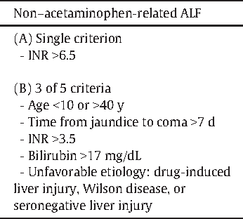
LIVER TRANSPLANT
Last option-
King’s College transplant criteria

Slide 24
Recent Advances
MARS (Molecular Adsorbent Recirculating System) and other extracorporeal liver support devices have been used as a bridge to liver transplantation or recovery.
Prometheus (Fractionated Plasma Separation and Adsorption)
SPAD (Single-pass Albumin Dialysis) These may stabilize patients awaiting
Dynamic assessment rather than waiting for classical King's College criteria alone, as deterioration in yellow phosphorus poisoning can be rapid.

Slide 25
Prognostic Models
MELD score
Dynamic INR trends
Lactate-based prediction models
No universally accepted yellow phosphorus-specific prognostic score has yet replaced existing liver failure criteria

Slide 26
Take home message
Serial INR -single most important parameter
Early Nac initiation
A symptom free period does not mean recovery
Acute liver failure is the major cause of death
Need observation for atleast 72hrs
Early referral to liver transplant before encephalopathy develops.

Slide 27
References:
Haddad and Winchester clinical management of poisoning and drug overdose
Goldfrank’s toxicologic emergencies
Vv pillai and paranthaman toxicology

Slide 28
THANK YOU

