Slide 1
A case of NITROBENZENE poisoning
V MU
CHIEF Dr J.SANGUMANI MD.,D.Diab. ASST Dr R.SUNDARAM MD.,
Dr K.S.RAGHAVAN MD.,D.Diab.
PRESENTOR: S.SRIDHAR PG

Slide 2
Case History
55 yr old male patient admitted with alleged history of ingestion of Benzovit(25% nitrobenzene ) around 12 noon and was admitted in GRH at 7pm.
H/O vomiting (+)
H/O breathlessness (+)
H/O abdominal pain (+)
No H/O seizures
No H/O altered sensorium
No H/O chest pain/palpitation/syncope

Slide 3
Case History
No H/O Jaundice
No H/O diarrhoea
No H/O Discolouration urine/Reduced urine output
No H/O abdominal distension
No H/O fever

Slide 4
Past history
Not a k/c/o DM, SHT, TB, Bronchial Asthma, COPD, CKD, CAD, CLD.
No H/O previous suicidal attempts.
No H/O jaundice in past
Pt not a smoker, not an alcoholic, on mixed diet with normal bowel and bladder habits.

Slide 5
On examination
Pt was conscious
oriented
tachypneic,
afebrile, no pallor, no icterus, no clubbing, no pedal edema
Pt had bluish discolouration of nails, lips and undersurface of the tongue

Slide 6
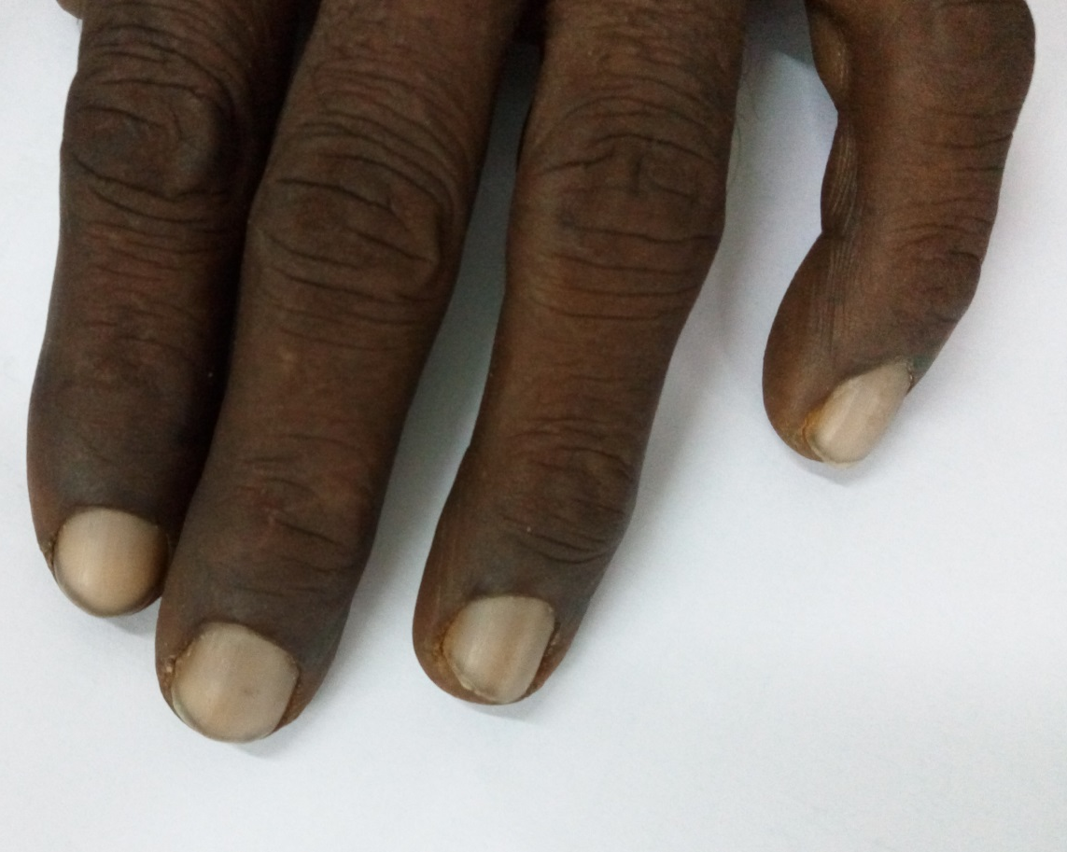
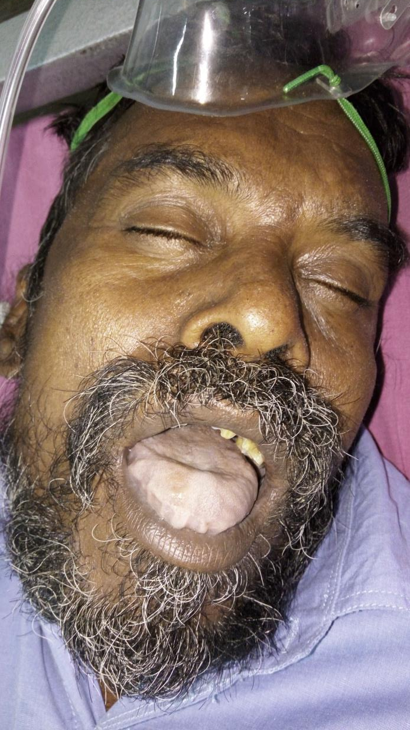

Slide 7
BP:110/70 mmhg
PR: 120/MIN
RR: 28/MIN
SPO2: 81% IN ROOM AIR
82% WITH NASAL O2
VITALS :

Slide 8
SYSTEMIC EXAMINATION
CARDIOVASCULAR: S1S2 (+) No murmur. JVP not elevated.
RESPIRATORY SYSTEM: B/L air entry (+), NVBS(+), no added sounds.
ABDOMEN: soft, no organomegaly, bowel sounds(+).
CNS: B/L pupils 3 mm reacting to light. EOM full
moving all limbs, no neck muscle weakness, no fasciculations.

Slide 9
Treatment
Stomach wash was given.
Pt was kept on NPO, ryle’s tube aspiration .
IV fluids were administered.
Inj Methylene blue 1% solution 50 mg in 100ml 5%D over 30mins iv stat followed by 30 mg iv 6th hrly *3days
Inj Ascorbic acid 500mg iv od * 6 days.
Inj.Ranitidine 50 mg iv bd.

Slide 10
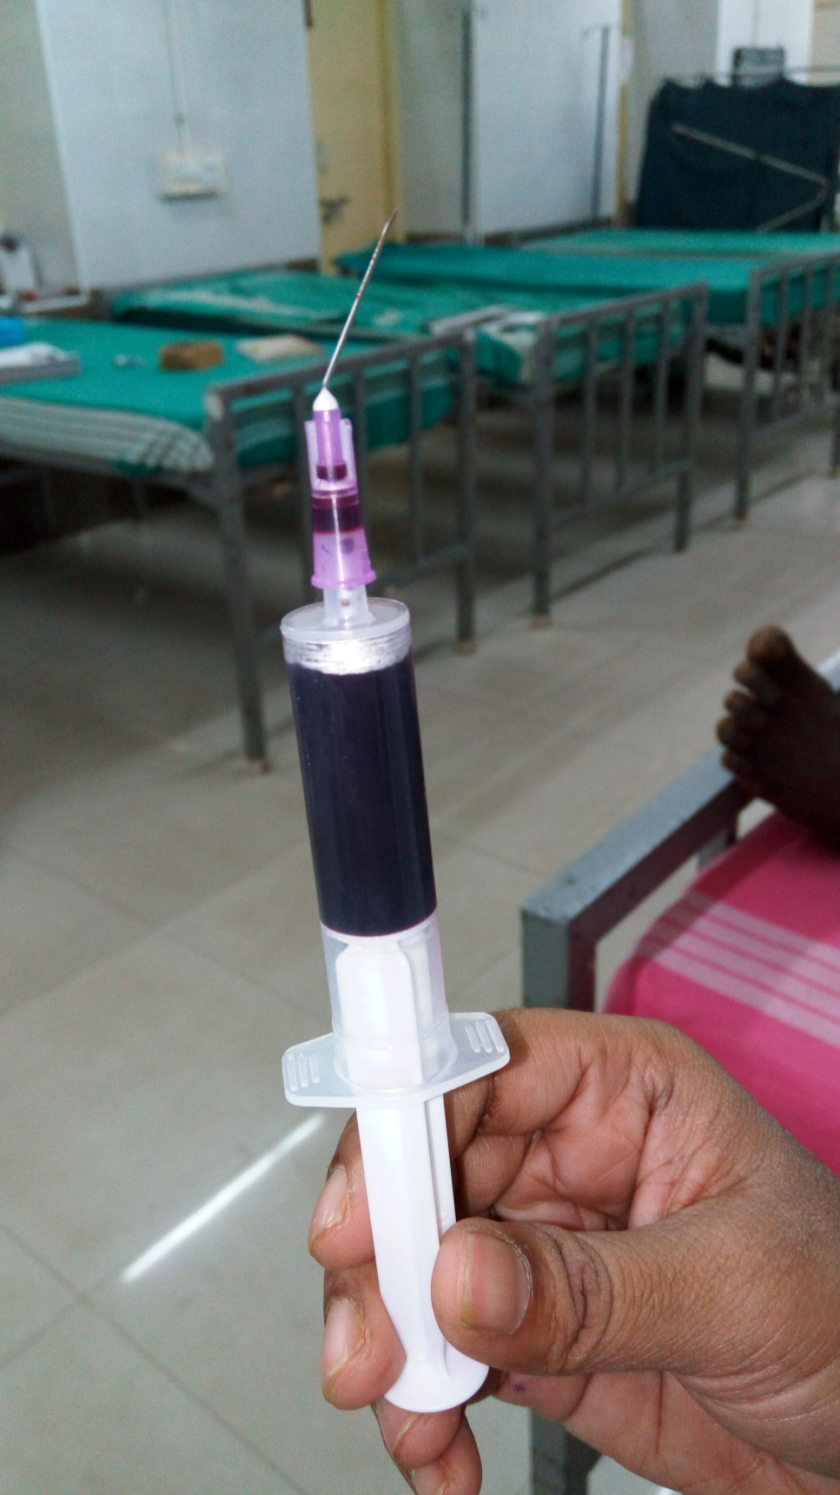

Slide 11
Investigations
 | 10/2 | 13/2 | 19/2 | 1/3
HAEMOGLOBIN | 15.1g% | 10.5g% | 9.8g% | 12.3g%
TOTAL COUNT | 12,200 cells | 8200 cells | 7800 cells | 6300cells
DC | P92 L4 Mix4 | P75 L17 Mix8 | P64 L24 Mix12 | P69 L24 Mix8
ESR | 10mm/Hr | 20mm/Hr | 36mm/Hr | 16mm/Hr
PLATELET | 1.52 Lakhs | 1.39 Lakhs | 1.64 Lakhs | 2.16 Lakhs
HEMATOCRIT | 43% | 31% | 28% | 35%

Slide 12
ABG
pH – 7.41
PaCO2- 32mmHg
PaO2- 95mmHg
SPO2- 82%

Slide 13
 | 10/2 | 13/2 | 16/2
RBS (mg/dl) | 65 | 72 | 97
UREA (mg/dl) | 44 | 36 | 34
CREATININE (mg/dl) | 1.2 | 0.8 | 0.8

Slide 14
LFT | 10/2 | 13/2 | 15/2 | 17/2 | 20/2 | 27/2
Total BILIRUBIN | 1.8 | 5.5 | 3.6 | 4.8 | 4.2 | 1.7
DIRECT BILIRUBIN | 0.7 | 1.1 | 1 | 1.8 | 1.1 | 0.8
INDIRECT BILIRUBIN | 1.1 | 4.4 | 2.6 | 3.0 | 3.1 | 0.9
SGOT | 50 | 22 | 31 | 64 | 96 | 62
SGPT | 36 | 20 | 18 | 37 | 57 | 35
RBS RFT – within normal limits

Slide 15
Complete hemogram with peripheral smear
RBC – 2.69million/mm3
Macrocytes with decreased red cell population.
Reticulocyte count : 5%
Corrected reticulocyte count: 3.5%
DIRECT COOMBS TEST : Negative

Slide 16
Urine Alb- nil
Sugar – nil
deposits – 0-3/hpf
bile salt – negative
bile pigment – negative

Slide 17
MGE OPINION
?Toxic hepatitis
Suggested viral markers – negative
USG abdomen and pelvis – mild splenomegaly

Slide 18
CARDIOLOGIST OPINION
Echo was normal
Stable cardiac status

Slide 19
Psychiatric counselling was given and patient was discharged and asked to come for follow up.
Condition on discharge: consious, oriented, not pallor, mild icterus (+), no cyanosis, no clubbing, no pedal edema.
Cvs: s1s2(+), no murmur.
Rs : Nvbs(+).
Cns: No focal neurological deficit.

Slide 20
Aim of presentation
Uncommon poisoning and presentation.
Subsequent adverse effects.
Unique treatment.
THANK YOU

