Slide 1
CPC
By Sixth Medical Unit
CHIEF - PROF DR.P.V.BALAMURUGAN MD
ASST PROFESSORS :
DR.VIGNESH MD
DR.GAYATHRI MD
PRESENTER : DR.M.KRUTHIKA

Slide 2
CHIEF COMPLAINTS
A 59 year old male patient Shanmuganathan , bus driver by occupation was brought to GRH referred from Private hospital with chief complaints of FEVER for the past 6 months.

Slide 3
HISTORY OF PRESENTING ILLNESS
The patient was apparently normal before 6 months after which the patient developed
Fever - low grade , intermittent in nature mostly in night, relieved by medication and associated with chills and rigor.
H/o loss of weight +
H/o loss of appetite +
H/o Conjunctivitis +
Patient was taken to Private Hospital, Investigations showed bicytopenia. ESR, CRP found to be elevated, IL-6 elevated and COVID antibody was found to be positive
Diagnosed as MIS - A Syndrome.
Patient treated with Tocilizumab.
Symptoms improved and Patient Discharged.

Slide 4
After 15 days Patient again developed fever taken to the same Hospital. IL6 was elevated, treated with 2nd dose of Tocilizumab.
After 15 days Patient again developed fever – taken to another Private Hospital – Investigations showed Pancytopenia, Normal Triglyceride, Increased Ferritin.
CT Abdomen done - Hepatitis with Mild Splenomegaly.
Diagnosed as Partial HLH.
Started on Steroids.
Symptoms Improved.
After few days Patient developed fever, loss of Appetite, loss of Weight brought to GRH for further Investigations and Management.

Slide 5
No H/o Cough
No H/o Joint Pain
No H/o Ear Pain
No H/o Ear Discharge
No H/o chest pain
No H/o breathlessness
No H/o jaundice
No H/o burning micturition
No H/o seizures
No h/o headache
No H/o vomiting

Slide 6
PAST HISTORY
K/c/o T2DM for the past 6 months on OHA and INSULIN .
Not a k/c/o SHTN/TB/BA/Epilepsy/CAD/Thyroid Disorder.

Slide 7
PERSONAL HISTORY
Mixed diet
Bowel and bladder habits - normal
Sleep pattern - normal
Occasional smoker and alcoholic

Slide 8
GENERAL EXAMINATION
Pt conscious
Oriented
Afebrile
Pallor +
No icterus/ cyanosis /clubbing / pedal edema

Slide 9
SYSTEMIC EXAMINATION
CVS- S1 S2 + , no murmur
RS - BAE + , no added sounds
P/A - soft BS+ , no organomegaly
CNS - conscious ,oriented

Slide 10
VITALS
BP - 120/70 mmhg
PR - 92/min
SPO2 - 99% in room air
CBG - 221 mg/dl

Slide 11
Date/ Investigations | 10.3.2025 | 12.3.2025 | 15.3.2025 | 28.3.2025 | 8.4.2025 | 15.4.2025 | 21.4.2025
Hb | 8.8 | 7.5 | 7.6 | 7.2 | 7.6 | 7.5 | 7.5
TC | 3500 | 2500 | 2000 | 2200 | 2500 | 3700 | 3100
PCV | 27.3 | 24.2 | 23 | 21.6 | 23 | 22.5 | 22.5
PLT | 82000 | 85000 | 92000 | 98000 | 1.05 | 1.06 | 1.1
RBS | 79
U/Cr | 28/0.3 |  |  | 52/1.0 | 41/1.2
TB/DB/IB | 0.3/0.1/0.2 |  | 0.4/0.3/0.1 | 0.8/0.4/0.4 |  |  | 1.0/0.5/0.5
OT/PT/ALP | 28/31/220 |  | 23/39/205 | 15/18/192 |  |  | 14/9/240

Slide 12
Date/Investigations | 10.03.2025 | 12.03.2025 | 14.04.2025
LDH | 540 | 528 | 520
qCRP | 82.5 | 89.6 | 203.2
ESR | 92 | 140 | 90
Cholesterol | 100
TGL | 101
HDL | 22
Sr. Ferritin | 1000
CPK | 104
AEC/ANC |  |  | 1026/190

Slide 13
Date/Investigation | 28.03.2025 | 04.04.2025
PPBS | 213
Na/K | 138/4.2 | 126/3.3
Uric Acid | 6.9
PT/INR/aPTT | 13.9/1.0/31.0
Protein/A/G | 4.8/2.6/2.1 | 4.6/2.6/2.0
Procalcitonin |  | 1.58

Slide 14
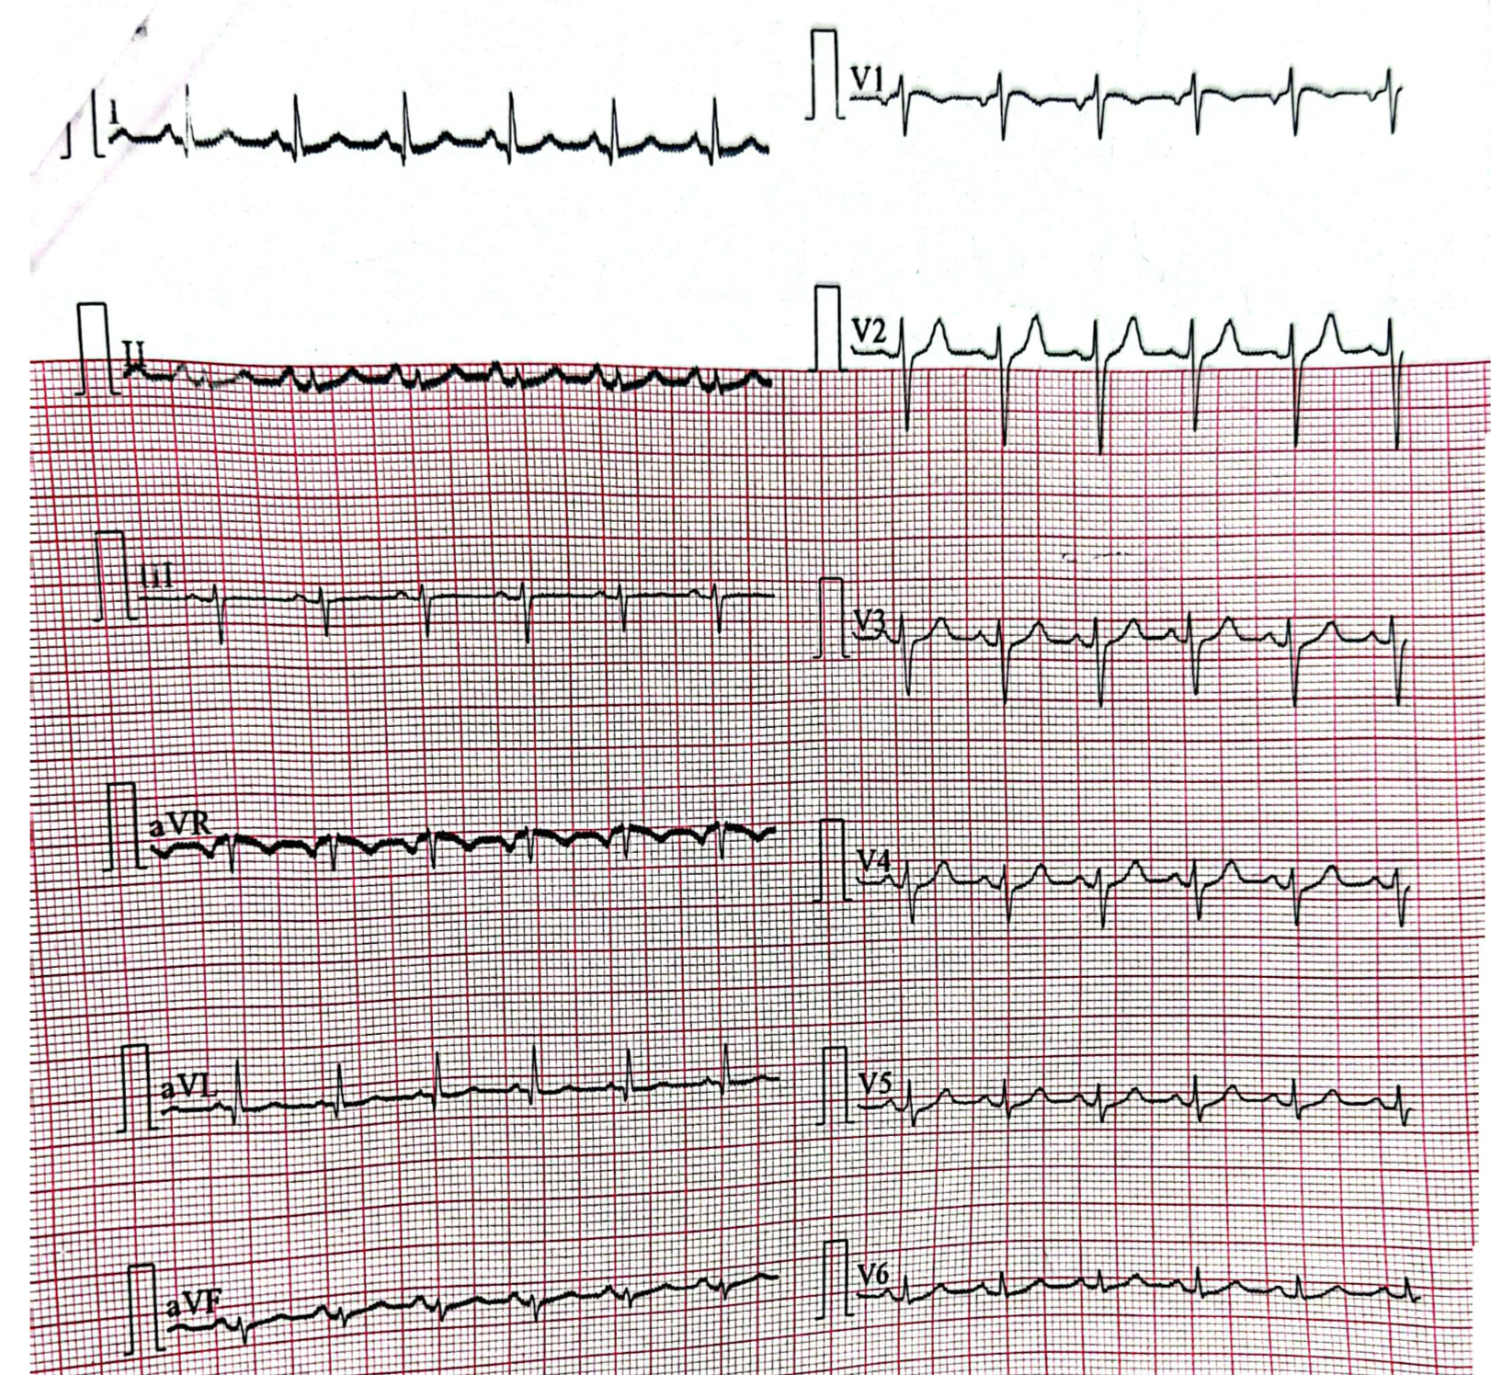
ECG – NORMAL STUDY

Slide 15
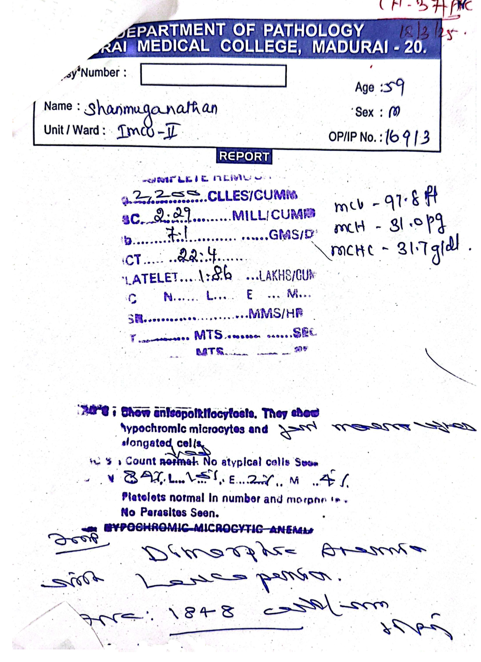
CHG-PS (18/3) - DIMORPHIC ANEMIA, LEUCOPENIA

Slide 16
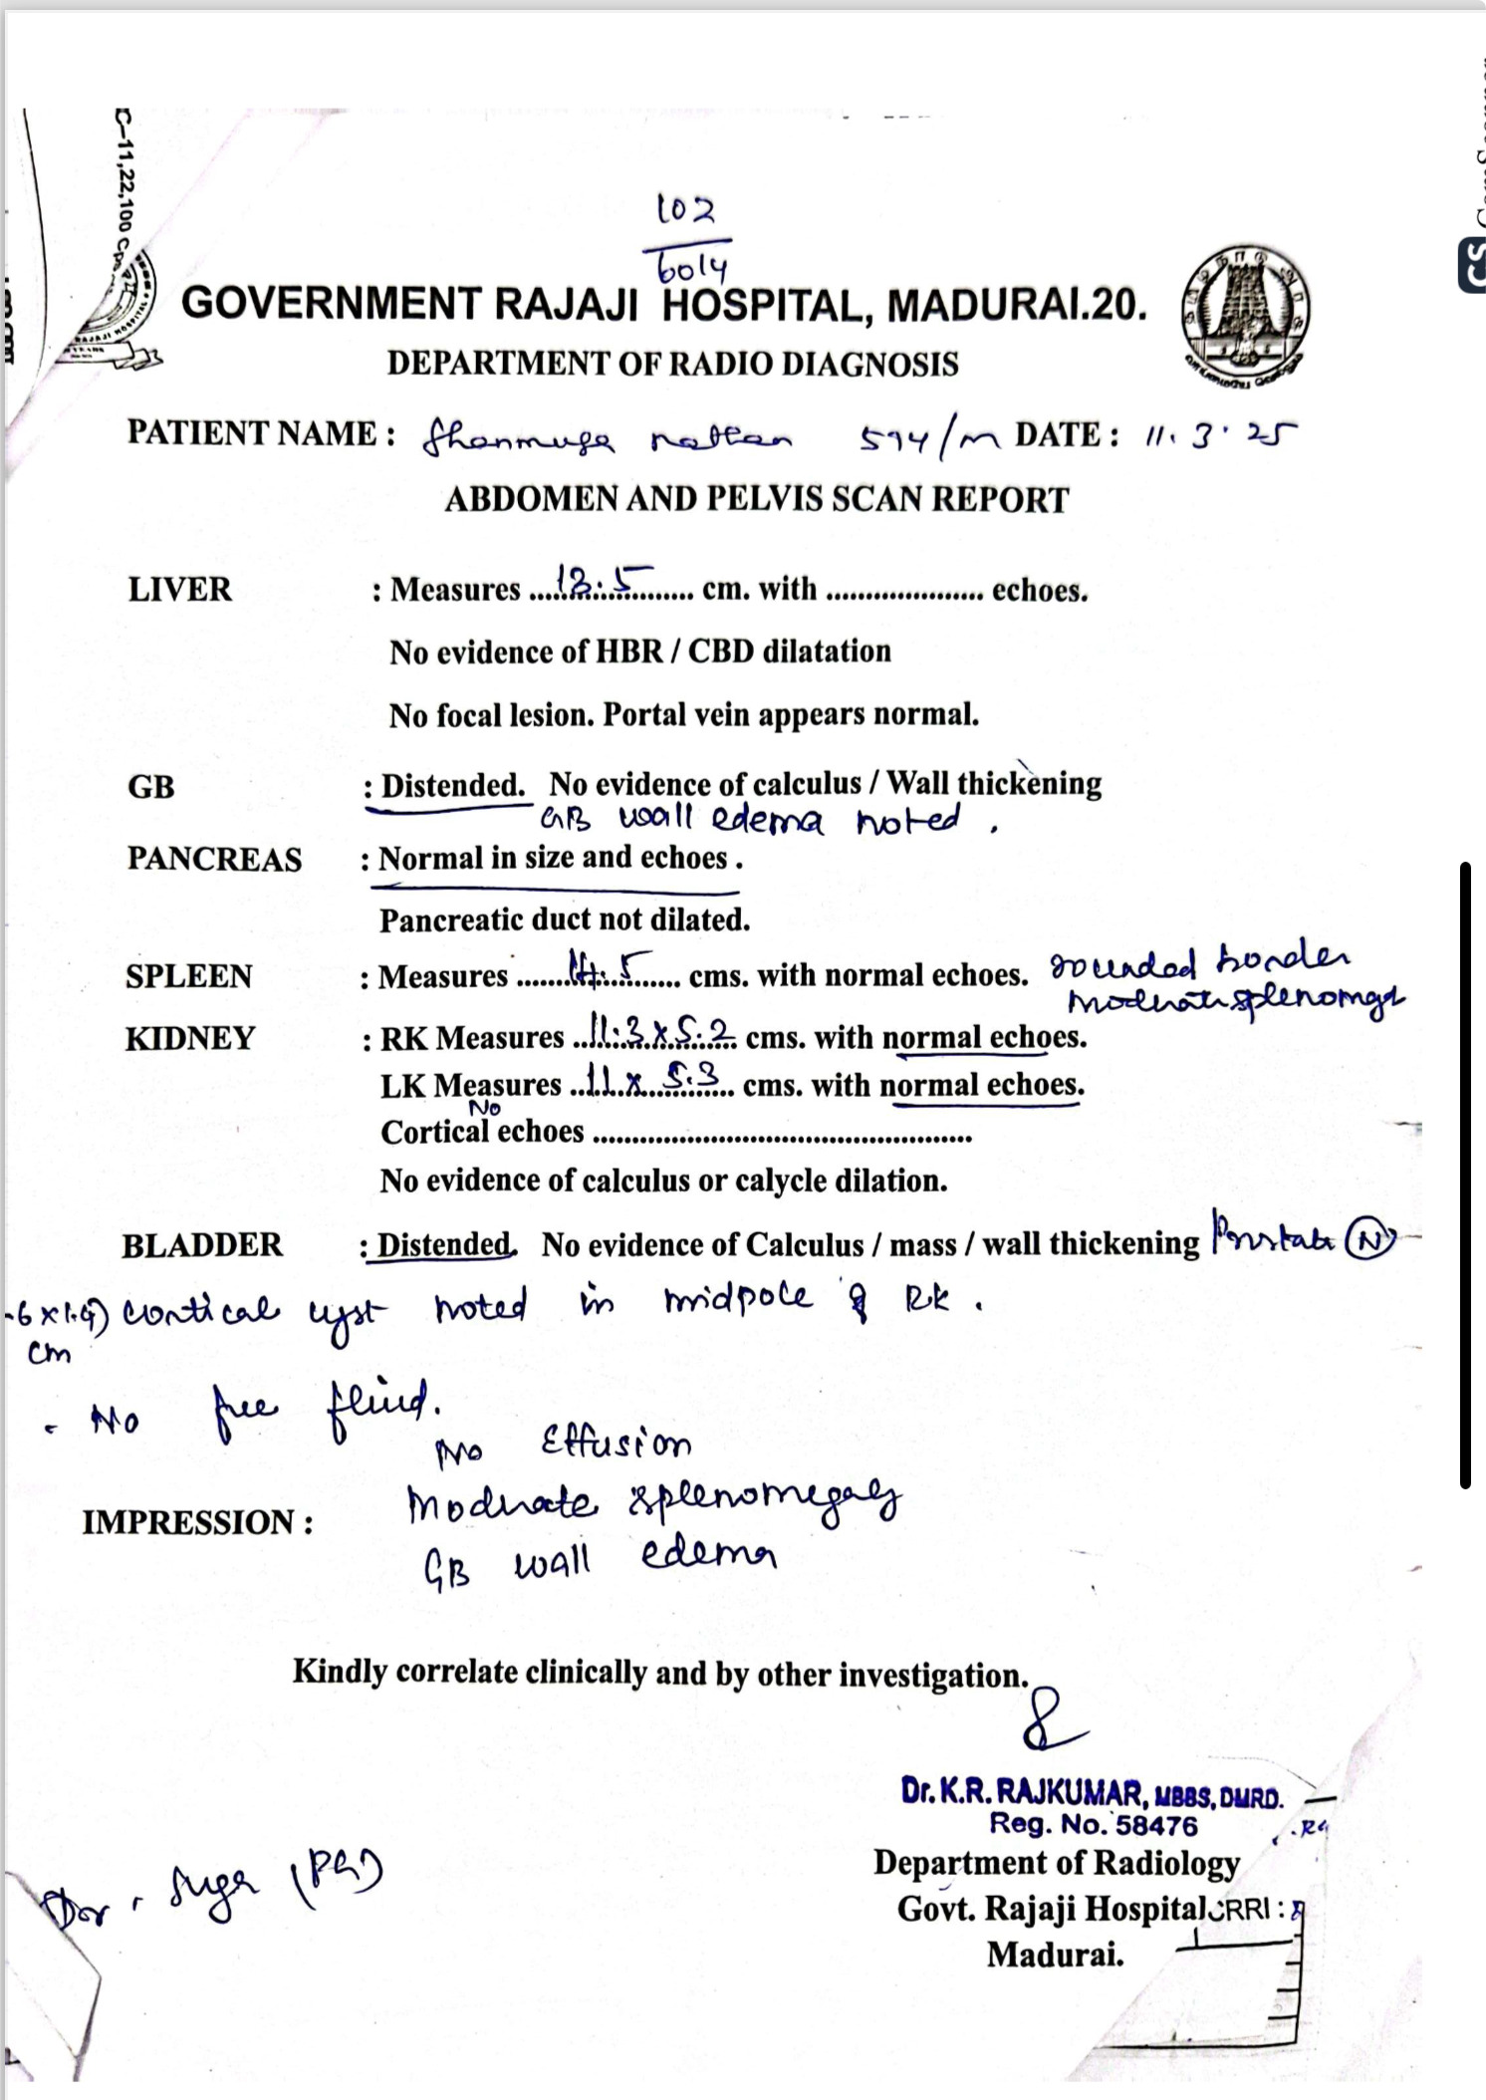
MODERATE SPLEENOMEGALY
GB WALL EDEMA +

Slide 17
BONE MARROW STUDIES
BM Aspiration- Normocellular marrow.
BM Biopsy - Normocellular marrow with Normal appearing Erythroid, Myeloid precursors and reduced Megakaryocytes..

Slide 18
ECHO
Grade 1 LV DIASTOLIC DYSFUNCTION
EF - 60%
No evidence of vegetations

Slide 19
OPHTHALMOLOGY OPINION
Normal fundus
No evidence of uveitis .

Slide 20
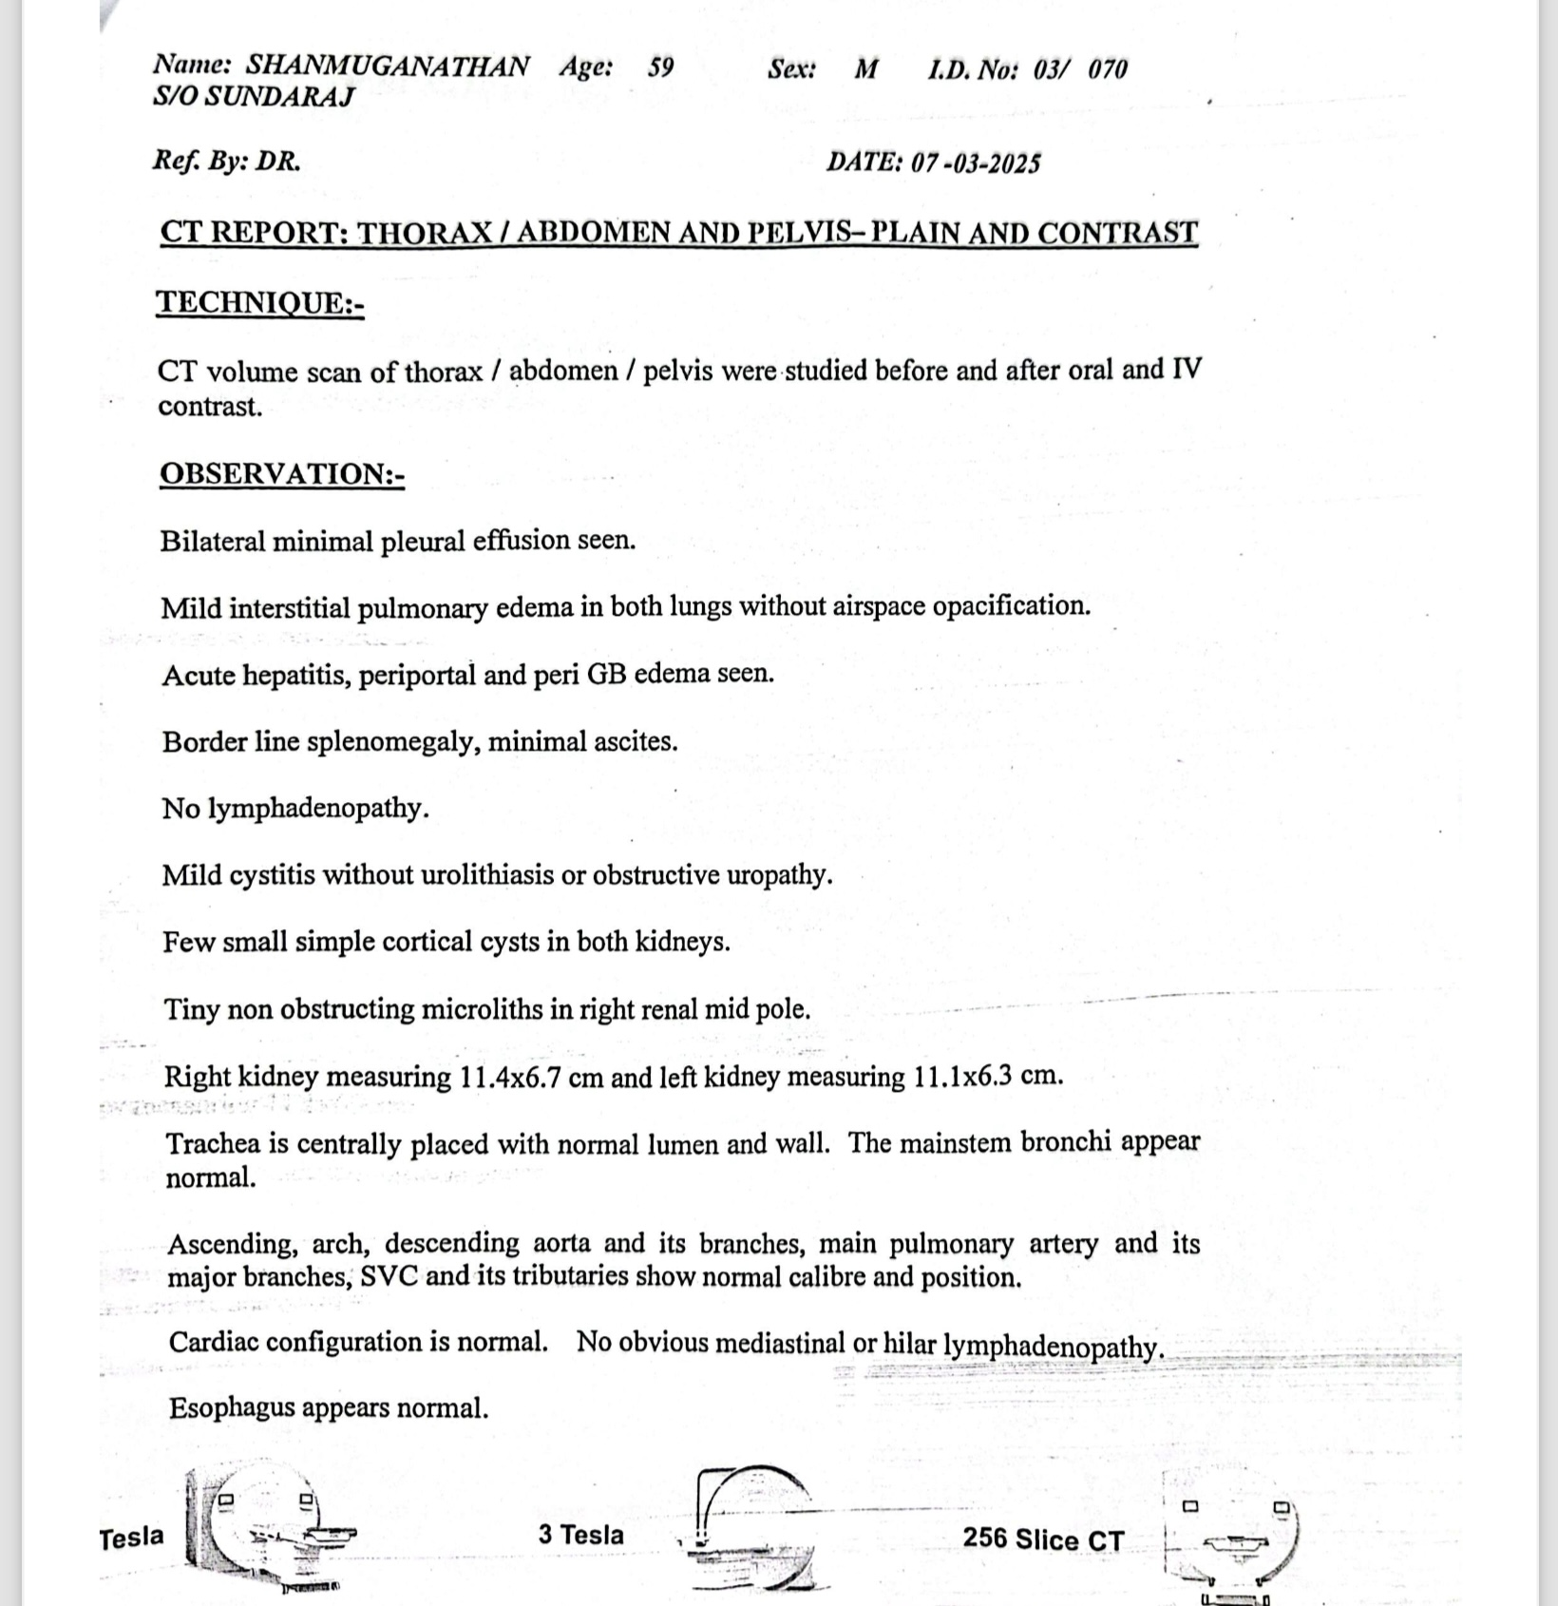
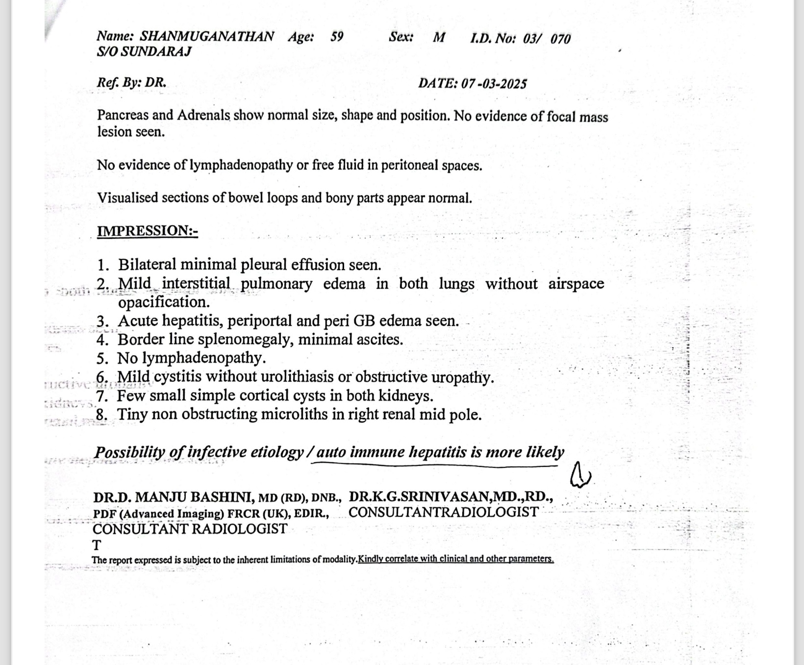
CT ABDOMEN AND PELVIS

Slide 21
URINE ALBUMIN- NIL
URINE SUGAR- 1+
URINE DEPOSITS- 2-4 pus cells
URINE C/S –NORMAL
BLOOD C/S- NORMAL
ANA - NEGATIVE
VCTC – NON REACTIVE
VIRAL MARKERS- NEGATIVE
CT CHEST- NORMAL
Sputum CBNAAT - NEGATIVE
BM CBNAAT - NEGATIVE
Mantoux TEST – NEGATIVE
FIBRINOGEN- 240mg/dl
VITAMIN B12- 3868 pg/ml

Slide 22
WHATS NEXT ?

