Slide 1
HOLT ORAM SYNDROME-FORME FRUSTE
। V MEDICAL UNIT
Chief- Prof. Dr.G.Bagialakshmi.MD Asst Prof - Dr.N.Ragavan MD Dr.S.Krishnasamy prasad MD

Slide 2
CHIEF COMPLAINTS
30 year old female presented with complaints
Breathlessness on exertion-3 months
palpitation-4 days

Slide 3
H/O PRESENTING ILLNESS
30 Year old female
H/o Dyspnoea+ insidious onset 3 months progressive NYHA class 3
NO H/o PND/Orthopnoa
H/o Easy Fatigability +
H/O Palpitation +
No H/o chestpain/syncope
No H/o oliguria/swelling legs
No H/o Fever/joint pain
No H/o cyanotic spells
No H/o cough with Expectoration/Hemoptysis

Slide 4
PAST HISTORY
H/o recurrent respiratory tract infection +
K/C/O Hyperthyroid-7years on Tab.carbimazole5mg tds
No H/o developmental delay
Ante natal ,Natal and Post natal history uneventful
Not a k/c/o diabetes /hypertension/pulTB/Epilepsy/Bleeding disorder

Slide 5
MENSTRUAL HISTORY/FAMILY HISTORY
Attained menarche at the age of 13 years
Regular menstrual cycles -3/28
Studied upto 10 th std
Married since 8years ,3degree consanguinos marriage,1 female child-7yr ,Both Husband and child had ASD-operated

Slide 6
GENERAL EXAMINATION
Patient conscious ,Moderately built and nourished,
No pallor/,icterus
No Clubbing
No Cyanosis
Bilateral pitting pedal edema present
JVP elevation+,
Hypoplasia of Left Thumb+,Deformity of Right Thumb+
No Generalised lymphadenopathy
No carotid thrill/Bruit
thyromegaly+
No peripheral signs of AR
No E/O Rheumatic fever/Infective Endocarditis
No marfanoid features

Slide 8
VITALS
Pulse-80/min
BP-110/70mm of hg
Spo2-98% with room air
Respiratory rate
18/min

Slide 9
SYSTEMIC EXAMINATION
CARDIO VASCULAR SYSTEM –
JVP elevated
Apical impulse in left 5th ic space 2cm lateral to MCL,
P2 Palpable,
Parasternal heave grade II present
MA- S1, S2 +,No murmur
TA-S1, S2+,No murmur
PA-s1 ,s2+,P2 loud,ESM+ ,Wide fixed split S2
AA-S1,S2+,No murmur

Slide 10
SYSTEMIC EXAMINATION CONTD.
RESPIRATORY SYSTEM-
Trachea Shifted to Right side
B/L Air Entry+
B/L Normal vesicular breath sounds +
B/L basal fine end inspiratory crepitation present
GASTROINTESTINAL SYSTEM-
P/A soft,no organomegaly
CNS:
No focal neurological deficit

Slide 11
INVESTIGATIONS
TC
10,800CELLS/CMM
P-59%
L-41%
ESR-2mm/hr
HB-10.1gm%
PLT-1.76 Lakh

Slide 12
INVESTIGATIONS
Sugar-nil
Albumin-nil
Deposits-1-2 pus cells
RBS -113mg%
BLOOD UREA- g%18 m
S.CREATININE -0.8g%m
Bilirubin (T)-0.7mg/dL
D.Bilirubin-0.4mg/dl
I.Bilirubin-o.3 mg/dl
S.proteins-6 g/dl
S.Albumin 4.5g/dl
S.globulin-1.5g/dl

Slide 13
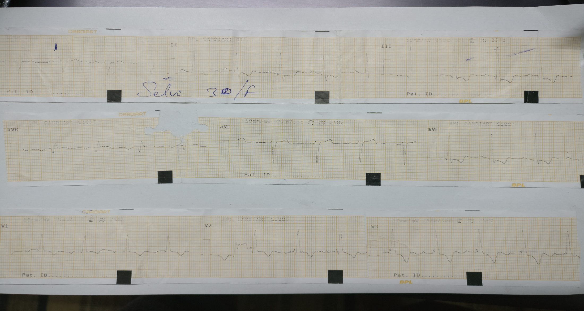

Slide 18
CARDIOLOGIST[O]
ECHO revealed Large ASD-OS left to right shunt ,mild pulmonary HT
Suggested;Tab-Digoxin,Syp.KCL,CTS opinion
CTS OPINION
A case of ASD-OS with mild pul HT
Suggested surgical closure

Slide 19
SPECIALITY OPINIONS
ENDOCRINOLOGIST[O]
TSH 16.02IU,FREE T4 0.86
?drug induced hypothyroidism
adviced to stop Tab. carbimazole

Slide 20
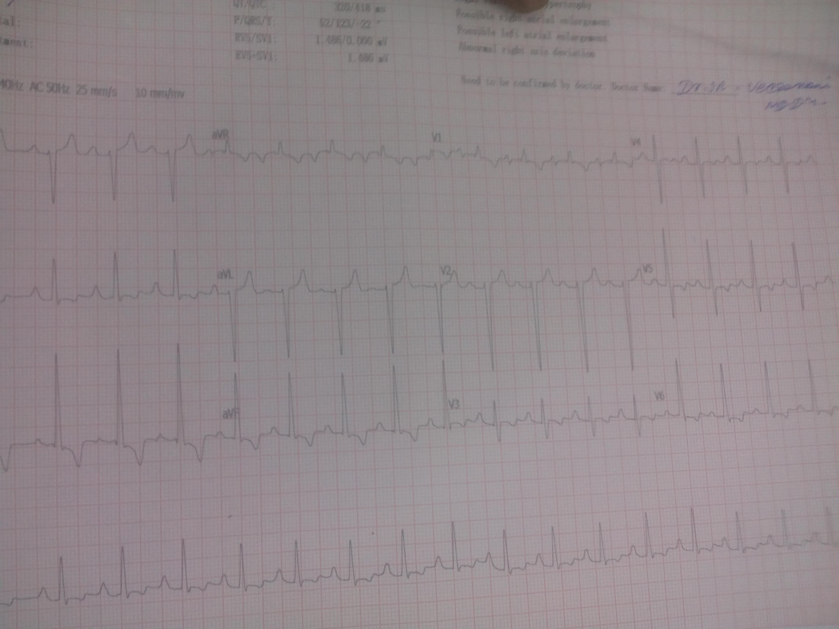
DIAGNOSIS
HOLT ORAM SYNDROME-FORMEFRUSTE,Congenital Acyanotic Heart Disease
OS-ASD
Mild Pul HT/CCF
Drug induced Hypothyroidism

Slide 21
AIM OF PRESENTATION
Rarity

