Slide 1
CT CHEST FOR DISCUSSION
1st medical unit

Slide 2
History!
Patient presented to GRH MADURAI with complaints of breathlessness for 2 months.
H/o PRESENTING illness:
H/o Breathlessnessness on exertion for past 2 months MMRC GRADE 2, No aggravating or relieving factors.
No H/o orthopnea and PND.
H/o cough with expectoration for past 2 months Not blood stained ;non purulent; aggravated on right lateral position No H/o Hemoptysis No H/o fever/night sweats/Loss of weight and loss of apetite.

Slide 3
Past H/o: H/o similar complaints 1 year back for which she was admitted in a private Hospital.
Not a known case of Diabetes/Hypertension/Bronchial asthma/Pulmonary tuberculosis.
No H/o prior intake of ATT. Personal H/o : Takes mixed diet.Bladder and bowel habits normal.Married. .Has two children.No prior history of abortion.
Worked in Gravel factory for 8 years 20 years back.

Slide 4
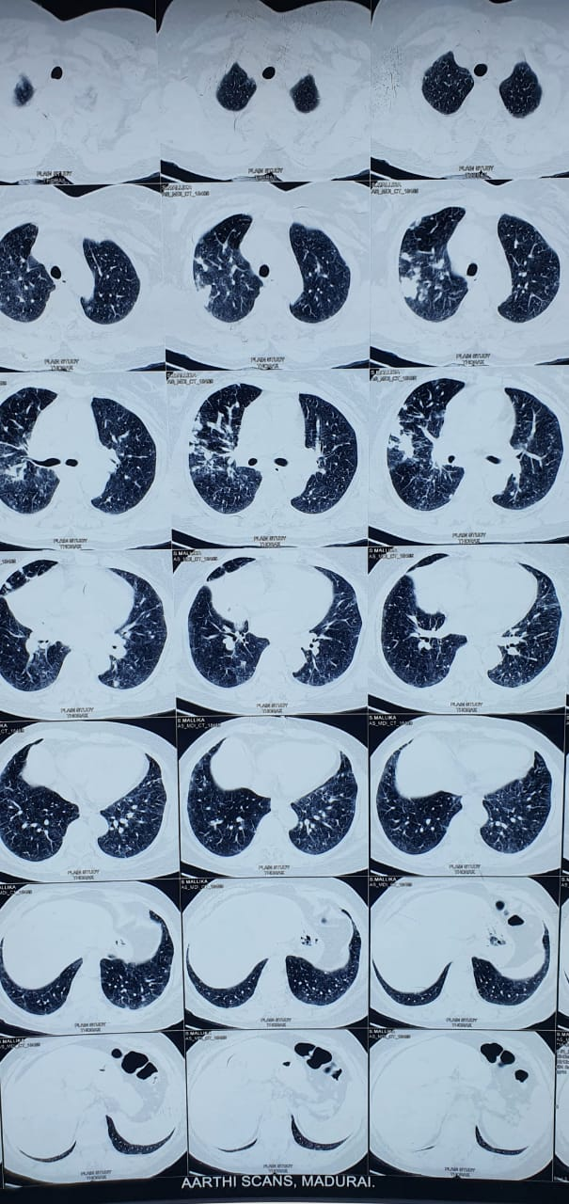
Ct chest

Slide 5
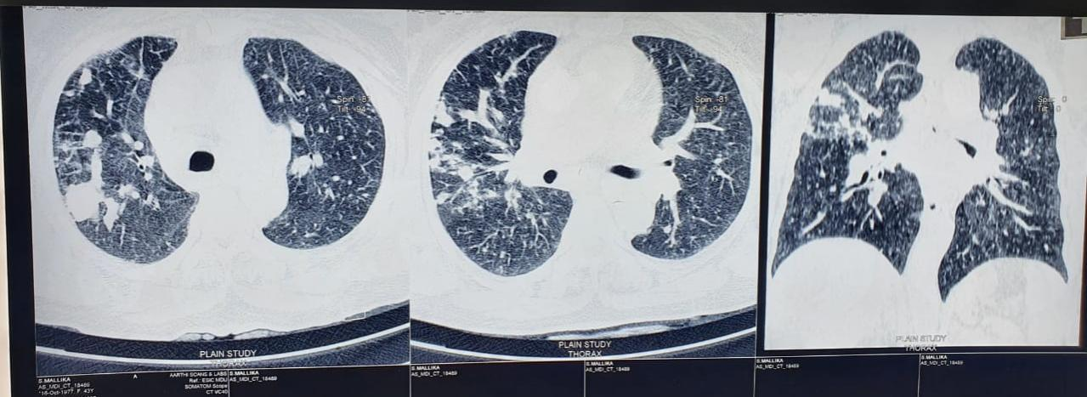

Slide 6
Thank you

