Slide 1
RECENT ADVANCES
BY Vth MU
CHEIF: PROF.Dr.SYED BAHAVUDEEN HUSSAINI M.D,
ASST.PROF: Dr.VINOTH KANNAN M.D,
Dr.PRIYA M.D,
PRESENTOR:Dr.D.MOHANDOSS
POSTGRADUATE (1st year)

Slide 2
RECENT ADVANCES IN NEUROLOGY
Extended window for stroke management
Neurostimulation Implantable Device

Slide 3
Extended window for stroke intervention

Slide 4
Standard Treatment Windows:
Ischemic stroke- intravenous t-PA is within 4.5 hours of symptom onset.
Endovascular thrombectomy - up to 6 hours after symptom onset.
Extended Time Window:
Recent trials like DAWN and DEFUSE 3 have demonstrated that endovascular thrombectomy can be beneficial for select patients up to 24 hours after symptom onset.
This is due to individual variations in collateral circulation, which can keep brain tissue viable for longer periods.
Diffusion-weighted imaging (DWI) and CT perfusion (CTP) can identify a mismatch between the irreversibly damaged core of the infarct and the surrounding penumbra.

Slide 5
INDICATION
For patients presenting between 6 and 24 hours after stroke onset
key imaging inclusion criteria for endovascular intervention include an infarct core volume of less than 70 mL on DWI or CTP
ratio of ischemic tissue to initial infarct volume of 1.8 or more.

Slide 6
Treatment Options:
Thrombolytic therapy (like IV-tPA)
Endo vascular therapy (thrombectomy).
Complications:
Recanalization
Intracranial Hemorrhage (sICH).

Slide 7
Neurostimulation implantable Devices

Slide 8
Neurostimulation therapies
Both invasive and noninvasive approach
These apply electromagnetic energy to specific anatomical targets to induce neuromodulation
3 primary components:
stimulating electrode(s)
an internalized pulse generator (IPG) that serves as a battery pack
electrode extender(s) to subcutaneously connect the electrode(s) to the pulse generator.

Slide 9
Neurostimulation strategies include
1.Deep Brain Stimulation
2.Motor Cortex Stimulation
3.Responsive Neurostimulation
4.Vagal Nerve Stimulation
5. Spinal Cord Stimulation

Slide 10
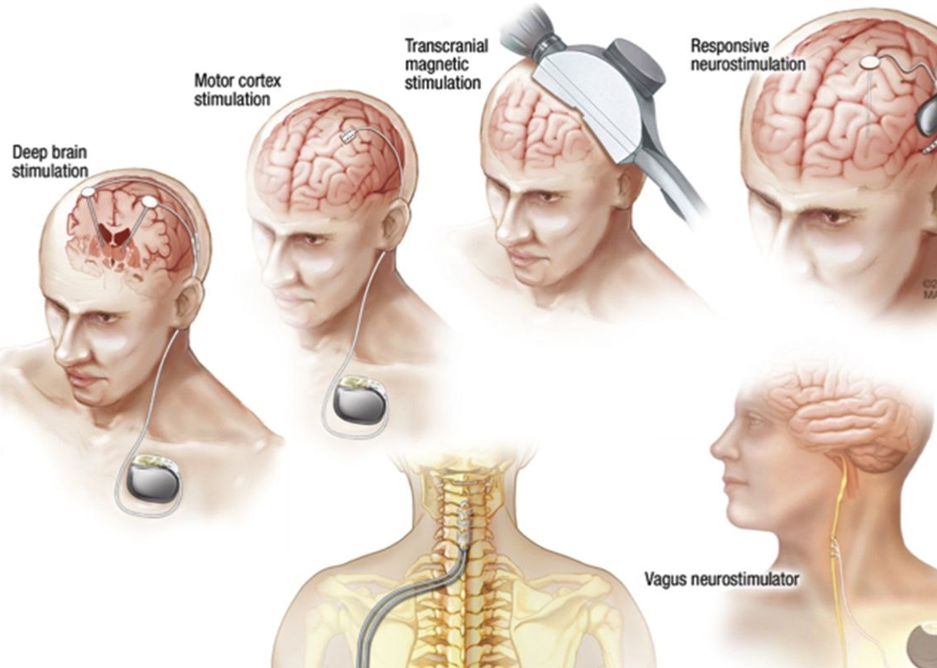
Neurostimulation
techniques

Slide 11
DEEP BRAIN STIMULATION
It involves implanting electrodes in specific areas of the brain to treat neurological disorders like Parkinson’s disease
Components
    Electrodes:implanted into the brain in specific regions (subthalamic nucleus (STN) or globus pallidus internus (GPi))
    Pulse Generator: implanted under the skin near the collarbone.
    Electrical Stimulation: helps regulate abnormal brain activity
    Adjustable Settings: The settings adjusted via an external device that communicates with the pulse generator, allowing fine-tuning for the best symptom control.

Slide 12
Parkinson's Disease: It's particularly effective for managing motor symptoms like tremors, rigidity, and bradykinesia (slowness of movement).
Essential Tremor: reduce hand tremors and improve quality of life.
Dystonia: For patients with severe, disabling muscle contractions
Obsessive-Compulsive Disorder (OCD): For patients who haven't responded to other treatments
Depression: studied for treatment of resistant depression.

Slide 13
Benefits and Risks
Benefits: DBS can offer significant symptom relief, especially in Parkinson's disease, allowing for better motor control, reduced medication doses, and overall improved quality of life.
Risks:
The procedure carries risks like any surgery, including infection, bleeding, or damage to brain tissue.
Side effects may also include mood changes, speech issues, or imbalance, but these can often be managed with adjustments to stimulation levels.

Slide 14
Vagal nerve stimulation (VNS)
A device is implanted under the skin in the chest, which then sends mild electrical signals to the vagus nerve in the neck, which in turn sends signals to the brain .
The implanted device delivers mild electrical pulses to the vagus nerve at regular intervals.
• These impulses travel to the brain, where they can help regulate brain activity and reduce the frequency of seizures in people with epilepsy.
• For depression, the electrical signals are thought to modulate brain activity related to mood and emotional regulation.

Slide 15
Motor cortex stimulation (MCS)
      used to treat chronic pain and movement disorders by electrically stimulating the motor cortex area of the brain.
      It involves implanting electrodes on or near the motor cortex to modulate neural activity and potentially reduce pain or improve motor function.
spinal cord stimulator
      It consists of a pulse generator (implanted under the skin, often in the buttocks or abdomen) and thin wires (leads) that are placed near the spinal cord.
      The pulse generator sends electrical signals through the leads to the spinal cord.
      These electrical impulses interfere with the transmission of pain signals, essentially "blocking" the pain signals from reaching the brain.
      The mechanism of action is often explained by the "gate control theory," which suggests that stimulating larger nerve fibers can close the "gate" to pain signals.

Slide 16
MR GUIDED FOCUSED ULTRASOUND
(MRgFUS)

Slide 17
"Focused Ultrasound: A Breakthrough for Treating Neurological Conditions,"
Focused ultrasound is a therapy that uses MRI guidance to treat neurological conditions like essential tremor and Parkinson's disease.

Slide 18
The procedure uses a helmet-like device with about a thousand ultrasound beams that converge to create a precise "lesion" in the brain, which disrupts the abnormal communication pathways that cause symptoms.
The target is smaller than a grain of rice and can be moved with a high degree of accuracy.
The treatment is monitored in real-time using temperature measurements with an MRI, to safely treat a very specific region within the thalamus to alleviate tremors.

Slide 19
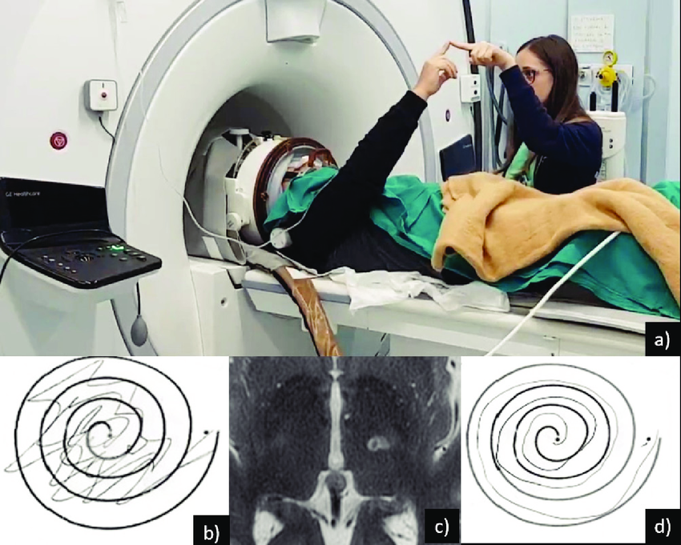

Slide 20
The patient is awake during the procedure and can provide real-time feedback, with results often seen almost instantaneously.
The procedure typically takes two to three hours, and since it is non-invasive and requires no incisions or implants, patients can go home the same afternoon.
this therapy is a collaborative effort between radiology and neurosurgery and is considered a form of brain surgery that doesn't require an operating room.

Slide 21
RECENT ADVANCES IN GASTROENTEROLOGY
Wireless Capsule Endoscopy
Gut Brain Axis
IBD Therapeutic Advancements

Slide 22
Wireless Capsule Endoscopy

Slide 23
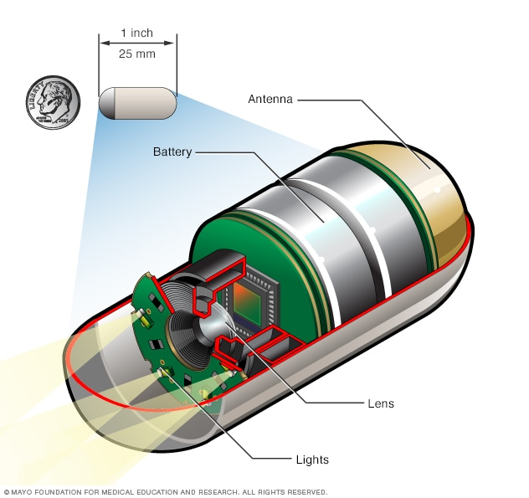
Capsule endoscopy is a procedure that uses a tiny wireless camera to take pictures of the GI tract.
A capsule endoscopy camera sits inside a vitamin-sized capsule.
After it's swallowed, the capsule travels through the GI tract.
The camera takes thousands of pictures that are sent to a recorder worn on a belt around the waist.

Slide 24
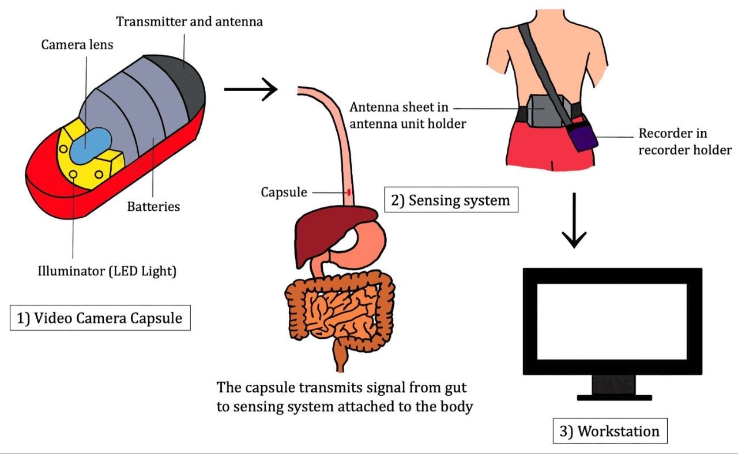

Slide 25
Capsule endoscopy is done to:
• Find the cause of GI bleed
• Diagnose inflammatory bowel diseases.
• Identity growth or malignancy
• Diagnose celiac disease. Sometimes used in diagnosing and watching this immune reaction to eating gluten.
• Look at the esophagial varices and Screen for polyps.
•If the results of an imaging are unclear, a capsule endoscopy might get more information.

Slide 26
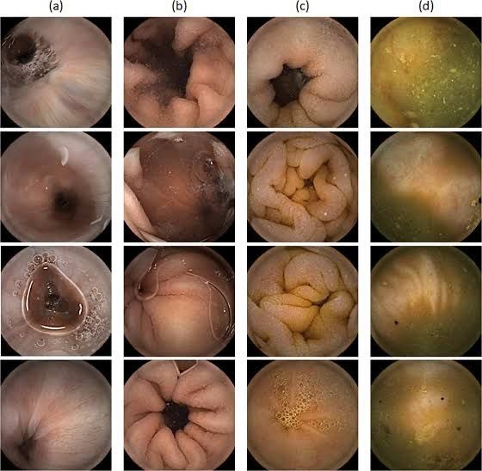

Slide 27
Complications:
Bowel obstruction (very rare but should screen for stricture before initiating capsule endoscopy)
The limitations of the technique include :
Expense
Poor image quality due to stool and fluid, and difficulty interpreting images.
If abnormalities are found conventional colonoscopy is needed to obtain a tissue diagnosis.

Slide 28
GUT BRAIN AXIS

Slide 29
The "gut-brain axis" is a dynamic communication network involving the gut, brain, and various systems (immune, neural, and hormonal).
​It represents significant implications for mental health, neurodevelopment, and neurodegenerative diseases.
​Maintaining a healthy gut is crucial for overall well-being, and research is uncovering the complex ways the gut microbiota influences brain function.
​Novel therapeutic strategies that target the gut microbiota hold promise for treating a range of neurological and psychiatric disorders.

Slide 30
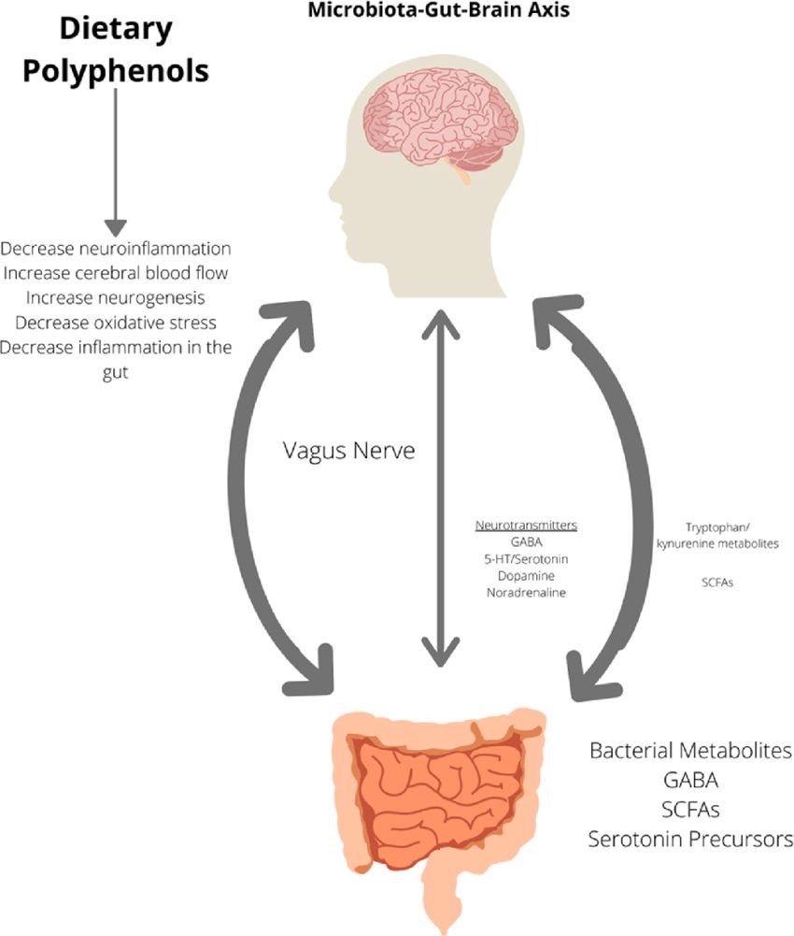

Slide 31
The communication between the gut microbiota and the brain is complex and bidirectional.
​Neural Pathways: The vagus nerve, a major cranial nerve, acts as a primary communication channel, transmitting signals between the gut and the brain.
​Immune System: The gut-associated lymphoid tissue (GALT) and other immune cells in the gut release cytokines and signaling molecules that can affect brain function.
​Metabolic Pathways: The gut microbiota produces a variety of metabolites, including short-chain fatty acids (SCFAs), which can influence brain function and cross the blood-brain barrier.
​Endocrine Pathways: The gut microbiota can modulate the release of hormones such as serotonin and cortisol, which play a role in the body's stress response.

Slide 32
Therapeutic Interventions
​Probiotics and Prebiotics: Pre and probiotics improve gut and cognitive function, and may help with mood, memory, and stress response.
​Fecal Microbiota Transplantation (FMT): transplanting fecal matter from a healthy donor to a recipient,used in conditions, including Clostridium difficile infection and some FGIDs.
​Dietary Interventions: diet rich in fiber, polyphenols, and fermented foods can promote gut health, while diet high in fat, refined sugars, and salt can have negative effects.

Slide 33
RECENT ADVANCES IN PULMONOLOGY
DEXMEDETOMIDINE IN MECHANICALLY VENTILATED PATIENT

Slide 34
DEXMEDETOMIDINE IN MECHANICALLY VENTILATED PATIENTS

Slide 35
Dexmedetomidine is a sedative used for both intubated and non-intubated patients in an intensive care setting, as well as for procedural and peri-operative sedation. It's also used off-label for things like treating delirium, as an analgesic, and for alcohol withdrawal.
​Key Characteristics and Mechanism
​Dexmedetomidine is an alpha-2 agonist that works by inhibiting the release of norepinephrine in the brainstem, which produces a state of sedation, reduces anxiety, and provides some pain relief.
It's highly selective for the alpha-2 receptor, which is significant when compared to other alpha agonists.

Slide 36
A notable feature:
    It doesn't cause significant respiratory depression, making it safe for non-intubated patients.
    It also has analgesic properties, which can reduce the need for opioids.
​Adverse Effects and Contraindications
    ​ Most common side effects: hypotension, bradycardia, and hypertension.
    Hypertension can occur with a rapid loading dose,
    Hypotension and bradycardia are caused by its effect on norepinephrine release.
    ​ While
    No absolute contraindications, but should be used with caution in patients having bradycardia, hypotension, or heart failure.

Slide 37
Dosing:
    ​For ICU sedation, the typical dosage is 0.2 to 0.7 mcg/kg per hour, but it can be increased.
    A loading dose can be given but is often avoided in critically ill patients.
    ​For anesthesia, a loading dose of 0.5 to 1.0 mcg/kg is typical, followed by a continuous infusion.
    ​For peripheral nerve blocks, a dose of 1 mcg/kg is used.
    ​For agitation,120 mcg for mild agitation or 180 mcg for severe agitation.(SL or buccal)
​

Slide 38
MONITORING:
No specific drug monitoring is required.
But it's important to closely monitor the patient's level of sedation, heart rate, blood pressure, and oxygen saturation.
There is no antidote for an overdose; treatment consists of supportive care.

Slide 39
RECENT ADVANCES IN ONCOLOGY
CAR T-CELL THERAPY
PEMBROLIZUMAB

Slide 40
CAR T CELL THERAPY

Slide 41
Chimeric Antigen Receptor (CAR) T-cell therapy
    It is a revolutionary cancer immunotherapy that involves genetically modifying a patient's T-cells to recognize and attack specific tumor antigens.
    For example, Tisagenlecleucel targets CD19 on B-cells, while Axicabtagene ciloleucel also targets CD19 but with a different signaling mechanism.
    Used in B-cell malignancies, such as leukemia and lymphoma,
    Research is expanding to solid tumors with targets like HER2, EGFR, Mesothelin, and others.

Slide 42
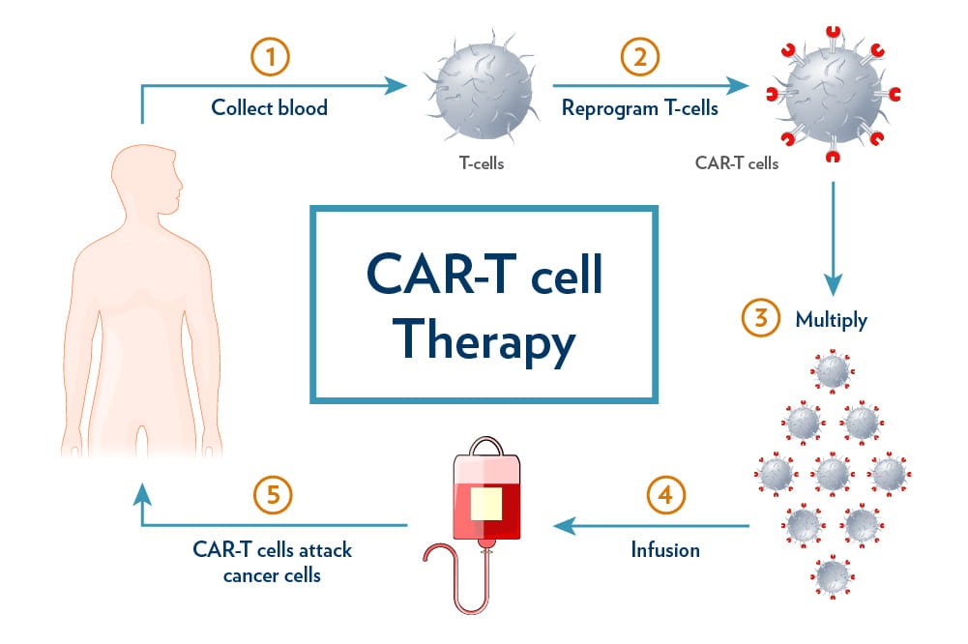

Slide 43
Significant side effects:
    The most common are Cytokine Release Syndrome (CRS) and CAR-related Encephalopathy Syndrome (CRES).
    CRS includes fever, hypotension, and organ toxicities.
    CRES manifests as confusion, agitation, and other neurological symptoms.

Slide 44
Other adverse effects may involve multiple systems, including:
    Neurological: Headaches, delirium, seizures.
    Hematologic: Anemia, neutropenia, and other blood abnormalities.
    Cardiovascular: Hypotension, arrhythmia, and heart-related issues.
    Pulmonary: Hypoxia and respiratory problems.
    Renal: Kidney injury and electrolyte imbalances.
    Gastrointestinal: Nausea, vomiting, diarrhea.
    Musculoskeletal: Weakness, elevated creatine kinase.

Slide 45
PEMBROLIZUMAB

Slide 46
Mechanism of Action:
      Pembrolizumab is a humanized monoclonal antibody that blocks the PD-1 (Programmed Death-1) receptor on T-cells.
      PD-1 is an immune checkpoint that prevents T-cell activation.
      By inhibiting the PD-1 receptor, pembrolizumab allows T-cells to remain active, enhancing the immune system’s ability to target and destroy cancer cells.

Slide 47
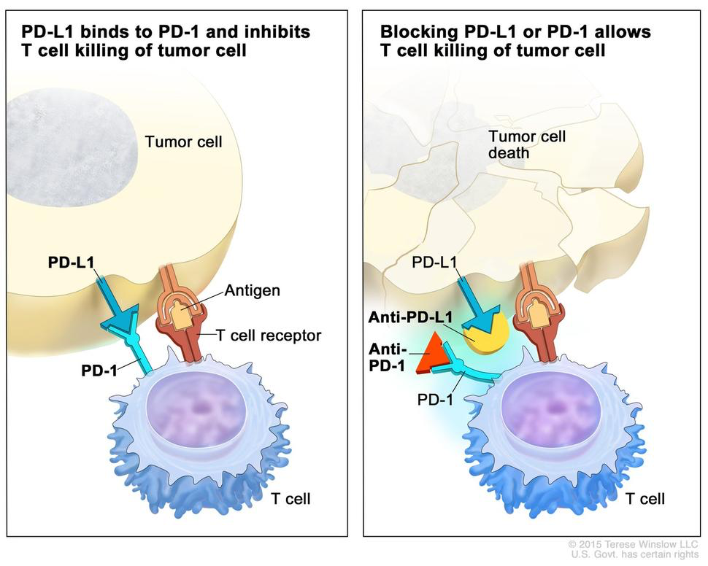

Slide 48
FDA-Approved Indications:
      Melanoma
      Non-Small Cell Lung Cancer (NSCLC):non-squamous&Squamous(first-line with chemotherapy)
      Head and Neck Squamous Cell Carcinoma (HNSCC)
      Renal Cell Carcinoma (RCC) ( in combination with axitinib )
      Advanced urothelial carcinoma post-platinum chemotherapy

Slide 49
THANKYOU

