Slide 1
BEHIND THE SCREEN-CONTROVERSIES
BY FIRST MEDICAL UNIT
CHIEF:PROF. DR.M.NATARAJAN M.D.,
ASST. PROFESSORS: DR.V.PALANIKUMARAN M.D.,D.DIAB
DR. VASANTHAKALYANI M.D.,DCP
DR. SURESHKUMAR M.D.,

Slide 2
A 24 year old female came to the hospital with
- C/O blurring of vision over left eye for 10 days

Slide 3
HISTORY OF PRESENTING ILLNESS :-
The patient was apparently normal before 4 months. Then she developed h/o fever for 4 months, low grade, intermittent, not associated with chills and rigor and relieved by medications and associated with unintentional weight loss
Then patient was diagnosed as ileocecal TB and started on ATT(HRZE regimen, 4 FDC/Day)
After 45 days of ATT, patient developed blurring of vision over left eye
H/O abdominal pain+
H/O malena+
No h/o loose stools
No h/o breathlessness
No h/o vomiting
No h/o headache
No h/o chest pain
No h/o reduced urine output
No h/o abdominal distension
(H-300mg, R-600mg, z-1600mg, E-1100mg)

Slide 4
Past history :-
Not a k/c/o DM/HTN/BA/CAD/CKD/EPILEPSY/THYROID DISORDERS
Personal history :-
Mixed diet
Normal bowel and bladder habits
Normal sleep pattern
Menstrual history :-
Attained menarche at 14 years of age
Regular cycles 4/30

Slide 5
O/E :-
Patient conscious, oriented
No pallor
No icterus
No cyanosis
No clubbing
No pedal edema
No generalized lymphadenopathy

Slide 6
VITALS :-
BP – 110/70
PR – 80/min
SpO2 – 98% RA
Weight- 47.7 kg
S/E :-
CVS – S1,S2 +
RS – NVBS
P/A – Soft, BS+
No organomegaly
CNS – pt conscious & oriented
moves all 4 limbs

Slide 7
OCULAR EXAMNINATION :-
 | RIGHT EYE | LEFT EYE
Visual acuity | 6/6 | 3/60
Pupil | NORMAL | DEFECTIVE
Colour vision | NORMAL | DEFECTIVE
Central field | NORMAL | DEFECTIVE
Fundus | NORMAL | NORMAL
At present, there is no evidence of RAPD( Relative afferent pupillary defect)

Slide 8
INVESTIGATION :-
WBC | 5900 | ANA | NEG
HB | 11.3 | Ur.albumin | nil
PLT | 2.5 LAKHS | Ur.glucose | nil
ESR | 44 mm/hr | Ur.deposits | No pus cells
CRP | 12.53 | AEC | 210
RBS | 82 | Urea | 32
T.BIL | 0.3 | Creatinine | 0.9
OT | 23
PT | 20

Slide 9
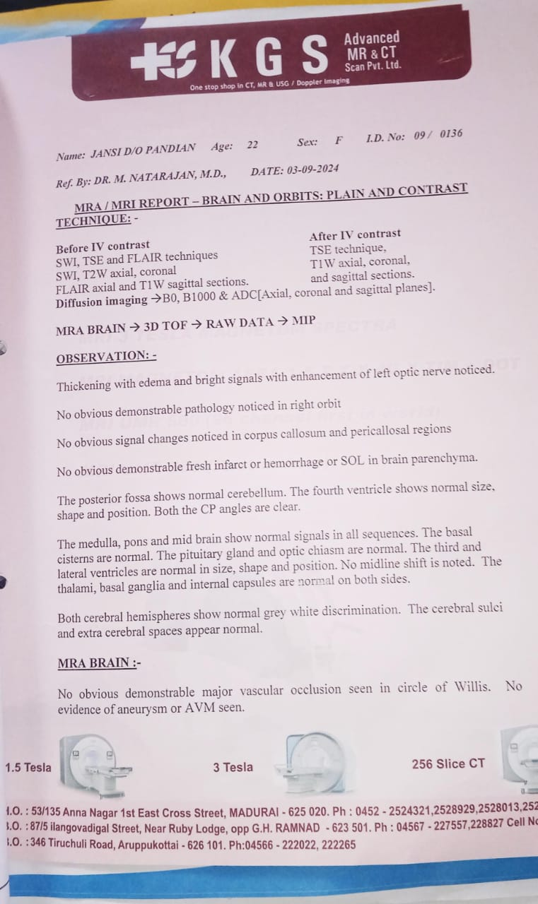

Slide 10
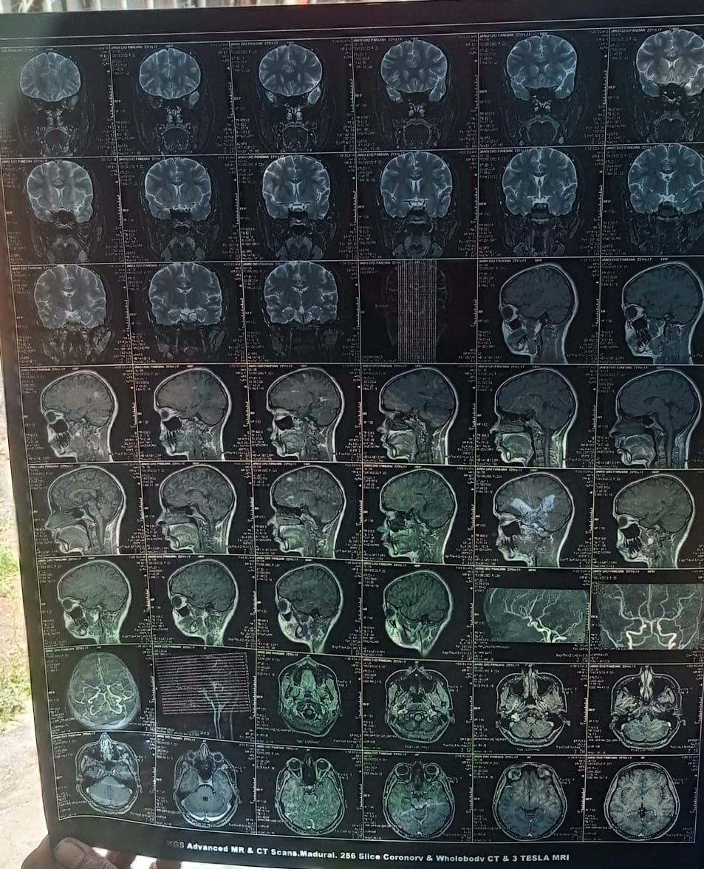

Slide 11
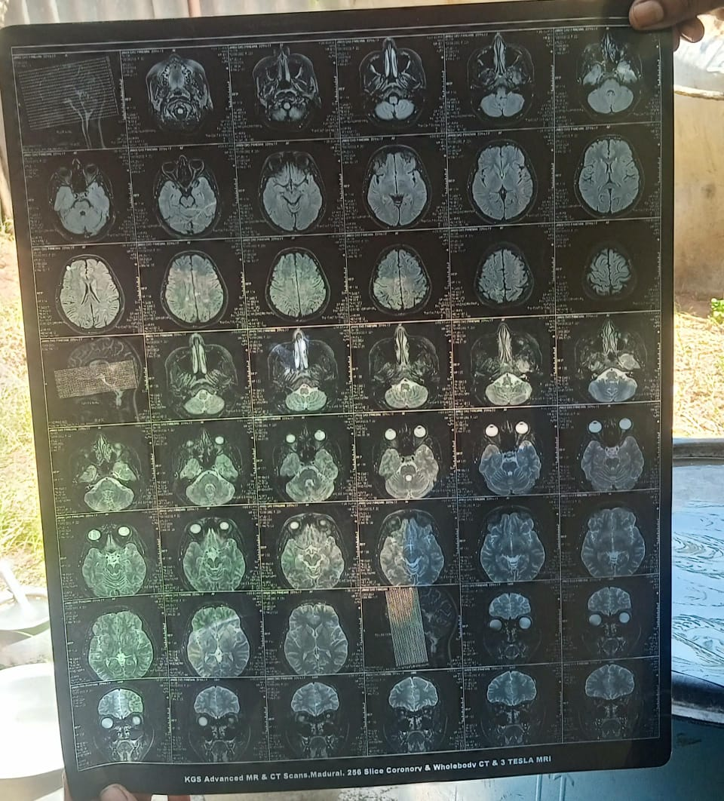

Slide 12
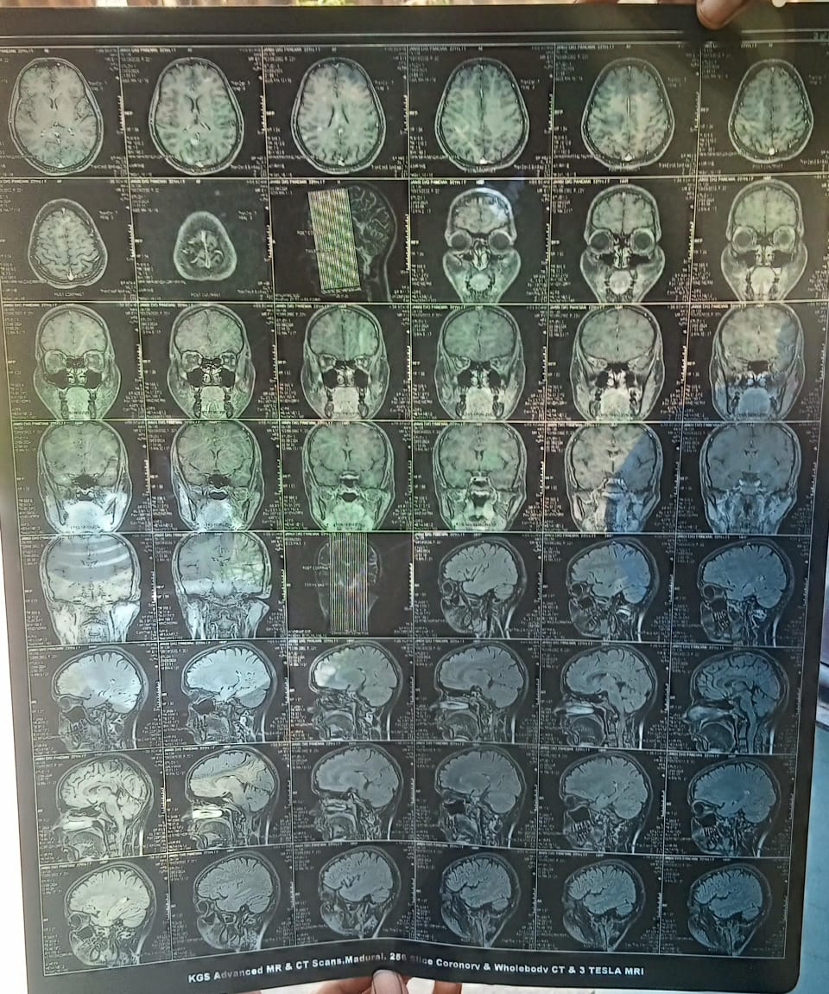

Slide 13
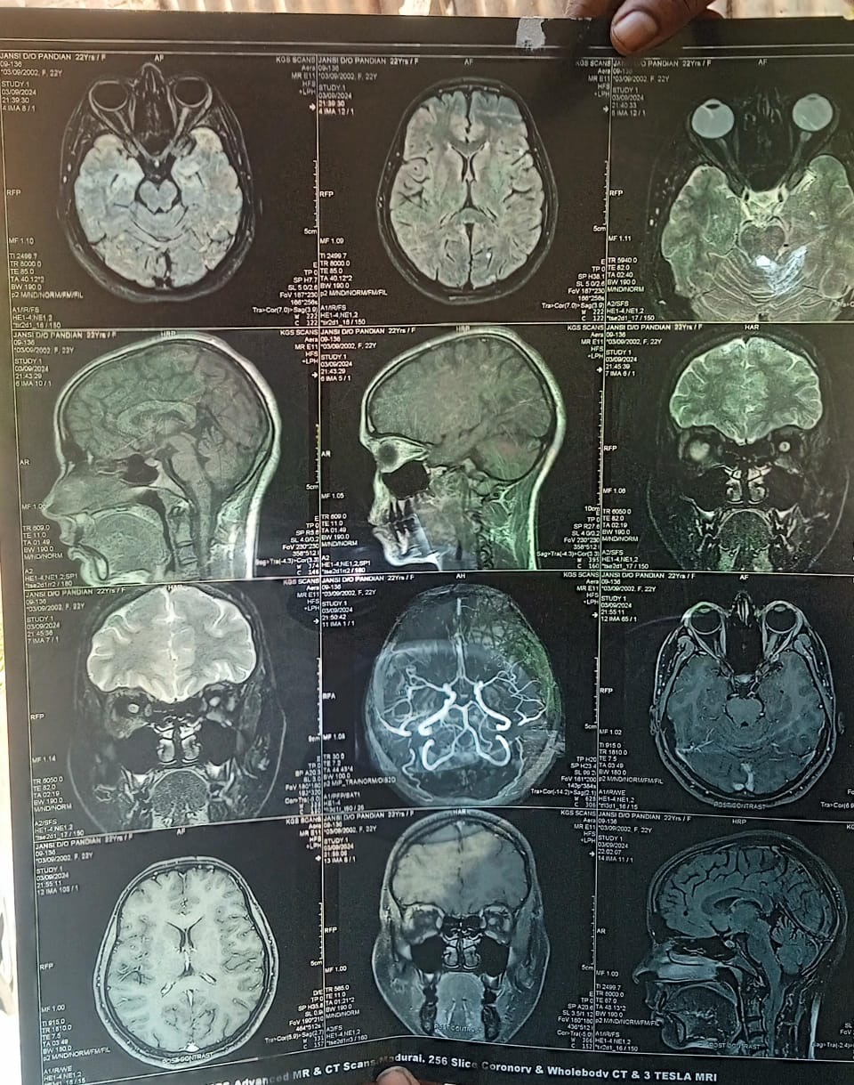

Slide 14
MRI-BRAIN AND ORBIT(PLAIN AND CONTRAST)
IMPRESSION
-Possibility of left side retrobulbar neuritis is more likely

Slide 16
TREATMENT GIVEN
Withheld ATT
Inj Methyl Prednisolone 1gm iv OD for 5 days
Patient switched over to oral prednisolone
T. Pantoprazole 40mg 1 OD
T. Calcium+VitD3 1 OD

Slide 17
OPHTHAL REVIEW:
After treatment with steroids, patient vision has improved by >30%.

