Slide 1
MRI FOR DISCUSSION
BY FIRST MEDICAL UNIT
CHIEF:PROF. DR.M.NATARAJAN M.D.,
ASST. PROFESSORS: DR.V.PALANIKUMARAN M.D.,D.DIAB
DR. VASANTHAKALYANI M.D.,DCP
DR. SURESHKUMAR M.D.,

Slide 2
A 65 year old female came with chief complaints of
Left hip pain for 2 months

Slide 3
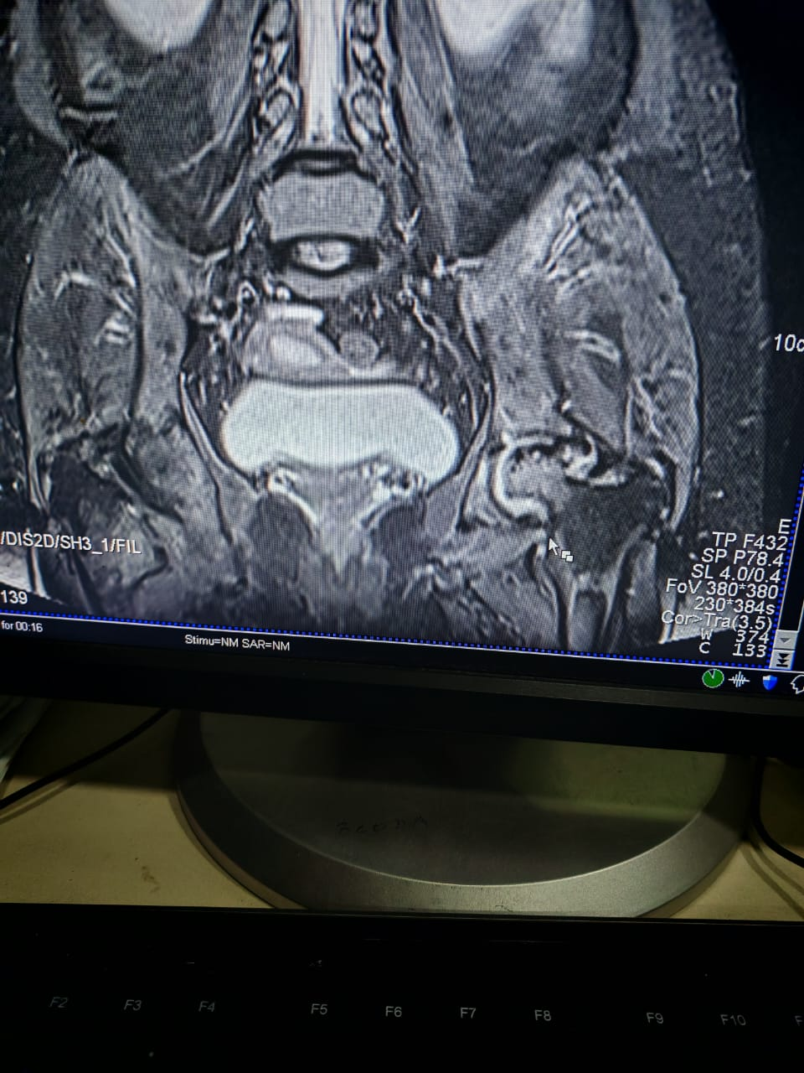

Slide 4
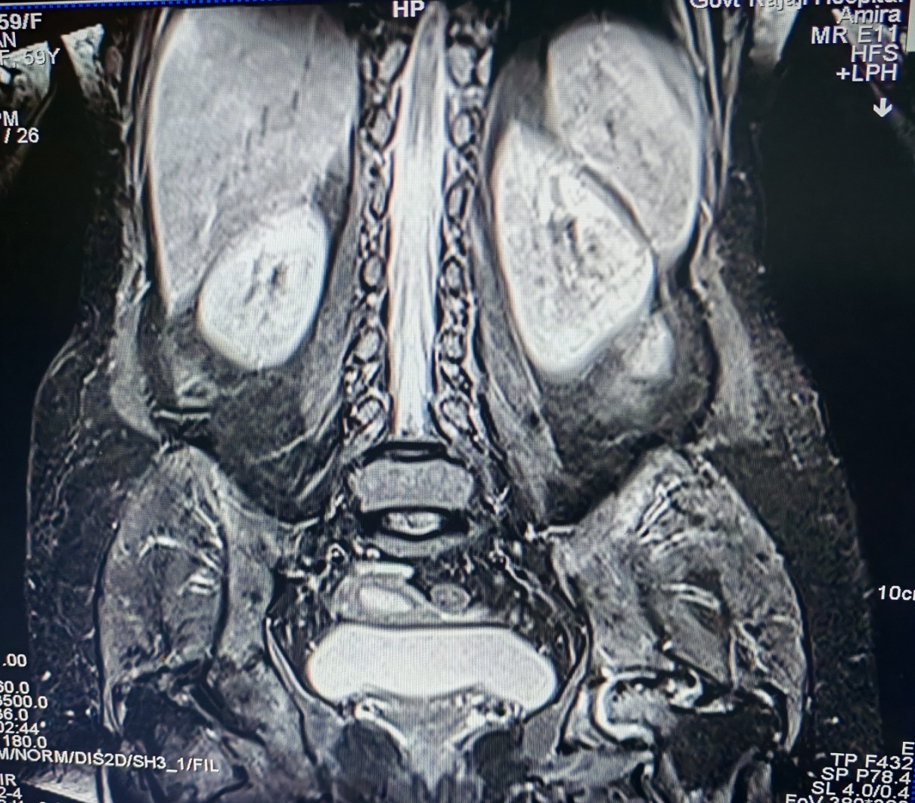

Slide 5
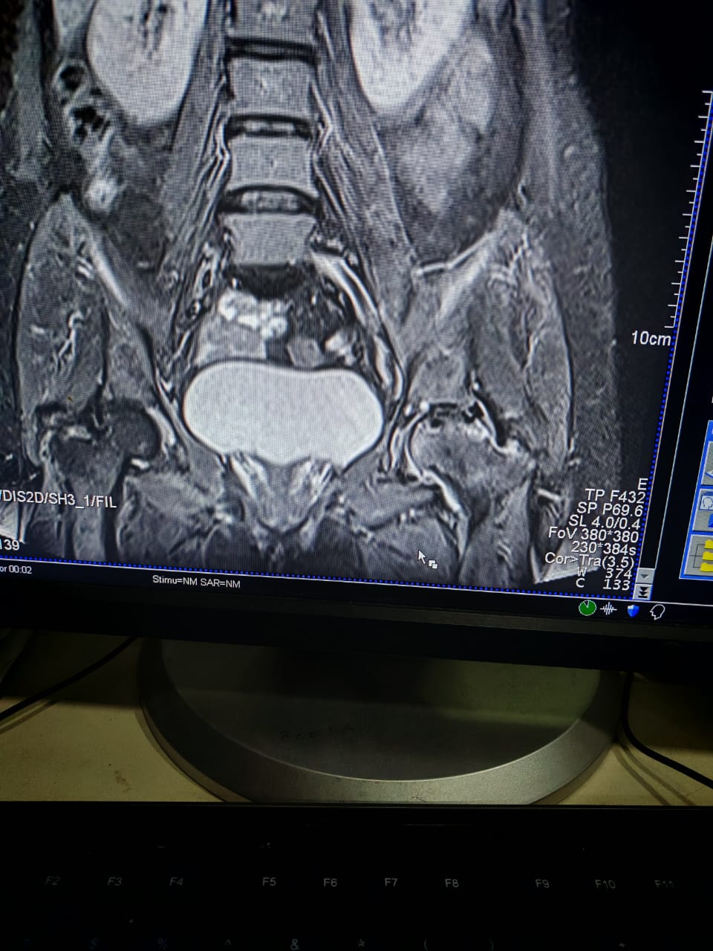

Slide 6
LET’S DISCUSS

