Slide 1
Clinico pathological correlation
By 2nd medical unit
CHIEF : Dr. G. BAGIALAKSHMI M.D.
ASSISTANT PROFESSORS: Dr. P.S. VALLIDEVI M.D.
Dr. PON SENTHIL KUMAR M.D.
Dr. ILAMARAN M.D.

Slide 2
Chief complaints
70 year old male Mr. Sevagarathnam presented with
C/o bilateral leg swelling for 3 months
C/o breathlessness for 1 month

Slide 3
HOPI
Pt was apparently normal before 3 months then he developed
C/o bilateral pedal edema for 3 months
C/o dyspnea for 1 month – NYHA grade 3 , not releived by rest, aggravated over last 1 week
H/o abdominal distension
No h/o facial puffiness
No h/o Orthopnea/PND
No h/o chest pain/palpitations

Slide 4
No h/o jaundice/reduced urine output
No h/o bleeding manifestations
No h/o fever/seizures/altered sensorium
No h/o cough
No h/o abdominal pain/vomiting/ diarrhoea

Slide 5
Past history
Not a K/C/O T2DM/SHTN/CAD/CKD/PTB/Thyroid disorder

Slide 6
Personal history
Mixed diet consumer
Normal sleep habits
Normal bowel and bladder habits
Reformed alcoholic and smoker

Slide 7
General examination
Conscious
Oriented
Afebrile
No pallor
No icterus
No cyanosis
No clubbing
No lymphadenopathy
Bilateral pitting pedal edema+
JVP elevated

Slide 8
Vitals
BP – 130/80 mmHg
PR – 82/min
SpO2 – 96% in RA
RR – 14/min

Slide 9
Systemic examination
CVS – S1S2+, PSM + @ tricuspid area
RS – BAE+ , crepitations heard over right infrascapular area
P/A – soft, BS+
CNS – conscious
Bilateral pupil 3mm RTL
L/E – multiple hypopigmented patches present over lip, chest ,upper and lower limb

Slide 10
Investigations
CBC
TC – 9000
DC – 68/20/10
Hb – 10.0
PCV – 35.1
Platelets- 2.4L
ESR – 44mm/hr
RFT
RBS – 128
Urea – 12
Creatinine – 0.7
Na – 127
K – 4.0

Slide 11
LFT
TB – 0.5
DB – 0.3
IB – 0.2
OT - 38
PT - 38
ALP – 138
PRO – 5.1
Alb – 2.5
Glo - 2.6
CRP – 3.2
Urine
Alb – ++
Sugar – nil
Dep – 1-3 PC
Pro – 254
Creat – 29
Spot PCR – 8.7
24 hr urine protein – 3100mg/day

Slide 12
CHOL – 113
TGL – 100
HDL – 18
HbsAg – negative
HCV - negative
VCTC – NR
LDH - 843
Calcium – 7.1
Magnesium – 1.0
Phosphorus – 2.5
Uric acid – 9.4
PT - 15.0
INR – 1.09
APTT – 27.6

Slide 13
Peripheral smear
Tc – 9500
RBC – 4.01
Hb – 11.2
Hct – 31.5%
Platelet- 4.48L
Dc – 71/21/4/4
Imp : hypochromic microcytic anemia

Slide 14
Blood C/s – no growth
Urine C/s – no growth
TSH – 2.29
Urine bence jones protein – negative
Electrophoresis – no M protein spike
C3 – 100(80-178)
C4 – 20(12-42)

Slide 15
Sputum
CBNAAT – MTB not detected
Culture- E.coli grown in culture
Sensitive to ceftazidime , meropenem, gentamycin, cefotaxime, tetracycline

Slide 16
Pleural fluid analysis
Pro – 1397
Sug – 101
Tc – 10 cells ( P 6/ L 4)
LDH – 72
ADA – 6.9
CBNAAT – MTB not detected
Culture– no growth

Slide 17
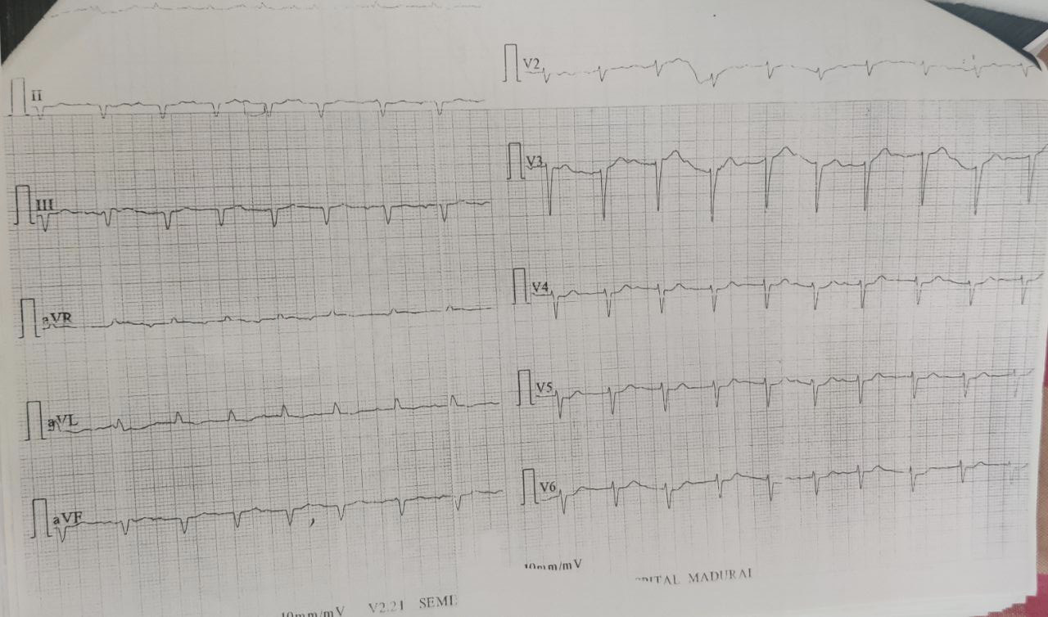
Ecg

Slide 18
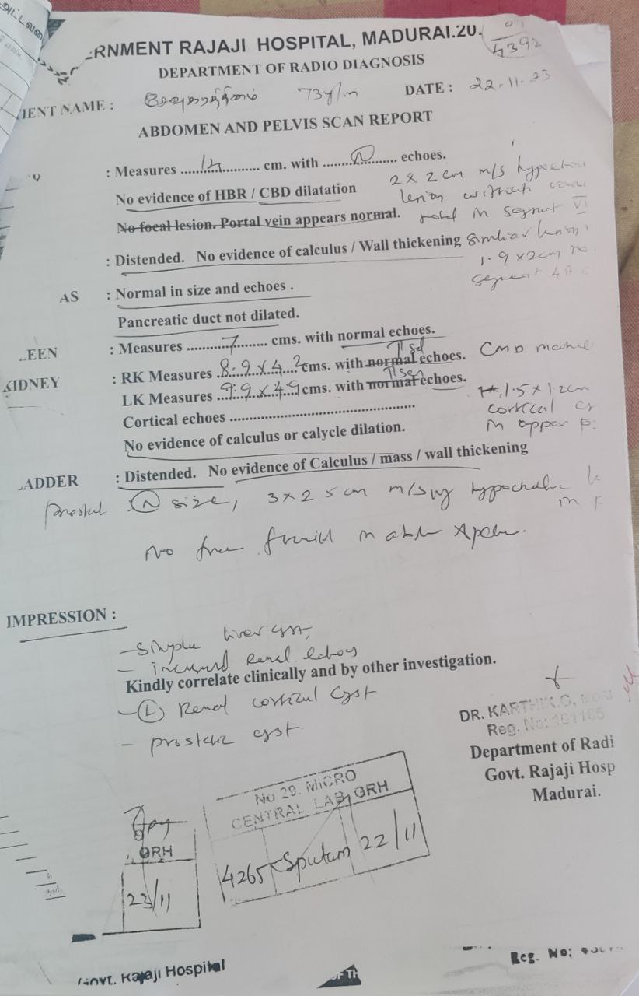
USG abdomen

Slide 19
CT CHEST
Left moderate to gross pleural effusion with passive collapse of left LL
Paraseptal emphysematous changes in B/L upper lobes with fibrotic strands
Nodular septal thickening with fine linear reticular opacities noted in right lung middle and lower lobe
Bilateral fissural effusion, B/L pleural effusion (R>L)
Moderate cardiomegaly, LV,RV dilated
Multiple hypodense lesion noted in both lobes of lungs

Slide 20
Cect abdomen
Bilateral moderate hydrocele
Prostate volume 51cc
4*3 cm cystic lesion in seminal vesicle – midline seminal vesicle cyst
Multiple hypodense cystic lesion in both lobe of liver, 3.6*1.8 cm in segment 8 of right lobe of liver without any contrast enhancement

Slide 21
Echo
Biventricular hypertrophy
RV free wall thickness 7mm
IVS – hyperechoic (glistening), IVS(d) – 1.7cm
Moderate MR, severe TR, TRPG -62mmHg, TAPSE – 16mm
Biatrial enlargement
Moderate pericardial effusion
Bilateral pleural effusion
IMP : RCM

Slide 22
Dermatologist opinion
Imp : VITILIGO VULGARIS
To do – Bence jones protein, serum electrophoresis
Adv – T. BC 1 OD
T. FST 1 OD
0.1% betamethasone oint E/A

Slide 23
Ophthalmology opinion
BE normal fundus at present

Slide 24
Nephrologist opinion
Imp – RCM/ nephrotic syndrome for evaluation
Suggested : SRD, FRD, strict I/O monitoring
Inj furosemide 20mg-20mg-0 iv
Plan - renal biopsy

Slide 25




Thank you
Presenter name
Email address
Website

