Slide 1
A mas(S) mimicker
By 2nd medical unit
Chief : dr. G. BAGIALAKSHMI M.D.
Assistant professor : dr. P.s. VALLIDEVI M.D.
Dr. PON Senthil Kumar M.D.
Dr. M. ILAMARAN M.D.
PRESENTOR : dr. A. Aswin

Slide 2
CHIEF COMPLAINTS
60 year old male presented with
c/o cough for 1 month
C/o breathlessness for 1 month

Slide 3
HOPI
Patient was apparently normal 1 month back then he developed
C/o dyspnea for 1 month – insidious, gradually progressive , aggravated on exertion
C/o cough with expectorant for 1 month – whitish in colour
C/o fever for 1 month – low grade , intermittent, relieved with medication
C/o easy fatiguability
H/o loss of weight over 1 month (6kg)
No h/o chest pain/ palpitations
No h/o abdominal pain/vomiting/diarrhoea
No h/o reduced urine output/bleeding manifestations

Slide 4
No h/o altered sensorium/seizures/neck stiffness
No h/o leg swelling /abdominal distension
No h/o jaundice/itching
No h/o trauma

Slide 5
PAST HISTORY
K/C/o T2DM for 12 years on OHA’s
N/k/c/o SHTN/PTB/BA/CAD/CKD/CVA
H/o treated in private hospital for 1 month on a OP basis for ?pneumonia/?lung mass

Slide 6
Personal history
Mixed diet consumer
Occasional alcoholic
Not a smoker
Normal bowel and bladder habits
Occupation – Sub Inspector of Police (Retired)
No h/o TB contact

Slide 7
General examination
Patient conscious,oriented
Afebrile
Dyspneic +, tachypneic+
Pallor +
No icterus
No cyanosis
No clubbing
No generalised lymphadenopathy
No pedal edema

Slide 8
Systemic examination
RESPIRATORY SYSTEM
ORAL CAVITY –normal
RS – BAE+, bilateral crepitations present In basal lung fields (R>L)
Cvs – S1S2+, No murmur
PA – Soft , BS+
CNS – Conscious, oriented, bilateral pupil 3mm RTL

Slide 9
ECG

Slide 10
Investigations
 | 25/7 | 26/7 | 28/7 | 29/7 | 30/7
HB | 10.4 | 10.7 | 10.4 | 10.0 | 9.4
TC | 2700 | 3500 | 3500 | 3100 | 3500
DC | 42/38/15 | 61/33/6 | 48/36/12 | 44/34/16 | 40/42/16
PCV | 31 | 31 | 31 | 30 | 30
PLT | 16000 | 31000 | 17000 | 9000 | 34000
ESR | 4

Slide 11
 | 25/7 | 28/7
Sugar | 217 | 70
Urea | 60 | 84
Creatinine | 1.1 | 1.5
TB | 1.9 | 5.4
DB/IB | 1.1/0.8 | 4.2/1.2
OT/PT | 186/104 | 124/97
ALP | 152 | 158
Na | 124 | 131
K | 4.9 | 4.4

Slide 12
 | 26/7
Calcium | 10.4
Phosphate | 2.3
Uric acid | 4.7
LDH | 1450
 | 26/7
S.CK | 55
S.CK-MB | 30

Slide 13
 | 27/7
FBS | 104
CHOL | 100
TGL | 414
HDL | 18
LDL | 26
S. Ferritin | >1000
 | 27/7
qCRP | 42.2
VCTC | NR
Viral markers | Negative

Slide 14
Complete hemogram
RBC – microcytic, hypochromic, few macrocytes, target cells and polychromatophilic RBC ‘s
WBC – counts mildly decreased, N – 49%, L – 39%, M – 11%, E – 1%
Platelet – decreased in smear, occasional giant platelets seen
Reticulocyte count – 1.2%
RPI – 0.56

Slide 15
ABG
pH – 7.34
pCO2 – 19
pO2 – 102
Na – 132
K – 4.6
Ca – 1.39
Glu – 184
Lac – 9.3
Hct – 30
HCO3 – 11.0
Hbc – 9.3

Slide 16
HRCT CHEST(8/6)

Slide 18
Cardiology opinion
LVID d – 4.5cm
LVID s – 3.0cm
LVEF – 60%
No RWMA at rest
Mild pericardial effusion
Mild TR
No PHT
Grade 1 LVSD

Slide 19
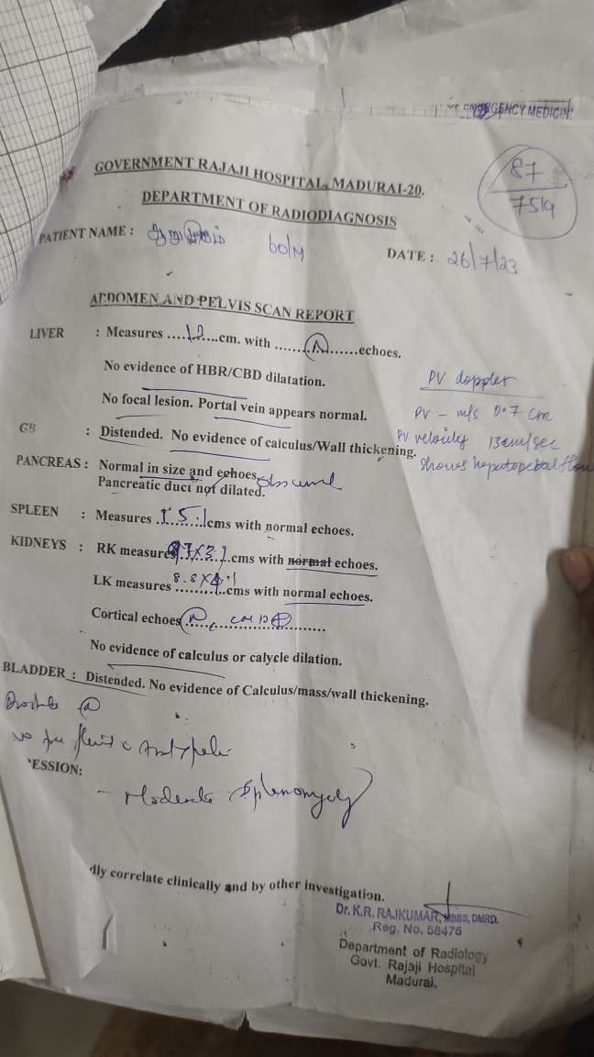
USG ABDOMEN
Imp : Moderate splenomegaly

Slide 20
Bone marrow aspiration

Slide 21
Bone marrow biopsy

Slide 22
WHAT NEXT ???

