Slide 1
SCRUB TYPHUS
By 2nd medical unit
Chief prof.dr.s.peer Mohamed md
Asst professors:
Dr.m.suresh kumar md
Dr.Satheesh kumar md

Slide 2
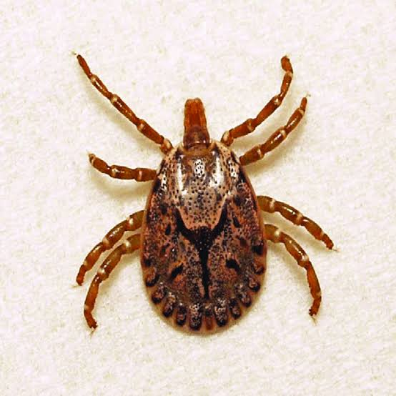
INTRODUCTION
Scrub typhus is an important cause of febrile illness in rural areas of Asia and Northern Australia.
Caused by Orientia tsutsugamushi(formerly Rickettsia tsusugamushi)
Acquired through bite of larval stage of Trombiculid mite of genus Leptotrombidium (chiggers)

Slide 3
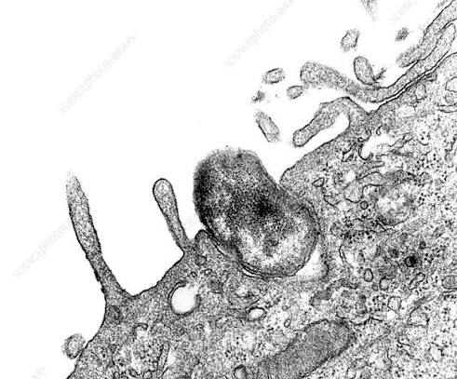
microbiology
Infected mites are characteristically found in discrete foci called mite islands, which can occur in a wide range of vegetation types from scrubs, gardens, paddy fields.
O.Tsutsugamushi is an obligate intracellular gram negative coccobacillus.
Three primary variants –Karp , Gilliam, Kato
O. Tsutsugamushi is maintained transovarially in the mite population and in rodents on which the larval stage of the mite normally feeds.
Humans are accidental hosts.

Slide 4
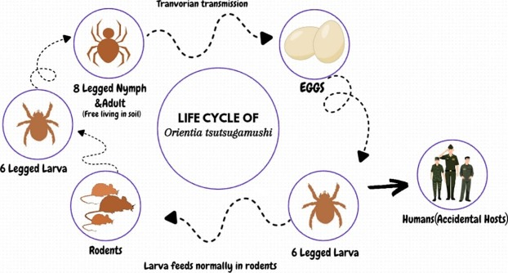

Slide 5
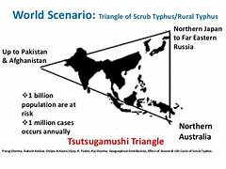
epidemiology
O.Tsutsugamushi is primarily distributed throughout the Asia pacific rim.
Endemic in India,Korea, Vietnam,Pakistan,Japan

Slide 6
pathogenesis
Chiggers inoculate O.tsutsugamushi pathogens
Bacteria multiply at the inoculation site, and a papule forms that ulcerates and becomes necrotic,evolving into an eschar with regional lymphadenopathy, that may progres to generalised lymphadenopathy within a few days.
Perivasculitis of small blood vessels occurs.Endothelium involvement occurs.
O.Tsutsugamushi stimulates phagocytosis by immune cells and then escapes the phagosome, replicates in the cytoplasm and then buds from the cell.

Slide 7
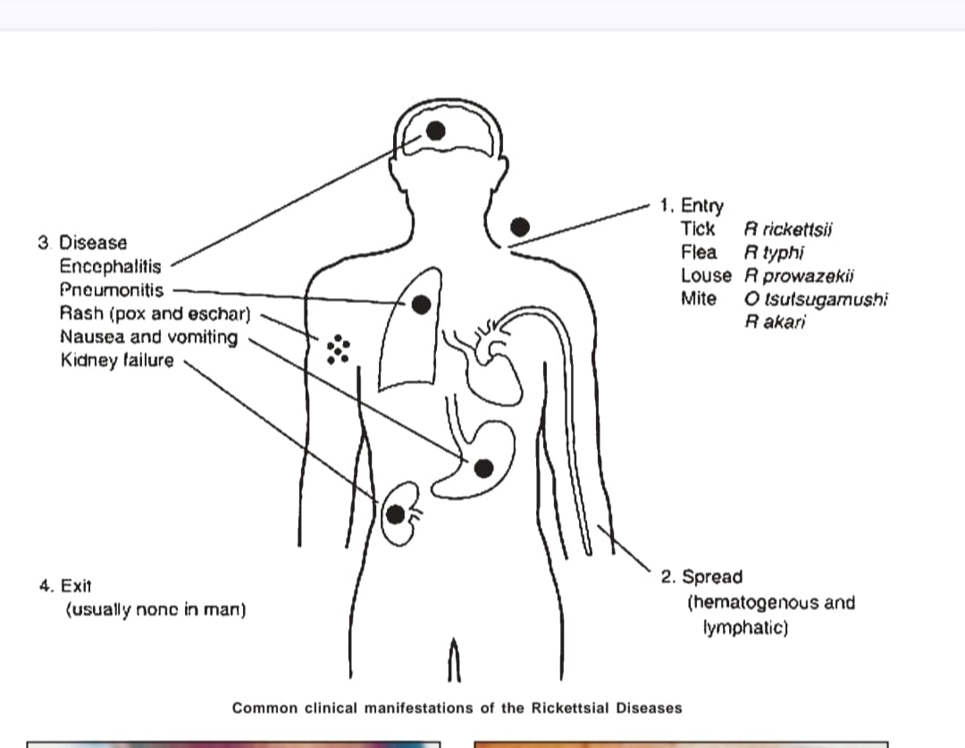

Slide 8
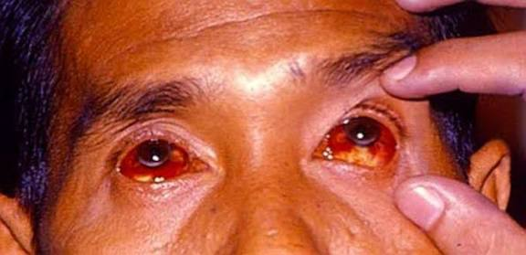
Clinical features
Scrub typhus presents as a systemic vasculitis-like infection.
Symptoms usually occur between 6 and 10 days after the mite bite.
Fever, generalized or regional lymphadenopathy, a macular or maculopapular rash, severe headache and myalgia.
Muscle tenderness is minimal or absent. Nausea and vomiting, diarrhoea, constipation, conjunctival suffusion and reversible sensorineural deafness can also occur.

Slide 9
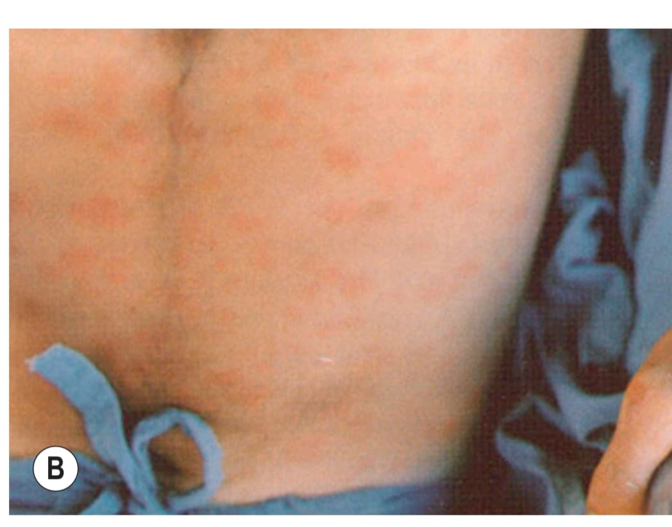

Slide 10
eschar
Painless papule at the site of chigger bite, often in concealed moist areas of the body like axilla and inguinal region
Later develops into classical eschar
Not usually larger than 1cm in diameter
Central necrotic black scab surrounded by raised ring and surrounding erythema, not itchy or painful, seen in as many as 50% patients.

Slide 11
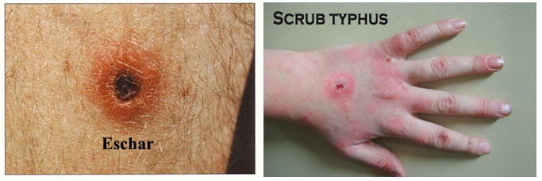

Slide 12
Signs and symptoms
Lymphadenopathy- localized followed by generalized lymphadenopathy
GIT- nausea, vomiting, diarrhea, superficial erosions and ulcers in upper GI tract
Respiratory- mild cough to ARDS like picture
Cardiovascular- relative bradycardia
Renal- AKI

Slide 13
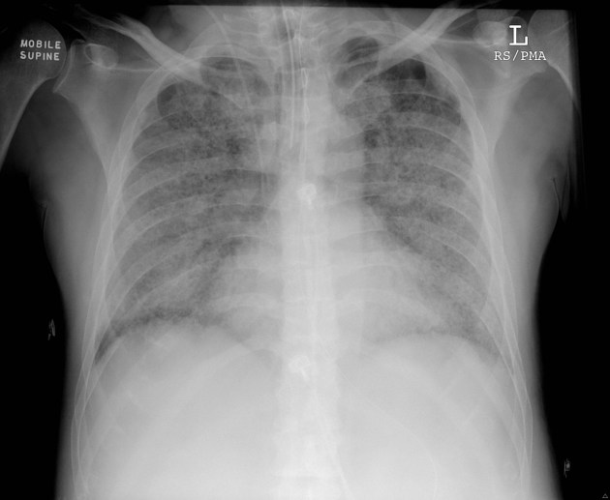
complications
Jaundice
Meningoencephalitis
Myocarditis
Interstitial pneumonia leading to ARDS
Renal failure

Slide 14
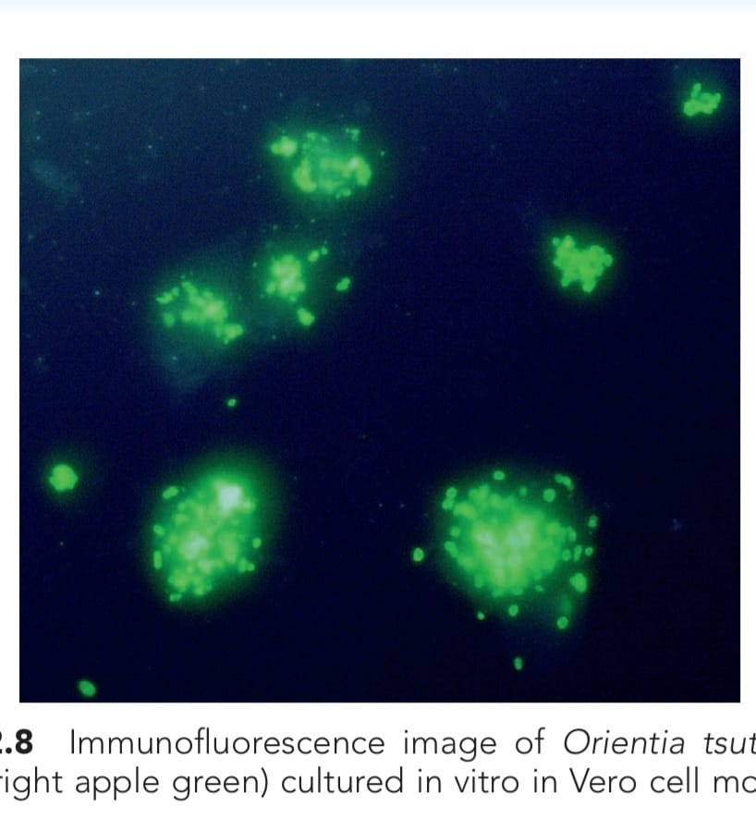
diagnosis
Indirect immunofluourescent assays – mainstay of diagnosis
Enzyme-linked immunosorbent assays (ELISA) similarly use cell culture-derived O. Tsutsugamushi antigens or recombinant proteins to detect orientia-specific antibodies. ELISAs have the benefit of performing multiple tests at one time, are inexpensive, sensitive, specific aidind reproducible.
Polymerase chain reaction methods detecting different gene targets of O. Tsutsugamushi have been developed but, despite the high sensitivities and specificities. immunofluorescence image of orientia tsutsugamushi (stained bright apple green) cultured in vitro in vero cell monolayers.

Slide 15
CaSE DEFINITIONS ACC TO NHM
Clinical case:
Acute undifferentiated febrile illness of 5 days or more with or without eschar should be suspected as a case of rickettsial infection(if eschar is present, fever of less than 5 days duration should be considered as scrub typhus)
Other presenting features may be headache and rash lymphadenopathy,multiorgan involvement like lung,liver and kidney involvement.

Slide 16
IDSP CASE DEFINITION:
Acute undifferentiated febrile illness of 5 days or more (in which common etiologies such as dengue, malaria, and typhoid have been ruled out)
With or without eschar should be suspected as a case of rickettsial infection. (If eschar is present, fever of less than 5 days duration should be considered as scrub typhus.)
Other presenting features may be headache and rash, lymphadenopathy;*
Multi-organ involvement like liver, lung or kidney and encephalopathy in complicated cases.
And/or
Titres of 1:80* or above in OXK antigens by weil felix test may be an initial indication. A paired serology is advisable.

Slide 17
A probable case Laboratory-confirmed by any one of the following assays:
A case is one in which IgM ELISA is positive for scrub typhus.
O. Tsutsugamushi DNA is detected in eschar samples or whole blood by PCR
Seroconversion or four fold rise or fall in antibody titres in paired sera detected by indirect immune fluorescence assay (IFA) or indirect immunoperoxidase assay (IPA) or ELISA

Slide 18
Weil felix test
Weil-felix test detects cross-reacting antibodies to proteus mirabilis OX-K.
The weil- felix test is still used because of its low cost.- Notoriously unreliable and no longer advised.- Fifty per cent of patients have a positive test result during the second week
Weil felix test is based on cross reactions which occur between antibodies produced in acute rickettsial infections with antigens of OX (OX19, OX 2 and OX K) strains of proteus.
Typhus group (R.prowazekii, R.typhi) react with P.Vulgaris OX 19- scrub typhus reacts with P.Mirabilis OX K- spotted fever group react with OX2 and OX19.

Slide 19
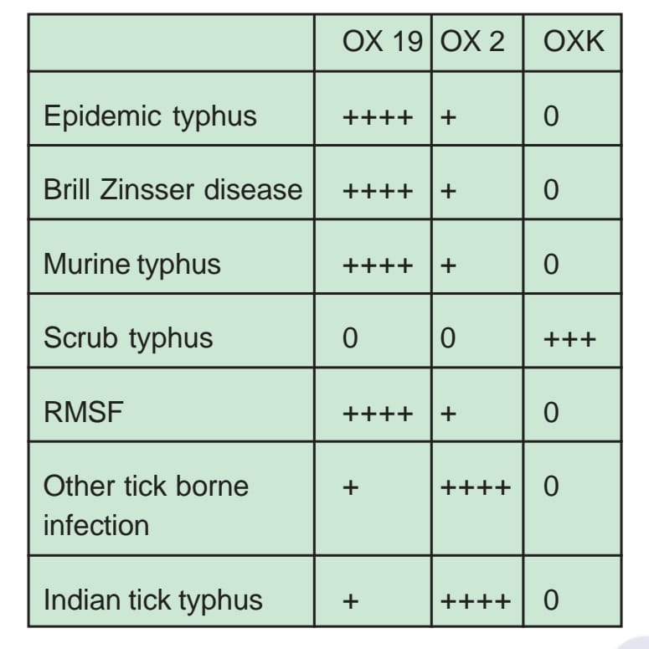

Slide 20
investigations
Leucopenia with relative lymphocytosis
Thrombocytopenia
LFT-
Serum bilirubin – mild elevation
SGPT SGPT- moderately increased

Slide 21
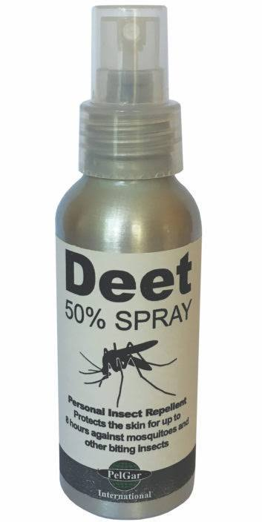
prevention
Partly prevented or controlled by wearing protective clothing, by treatment of clothing with repellents or acaricides, application of DEET, etc. to exposed areas of the skin, when walking in terrain of endemic areas.
Scrub typhus remains easily treatable , though to date, no sufficiently protective vaccine has been developed.

Slide 22
treatment
Scrub typhus is very responsive to treatment with appropriate antibiotics, which should be given empirically if the diagnosis is suspected.
Doxycycline is the standard treatment with an adult oral dose of 100 mg twice daily for 7 days.
Tetracycline 500 mg every 6 hours for 7 days may also be used.
Azithromycin (1000–500 mg on the first day followed by 500–250 mg daily for 2 days) is an effective alternative and has been shown to be effective in a single-dose treatment.
Azithromycin is particularly useful in pregnancy.

Slide 23
Treatment contd.
Chloramphenicol is an alternative to the tetracyclines (500 mg every 6 hours in adults or 50–75 mg/kg per day in children for 7 days), although side effects need to be considered.
Rifampin (600 to 900mg /day) – in doxycycline resistant areas – useful in scrub meningitis.

Slide 24


