Slide 1
CPC
By Fifth Medical Unit
CHIEF - PROF DR. SYED BAHAVUDEEN HUSSAINI MD
ASST PROFESSORS :
DR.R.VINOTH KANNAN MD
DR.V.P.PRIYA MD
PRESENTER : DR.S.PRADEEPSHANKAR
Second year post graduate

Slide 2
CHIEF COMPLAINTS
A 57 year old female patient brought by her attender to our hospital with complaints of breathlessness and right lower limb swelling for past 5 days.

Slide 3
HISTORY OF PRESENTING ILLNESS
History of right lower swelling for past 5 days which was imsidious in onset , progressive in nature associated with warmth, redness and tenderness.
History of fever for 4 days which was low grade intermittent in nature associated with chills and rigor , evening rise in temperature and night sweats.
History of breathlessness for past 4 days which was insidious in onset , progressive in nature , aggravated with exertion and relieved by rest.
History of diffuse chest pain for past 4 days , dull aching pain , not radiating , not associated with palpitation and sweating.
History of loss of weight approximately 10 kg in past 3 months
History of loss of appetite for past 3 months.

Slide 4
History of easy fatiguability.
History of cattle exposure .
History of decreased urine output for past 2 days.
No history cough with expectoration.
No history of abdominal pain/ burning sensation while passing urine.
No history of bleeding gums/Hematuria/ Malena/ Hematochezia.
No history of weakness of limbs.
No history of nausea/vomiting.
No History of loose stools /Constipation.
No history of trauma.
No history of alterd sensorium / blurring of vision / headache / seizure .
No history of dog bite.

Slide 5
PAST HISTORY
History of right sided breast mass 20 years back for which patient operated at private hospital . Biopsy records and treatment details not available
History of low back ache with difficulty in walking 3 months back for which patient admitted in Private hospital and diagnosed to have L5 – S1 Spondylolysthesis.
For which spine fixation surgery done and patient on bed rest for past 3 months.
During the time of admission for spine surgery , patient was found to have Severe Anemia Hb- 3.0 and 4 Packed cell transfusions done.
Not a known case of Diabetes mellitus/Hypertension/Bronchial asthma/TB.
No history jaundice/tattooing.

Slide 6
PERSONAL HISTORY
Mixed diet
Bowel and bladder habits - normal
Sleep pattern - normal
No history of addiction
2 live children and attained menopause 10 yrs back.
Home maker.

Slide 7
GENERAL EXAMINATION
Pt conscious
Oriented
Afebrile
Pallor +
Dyspneic +
Tachypneic +
Right lower limb swelling +

Slide 8
SYSTEMIC EXAMINATION
CVS- S1 S2 + , ejection systolic murmur in Pulmonary area
RS - BAE + , Air entry decreased on bilateral infrascapular and infra axillary area.
P/A - soft BS+ , no organomegaly
CNS - conscious ,oriented , moves all 4 limbs , Bilateral pupil 3mm RTL

Slide 9
LOCAL EXAMINATION
Right lower limb- Diffuse swelling of entire lower limb
warmth and tenderness +
Capillary refilling – Adequate
Movements and sensation - Normal
Pulse | Right | Left
Femoral artery | Normal | Normal
Popliteal artery | Normal | Normal
Anterior tibial artery | Feeble | Normal
Posterior tibial artery | Feeble | Normal
Dorsalis pedis artery | Feeble | Normal

Slide 10
VITALS
BP - 120/70 mmhg
PR - 110/min
SPO2 - 90% in room air and 98 % with 6 L of O2
Respiratory rate – 22 / minute
CBG – 130 mg/dl

Slide 11
Date/ Investigations | 18.7.2025 | 19.7.2025 | 20.7.2025 | 22.7.2025 | 26.7.2025
Hb | 4.4 | 4.3 | 5.1 | 7.2 | 7.6
TC | 6300 | 5200 | 5800 | 5400 | 7000
MCV | 102 | 104 | 102.2 | 103.3 | 102
PLT | 109000 | 119000 | 97000 | 115000 | 202000
RBS | 115 | 110 | 118 | 120 | 15
U/Cr | 40/1.4 | 30/1.3 | 30/1.2 | 19/1.1 | 33/1.2
TB/DB/IB | 0.3/0.2/0.1 |  | 0.4/0.3/0.1 | 0.8/0.4/0.4
OT/PT/ALP | 14/10/232 |  | 23/39/205 | 15/18/192

Slide 12
Date/Investigations | 18.07.2025 | 20.07.2025 | 26.07.2025
LDH | 340 | 360 | 340
qCRP | 130 | 65 | 35
ESR | 100 mm | 96 mm | 95 mm
Cholesterol | 137
TGL | 219
HDL | 18
Na+/K+ | 121/3.6 | 129/3.5 | 128/3.4
ALB/GLOBULIN | 3.1/4.2 | 3.2/4.3 | 3.0/4.2
Calcium/PO4/Uric acid | 9.5/2.7/7.1 | 9.4/2.6/5.1 | 8.5/3.5/3.7

Slide 13
VCTC | Non reactive
Viral markers | Negative
ANA | Negative
Urine routine | Alb-Nil , Sugar - Nil
Serum ferritin | 1000
PT/INR/APTT | 13.5/0.95/15.6
Serum Vitamin D3 | 90 ng/mL
D-Dimer | 2500 ng/mL
Bence jones protein | Negative

Slide 14
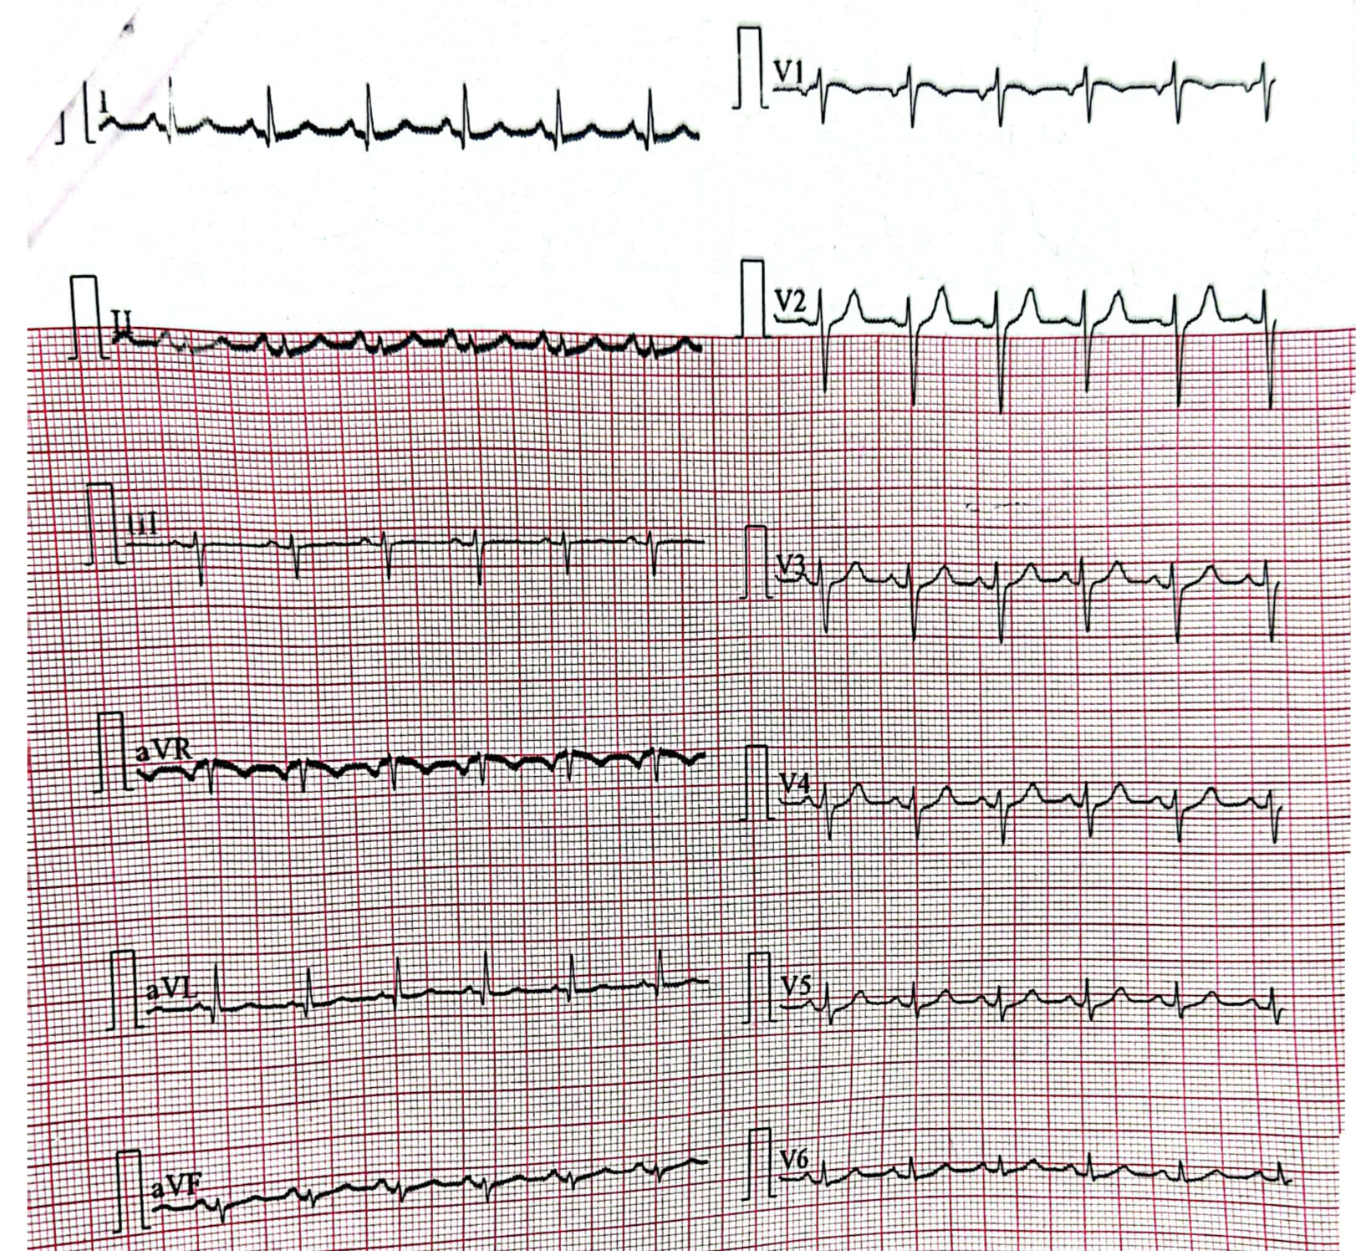
ECG – NORMAL STUDY

Slide 15
ECHO on 21/07/2025
NO Regional wall motion abnormality
EF - 60%
No pericardial effusion
No clot.

Slide 16
COMPLETE HEMOGRAM WITH PERIPHERAL SMEAR ON 19/07/25
RBC – Shows hypochromic microcyte , normochromic normochromic normocytes and elongated cells.
Hemoparasites not seen.
WBC count is normal . Reactive lymphocytes seen.
Differential count- Neutrophil- 66% Lymphocyte -32 % Eosinophil – 2%
Platelet – Count is adequate. Clumps present.

Slide 17
OPHTHALMOLOGY OPINION
Both eye Anemic retinopathy
.

Slide 18
USG ABDOMEN PELVIS ON 20/07/2025
Liver measures 13 cm Normal echoes
Gall bladder distended.
Pancreas- Obscured
Spleen – 12.5 cm
Right kidney measures 9 * 4.5 cm normal echoes CMD maintained
Left kidney measures 9* 5 cm Normal echoes CMD Maintained
Bladder – empty
Uterus – Post menopausal
No free fluid in abdomen and pelvis.

Slide 19
RIGHT LOWER LIMB VENOUS DOPPLER FINDINGS on 19.07.2025
Extensive acute thrombosis seen involving right deep veins namely
1. Right external iliac vein.
2.Right common femoral vein.
3.Right both superficial and deep peroneal vein.
4.Popliteal vein.
5.Short saohenous vein.
6.Superficial subcutaneous leg veins.
IMPRESSION : Extensive right lowerlimb both deep and superficial venous acute thrombosis
Right lower limb cellulitis
IVC Normal

Slide 20
CT PULMONARY ANGIOGRAM WITH ABDOMINOPELVIC AND MUSCULOSKELETAL FINDINGS
No evidence of pulmonary thromboembolism.
Minimal bilateral pleural effusion with subpleural fibrotic stranding.
Old healed right-sided rib fractures (3rd, 4th, 6th–8th) with callous formation.
Diffuse severe osteoporosis with multilevel vertebral planar deformities and ventral compressive fractures.
Pedicle screw and rod fixation involving L3 and S1 vertebrae.
Grade 3 L5–S1 anterolisthesis with spondylolysis — advanced degenerative instability.
Acute extensive DVT involving right external iliac, common femoral, superficial femoral, and deep femoral veins, with associated right lower limb cellulitis.
No ascites.

Slide 21
OPINIONS OBTAINED
Vascular surgery opinion on 19/07/2025
Impression : Acute right iliofemoral DVT / ? Pulmonary thromboembolism.
Advice :Inj Heparin 5000U IV QID
Limb elevation / Creepe bandage.
Cardio opinion/ USG Abdomen and pelvis
Review once planned for discharge.

Slide 22
WHATS NEXT ?

