Slide 1
Chest xray for discussion
Vi medical uniT

Slide 2
Case details
50/f k/c/o T2DM/CA Breast Left – post MRM – ductal ca/er,her2neu positive x 2years
Pt is on insulin mixtard 20-0-15 s/c ,tamoxifen 40mg 1-0-1
Patient admitted for breathlessness x 10days sudden onset GradeII dyspnea
H/o vomiting x 7days non bilious non blood stained
H/o cough with white mucoid scanty expectoration x 7days
No h/o fever

Slide 3
Clinical exam
Pt conscious, oriented
Tachypneic RR- 24/MIN
NO pallor/pedal edema/cyanosis/clubbing/LN/lymphedema
BP-120/70mmHg , PR- 112/min, SpO2 – 93% RA , CBG- High
CVS-S1S2+,P/A-Soft, non tender,no organomegaly, CNS-NO FND
RS-
Trachea midline, left mrm scar+ no discharge,
B/L AE, B/L Wheeze + ,no other added sounds

Slide 4
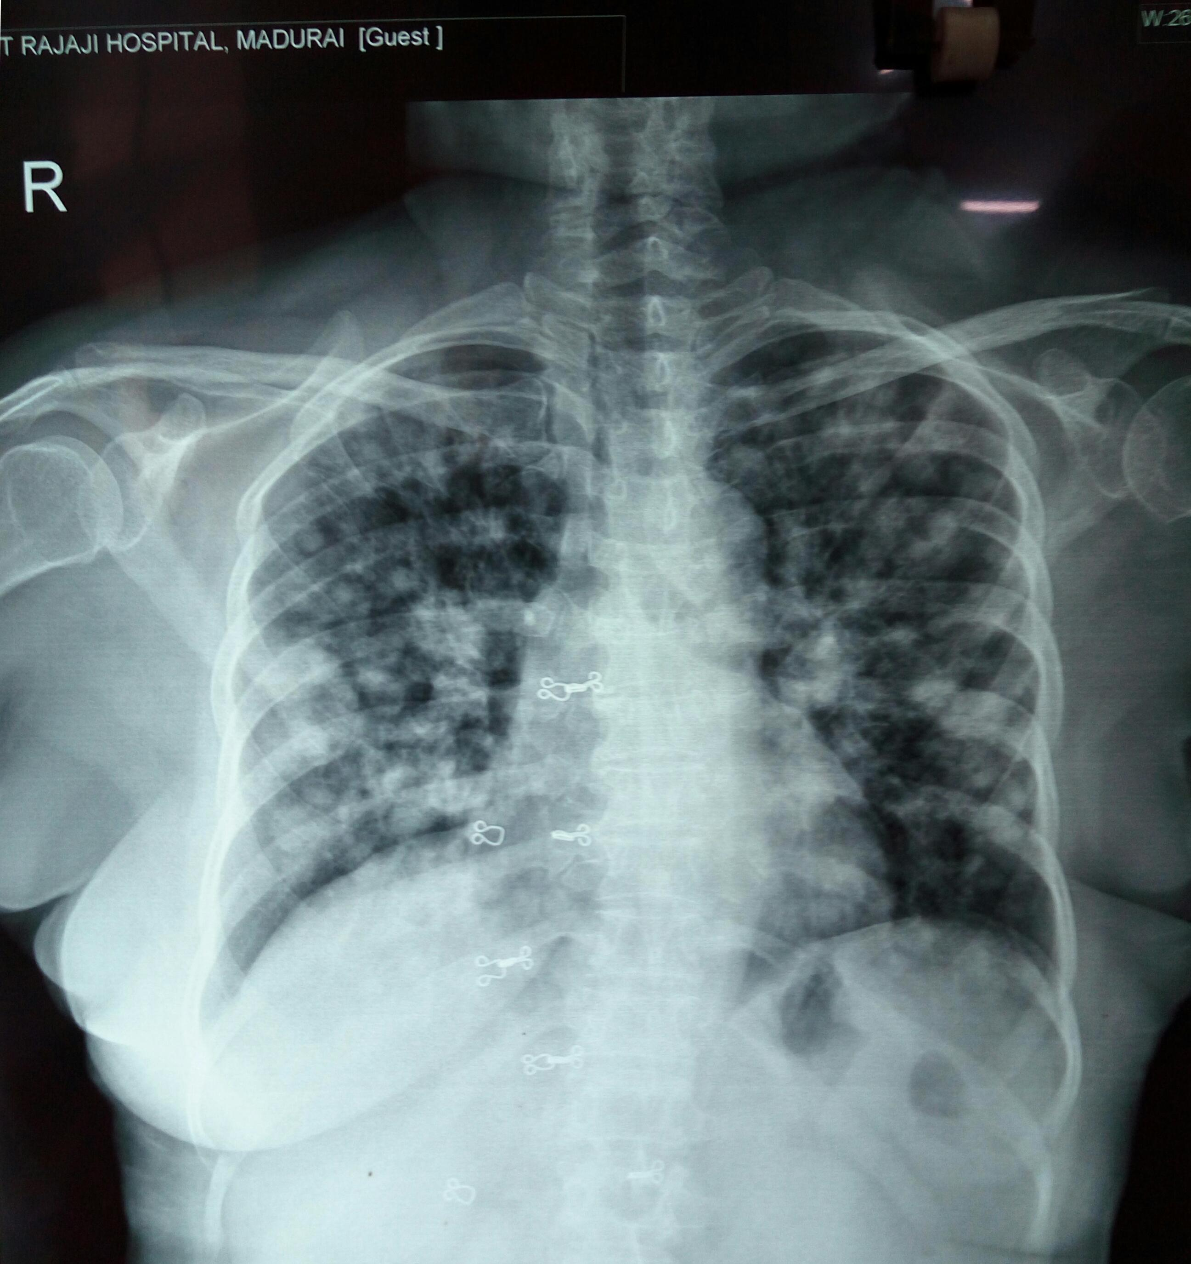

Slide 5
Cxr findings
E/o multiple welldefined Airspace opacities of varying sizes noted in b/l lung fields more in b/l basal and peripheral lung fields
P/o LUNG METASTASIS

Slide 6
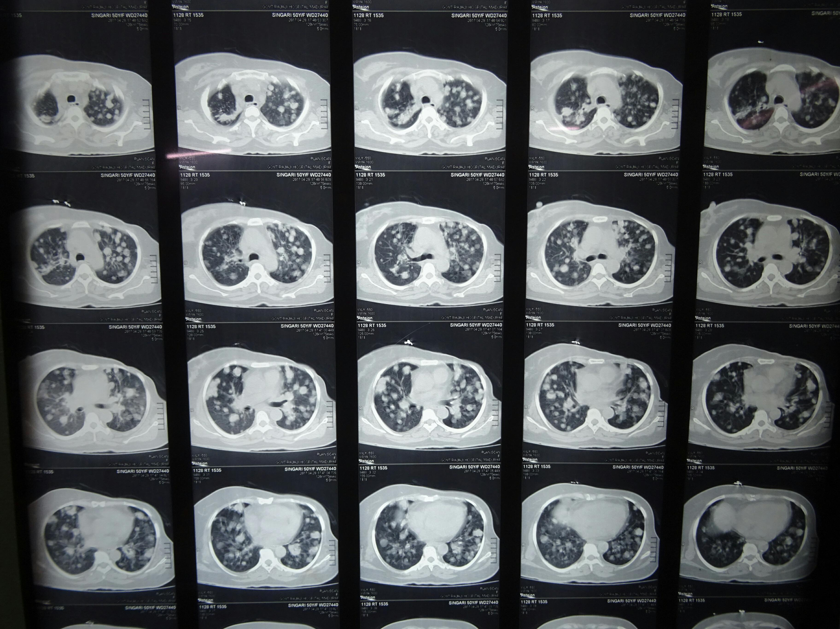

Slide 7
CT CHEST FINDINGS
Left breast surgically absent
e/o multiple welldefined nodular opacities noted in b/l lung fields – P/O METASTASIS
e/o homogeneous opacity with airbronchogram noted in Right Upper lobe – P/O CONSOLIDATION

Slide 8
Discussion
0.5 -2mm
Miliary TB
Fungal Infection
CW pneumoconiosis
Sarcoidosis
Hemosiderosis
Silicosis
Siderosis/Stannosis/Barytosis
2-5mm
Carcinomatosis +/- lymphatic obstruction
Lymphoma
Sarcoidosis
Multifocal pneumonia
Pulmonary edema
Intra alveolar hemorrhage

Slide 9
Discussion
Multiple Pulmonary Nodules >5mm
Metastases
Abscess
Coccidioidomycosis
Histoplasmosis
Hydatid
Wegener’s granulomatosis
Rheumatoid nodules
Caplan’s syndrome
Sarcoidosis
Amyloidosis
Pulmonary massive fibrosis
AV Malformations

