Slide 1
An atopic monster
CHIEF: DR.K.SENTHIL.MD
ASSOCIATE PROF: DR.K.MURALIDHARAN MD
ASST PROF: DR V.MANIKANDAN MD
DR.SARAVANA MADAV MD
DR.ILAMARAN MD DM
PRESENTOR –DR.V.ANUSHA

Slide 2
Chief complaints
A 55 year old female presented with alleged history of snake bite of left foot on 10/2/23
H/o swelling and pain over the left foot

Slide 3
History of present illness
H/o chest pain –acute in onset, progressive in nature ,compressive type
Associated with sweating and palpitation
No h/o abdominal pain
No h/o reduced urine output
No h/o blurring of vision
No h/o hematuria
No h/o malena
No h/o difficulty in lifting head

Slide 4
contd..
No h/o fever
No h/o cough with expectoration
No h/o breathlessness
No h/o loss of consciousness
No h/o seizures

Slide 5
Past history
Not a known case of Type 2 diabetes mellitus, systemic hypertension ,TB ,epilepsy , thyroid disorder
No h/o previous surgeries /blood transfusion

Slide 6
Personal history
Takes mixed diet
Normal bowel and bladder habits
Normal sleep pattern

Slide 7
General examination
Pt conscious ,oriented
Afebrile
No pallor
Not icteric
No cyanosis
no clubbing
No pedal edema
No lymphadenopathy

Slide 8
Vitals
Bp-120/70 mmhg
PR-88/min
Spo2-98% in room air

Slide 9
System examination
Cvs-S1 S2 heard , No murmurs
Rs- BAE+, No added sounds
P/A – soft, bs+
CNS – conscious ,oriented
Moves all 4 limbs
B/L pupil 3mm RTL
No ptosis, neck muscle weakness

Slide 10
Local examination
Swelling of left leg upto midleg
Tenderness+
Warmth+
Distal pulses felt

Slide 11
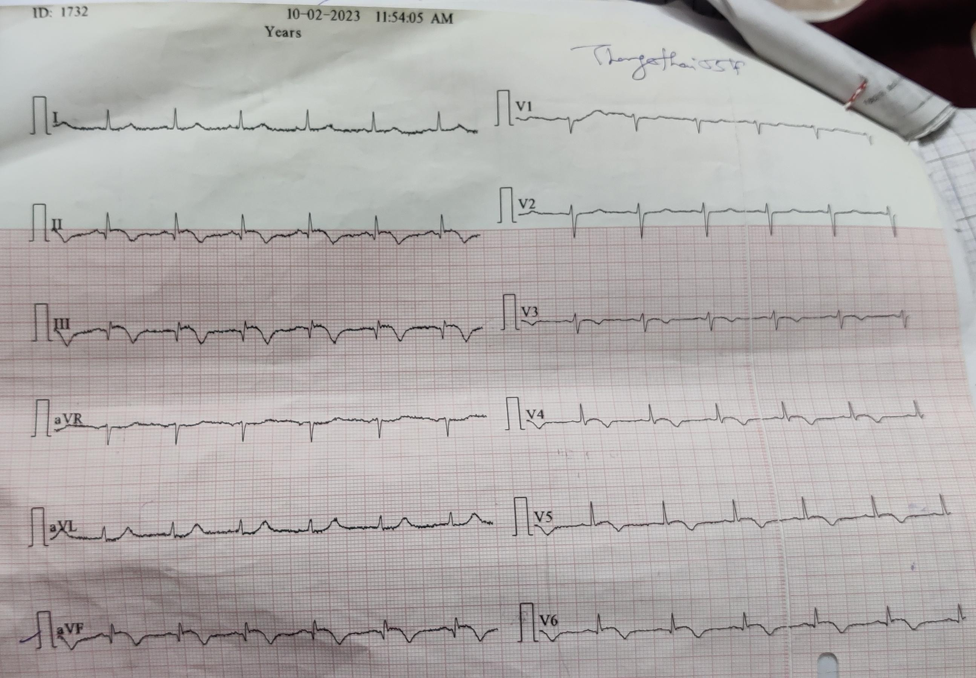
Ecg

Slide 12
Lab findings
10/2/2023 | 10/2/23 | 11/2/23 | 12/2/23 | 13/2/23 | 15/2/23
Tc | 7000 | 18400 | 13100 | 12300 | 9200
Dc | 52/46/2 | 92/6/2 | 89/7/4 | 76/16/8 | 74/18/8
Hb | 10.5 | 11.2 | 11 | 11 | 11.9
Pcv | 31 | 37 | 38 | 37 | 36
Plt | 1.49 | 1.8 | 1.00 | 1.3 | 1.17

Slide 13
 | 10/2/23 | 11/2/23 | 12/2/23 | 13/2/23 | 15/2/23
Urea | 25 | 77 | 81 | 64 | 55
Creatinine | 0.6 | 1.0 | 1.4 | 1.4 | 1.1

Slide 14
CKMB -221
TROP I – POSITIVE
WBCT- Less than 20 min
Peripheral smear -NEUTROPHILIC LEUCOCYTOSIS

Slide 15
What next??

